Slide 1

Sensor Network Gesture Recognition
Team member
Anand Rajesh Gajaria
Kritkorn Supyen
Siddhant Singh
Rev.1
Date: 05-12-2022

Slide 2


Slide 3



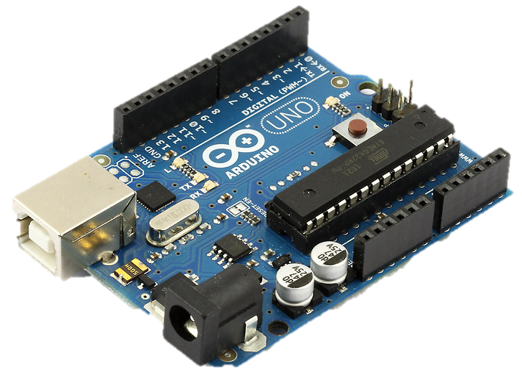




Local Control
Camera
Monitor
Servo
RGB LED
Buzzer

Slide 4





Network Topology
Google Cloud Platform
SFTP
2222
Local
8080
MySQL
3306
3000
Webserver

Slide 5

Thank you

