Slide 1
High-Score Server System
Author(s): Michael Moldenhauer

Slide 2
Introduction
The High-Score Server is a program which will track the highest-scoring players amongst all the team’s games which will be playing in the gaming session at the end of this course and display them on the room-facing game screen along with the games themselves.

Slide 3
Our Feature
As there is only one developer, there is effectively only one feature – the server system, which has two use cases: one to send scores to the server, the other to acquire the data from the server for display (this author is not sure if this will be a separate program or part of the server program itself.). Note that design decisions discussed here are tentative; the final product may not resemble this exactly.

Slide 4
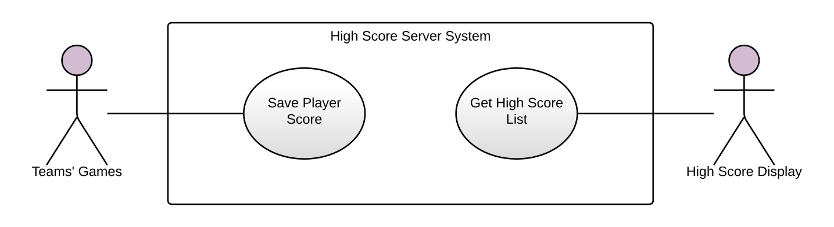
Use Case Overview

Slide 5
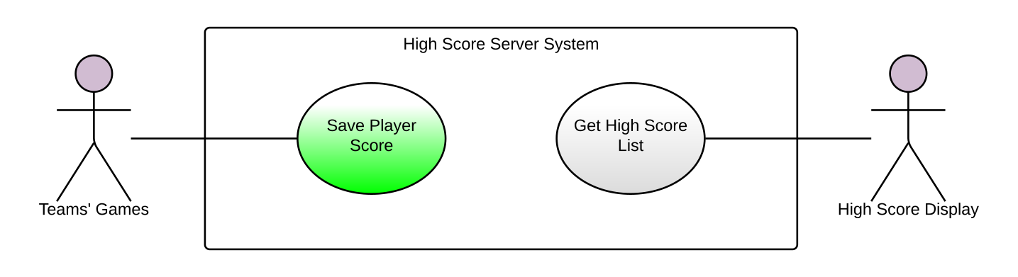
Communication with Server
The games communicate with the server through a client program and interface library.
Complexity: 3 – Most complex
Priority: 1 - Highest

Slide 6
Client Program
The client program manages the connection to the server, allowing the user to connect and disconnect to and from it at the press of a button, and accepts data from the game through a library interface.

Slide 7
Communication Interface
The communication library consists of a header file to include in the game source and linkable library (perhaps a .dll; not decided yet). This header provides an “HSSInterface” object which is used to interface with the client program. Such should be declared like this wherever need be to give the object suitable lifetime and access to cover all scored game play:
HSSInterface serverCommunicator;

Slide 8
Communication Interface
This needs to connect with the client program using the “connect” method. It returns a Boolean value indicating its success or failure – true is success, false is failure.
if(!serverCommunicator.connect()) {
... Handle errors ...
}

Slide 9
Communication Interface
Likewise, you can disconnect by using the “disconnect” method. Alternatively, the connection will be disconnected upon communicator object destruction.
serverCommunicator.disconnect();
// or just let it go out of scope / delete!

Slide 10
Communication Interface
To send your game’s score to the server, use the “sendScore” method. It takes 3 arguments - the first two are strings representing respectively the name of the game and the name of the player (or initials), and the third is an integer that is the score to report, e.g.
// Report that “Sally” playing the game “TombRoaster”
// scored 50,000 points.
serverCommunicator.sendScore(“TombRoaster”, “Sally”,
50000);

Slide 11
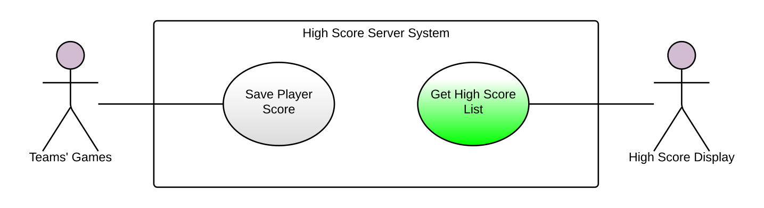
High Score Display
The display is provided by a second, separate client program that may or may not run on the same machine as the server. The high score server will continuously update the display at 1-second intervals. Alternatively it may be fused with the server program itself, but these design specs envision a separate program.
Complexity: 2 – Less complex
Priority: 1 - Highest

Slide 12
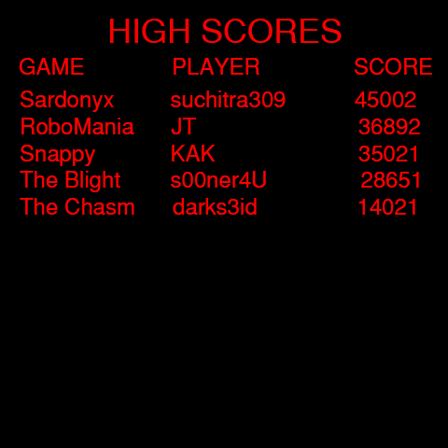
Display Mockup
The display should look something approximately like this. This is only a draft mockup; the final design may be different.

Slide 13
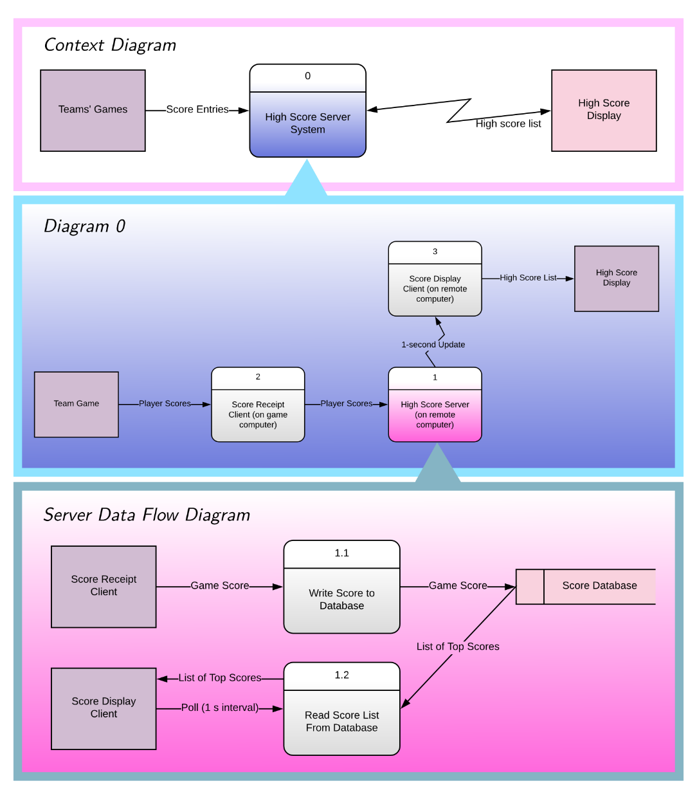
Appendix: Dataflow Diagrams
Finally, we give a brief look at the
the dataflow diagram for the server.

Slide 14
That’s all, folks!
Questions?

