Slide 1
Sudoku Application
Creator: Maikl Awad

Slide 2
What Is Sudoku?
Sudoku uses logic in order to solve a combinatorial numerical puzzle
The user must adhere to the following rules:
No same number can be in the same respective row
No same number can be in the same respective column
No same number can be in the same respective box

Slide 3
Why Play Sudoku
Challenges a person's strategic approach to problem solving
Promotes learning through timed puzzles that motivate the user to improve
*In a study done by Howard Litwin, Ella Schwartz and Noam Damri on 16,572 European adults aged 65–100 years found, “that CSLA can indeed impact cognition in late life, above and beyond the effects of a wide range of factors known to be related” (2016).

Slide 4
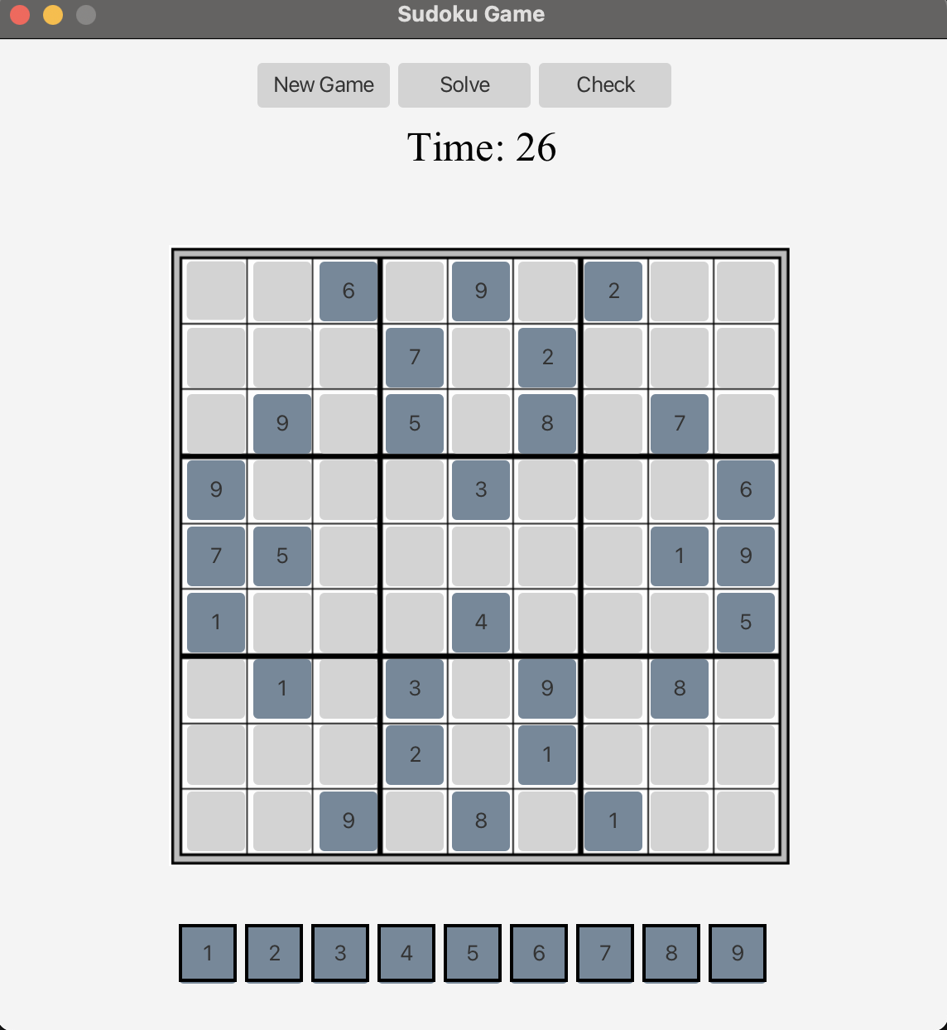
User Experience
Application allows the user:
-Start a new game
-Solve any Sudoku Puzzle
-Check if Puzzle has been solved
Time tracker:
User has a visual sense of skill level by knowing the amount of time it takes to solve a puzzle
Instant feedback:
Visually informs the user on if their numeric placement is in a valid or invalid spot

Slide 5
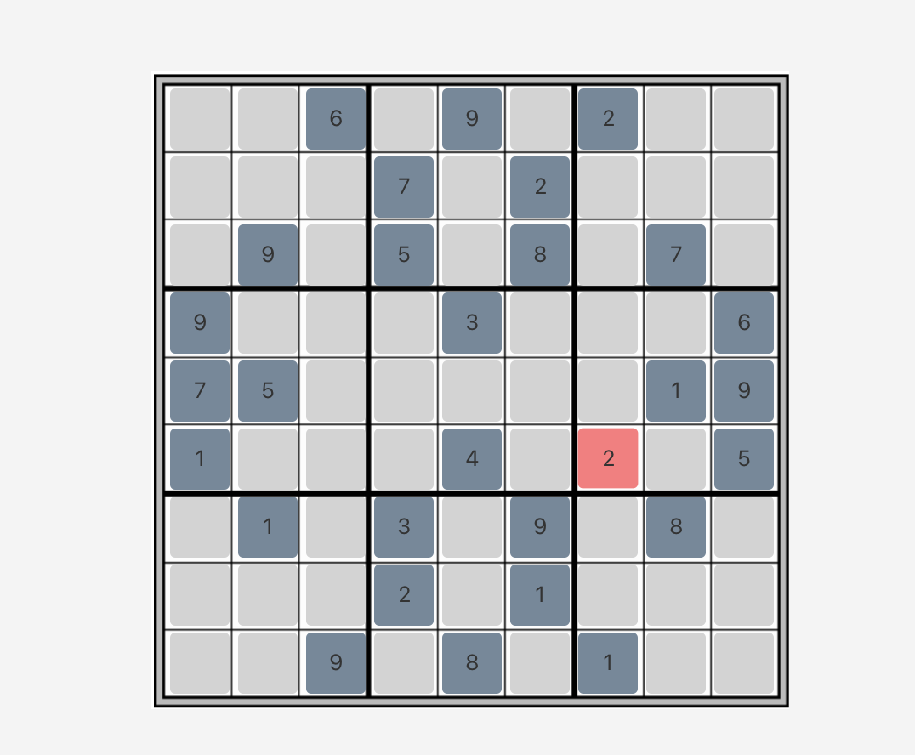
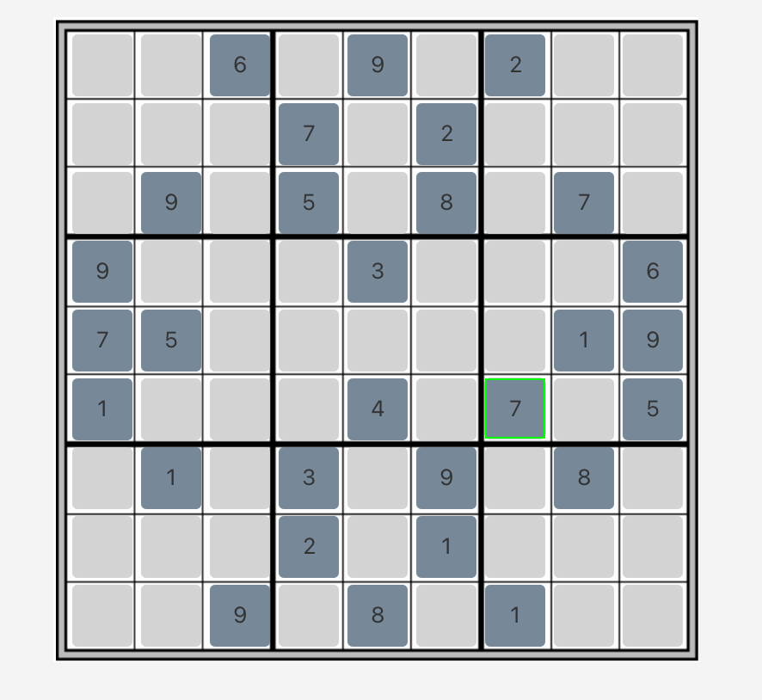
Instant Feedback Visual
Visual of the instant placement feedback

Slide 6
Back End
Object Oriented Programming (OOP) was used to visualize data in an abstract form.
Each placement cube was an object that was encapsulated in another object that inherited from another object.
This approach made tracking data much more manageable.

Slide 7
Algorithms
Many forms of algorithms:
Creation of the predefined Sudoku
The check algorithm
New game algorithm
Most important algorithm created:
Solving algorithm
Recursion
Back Tracking
Memory manipulation

Slide 8
References
Litwin, H., Schwartz, E., & Damri, N. (2016). Cognitively stimulating leisure activity and subsequent cognitive function: A share-based analysis. The Gerontologist. https://doi.org/10.1093/geront/gnw084

