Slide 1

The Task
Develop a system to classify the operational state of an industrial cobot from video data.
Goal: Distinguish between "start" (operational) and "stop" (non-operational) states.
Application: Robust monitoring of cobot activity to enhance productivity and identify anomalies under various scenarios and environmental conditions.

Slide 2
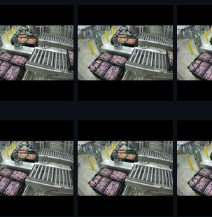
Problem Formulation
Data Provided: 6x 1hour Video recordings of cobot operations.
Data Extraction: Videos segmented into 5-second non-overlapping sequences at 3 fps, resulting in 15-frame sequences.
Labeling:
Start (0): Cobot operational.
Stop (1): Cobot non-operational (5 second rule).
Dataset Size: Approximately 700 "Start" and 800 "Stop" sequences, 22,500 individual frames
Preprocessing: Frames resized to 224×224 for model compatibility.

Slide 3
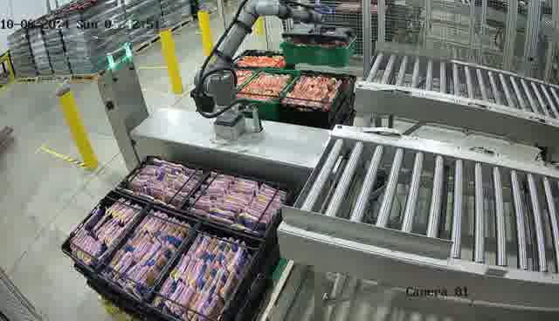
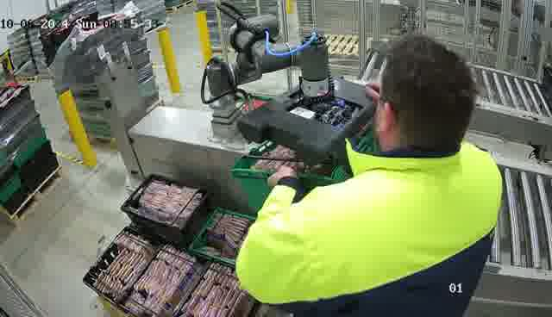
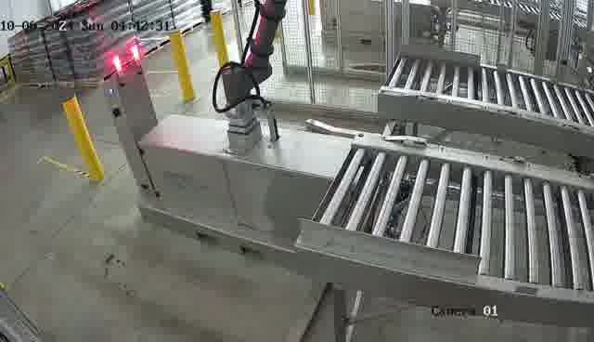
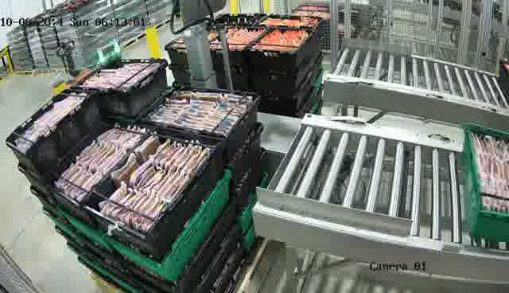
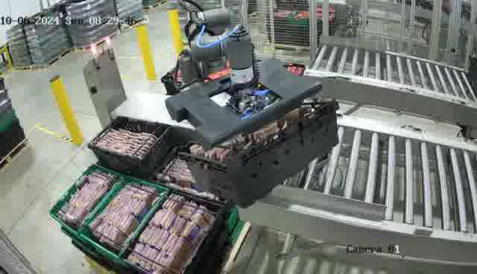
Sequence Cases & Variability
Normal Operations
Human Interactions
Empty Queue & Idle States
and more…
Occlusions
Misgrabs

Slide 4
Data Augmentations
Goal: Enhance generalisation, regularise the model, and address the limited dataset size.
Augmentations Used:
Horizontal Flip: Random flips at 50% probability.
Affine Transformations: Small rotations (±5°), translations (±2%), and scaling (95%-105%).
Perspective Transformations.
Color Jittering: Brightness and contrast ±30%.
Gaussian Blur Kernel.

Slide 5
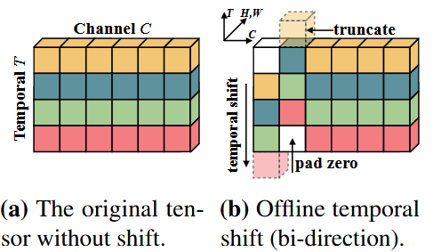
Model Selection
TSM: Temporal Shift Module for Efficient Video Understanding Lin, J., Gan, C., & Han, S. (2019) https://arxiv.org/abs/1811.08383
Lightweight & efficient for modelling temporal dynamics in videos.
Shifts a portion of the feature channels along the temporal dimension, allowing exchange of information between adjacent video frames without computational overhead.
Shifts a fraction of channels forward and backward in time while keeping the rest unaltered.
Allows temporal interaction across frames while maintaining spatial feature integrity.
Effective for action recognition, while being computationally efficient compared to many 3D convolution-based approaches.

Slide 6

Training Configuration
Backbone Model
ResNet50 as feature extractor
Loss Function
$$CrossEntropyLoss= \frac{1}{N}\sum_{i=1}^{N}{y_{i}log⁡(\hat{y_{i}})}$$
Adam Optimiser
Learning rate: 1e-4
Learning Rate Scheduler
Step size: 8
Gamma decay: 0.2
Training Configuration
Number of epochs: 30 - 40
Batch size: 6
Dropout: 0.5

Slide 7
Model Variations
1. Random-Split Model:
Training and validation data were randomly sampled from the entire dataset.
Split ratio: 70% training, 10% validation, 20% testing.
2. Sequential-Split Model:
120 consecutive "start" and "stop" sequences were reserved for testing.
Goal: Evaluate generalisation on completely unseen temporal distributions.

Slide 8
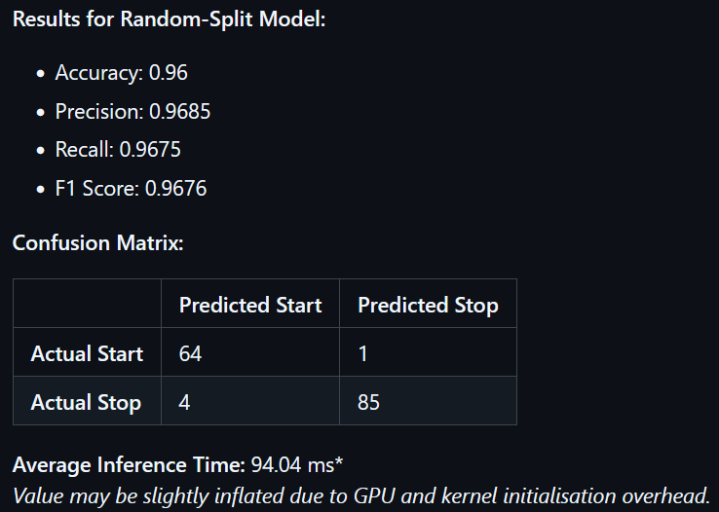
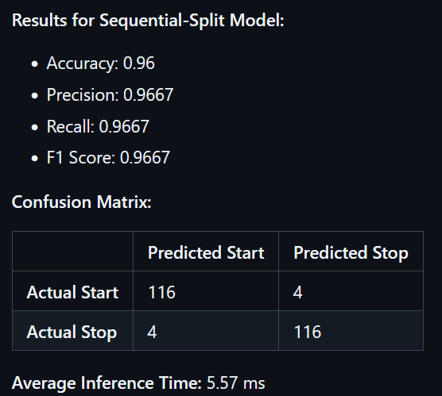
Results

Slide 9
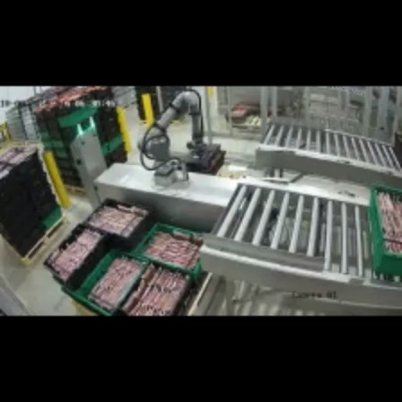
Next Steps
Further Optimisation and Hyperparameter Tuning.
Training on Additional Data: Incorporate more diverse and extensive datasets for broader scenarios.
Introduce Additional State Classes: Expand classification with more states like operational standby, malfunctions, and other conditions.
Develop an End-to-End Pipeline: Build a complete pipeline for generating detailed operational reports and activity timings.

Slide 10
Thank you!
Presented by Michail Panagopoulos for Robominder LTD – December 2024

