Slide 1
CRIME IN MONTGOMERY COUNTY
Mike and Yasmin
Data 201 – Project 1

Slide 2
DATA SOURCE
In this project, we will examine different types of crime commited in Montgomery County.
The source for this dataset can be found https://data.montgomerycountymd.gov/Public-Safety/Crime/icn6-v9z3
The data found in this dataset is provided by “EJustice”, a respected law enforcement records-management system used by the Montgomery County Police Department. It is important to mention that names and other private information is not included for safety and privacy reasons.
This dataset consists of 279k rows and 30 columns. Some columns included are Incident ID, Start_Date_Time, End_Date_Time, Victims, Location, and Police District to name a few. Another important column is the crime column which is broken down into 2 other columns that further explain the crime committed.
As Montgomery County Residents it is important to stay up to date with the level of crime committed across the county. Some questions of interest include which city in Montgomery County has the most reported crime? What is the most common type of crime committed? What time are crimes most likely to occur? All this with the hopes of being more aware of the level of crime in the county and to develop solutions to lower crime rates.

Slide 3
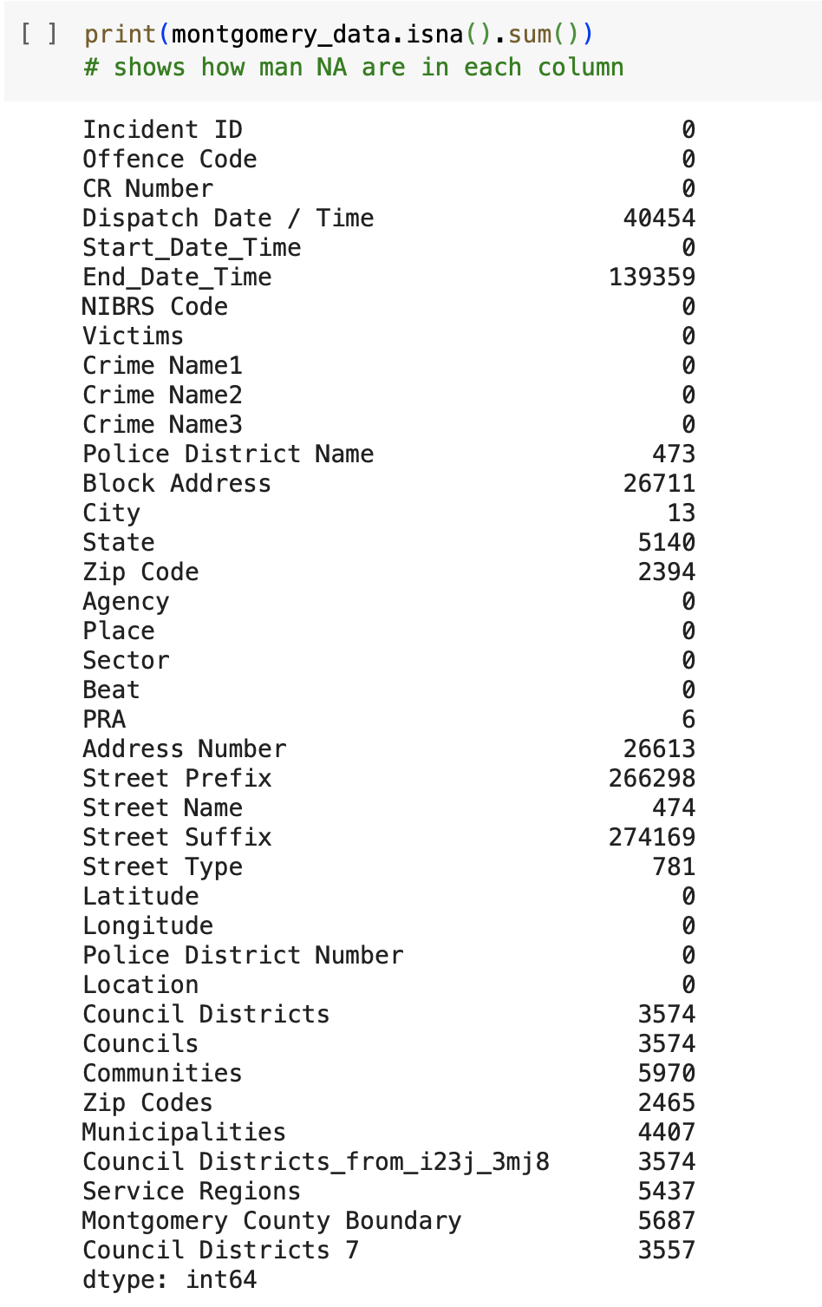
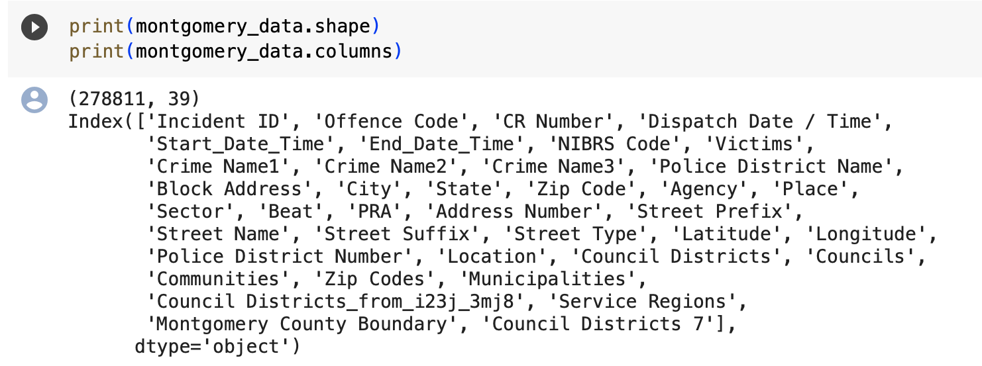
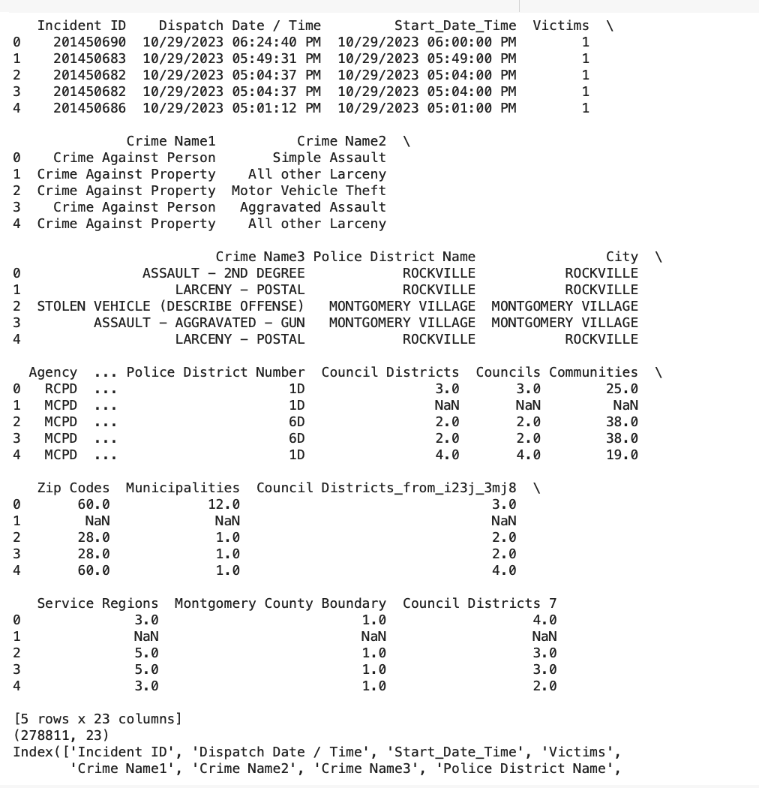
EXPLORING THE DATA
Getting a sense of what the data holds, how many columns/rows, how many NA, what does the data look like

Slide 4
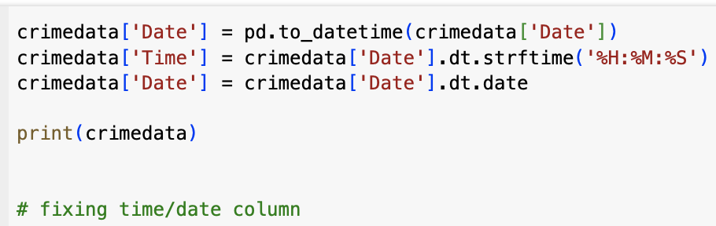
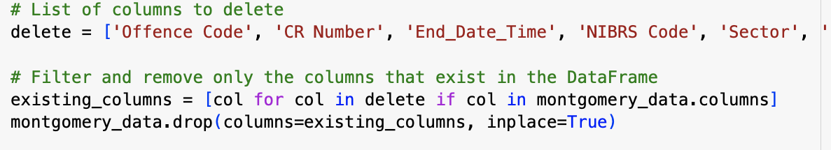
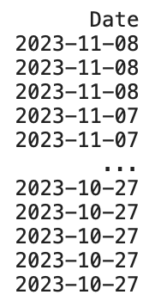
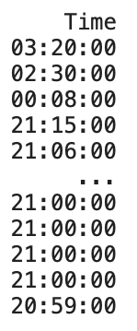
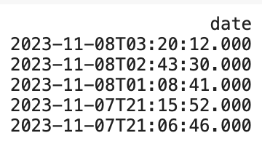
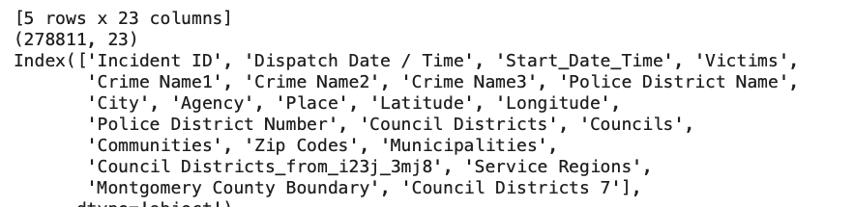
EDA & DATA WRANGLING
Deleting unnecessary columns
Fixing date and time columns

Slide 5
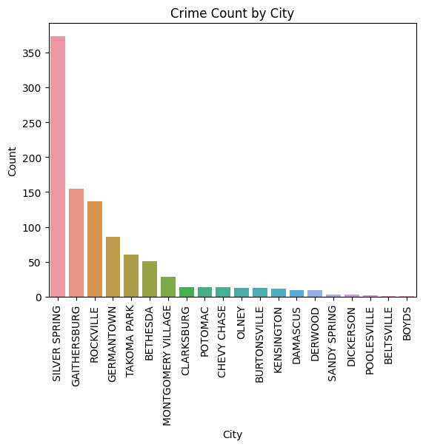
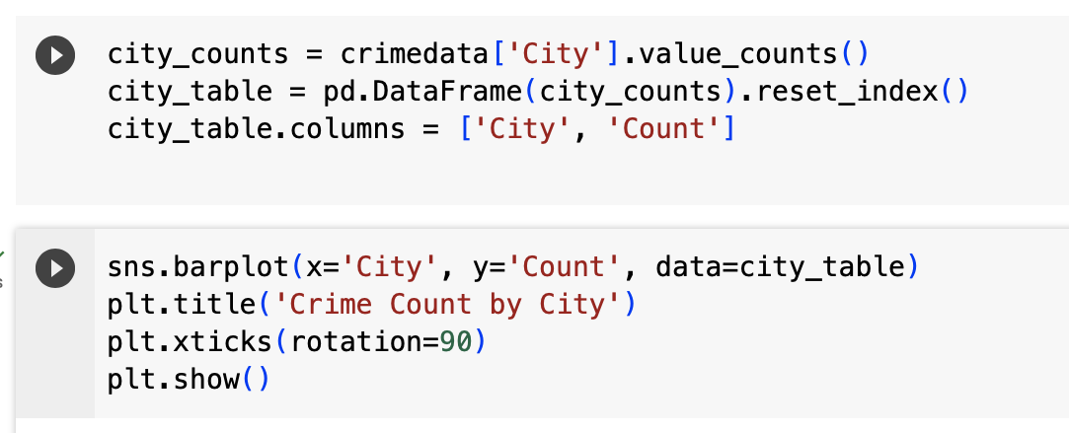
CITIES WITH HIGH CRIME RATES USING A SAMPLE OF 1000

Slide 6
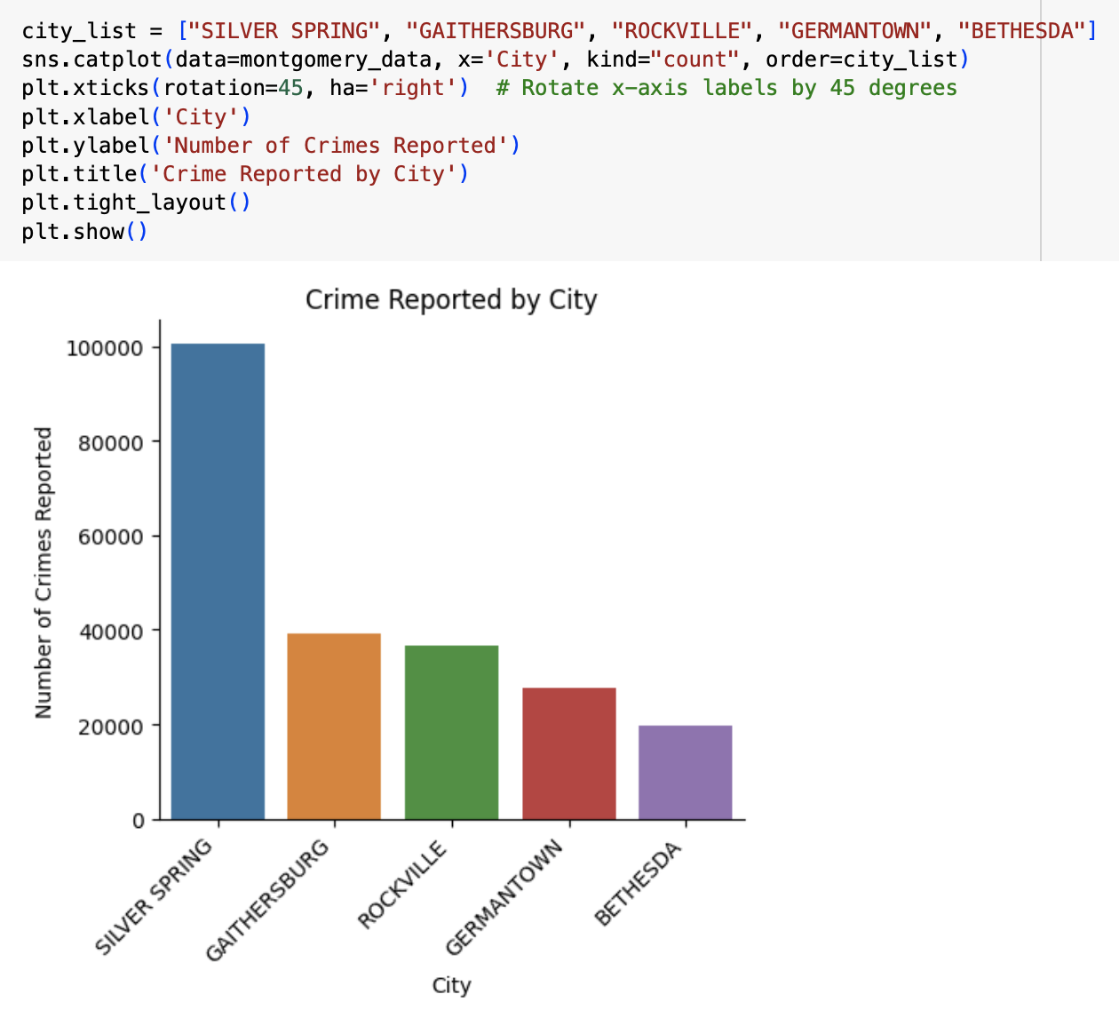
CITIES WITH HIGH CRIME RATES
Top 5 cities with high crime rates

Slide 7
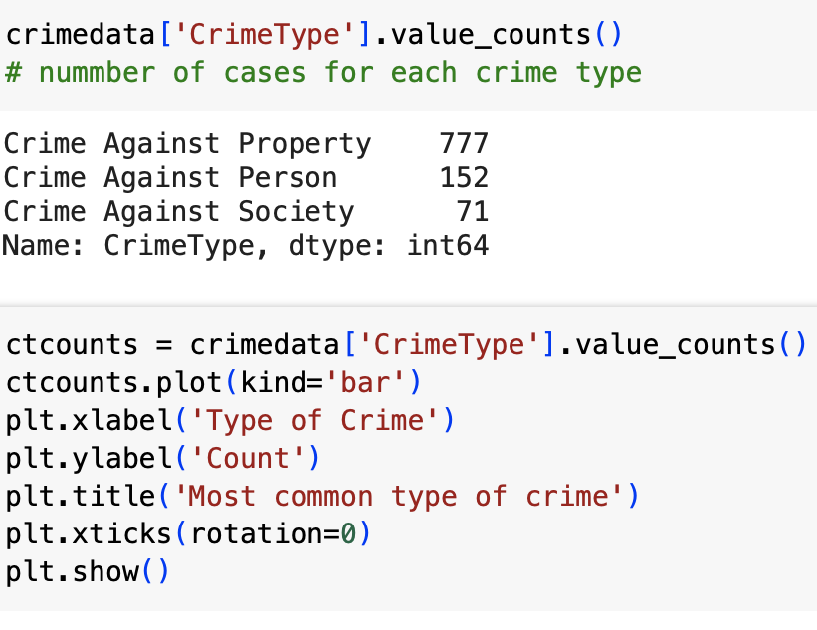
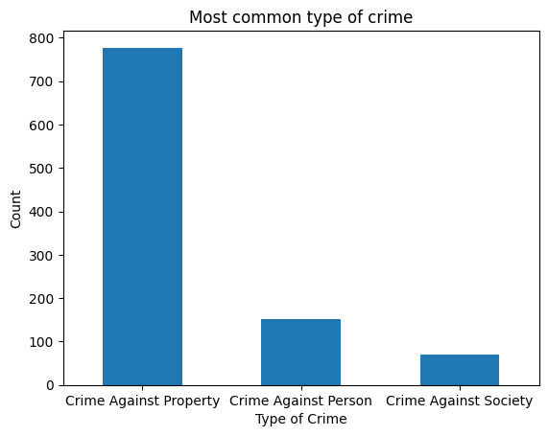
TYPES OF CRIMES
Crimes against property are most common type of crime in Montgomery County
Burglary
Theft
Vandalism
Arson

Slide 8
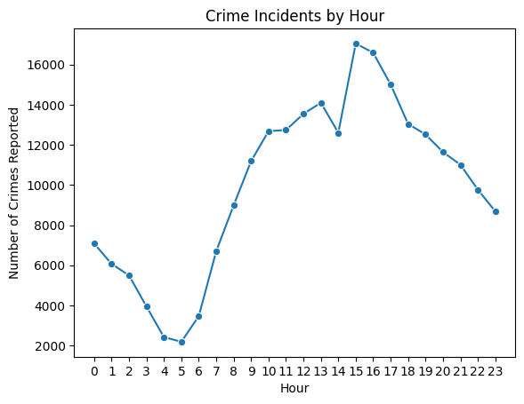
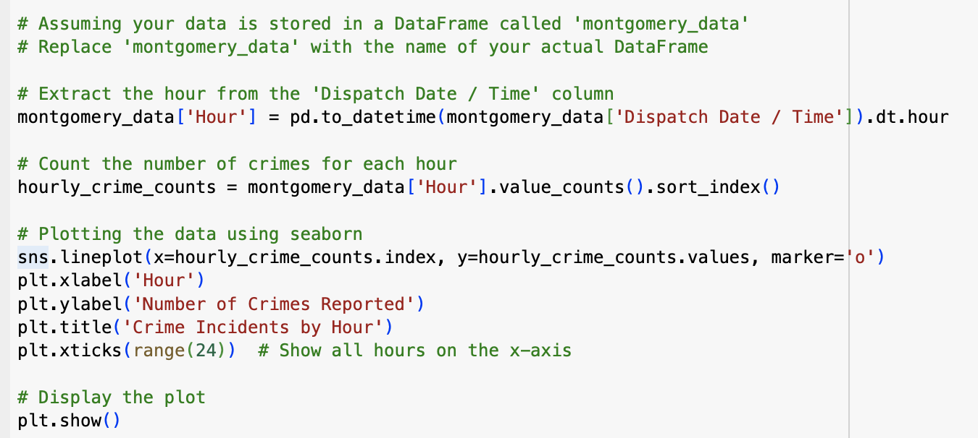
CRIME INCIDENTS BY THE HOUR

Slide 9
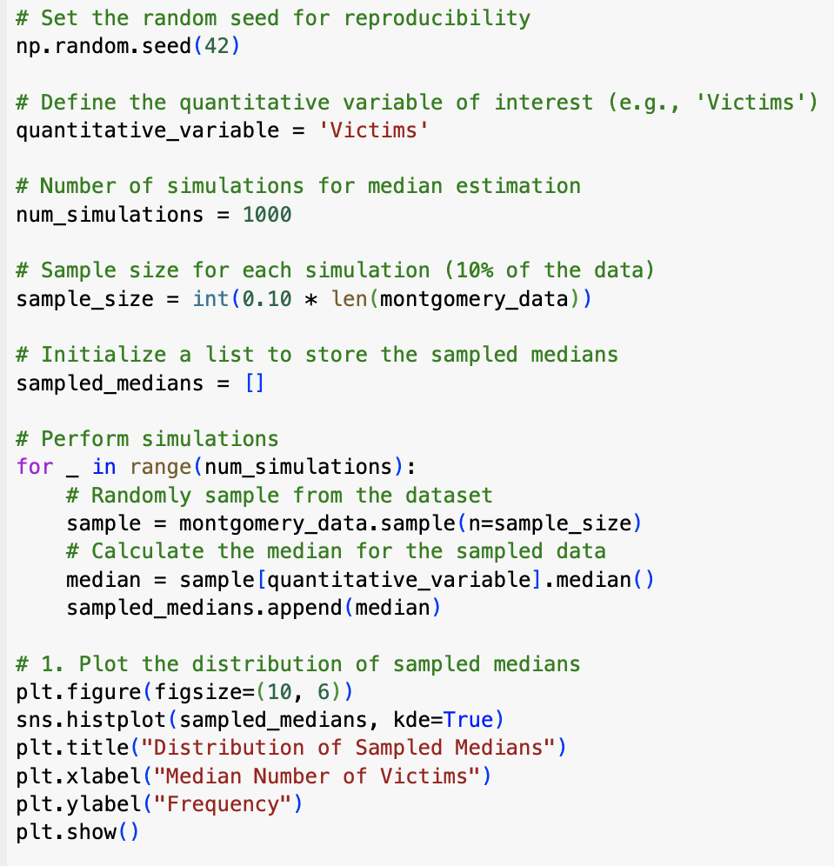
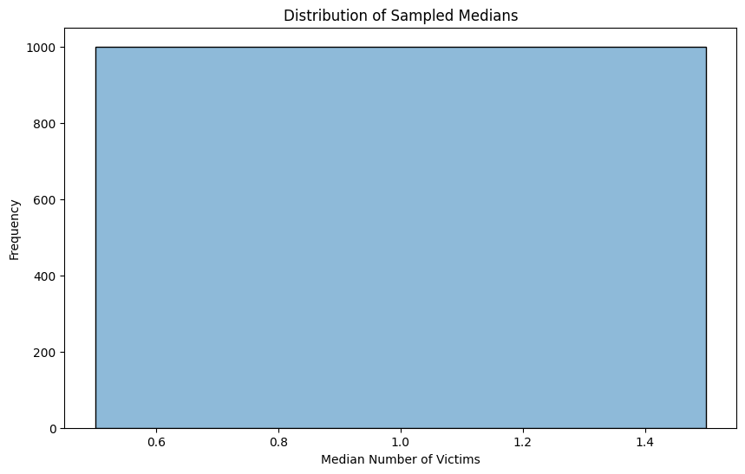
DISTRIBUTION OF SAMPLED MEDIANS

Slide 10
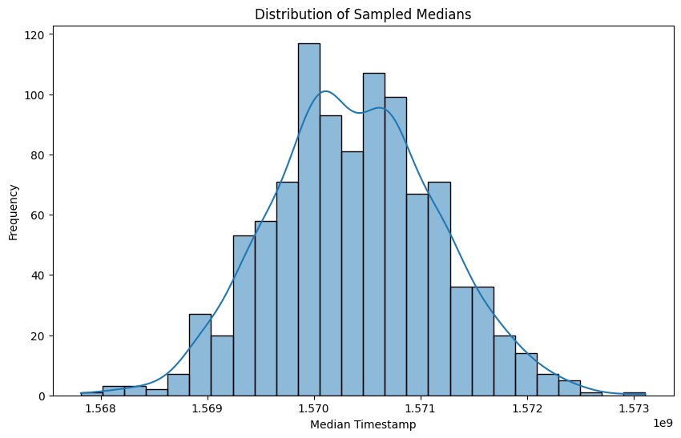
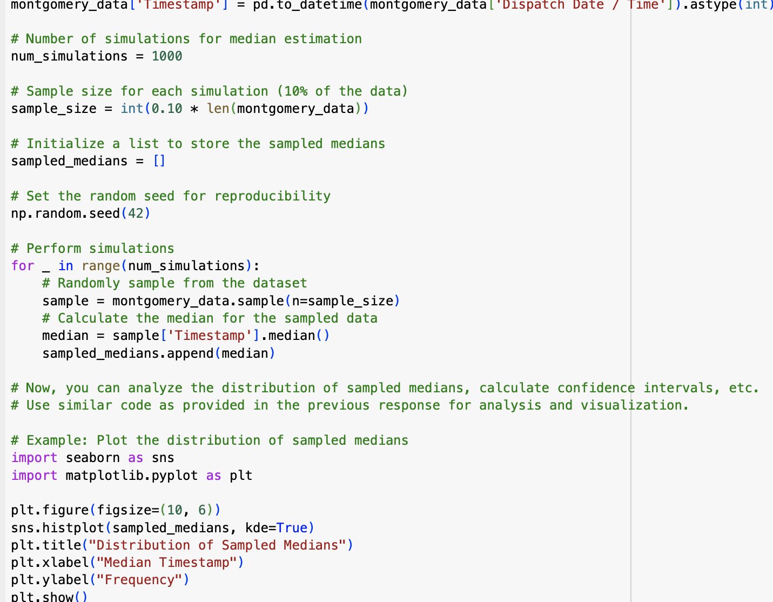

Slide 11
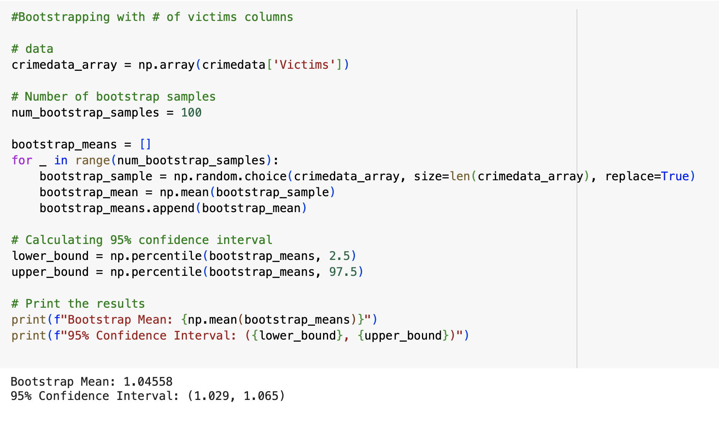
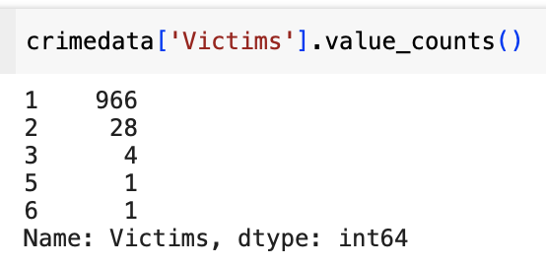
BOOTSTRAPPING
Bootstrap Mean : 1.04558
95% Confidence Interval : (1.029, 1.065)

