Slide 1
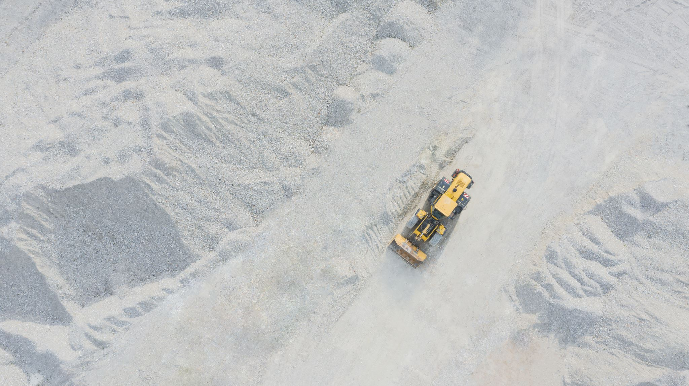
DOT Capstone Project
By: Mike Alfaro
Spring 2024

Slide 2
Brief Overview | Project Goal
This project is a collaboration between Montgomery County Department of Transportation – Highway Services and myself
DEP – The Department of Environmental Protection provided datasets and are responsible for monitoring stream/watershed health conditions.
The main goal of this project is to identify DOT’s salt route usage against watershed areas during snowstorms to identify relationships between salt usage on the watersheds condition.

Slide 3
Datasets | Tools
DOT – 7 datasets containing salt route information(Silver Spring, Bethesda, Colesville, Gaithersburg East, Gaithersburg West, Poolesville, and Damascus)
DEP – 2 datasets containing information on tributaries' health status and watershed locations.
Tools Used – R Programming(Leaflet, SF, Tidyverse, and Plotly)

Slide 4
Data Cleaning
Creating
Creating user-friendly column names
Renaming
Renaming values ensuring a uniform standard
Merging
Merging shapefiles
Building
Building a new data frame with the intersections of routes and tributaries

Slide 5
Limitations
Limited GUI Interface: R primarily operates through a command-line interface, which may not be as intuitive for users who prefer graphical user interfaces.
The data did not include the actual amount of salt usage used during snowstorms.
The model used an estimated salt rate usage per depot depending on the type of route(emergency or non-emergency)

Slide 6
Background Information
Stream Conditions are monitored by DEP after sampling aquatic life and water quality conditions (Index of Biotic Integrity - IBI)
IBI scores range from 0-100 which are used to determine the stream condition.
Excellent = 88-100 | Sensitive Fish and Bugs thrive Good = 64-88 | Some Sensitive Fish and Bugs can survive Fair = 42-63 | Mostly Tough species and less Sensitive Poor = 0-41 | Sensitive Life cannot survive
Not Monitored is usually due to denied access to test conditions or outside of MC.
Source: Montgomery County Department of Environmental Protection

Slide 7
The lack of Fish and Bug life Are Indicators of Unhealthy Streams
Sensitive organisms are rarely found in Poor/Fair tributaries given the harsh conditions for survival.
Typically, this is due to human change in the environment. For example, urban or highly developed areas.
Tributaries with Poor/Fair conditions have a greater amount of salt routes compared to tributaries with better health conditions.
Distribution of Routes in Tributaries

Slide 8
Balancing Road Safety with Environmental Impact
An increase in salt application can negatively affect tributaries and corresponding watersheds.
Applied salt may lead to an increased level of sodium in drinking water.
Among other things, excessive salt use can negatively impact wildlife, soil, infrastructure, rivers, streams, and human health.
Once salt is applied…there is no easy way of removing it.
Source: The New York Times (2022)

Slide 9
Raising Awareness - Interactive Web Map
Data Product - is an interactive web map that contains layers/information on tributaries and salt routes.
The reason for developing such a product is because knowing the context of where routes are and how they overlay with the tributaries is essential to understanding its impact and raising awareness.
Interactive Web Map

Slide 10

Overall Experience Pros V. Cons
Pros – Being exposed to the world of GIS (Day in the life, tools, career path, etc.)
Pros – Increased awareness of the impacts of salt on the environment.
Pros - Working with MC and DOT/DEP. Having a team who guided me and took the time to explain the data/concepts.
Cons – Huge learning curve in terms of learning GIS concepts, software, and tools.
Cons – Not being able to use ArcGIS which is typically the standard for GIS projects.
Cons – Time Limitations. Balancing school and work.

Slide 11
Project Recommendations
Incorporate Distance Dimension: This could provide insights into the relationship between route length and salt usage
Salt Management: Continued monitoring of salt routes to gather efficient data.
Identify any patterns between county-trained drivers and hired contractors.
Include State Road Salt Use: Comparing county-level salt usage with state-level
Route Optimization
This project only opens the door for further exploration.

Slide 12
Special Acknowledgments
Mentors at MC and DOT:
JP Chamoun
Reza Zarif
Victoria Lewis
Victoria Liu
Montgomery College Data Professors:
Michael J Iapalucci
Abdirisak Mohamed
Rachel Saidi
Montgomery College Data Science Students

Slide 13
Works Cited
Gross, J. (2022). Road salt works. but it’s also bad for the environment. The New York Times. https://www.nytimes.com/2022/01/07/climate/road-salt-water-supply.html
Stream conditions. Stream Conditions Page, DEP, Montgomery County Government, MD. (n.d.). https://www.montgomerycountymd.gov/DEP/water/clean-water-montgomery/stream-health/stream-conditions.html
Stream Health - Why We Monitor. Why We Monitor, Stream Health, DEP,Montgomery County Government, MD. (n.d.). https://www.montgomerycountymd.gov/DEP/water/clean-water-montgomery/stream-health/why-we-monitor-SH.html

