Slide 1
Creating a High-Touch
Customer Service Experience
Make your Contact Center
a Strong Differentiator
Consulting • ITaaS • Outsourcing

Slide 2
High-Touch
Oxford Dictionary definition of “high-touch”:
“denoting or relating to a business characterized by a very close relationship with its customers or clients”

Slide 3
Significant Trends Impacting Companies
Globalizing economy continually creates dynamic environment
Companies who succeed are those who best identify change and adapt to it
Significant change has been the trend from “call center” to “contact center” - phone to social media and more
Trend driven by customer demand
Contact Centers can be a strong differentiator

Slide 4
Characteristics of High-Touch Contact Centers
Do not measure “traditional metrics” ONLY, such as Handle Time, Speed of Answer, Abandoned Calls, etc.
Have an intense focus on overall Customer Satisfaction
Take a proactive approach to anticipating and satisfying customers’ questions and issues
Resolve customers’ issues the first time he/she calls “First-Call Resolution”, measure and improve “Net promoter Score” and “Employee Engagement”
Uses a systematic process for gathering/analyzing call data to understand the reasons customers call, and develops programs to satisfy needs proactively
Implements new Best Practices
Notes:
Get them to wake up each day knowing they can make a difference
Remember your competitors can copy your “business advantages” but they cannot copy your company culture

Slide 5
Best Practices to create “High Touch Customer Contact”
High-Touch Contact Centers:
Ensure a well-defined Customer Access Strategy
Have a never ending focus on creating “high-value”
Measure and improve VoC (Voice of the Customer)
View people development as a key to success
Build services to meet evolving customer expectations
Make effective use of the “key Metrics”
Use technology to improve High-Touch Customer Services

Slide 6
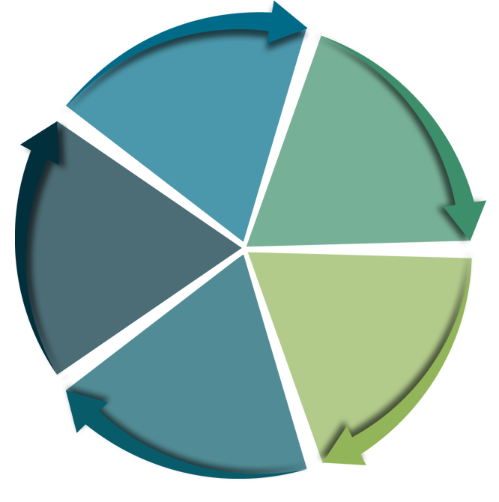
1: Ensure a well-define customer access strategy
Customers
Segments the Customer Base:
Business vs. Consumers
Geography
Purchasing Behavior
Demographics
Volumes
Contract Terms
Unique needs
Hours of Operation
Identifies appropriate hours operation and can vary by:
Contact Channel
Contact Types
Customer Segments, etc.
Customers
Hours of
Operation
Access
Alternatives
Service Level
Response Time
Access Alternatives
Identifies Communication Channels:
Web, social channels, email, IVR, fax, handhelds, kiosks, postal mail, face to face, etc.
Corresponding telephone numbers, social sites, web URLs, email addresses, fax numbers, etc.
Contact
Types
Service Level & Response Time Objectives
Identifies Contact center’s Service Level and Response Time objectives by:
Contact Channel
Contact Types
Customer Segments, etc.
Contact Types
Identifies the major interaction types:
Placing Orders
Order Changes
Billing Inquiries
Tech Support, etc.

Slide 7
1: Ensure a well-define customer access strategy (cont.)
Routing Methodology
Identifies how customers are routed by:
Customer Type
Type of Contact
Access Channel
Information Required
Identifies customer, products/services information which:
Must be accessible,
Must be captured,
Must be reported, and
How the Contact Center will comply with applicable privacy and reporting requirements
Routing
Methodology
Information
Required
Resource
Requirements
Resource Requirements
Defines people and technology needs by:
Customer Type
Type of Contact
Access Channel
Guidelines for
New Services
Analysis and
Collaboration
Guidelines for Deploying New Services
Identifies a framework for deploying new services including:
Technology Architecture
Corporate Standards
Investment Guidelines
Migration Plans, etc.
Analysis and Business Unit Collaboration
Defines how Contact Center information is used to:
Better understand customer behavior
Improve products, services and business processes
Contact center’s measures and contributions

Slide 8
2: Never ending focus on creating high-value
Leading Contact Centers align people, strategy, processes and culture to improve operations across TWO dimensions of value:
  To track and continuously improve Contact Center efficiency
  They use Contact Center analytics to continuously create strategic value
The results can be dramatic:
 | Best in Class (top 20%) | Average (middle 50%) | Laggards (bottom 30%)
FTR (First Time Resolution) | 84% | 47% | 13%
C-sat year on year increase | 14.3 | 3.6% | -2.0%
Agent productivity year on year increase | 11.7% | 2.7% | -3.2%
Aberdeen 2013 study

Slide 9
3: Measure & Improve VoC - Voice of the Customer
  “We have only two sources of competitive advantage: the ability to learn more about our customers faster than the competition, and the ability to turn that learning into action faster than the competition.” - Jack Welch
Define WHAT to measure and WHEN to measure it:
    Customer Satisfaction
        Global measure
        Transactional measure
    Customer Effort
        Actual effort required by the customer to resolve the issue vs.
        Customer’s anticipated effort
    Customer Loyalty - Net Promoter Score (NPS)
        How likely are you to recommend our product to someone else?
        Promoters 9, 10
        Passives 7, 8
        Detractors 0 to 6

Slide 10
4: View people development as a key to success
They support everyone who is impacted
    Agents, Supervisors, Managers and Directors
They leverage skills and knowledge
    Teach the contact center’s strategic value -“why” and not just “how”
    Structured plan for continued education
They understand the interdependency among Hiring, Training and Coaching
    “Culture-fit” hires lessen dependency on training/coaching
    Coaching provides valuable insights into hiring and training
They fulfill the basic needs in agent development
    Treat agents with respect and they will respect customers
    Give them a vision & values - listen and empower them
    Involve them in problem-solving and create passion in them
    Recognize their efforts and make performance soar
    Enrich agents’ jobs and give them the opportunity to grow

Slide 11
5: Build services to meet evolving customer expectations
High-Touch Contact Centers understand changes in customer expectations and continuously align their services to meet evolving customer needs
Top 10 Key Customer Expectations
Be Accessible
Treat me with courteously
Be responsive to what I need and want
Do what I ask promptly
Provide well-trained and informed agents
Tell me what to expect
Meet your commitments and keep your promises
Do it right the first time
Follow up
Be socially responsible and ethical

Slide 12
6: They make effective use of “Key Metrics”
  High-touch contact centers do not overestimate their contact center’s true value – instead they:
    Establish the right objectives and measures
    Interpret results accurately
    Use data to continuously improve services
  High-touch contact centers establish unique objectives and measures for their business – most common are:
Strategic Value | Contact Center’s value and impact on revenues, brand, R&D, Marketing, etc.
C-Sat and Loyalty | Customer Satisfaction is the primary objective which drives customer loyalty
Employee Satisfaction | Employee Satisfaction and Engagement clearly drive customer satisfaction
Quality and FTR | Quality is linked to objectives and First Time Resolution is “getting Quality right”
SL & Response Time | Getting customers to the right place at the right time
Schedule Adherence | Having the right agents in the right place at the right time

Slide 13
7: Use technology to improve High-Touch Services
Voice/data integration, coupled with cloud-based capabilities are enabling new capabilities:
    Multimedia Applications
    Multisite Operations
    Integrated reporting
    Workflow and Quality Management
    Performance management
Trends challenging contact centers’ technology use:
    Customers are better informed
    Agents must evolve to match customers’ needs and expectations
    Agent-assisted services must be deployed wisely
    Contact Center structures must be redefined
    Contact Centers are becoming more distributed

Slide 14
Best Practices to create “High Touch Customer Contact”
High-Touch Contact Centers:
Ensure a well-defined Customer Access Strategy
Have a never ending focus on creating “high-value”
Measure and improve VoC (Voice of the Customer)
View people development as a key to success
Build services to meet evolving customer expectations
Make effective use of the “key Metrics”
Use technology to improve High-Touch Customer Services
Through complimentary assessments, Auxis helps companies evaluate call center improvement opportunities…

Slide 15


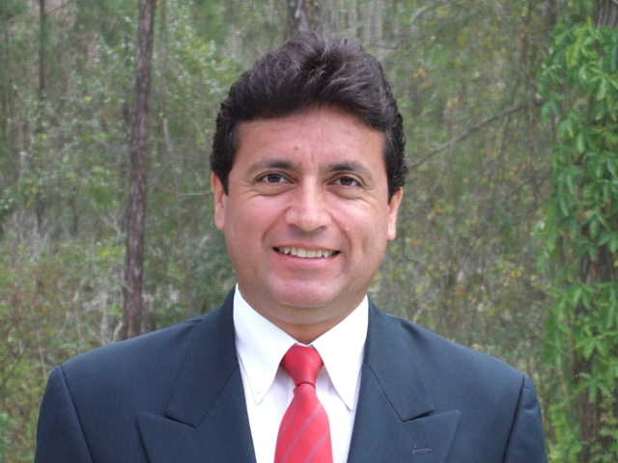
…for a Free Call Center Assessment contact us
Q&A
Edward Quintero
edward.quintero@auxis.com
727-934-0201
Thank You
FT LAUDERDALE,FL • TAMPA,FL • WASHINGTON,DC • SAN JOSE,COSTA RICA

