Slide 1






Objective of this exercise
Build and runs tests
Write code Make changes
Check the code in
Detects the change Raises a build event
In this lab, you will
Deploy a web app from GitHub to CodePipeline
Build and test the app
Use EBS to deploy the app
Make changes to your code and commit the changes to GitHub
Set up the CodePipeline to detect the change and rebuild the app for EBS to deploy.
Production

Slide 2
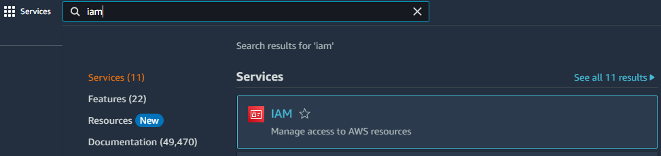
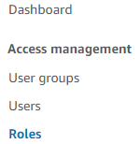
Create a Service role for your Elastic Bean Stalk service
Select Roles

Slide 3
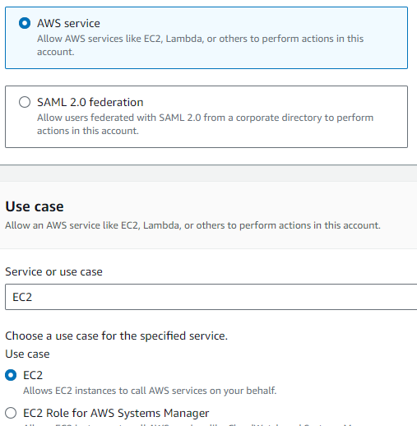

Slide 4
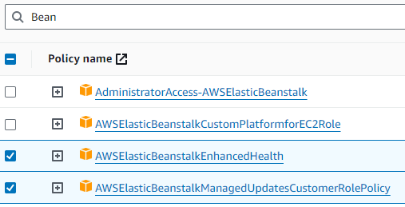
For the Permissions for the role add:

Slide 5
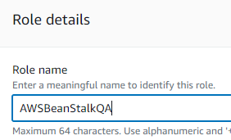

Type a name for the new Role and then click the Create role button.

Slide 6
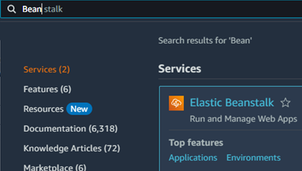

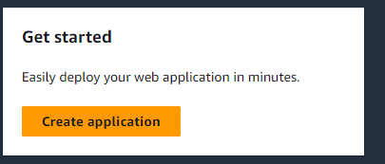
Create your BeanStalk application to upload your app
Type a name for your app (any name you like)

Slide 7
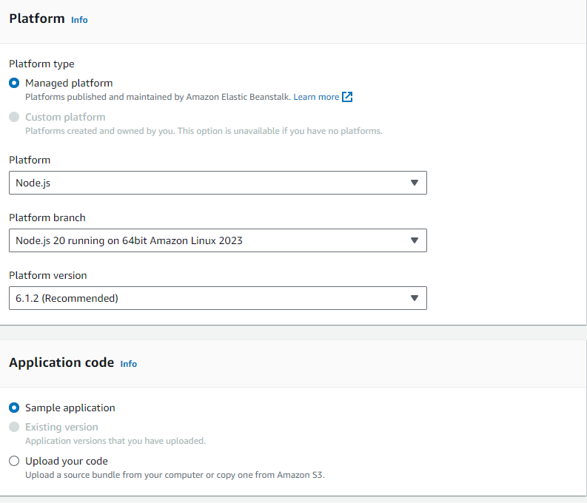


Select Node.js for your platform for a sample app and then click the Next button

Slide 8
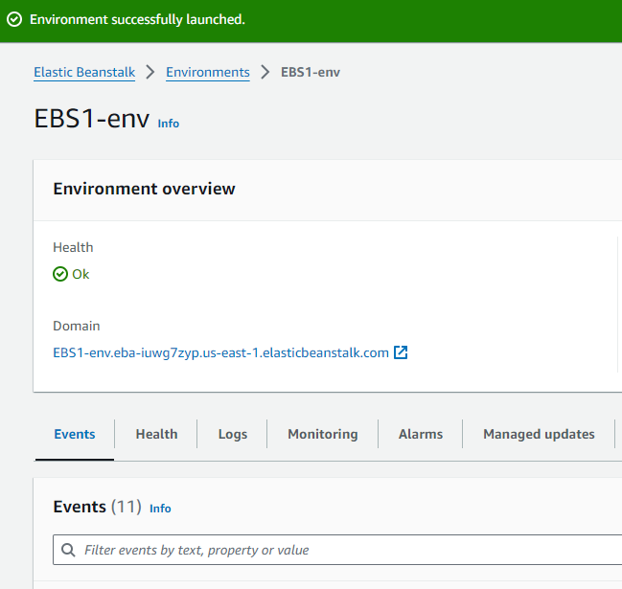
Click

Slide 9
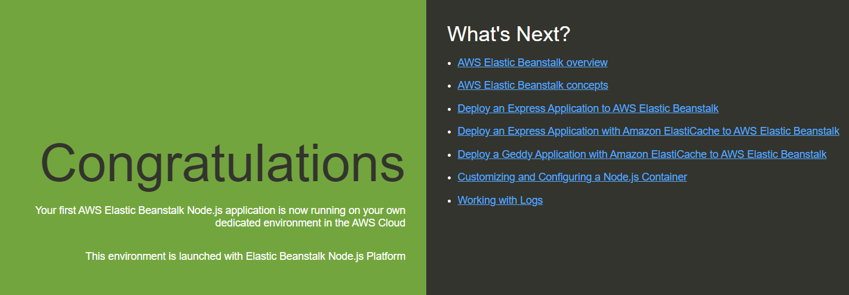
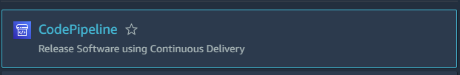
Deploy the sample NodeJS app using the AWS Elastic Beanstalk
Then start

Slide 10
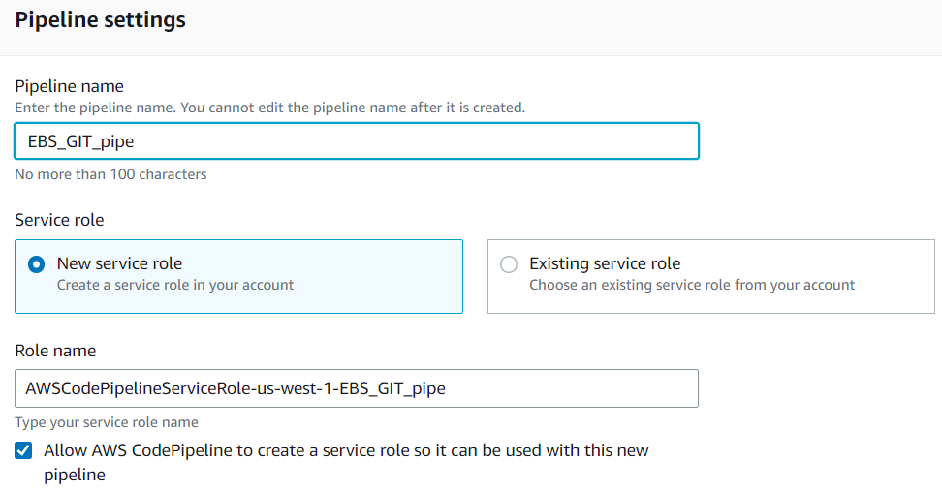

Slide 11
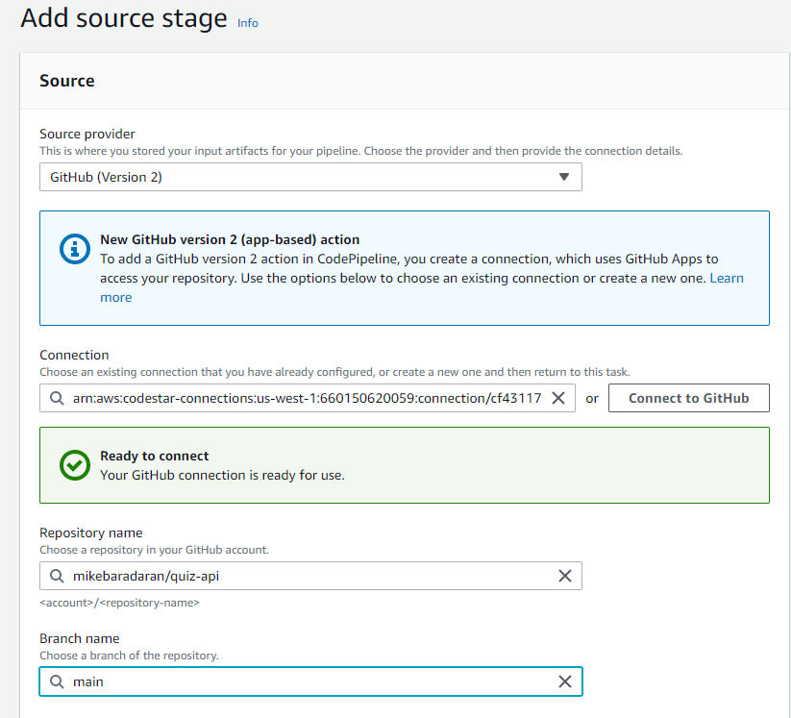

Slide 12
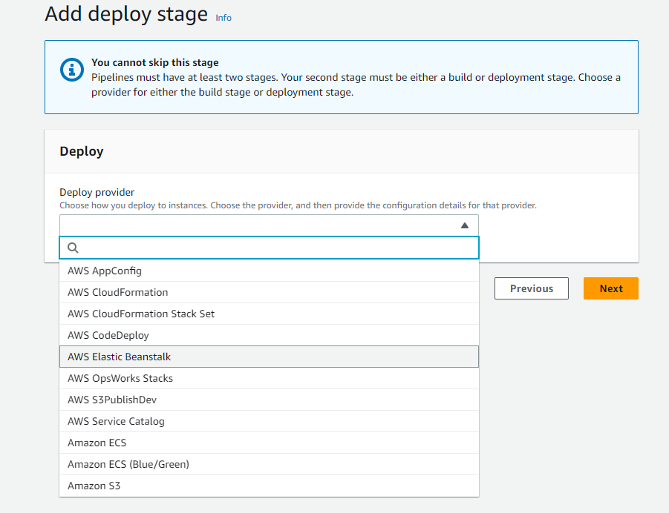

Slide 13
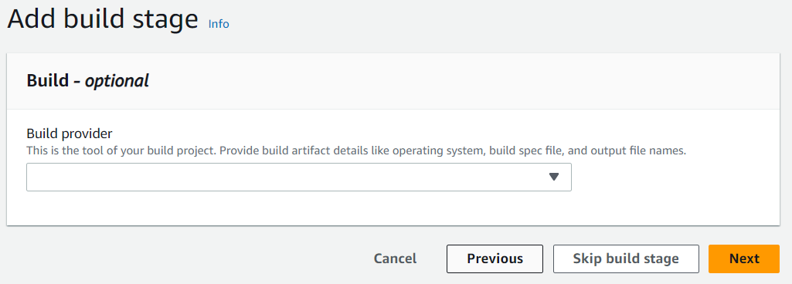
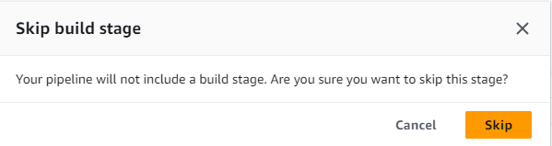

Slide 14
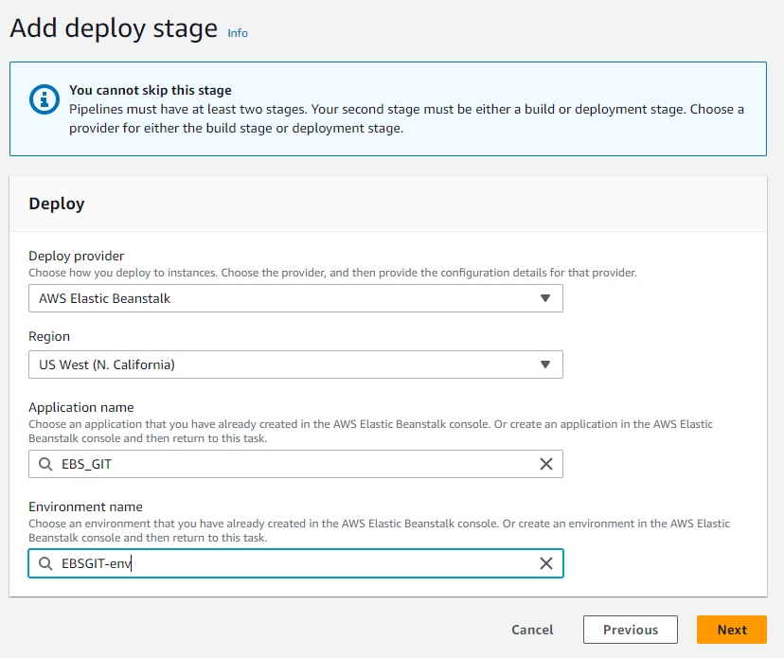

Slide 15
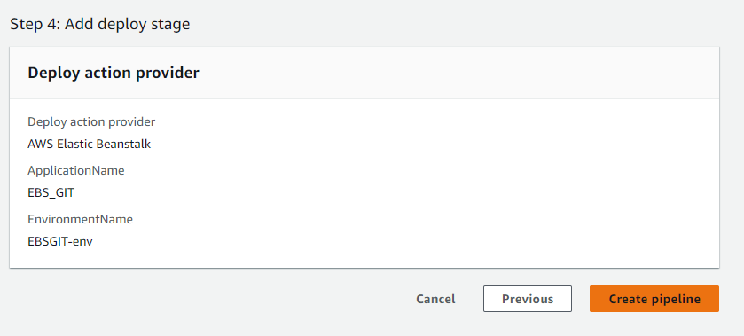

Slide 16
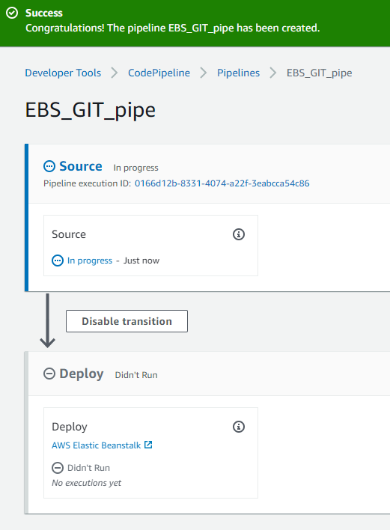
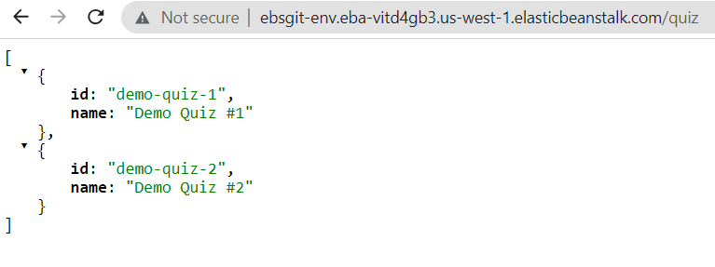
After a few minutes click here and click on your EBS URL

Slide 17
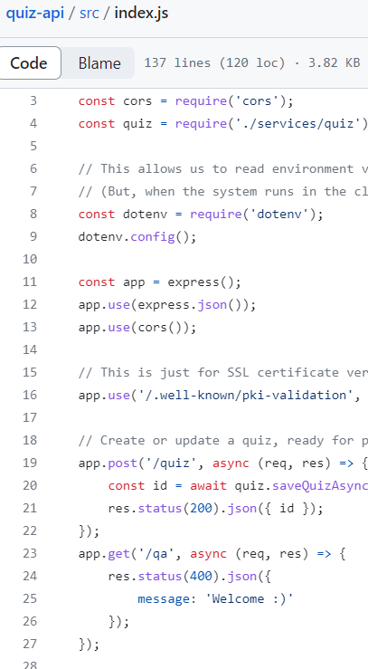
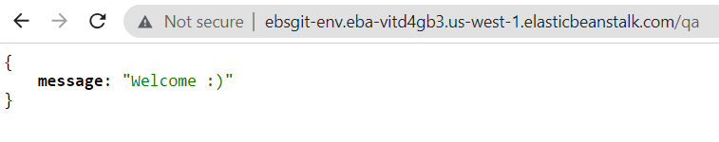
Make changes in GitHub

