Slide 1
Inheritance

Slide 2
Contents
Objectives
  To add functionality to existing classes using inheritance
Contents
  Basic concepts of inheritance
  Extending a simple class
Hands-on labs
Notes:
Now that you've mastered classes, it's time to move on to inheritance. Inheritance is a very powerful concept in object-oriented programming, because it allows you to define a new class (known as a sub class) in terms of how that class differs from some other class (known as a super class).
By the end of part three, you should be able to:
Use inheritance to define new classes
Ensure proper construction of a super class
Override methods in a sub class
If necessary, call methods in a super class
Explain the concept of polymorphism!

Slide 3
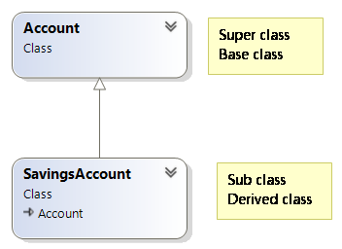
Base and derived classes
A class can inherit the features of another class.
The ‘sub’ class can:
  utilise all the features of the super class.
  override certain behaviour of the super class.
  add new features.
Inheritance is a fundamental object-oriented concept.
The code in the super class can be reused by the subclass. ✔️
New classes can be defined simply in the terms of their ✔️
differences from an existing class.
Notes:
Examples of inheritance are ubiquitous in our model of the real world. Our definition of a cat inherits the features of our definition of a mammal, which in turn inherits the features of our definition of an animal. A chair and a table both inherit the features of furniture. A taxi is a kind of car.
Notice that sub-classes take on features of the super class and can add or (slightly) modify features, but they cannot remove features.
Many different terms are used with inheritance. Occasionally parent-child is used as an alternative to super-sub class.

Slide 4
Inheritance in action
A vector graphics program
  Lots of commonality
    position and colour fields
    draw method
  Want to benefit from re-use
Create a base class called Shape
  Implement common code there
Derive classes from Shape
  Rectangle, Ellipse, Triangle
Notes:
Let's provide an example where inheritance would be a useful tool: a vector graphics drawing program. Such a program would normally allow you to create common shapes, such as ellipses, rectangles, and triangles. Each of these is likely to be a class in the application's model. However, it quickly becomes apparent that these classes all share common behaviours and properties; shapes are filled with a colour, all need to be drawn, etc.
Good OO practice would have you factor the common elements into a super class (maybe called Shape), from which all the other classes would be inherited. These sub classes would then gain the benefit of re-use of the code from the super class. However, the sub types would also need to be able to extend and modify the super class functionality; for example, each separate type would need to be able to provide its own algorithm to calculate the area of the shape, and many would need to add specific fields and constructors to support their different data requirements.
One of the key things that we observe is that we can apply a test to see whether inheritance will work in our model: the ‘is a kind of’ relationship. A triangle is a kind of shape; an ellipse is a kind of shape; a circle is a kind of ellipse. This test confirms that we are introducing inheritance relationships that make logical sense.

Slide 5
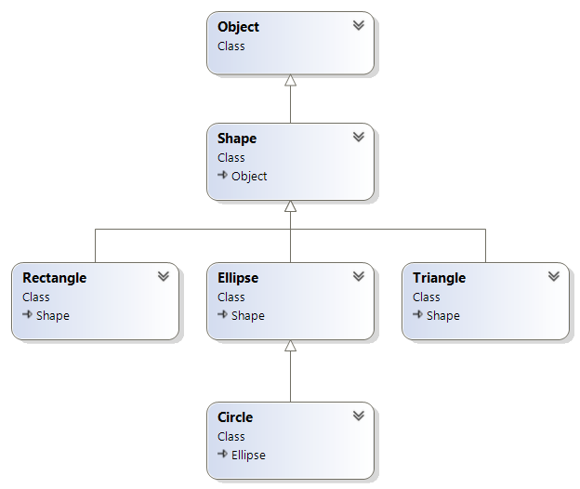
The inheritance hierarchy
Ultimate super class for all types
Super class of all
Shape types
Derived types that extend Shape
Single inheritance – each class
can have one direct super class
Notes:
Note that Java only supports single inheritance. Additionally, any class that does not explicitly extend another class implicitly extends the java.lang.Object class. In other words, the Object class is the only class that does not have a super class.
Single inheritance means that each class can only have one direct super class: the direct super class of Circle is Ellipse; the direct super class of Ellipse is Shape, etc. This single chain of inheritance can go many levels deep. Of course, multiple classes can be derived from a single super class, with Rectangle, Ellipse and Triangle all being derived from Shape.
In the next chapter, we will see that the use of interfaces provides a more coherent and less ambiguous approach to allowing a class to provide functionality to match multiple conceptual definitions.

Slide 6
Specifying the base class
public class Shape {
private int x, y;
private String colour;
...
}
Super class
public class Rectangle : Shape {
...
}
public class Ellipse : Shape {
...
}
public class Circle : Ellipse {
...
}
Sub classes extending the super class
Rectangle-specific members
Ellipse-specific members
Circle-specific members
Notes:
When you define a sub class, you need only to provide code for the things in the sub class which are different to the super class. You also need to establish the inheritance relationship between the sub and the super class. You do this by placing the super class name after the class name, separated by the keyword ‘extends’ as shown above.
Note that if you omit a super class name, the compiler will automatically make the super class java.lang.Object, as all types are ultimately derived from Object.

Slide 7
Sub class inherits all the super class fields
public class Shape {
private int x, y;
private String colour;
...
}
Can be exposed via public getters
X & y: 10, 10
colour: Green
Shape object
public class Ellipse : Shape {
private int width;
private int height;
...
}
X & y: 10, 10
colour: Green
Ellipse object
width: 20
height: 10
A sub type is a kind of super type
Notes:
Instance fields should normally be declared as private, which means that instances of derived classes will have these values but will not be able access them directly.
In our example, the super class (Shape) declares two instance fields, position and colour. All objects of the sub types will have their own copies of these instance fields, as shown in the picture of the Ellipse object above.
However, it is important to note that fields will typically be declared with the private modifier. This means that they will be inaccessible to the code in the sub classes (however the getXxxx() methods will be visible of course and invokable without a prefix or <dot>).
Of course, the sub type might also define its own fields, in which case objects of the sub type will have both the fields from the super class(es) and those from their own type. This last point is very important. In the code above, an Ellipse object is a kind of Shape object, because it has everything in it as defined by the Shape class, without them having to be defined again in the Ellipse class.

Slide 8
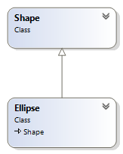
Constructing the derived objects
Base class constructors are not inherited.
  But default constructor of the base class is called.
You can invoke base class constructor.
  This is mandatory if there is no default (no argument) constructor in the base class.
Ellipse
Before constructing an Ellipse, must construct the Shape object within
Shape
Notes:
A class does not inherit any constructors from its base class. Therefore, the class has only the constructors explicitly defined in that class or, if none are defined, the default (no arguments) constructor.
Objects are always constructed from the top class down to the bottom class (i.e., from the java.lang.Object class down to the class that is being instantiated. This ensures that a constructor in a derived class can rely on proper construction of its base classes. However, this works only if the base class (superclass) has a default constructor, as the compiler can't guess which arguments you may wish to pass to the base class‘s constructor.
If the base class doesn't have a no arguments constructor, you must use super() to explicitly call a specific constructor in the base class. The arguments to super() must, of course, match those of the target constructor.
Note that when an object is created, the order of construction is as follows:
1. Its instance fields are initialised to default values.
2. Its constructor is called, which in turn:
calls the constructor of its base class (either implicitly or explicitly).
initialises its instance fields through their initialisers (if any).
executes the body of the constructor.

Slide 9
Derived class constructor
class Shape {
private int x, y;
private String colour;
public Shape(int x, int y, String colour) {
this.x = x; this.y = y;
this.colour = colour;
}
}
No default constructor
So all derived classes must invoke this .ctor
class Ellipse : Shape {
private int width, height;
public Ellipse(int x, int y, int width, int height, String colour)
: base(x, y, colour) {
this.width = width;
this.height = height;
}
}
Calling base constructor to initialise base fields
Ellipse e1 = new Ellipse(4,7, 23, 24, "RED");
Notes:
Here's an example of constructor usage with inheritance. The first thing to notice is that the Shape class only has one constructor, which takes two parameters.
The derived Ellipse class can define a constructors which specifies the super class (Shape) constructor to use.
In our example it has to do this, as the super class hasn't got a default no arguments constructor.
You will also notice that the Ellipse constructor takes two parameters (position and colour) which are passed up to the super class; this is very common with inheritance.

Slide 10
Derived class constructor – chaining
class Ellipse : Shape {
private int width, height;
public Ellipse(int x, int y, int width, int height, String colour)
: base(x, y, colour) {
this.width = width;
this.height = height;
}
public Ellipse(int x, int y) {
this(x, y, 10, 10, Color.BLUE);
}
}
Calling base constructor initialise base fields
Calling Ellipse constructor
Ellipse e1 = new Ellipse(4,7);
Notes:
The derived Ellipse class has defined two constructors.
The second Ellipse constructor doesn't need to specify which super constructor will be used, because it chains to the four argument Ellipse constructor. In fact, it isn't possible to use both this() and super() in the same constructor; you can either chain within your class or you can specify a base constructor. But if you do nothing the compiler sticks in super().

Slide 11
protected
Modifier that allows access to deriving types only
  Used to restrict access to methods
    Fields should always be private, remember
Let's view an example…
Notes:
While we're on the subject of visibility, it's worth reintroducing the protected modifier. When you declare a method with the protected modifier, you are stating that it is only accessible to the declaring class, and any class that is derived from it. This is an incredibly powerful feature, because it means that you can add methods, and even constructors, that only deriving classes can see.
A good example of this is shown above. Many java graphical types raise events (we'll cover events in a later chapter). A very common pattern for raising events is to raise the event in a protected method. Doing it this way enables a deriving class to override the conditions which control whether the event should be raised or not. If you made the method public, then any piece of code could raise the event, and if you made it private the deriving class would have no opportunity to control it.

Slide 12
Protected access modifier
namespace barclays;
public class CreditCard {
protected int pin;
public CreditCard(int pin) {
this.pin = pin;
}
}
namespace barclays;
public class Program {
public static void Main(string[] args) {
CreditCard cc1 = new CreditCard(111);
Console.WriteLine(cc1.pin);
}
}
namespace tesco;
using barclays;
public class Bank {
public static void Main(String[] args) {
CreditCard cc = new CreditCard(333);
Console.WriteLine(cc1.pin);
}
}
☒
Can only be accessed by extended classes
No access by a class outside of the project (assembly)
☒

Slide 13
Protected example within inheritance
namespace barclays;
public class CreditCard {
protected int pin;
public CreditCard(int pin) {
this.pin = pin;
}
}
namespace tesco;
using barclays;
public class TescoCreditCard : CreditCard {
public TescoCreditCard(int pin) : base(pin);
}
public void changePin(int newPin) {
this.pin = newPin;
}
}
Available to subclasses, even when they’re defined in a different project.
☑

Slide 14
Using Inheritance for creating custom exceptions
Custom exception class must derive from Exception
  Duplicate constructors
    Pass 'String message’ up to base class
    (the only time you can write to the inherited message field)
    Can add additional methods
View code example on the next slide …
Notes:
Custom exception types you author will be subclassed from class Exception or from an exception type derived from it. The ultimate ‘super’ Exception class (java.lang.Exception) defines a ‘message’ field but the only ‘write’ access to it is via the .ctor of class Exception.
If your exception type inherits from RuntimeException, then it is of course an unchecked exception and client code does not have to catch it or alternatively declare itself as throwing it via a ‘throws’ clause in the method signature.
Your exception types will typically mirror super class .ctors and then call them using ‘super(..)’ syntax, passing up a String that is stored and is then accessible to client code ‘catch’ blocks via the getMessage() method.
Some client code may catch ‘Exception’ some may catch ‘YourException’. Regardless of what type is caught a getMessage() method will be available.

Slide 15
A C# example
void methodY() {
throw new QAException();
}
public class QAException : Exception {
  public QAException(String message) : base(message);
  }
  public QAException() : base("General error");
  }
  public void log() {
  // log the message field
  }
}
void methodX() {
  try {
  methodY();
  } catch (QAException e) {
    Console.WriteLine(e.Message);
    e.log();
  }
}

Slide 16

Why do we do inheritance?
  Code reuse
  Perhaps there will be other
  reasons soon!
Sub class inherits and can add additional functionality
Review
Notes:
Inheritance is a very powerful weapon in the OO programmer's arsenal. Remember to use it wisely and judiciously, and it will help enormously. Java only supports a single inheritance model, which means that setting a super class is a very important design decision.

Slide 17
Lab
Working with inheritance
Duration 90 minutes

