Slide 1
CI Pipelines
Continuous Integration

Slide 2
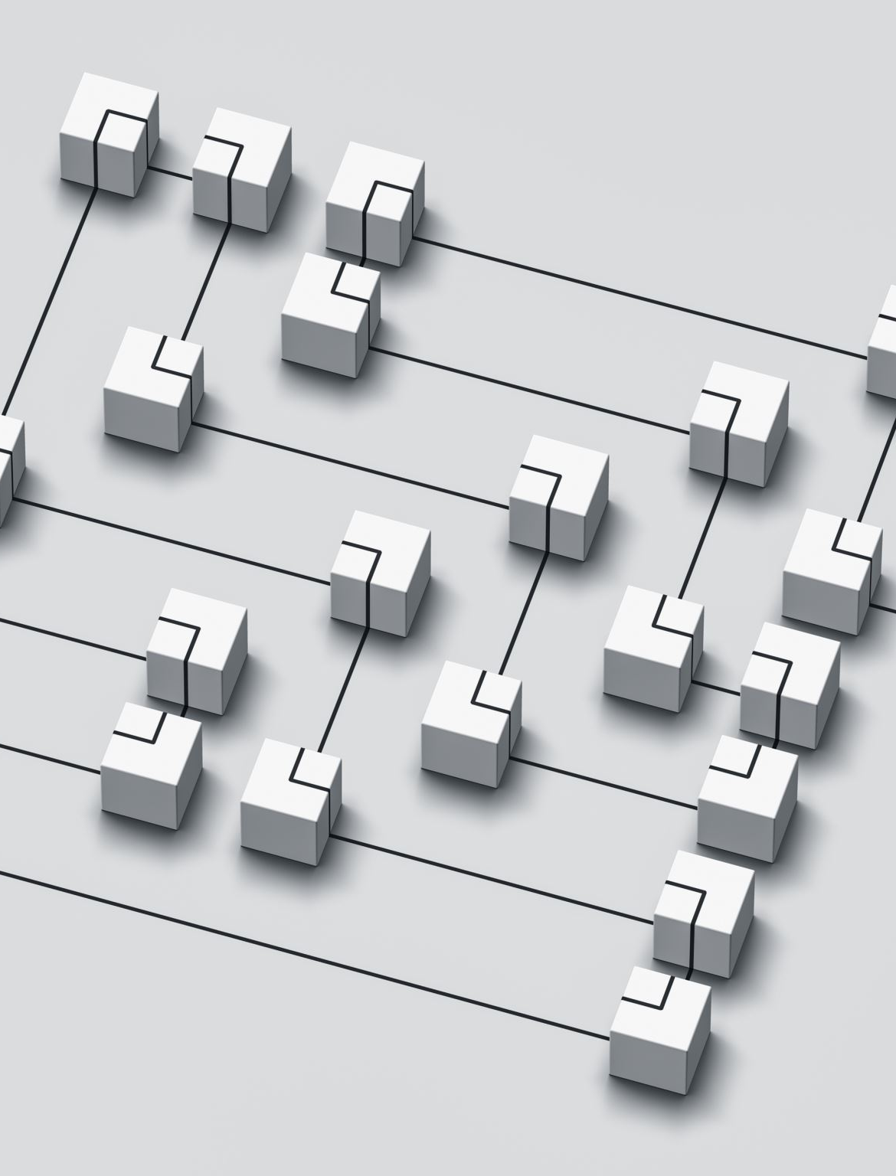
What is a CI Pipeline?
Automation & CI Pipelines
Automate the path from dev to delivery
We use a Continuous Integration (CI) pipeline
A CI pipeline automates key steps such as:
Triggering code builds
Running automated tests
Deploying software

Slide 3
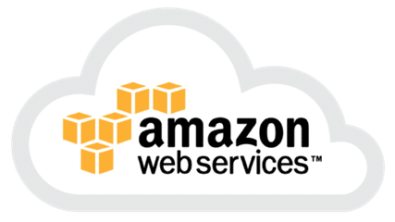
Pipeline Example - Amazon
Amazon & the Shift to AWS
Originally ran most of their infrastructure in‑house
Limited flexibility during seasonal spikes and led to wasted capacity
Moving their retail platform to AWS enabled:
Easy, on‑demand scaling
A much faster continuous deployment process
Impact:
It now deploys code on average every 11.7 seconds
made possible with a sophisticated, well‑designed CI pipeline

Slide 4

Pipeline Example - Netflix
Netflix & Cloud Reliability
Netflix needs highly reliable cloud infrastructure
Handling spikes in traffic is essential for smooth playback
Netflix created the Simian Army to test cloud resilience:
Tools that deliberately stresses and breaks AWS systems
Helps engineers uncover weaknesses in the infrastructure
Issues are investigated, fixed, and deployed rapidly powered by CI pipeline

Slide 5
The CI Pipeline
Source Code
Pull
Version Control System
Get Work
Developers
Project Tracking
Push
Update Work
Email the Devs
Pull Code
Poll Code
Send Code
Build Tool
Email Server
CI Server
DevOps
Build Report
Build Results
Run Tests
Test Results
Send artefact
Automated Testing
Artefact Repository
Test artefact
Live Environment
Testers
Testing Environment
Staging Environment
Environment Testing Done
Staging Passed
Notes:
Note: this is an animated slide – recommended for a tutor to talk about each aspect, example tools, etc.
This big picture diagram is telling the story of how code moves from a developer’s laptop all the way to a live environment, and who is responsible for each step.
The CI pipeline: who does what, what tools are involved, and how information flows.
1. Developers create and manage the code. They feed the pipeline!
Writing code, Pulling/pushing to a version control system, Updating tasks in project tracking tools
Everything starts with version control.
2. DevOps automates the build and test process (the middle section)
A CI server polls or receives code changes
It triggers a build tool
It runs automated tests
It stores outputs in an artefact repository
It emails developers when things break
Automation takes over as soon as code hits the repo. Humans shouldn’t manually build or test.
3. Testers validate the artefact in real environments
The right side shows the progression through environments:
Testing environment
Staging environment
Live environment
Each environment is a gate. The artefact must pass tests before moving forward.
The overall message a CI pipeline that is a workflow ecosystem that is:
Continuous — code flows automatically from commit to test
Collaborative — developers, DevOps, and testers each own a stage
Tool‑driven — version control, CI servers, build tools, test suites, and artefact repositories all connect
Quality‑focused — every step checks something before the artefact moves on

Slide 6
Exercise
Designing a pipeline
(45 mins)
Exercise: Design a CI Pipeline
In your groups, design a sample CI pipeline based on the diagram in the slide deck.
As you choose tools for each stage, make sure you answer:
Why did you choose this tool?
Does it cost anything to use?
What alternatives could you use instead?

Slide 7
Lab details
Your team is developing a small web application with:
A frontend (React or HTML/JS)
A backend API (Java, C#, or Python)
A shared Git repository on GitHub
Design a CI pipeline that automatically:
Builds and tests the backend
Runs linting on the frontend
Stores build artefacts for future deployment
Your task:
Using the diagram from the slide deck as a reference:
Sketch or describe a simple CI pipeline
  identify each stage (like Build → Test → Package)
Choose one tool for each stage
(e.g., GitHub Actions, Jenkins, Azure Pipelines, Travis CI).
For each tool, answer:
  Why did you choose it?
  (ease of use, cost, integration, etc.)
  Does it cost anything?
  What’s a realistic alternative?

Slide 8
End of section

Slide 9
Build Backend
Integrate directly with GitHub, where repo lives
Easy to configure using YAML
No extra infrastructure to maintain
Alternative:
Jenkins (self‑hosted, more complex)
Stages:
Build Backend
Test Backend
Lint Frontend
Package Backend
Store Artefacts
Test backend:
JUnit (Java)
pytest (Python)
NUnit (C#) …run inside GitHub Actions.
These are the standard testing frameworks
One‑command execution makes them ideal for CI
GitHub Actions integrates test reports easily
Lint Frontend
ESLint
Industry standard for JavaScript/React
Catches syntax errors and enforces consistent style
Run in CI with npm run lint
Package Backend
Maven (mvn package) for Java
pip wheel for Python
dotnet publish for C#
Store Artefacts:
Built‑in storage for build outputs
Easy to download for deployment or debugging
No extra services required
Alternative:
AWS S3
Azure Blob Storage
Trigger: Push code
➡️ Build Backend ➡️ Run Backend Tests
➡️ Lint Frontend ➡️ Package Backend ➡️ Upload Artefacts

