Slide 1
CLOUD DEPLOYMENTS WITH ACTIONS
Deployment to the Cloud

Slide 2
IaaS (Infrastructure as a Service)
Maximum flexibility and control
Customer manages most of the stack
PaaS (Platform as a Service)
Developer-friendly and convenient
Less control over underlying infrastructure
SaaS (Software as a Service)
Ready-to-use applications for end users
Minimal configuration required
In practice IaaS and PaaS are mainly used to deploy apps
Recap
cloud service types

Slide 3
Iaas deployments
IaaS is used to deploy applications to the cloud
Like on-premises deployment
Requires setup of VMs, networking, infrastructure
High control, but more responsibility
Common use case:
Migrating existing applications to the cloud
CI/CD considerations:
External CI tools (e.g. GitHub Actions) are less commonly used
Cloud-native CD tools are usually preferred
CI tools are better suited to PaaS deployments

Slide 4
Cloud developers use PAAS to deploy apps
To provide convenience, scalability, and high availability.
Common PAAS options include:
App Services provide managed hosting for web applications with support for many languages and frameworks.
Functions run small pieces of code in response to events
Container Services provide a managed environment for running containerised applications.
Kubernetes Services provide managed clusters for deploying and scaling container-based systems.
Platform as a Service
(paas) deployments

Slide 5
Exercise 3: PaaS Options
In breakout groups, fill out the table provided in the exercise guide

Slide 6
Exercise 3 – PaaS
In your groups, fill out the following table by researching what PaaS services the three major cloud providers offer:
 | Google Cloud Platform | Microsoft Azure | Amazon Web Services
App Service
Function
Container Service
Kubernetes Service

Slide 7
Paas options
 | Google Cloud | Azure | AWS
App Service | Google App Engine | Azure App Service | Elastic Beanstalk*
Function | Google Cloud Functions | Azure Functions | Lambda
Container Service | Google Kubernetes Engine** | Azure Container Instances | Elastic Container Service
Kubernetes Service | Google Kubernetes Engine | Azure Kubernetes Service | Elastic Kubernetes Service
* Specifically for web apps
** GCP has no separate service for deploying containers without Kubernetes

Slide 8
PaaS with GitHub Actions
GitHub Actions supports deployment to many Platform as a Service offerings.
Prebuilt deployment templates are available and can be customised as needed.
There are also many third-party actions from cloud providers that simplify integration.
  For example, some actions can deploy a zip file directly to an Elastic Beanstalk environment.
If no suitable action exists, you can still use the command line tools on the runner to deploy directly to the required service.

Slide 9

Exercise 4: Workflow Design
Design a GitHub Actions workflow for building and deploying an application which follows the architecture set out in the exercise guide

Slide 10
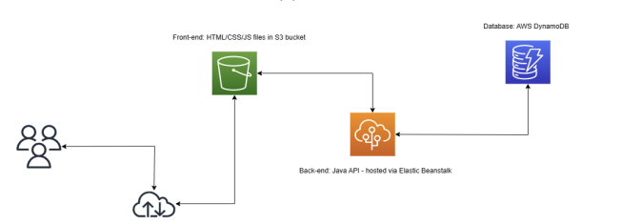
Solution: https://github.com/agray998/QAA-Module5-Workflow-Design-Solution
Take some time to study and understand the following solution architecture for a web application:
Design a workflow to build and deploy the above from source code.
Note: you do not need to implement this, your task is to design the workflow.
Your design should consider:
What tasks need to be performed in order to build and deploy each component?
Are there any available modules which facilitate these tasks?
What sensitive information might your workflow need access to?
How would you store this information?

Slide 11
Review
Cloud providers offer many options for deploying applications to the cloud.
Platform as a Service improves convenience and speeds up deployment
A wide range of Platform as a Service options are available for different application types
GitHub Actions integrates well with these services using provider and third-party actions

Slide 12
End of section

