Slide 1
Bynars Media Player
Team Bynars
Lexi Guches
Travis Heppner
Micheal Peterson

Slide 2
OVERVIEW
Media Player
Supports: Windows Vista, 7, 8, 10
Written in C#

Slide 3
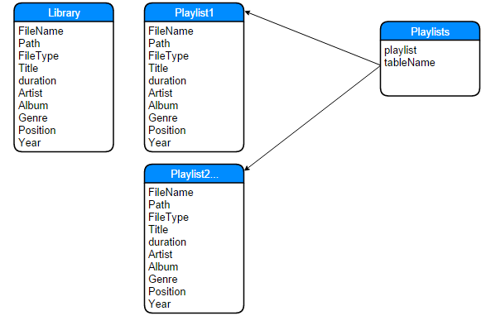
DataBase

Slide 4
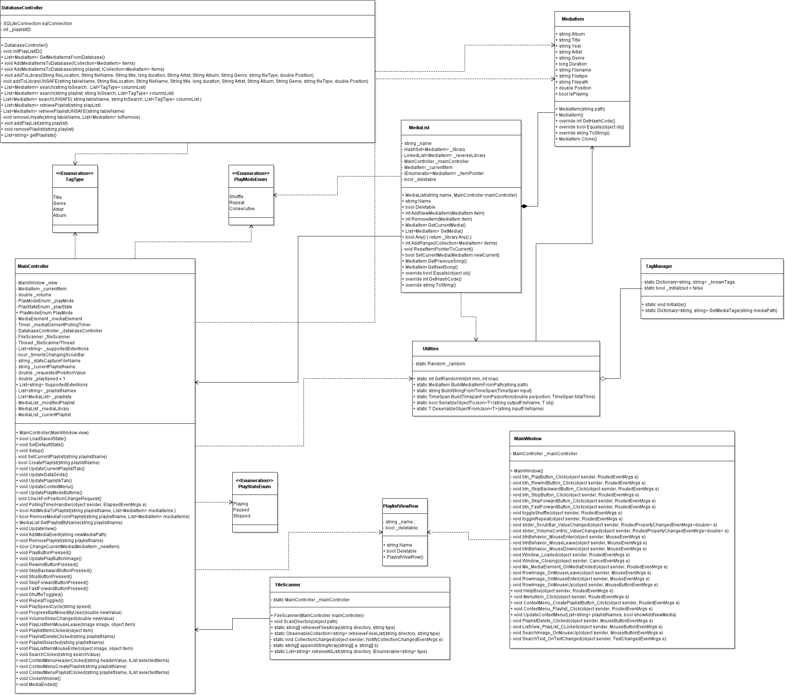
Class Structure

Slide 5
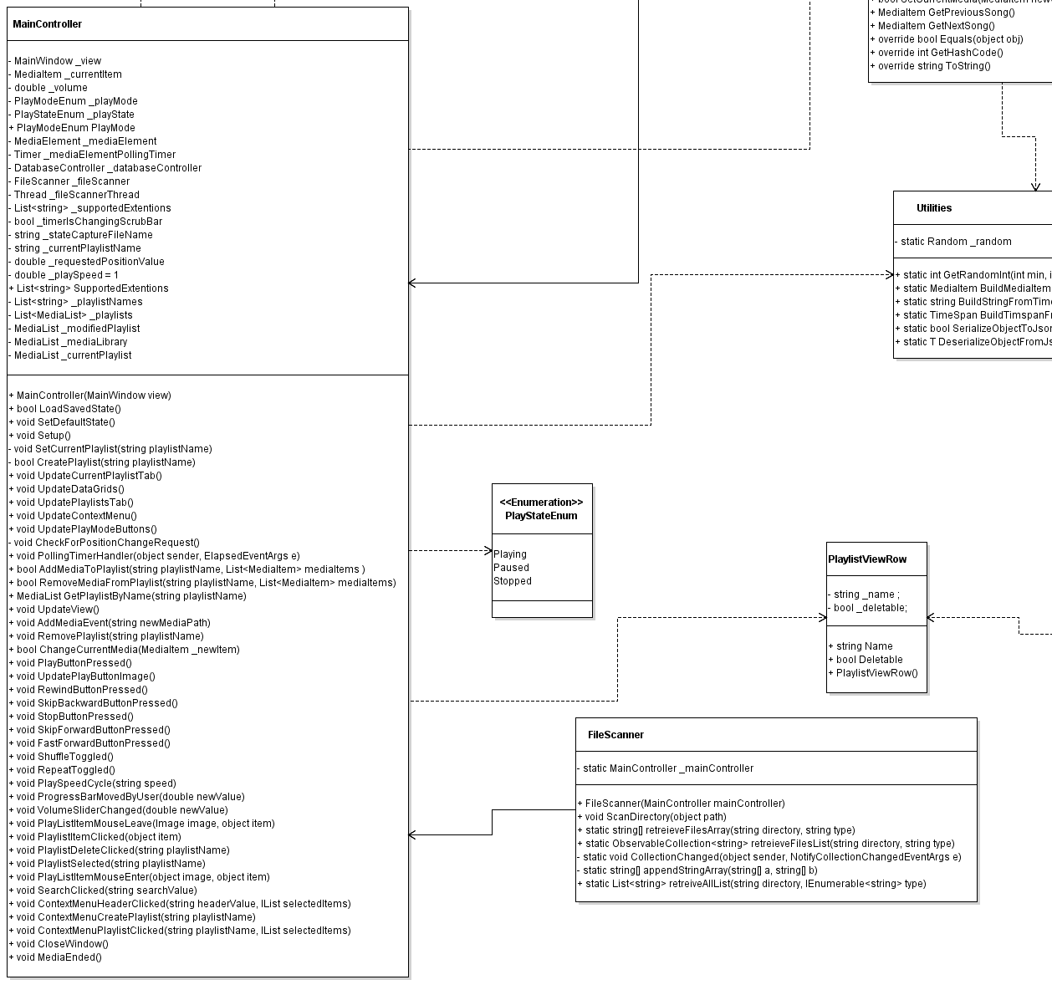
Now closer!

Slide 6
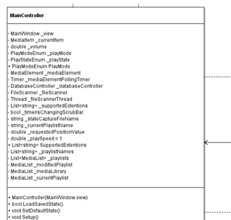
Even more

Slide 7
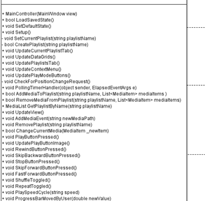
Bottom half

Slide 8
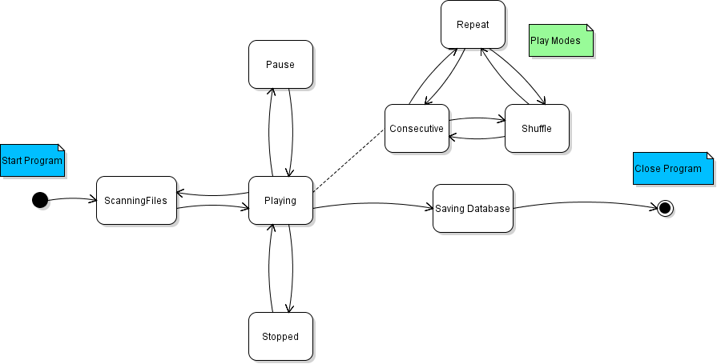
State Diagram

Slide 9
Break for demo

Slide 10
Successes
Functionality
Aesthetics
Smooth Running
Save State

Slide 11
Challenges
Unit testing
Tag Management

Slide 12
Failures
Restoring State
ListView Aesthetics
Visualizations

