Slide 1
Bynars Media Player
Team Bynars
Lexi Guches
Travis Heppner
Micheal Peterson

Slide 2
OVERVIEW
Media Player
Supports: Windows Vista, 7, 8, 10
Written in C#

Slide 3
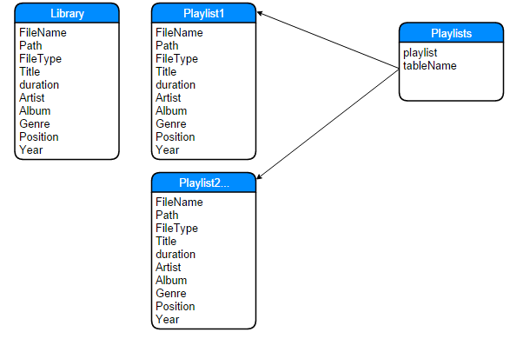
DataBase

Slide 4
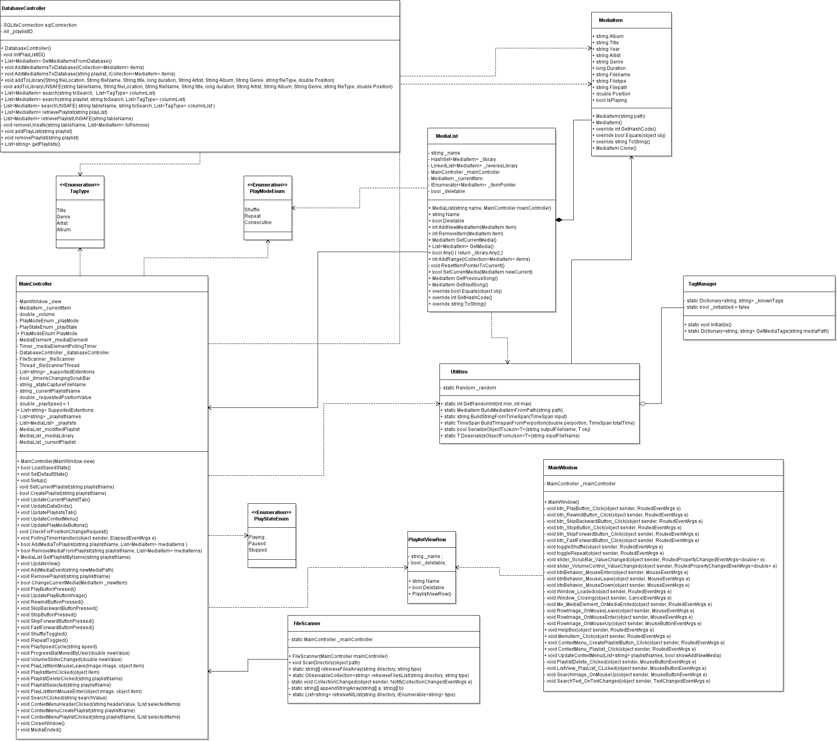
Class Structure

Slide 5
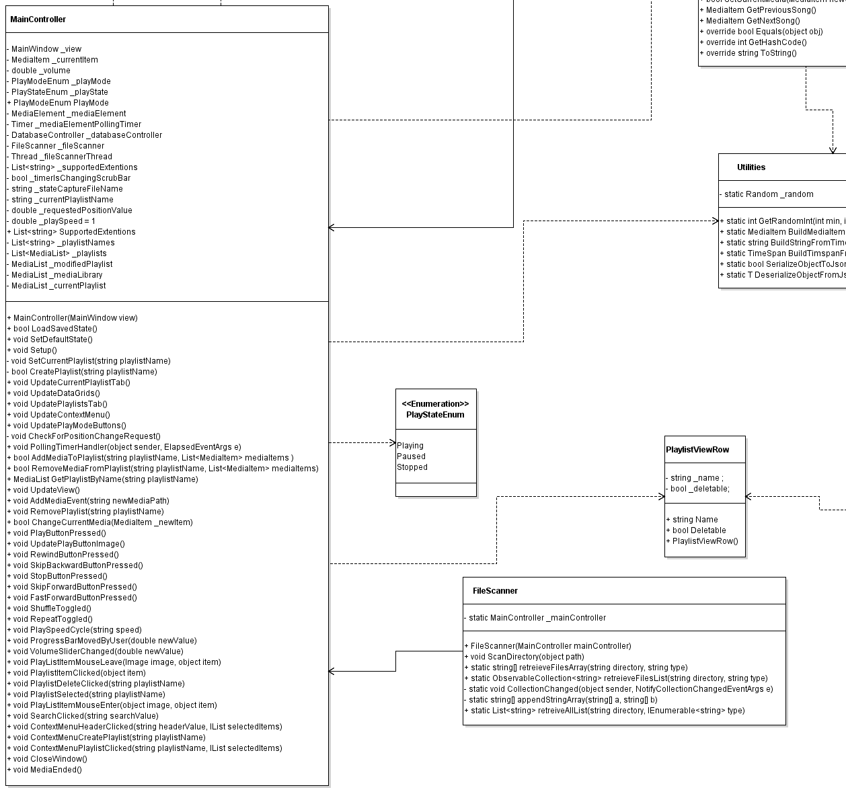
Now closer!

Slide 6
<somediagram>

Slide 7
Break for demo

Slide 8
Successes
Functionality
Aesthetics
Smooth Running
Save State

Slide 9
Challenges
Unit testing
Tag Management

Slide 10
Failures
Restoring State
ListView Aesthetics
Visualizations

