Slide 1
BUtiful Schedule:
Project Architecture
Katherine Hastie, Arthan Baht, Mike Beauzile

Slide 2
Overall Project Architecture
Web-Scraper
Input= URL
BU Student Link Course
Search
Saved Schedules
Parser
Output= HTML string
User can save chosen schedules
UI Manager
Shorter, categorized strings
UI Manager takes data from course array based on user input
Optimizer sends best schedules back to UI manager
“Course” class array
User and course array data go into optimizer
Schedule Optimizer

Slide 3
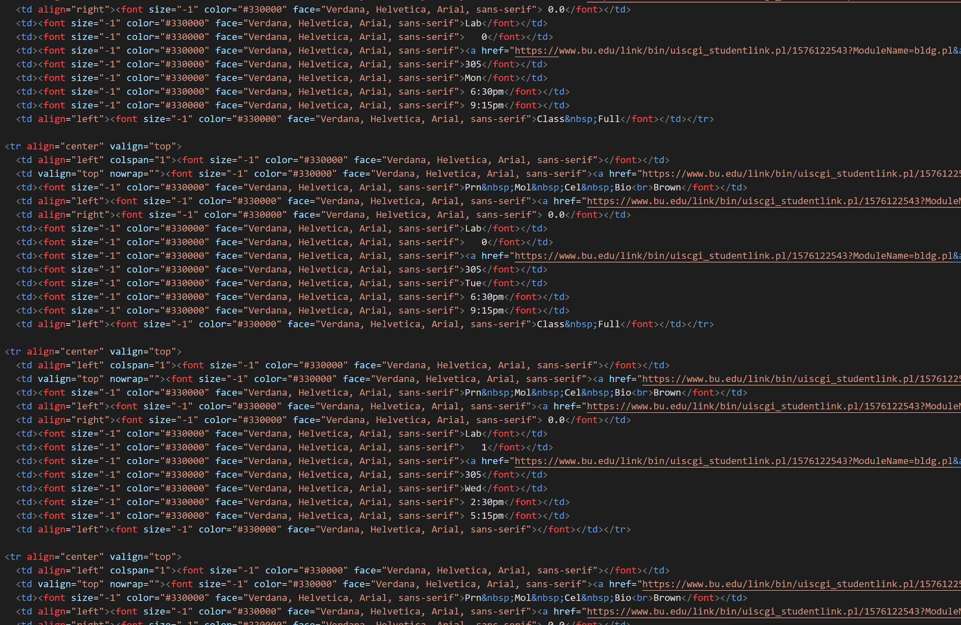
Web-scraper and Data-parser
Sample Student link html
Web-Scraper
Input: URL
Uses jsoup
BU Student Link Course
Search
Parser
Long HTML string
Short categorical strings
Output: HTML from website

Slide 4
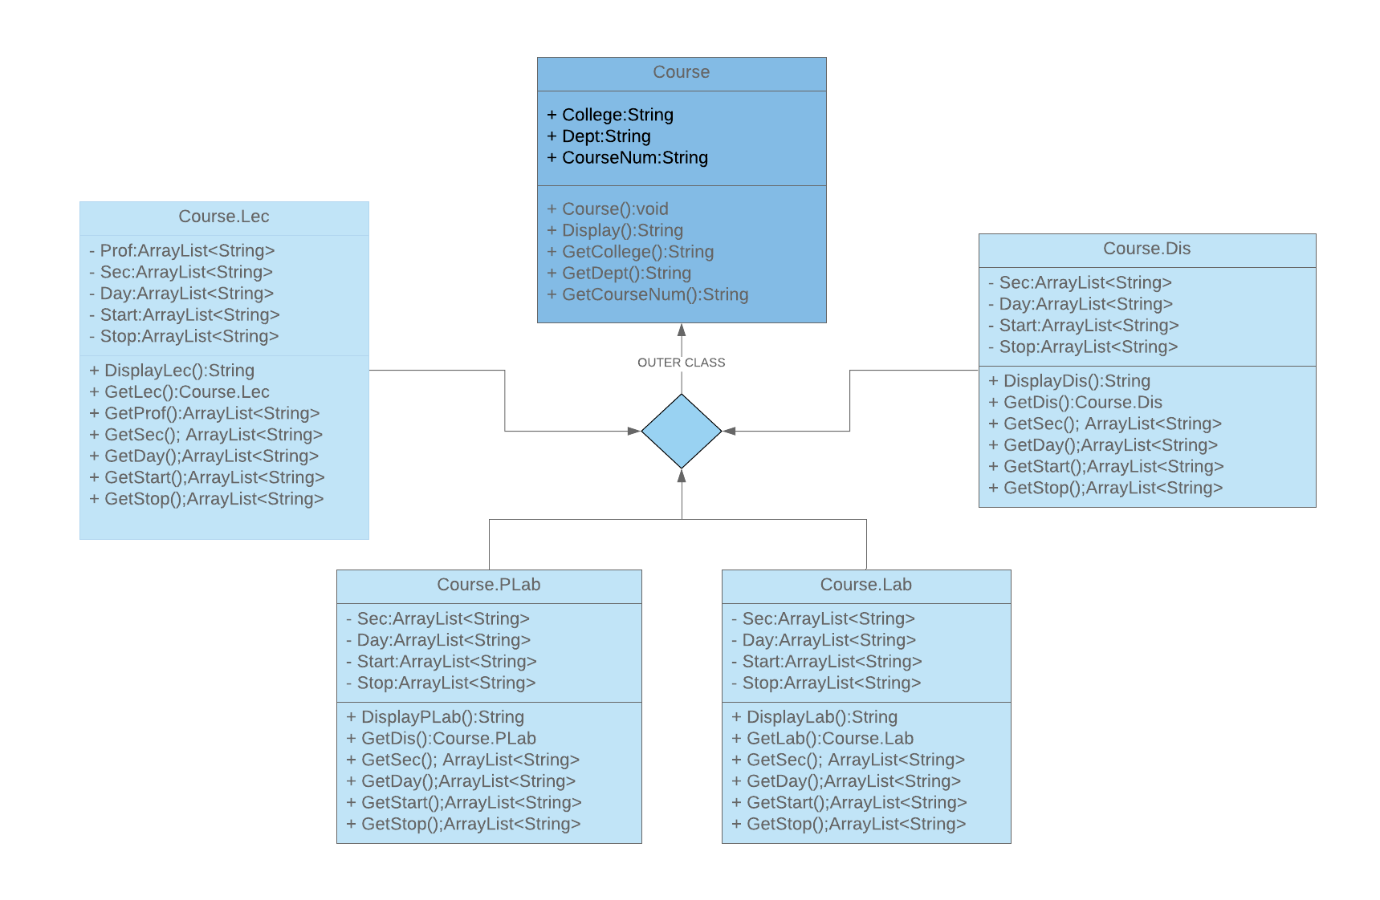
“Course” class array
Outer Class: Course
Contains the the course name
Used to
Inner Classes: Lec,Dis,Lab,PLab
Designate the type of class it is
Contains the days, times and professors
Inner class members used for optimization

Slide 5
Schedule Optimizer
Creates all possible configurations of classes
Eliminates those with time conflicts
Adds points to each remaining schedule based on preferences
Stores schedules with highest totals, sends back to UI manager
Schedule has | Points added
Top choice | x
2nd choice | x-1
3rd choice | x-2
4th choice | x-3
etc. | etc.
Professor:
Points added based on which professor schedule has are doubled.
Highest point total = most optimal schedule!
For every variable with x options:
If student cares more about...
Time:
Points added based on which start-stop time schedule has are doubled.

Slide 6
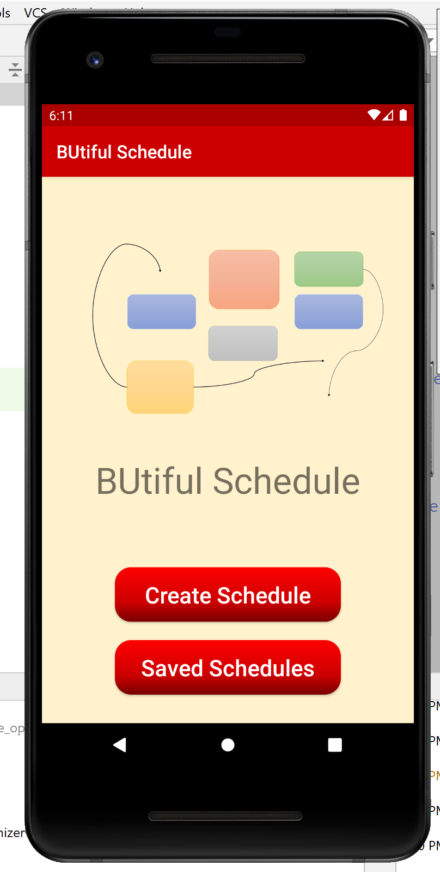
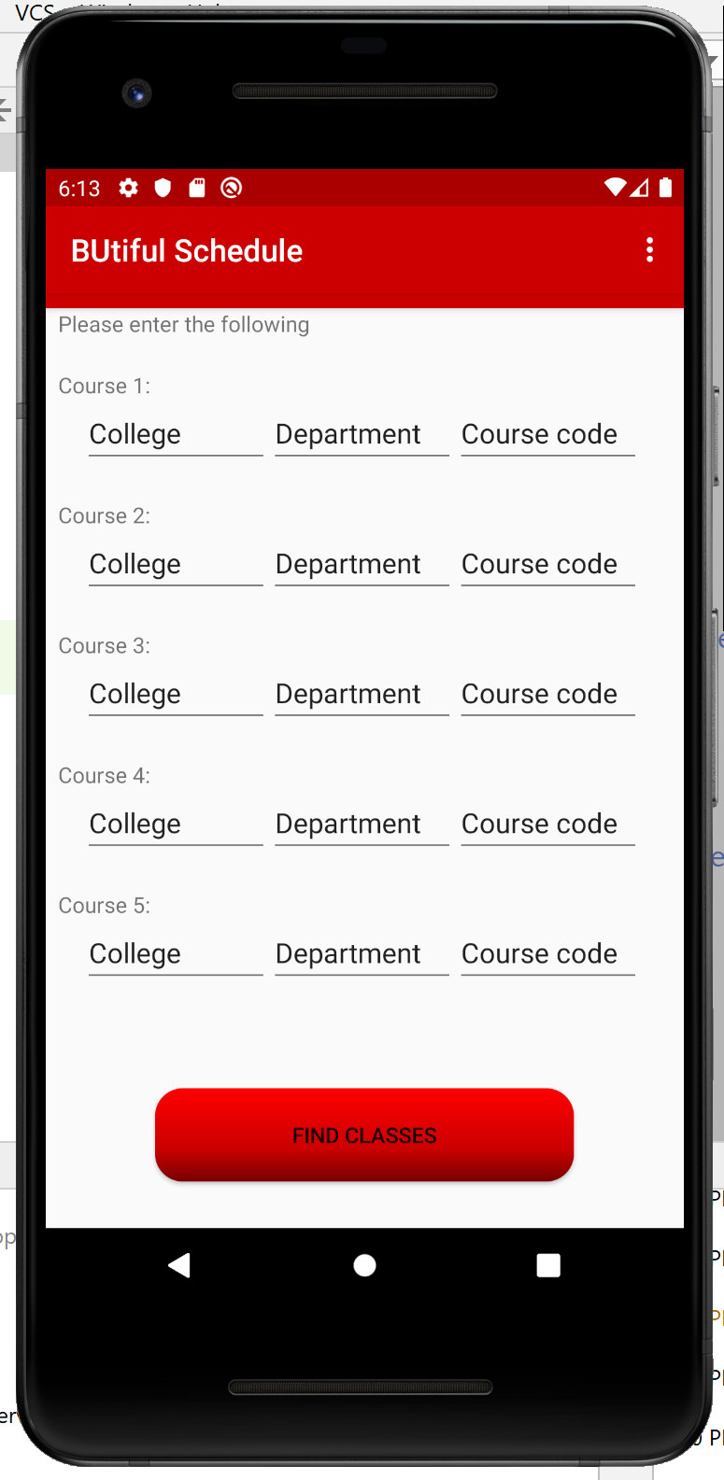
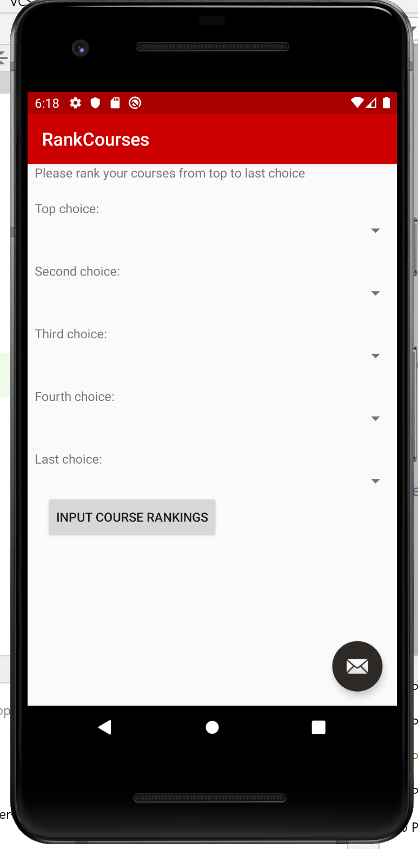
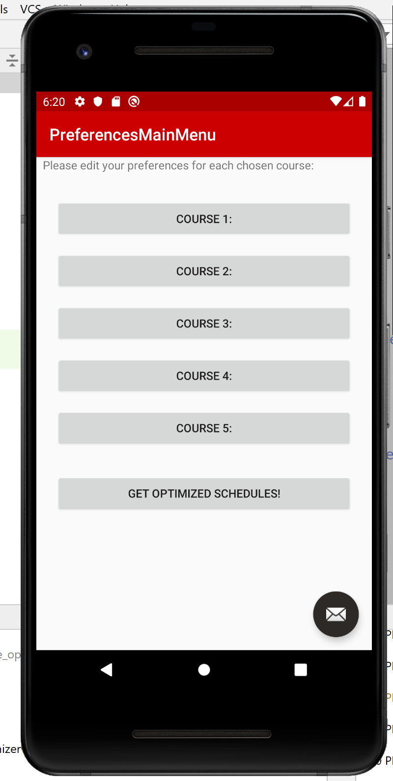
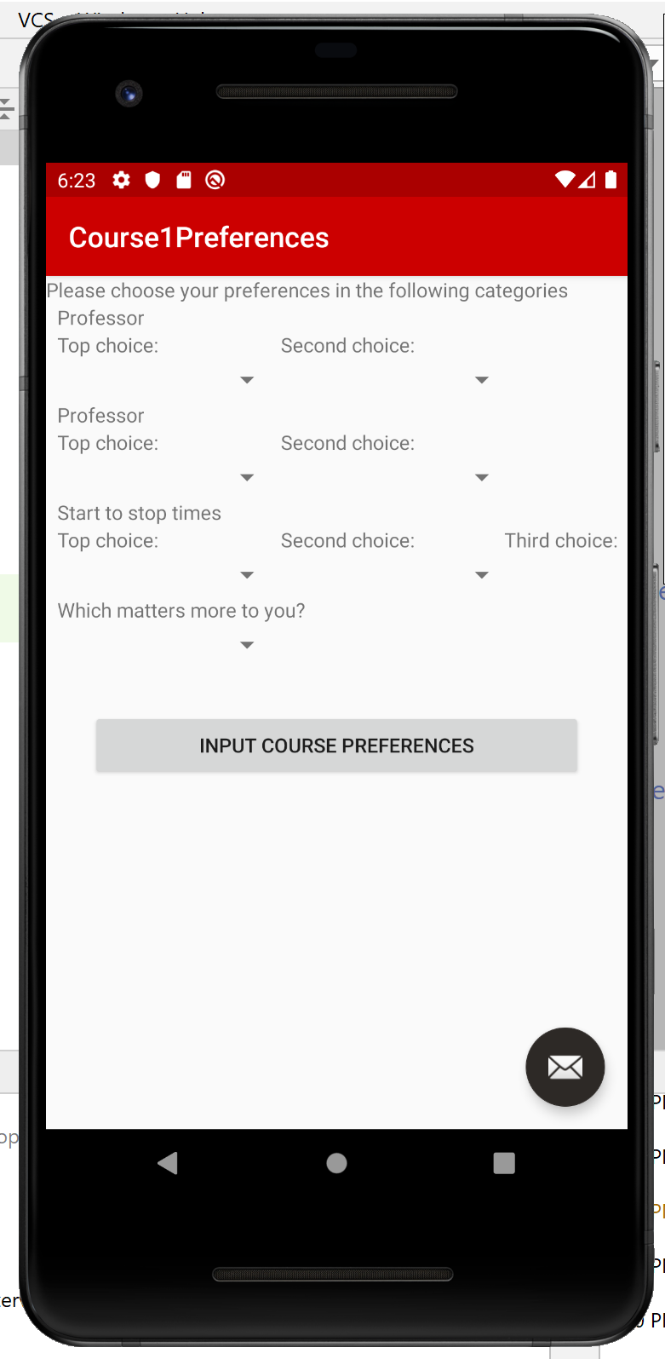
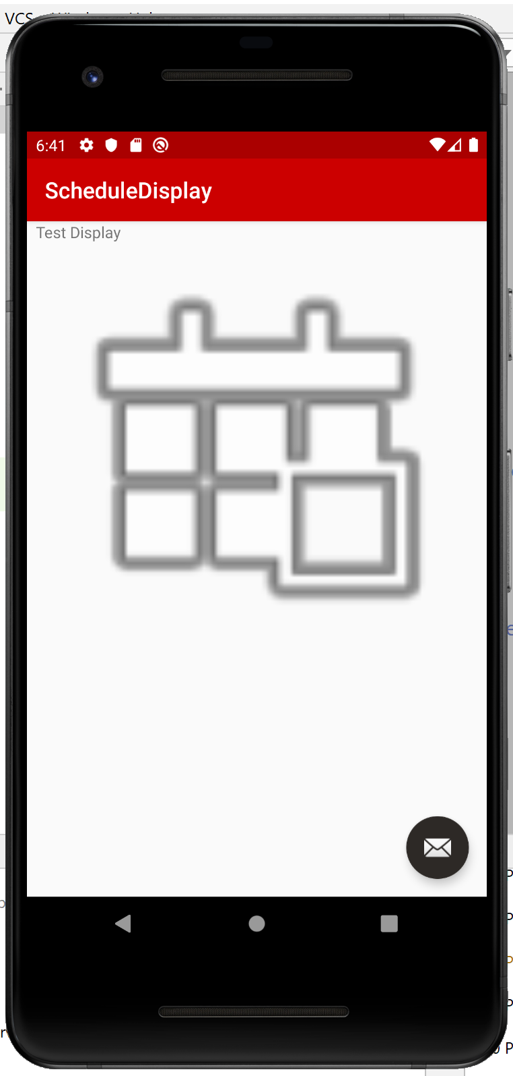
UI Manager
All arrows are from a BUTTON to a SCREEN
They represent the connections between interfaces facilitated by the UI manager.

