Slide 1
DATA DRIVEN
AN EXPLORATORY AND PREDICTIVE
DATA ANALYSIS
OF
TURTLE GAMES

Slide 2
What are we looking at:
  Turtles Games – A games manufactures and retailer with a global customer base
Why are we investigating it:
  To improve overall sales performance by answering a set of questions
How are we going to answer those questions:
  Through exploratory and predictive analysis of provided data samples divided in :
    Demographics info from clients
    Sales and product Data
2
2

Slide 3
Our methodology
We chose to drill the provided data for any possible clues and combinations that might reveal insights
We correlated some of the values we believe would profit the business
We will present what we identified and what we would recommend

Slide 4
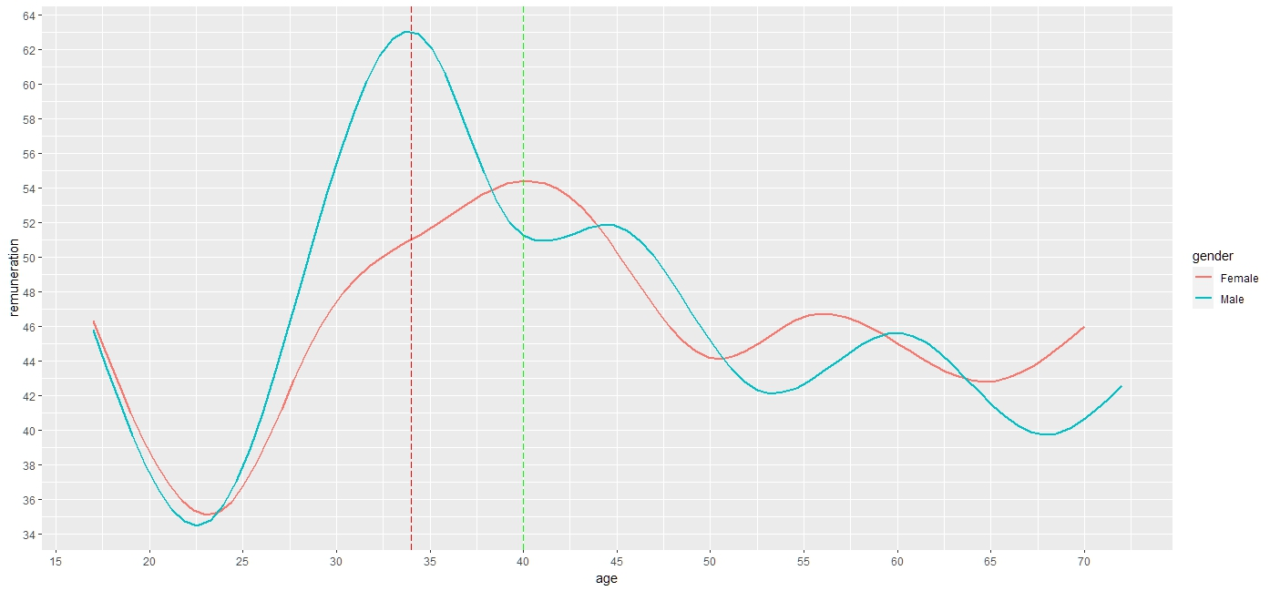
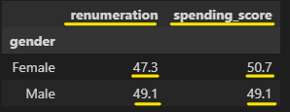
Who is our customer???
What we saw:
  Age about 40 years old
  Earns yearly about £48’000
  Has a spending score of 50 (out of 100)
  An average of 1580 loyalty points
  44% Male and 56% Female
  88% with graduate degree and above

Slide 5
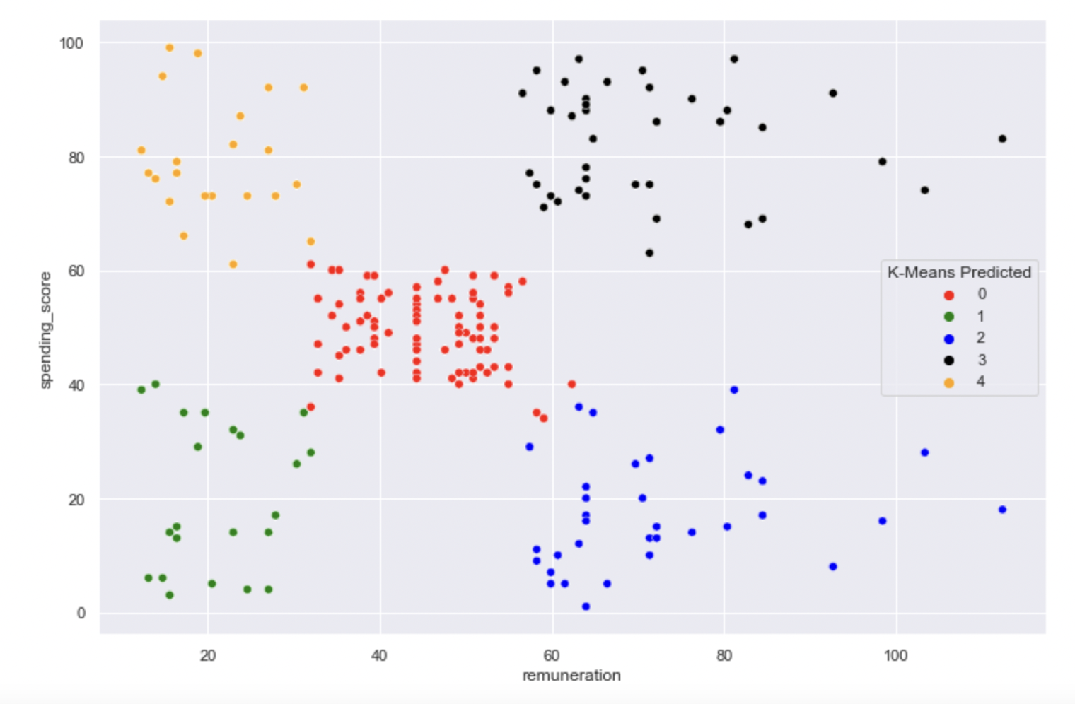
Are we sure???
Our groups basis our data:
  Low Key (Green) – Low year remuneration low mid spending
  “Average Joe” (Red) – Falls within mean of remuneration as well as spending score
  High Earner Economy Class (Blue) – Represents the cluster of high yearly income, spending score 1/3 of Low Key
  High Earner Deluxe (Black) – the VIP customers which earn and spend considerably more
  Big Spender (Yellow) – low to moderate income but quite high spending score

Slide 6
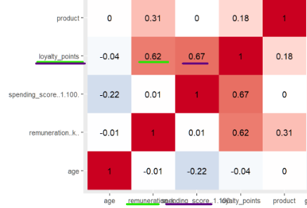
Loyalty Points
Turtle Games interested in how customers accumulate loyalty points
  i. Remuneration – Correlated values but not of high degree
  ii. Spending Score – Similarly correlated but not totally related
  iii. Age - Unrelated

Slide 7
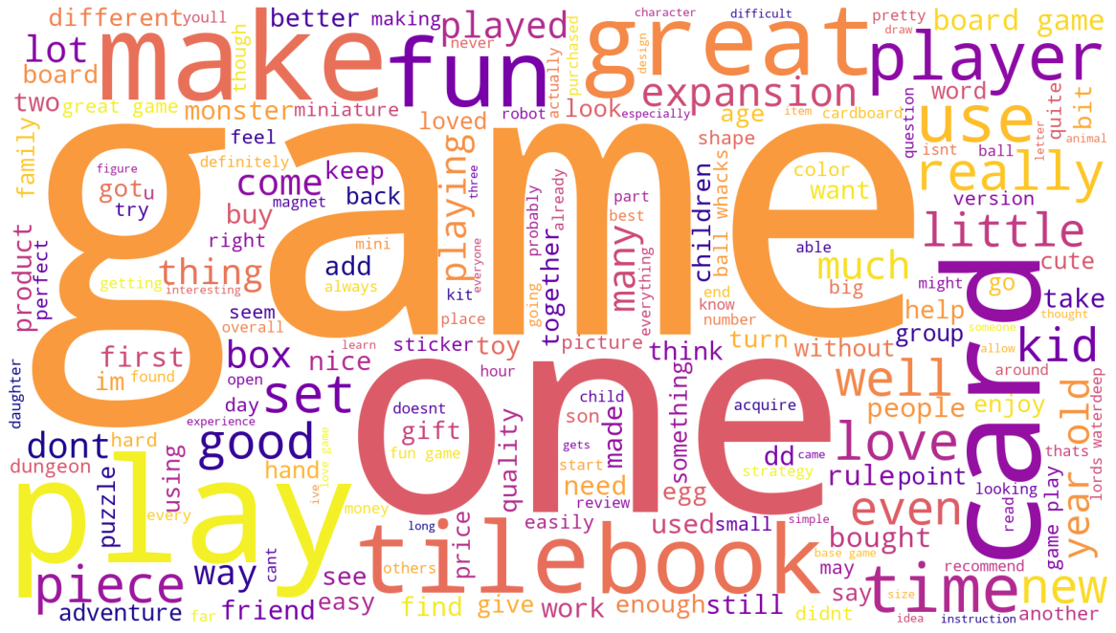
Do people like us??

Slide 8
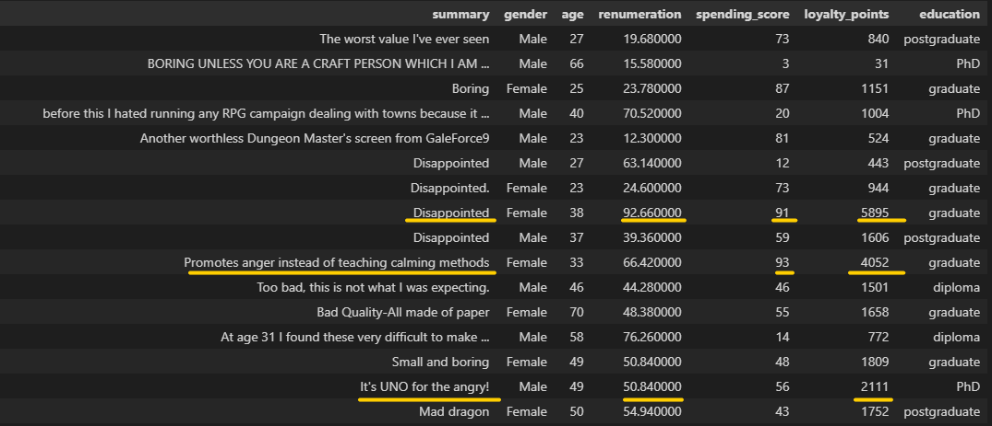
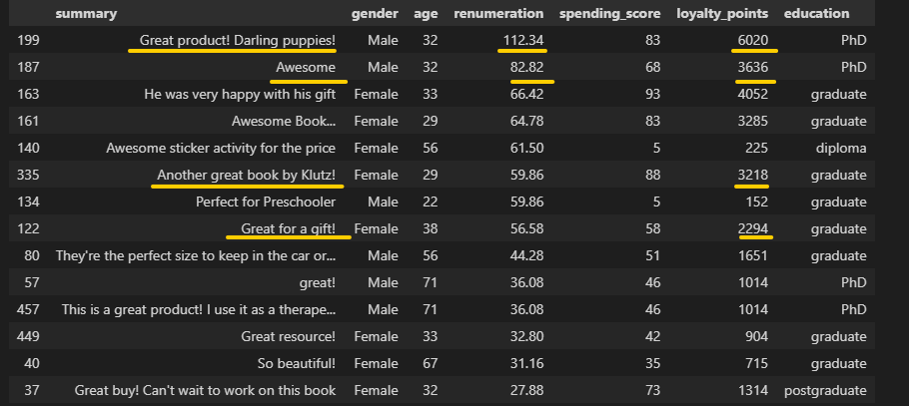
What are the comments
Natural Language Processing
  We see positivity in comments
  Positive polarity in the language
  Subjectivity in words used
  Neat picking sometimes might
  be useful

Slide 9
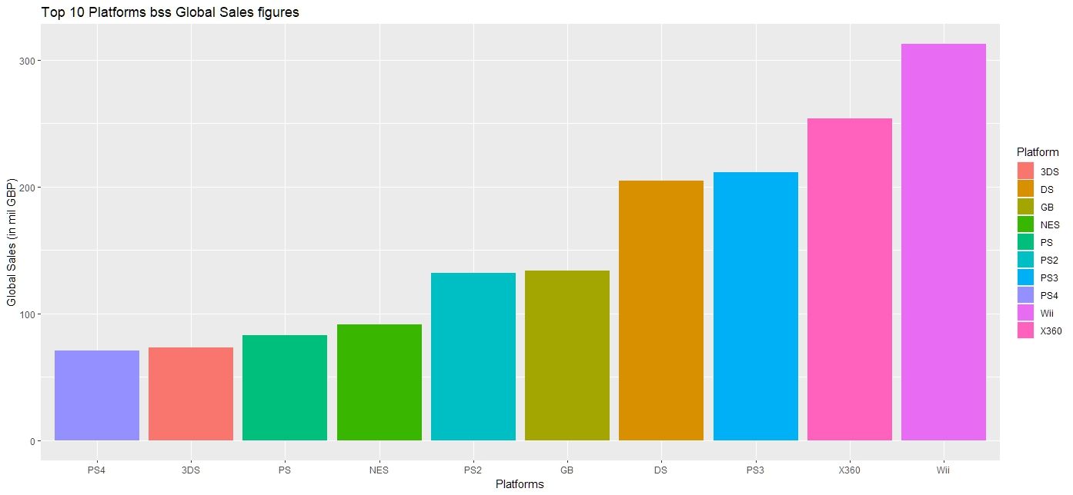
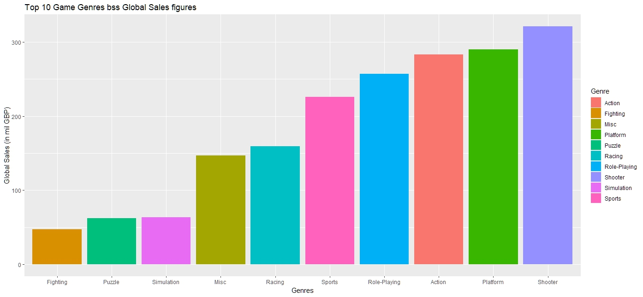
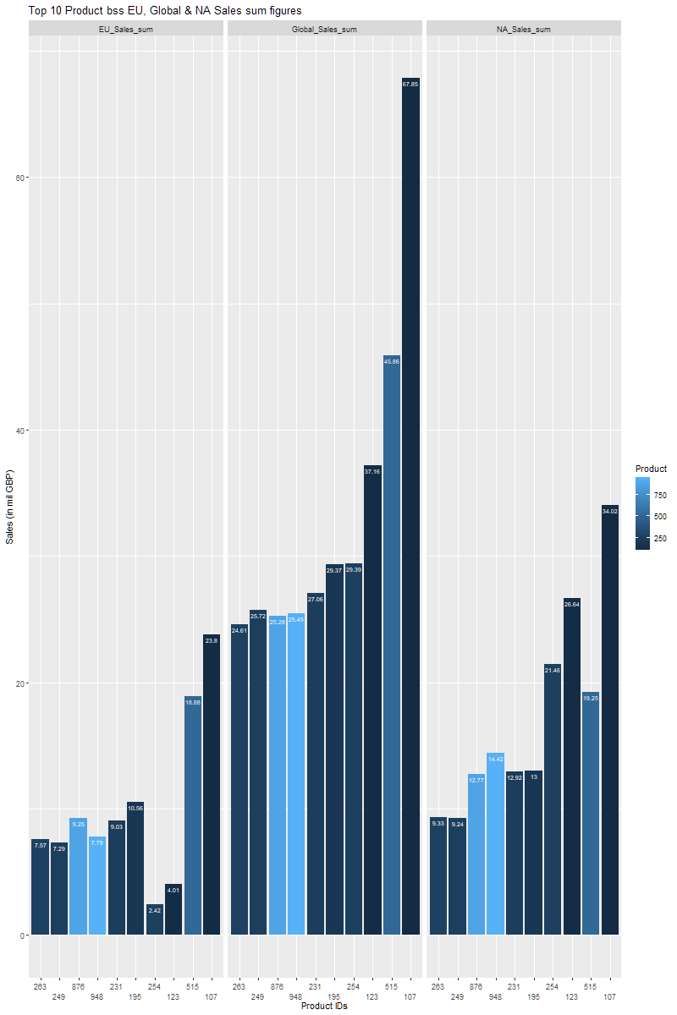
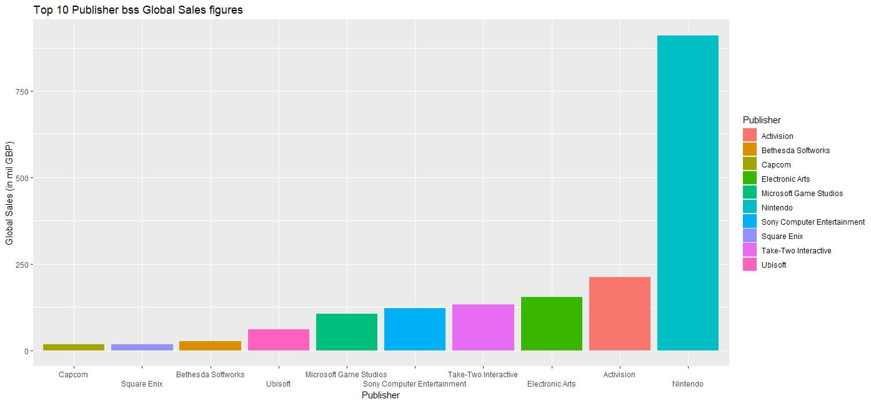
Top 10

Slide 10
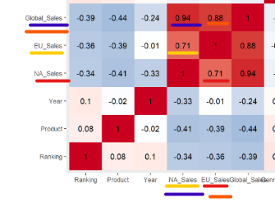
Sales Correlation
Global Sales show strong correlation 0.94 with NA Sales
Global Sales show almost same strong correlation 0.88 with EU Sales
EU and NA Sales share a smaller but still significant correlation of value 0.71

Slide 11
Discoveries & Recommendations
  Demographics:
    Strong female clientele (both in percentages and spending score) to be taken seriously consider to promote and pamper
    Analysis of reviews and comments and notifications for VIP customers
    Use cluster groups to focalize marketing strategies
  Loyalty Scheme:
    Loyalty points correlate at certain point from clients’ remuneration and spending score
    There are clients with high remuneration and high spending score that would benefit both sides by an established loyalty scheme
  Sales:
    Top games differ in region though top places stay similar globally
    Different trends in both regions absorbed from Global figures but each figure requires its own attention and adapted marketing approach
  Predictive Analytics:
    More historic data with more columns will offer better results to our regression model
    Data sampling and collection needs more accurate and effective wrangling
  Social Data:
    Data mining from social media or own website can reveal many valuable info and recommendations and show the correct path to increase of sales

