Slide 1
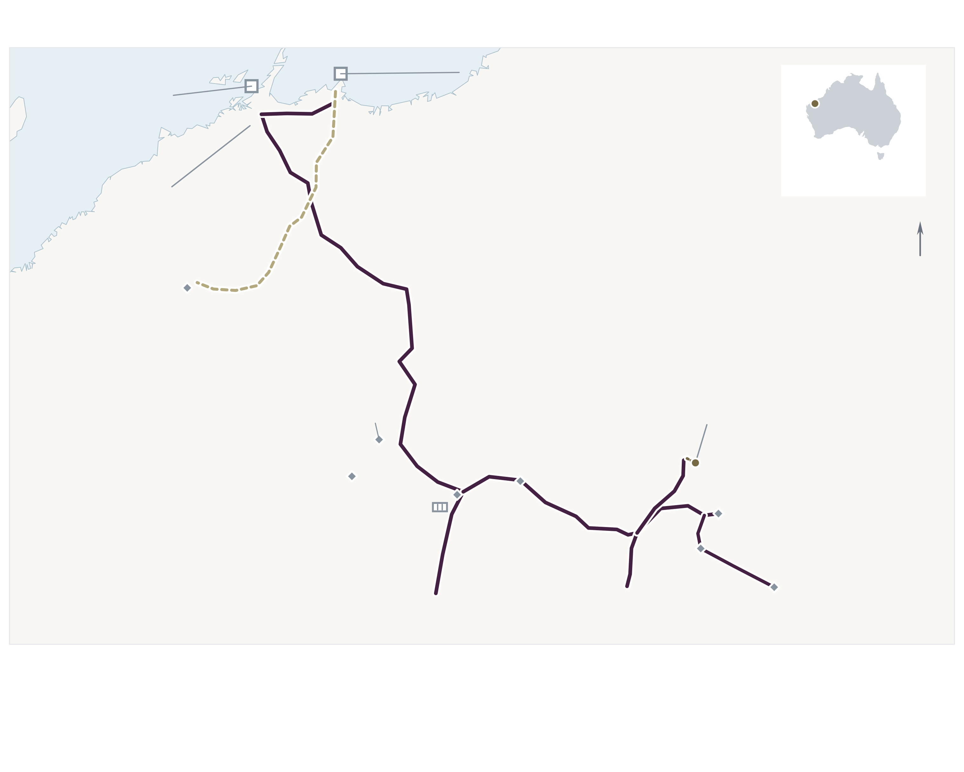
RIO TINTO / ASSET PROFILE
PUBLIC-SOURCE PROFILE
Pilbara Power
Integrated, mission-critical electricity platform
Captive generation and transmission supporting inland mines, coastal ports and selected Pilbara communities
~514 MW
~965 km
18
4
Disclosed generation
High-voltage transmission
Mines in Pilbara system
Export terminals in system
Power network
Generation portfolio
Generation, generalized corridors and selected loads
 | Asset | MW | Technology | Location / role
 | Yurralyi Maya | 200 | Gas | Dampier / Karratha
 | Paraburdoo | 120 | Gas | Western Pilbara
 | Cape Lambert | 80 | Gas / diesel | Coastal / port system
 | West Angelas | 80 | Gas / diesel | Eastern Pilbara
 | Gudai-Darri | 34 | Solar PV | Gudai-Darri mine
 | Total | 514 | Thermal + solar | 480 MW + 34 MW
Dampier ports
3
Cape Lambert ports
1
1
Cape Lambert
INDIAN OCEAN
80 MW
2
Yurralyi Maya
PILBARA, WA
3
N
200 MW
P I L B A R A
4
Pannawonica
Horizon Power links at
Dampier / Cape Lambert
5
Nammuldi / Silvergrass
5
Gudai-Darri
Marandoo
Solar · 33 kV tie
Four thermal power stations and Gudai-Darri solar | Reference capacities
Brockman
Network profile & operating characteristics
Tom Price / BESS
Yandicoogina
Paraburdoo
2
4
Hope Downs
NETWORK
CAPTIVE DEMAND
0
50 km
120 MW
West Angelas
•
790 km at 220 kV + 175 km at 132 kV
•
200–300 MW seasonal network load
Thermal
Solar
Mine / town
Port complex
•
3 switching stations + 12 bulk substations
•
Rio mines, processing plants and coastal ports
220 kV
132 kV
33 kV tie
Storage
•
33 kV distribution; limited Horizon Power links
•
Power supply to selected Pilbara communities
FUTURE DEMAND
Rhodes Ridge development is planned to use Rio’s existing rail, port and power infrastructure
16 SEP 2026 | 1
Notes:
SOURCES AND CAPACITY BASIS
Rio Tinto response to ACCC, 21 June 2024, capacity table p5 and network map p3
https://www.accc.gov.au/system/files/public-registers/documents/Response%20from%20Rio%20Tinto%20to%20ACCC%20Request%20for%20Information%20-%2021.06.24%20-%20PR%20VERSION%20-%20AA1000666%20Pilbara.pdf
514 MW follows the capacity table: Yurralyi Maya 200, Paraburdoo 120, Cape Lambert 80, West Angelas 80 and Gudai-Darri solar 34 MW. The same filing's map shows Yurralyi Maya 230 MW; this public-source discrepancy remains unresolved. Values are a published reference portfolio, not a certified current title/capacity register or transaction perimeter.
Rio Pilbara 2025 TRS, section 15.8: 790 km of 220 kV; 175 km of 132 kV; three switching stations; twelve bulk substations; 200-300 MW seasonal demand; limited 33 kV Horizon connections at Dampier and Cape Lambert
https://www.sec.gov/Archives/edgar/data/863064/000162828026009531/ex_961xrtioxtrsx2025xfin.htm
Rio Western Australia operating-system context: 18 mines; four terminals at two coastal complexes
https://www.riotinto.com/en/operations/anz/western-australia
Gudai-Darri solar local 33 kV tie, contractor disclosure
https://nrwcivilmining.com.au/project/gudai-darri-solar-farm/
Tom Price storage: existing BESS is a site context symbol, no MW/MWh assertion
https://www.riotinto.com/news/stories/pilbara-renewables
Rhodes Ridge future demand context
https://www.riotinto.com/en/invest/reports/annual-report/key-project-updates
MAP BASIS
Generation coordinates carried from the source-reviewed prior deck: Yurralyi Maya -20.76271,116.74214; Paraburdoo -23.191952,117.677106; Cape Lambert -20.64969,117.14165; West Angelas -23.15444,118.72437; Gudai-Darri -22.5276,119.0937. Location references: https://mapcarta.com/W583492109 ; https://www.gem.wiki/Paraburdoo_power_station ; https://mapcarta.com/W762017450 ; https://mapcarta.com/W1361428718 ; https://www.gem.wiki/Gudai-Darri_solar_farm
Routes are reprojected from the previous Rio-source-derived geometry. The 132 kV branch retains the source voltage class; the local 33 kV solar connection is separately styled. The Yandicoogina contextual marker is placed at the source-route endpoint; it does not locate every component of that mine. Additional load markers are generalized operating-area context, not substation coordinates. Nammuldi, Brockman 4, Hope Downs 1 and Hope Downs 4 location coordinates were rechecked against Global Energy Monitor's own public asset-location inventory: https://www.gem.wiki/Rio_Tinto_Nammuldi_%28Hamersley%29_Mine ; https://www.gem.wiki/Rio_Tinto_Brockman_4_%28Hamersley%29_Mine ; https://www.gem.wiki/Rio_Tinto_Hope_Downs_1_Mine ; https://www.gem.wiki/Rio_Tinto_Hope_Downs_4_Mine . The Hope Downs branch follows the south/east connection shown in Rio's map; it is generalized, not a surveyed route. The Nammuldi/Silvergrass label is a regional load-area label, not an assertion that both mines occupy the same coordinate. Coastal port symbols identify complexes, not individual terminals. Horizon interfaces are acknowledged as location-area text, not invented station coordinates. Storage symbol denotes the Tom Price operating area.
HYBRID MAP ARCHITECTURE — 17 SEPTEMBER 2026
This version supersedes prior map-editability claims. Each map contains exactly ONE embedded opaque RGB PNG at 600 dpi for the geographic base, coastline/lakes/rivers, transmission corridors, contextual site/load/port/storage symbols, short anchor leaders, locator geography and location-inset backgrounds. No editable shoreline, lake, river or transmission freeforms remain in the map panel. Only numbered circles, text/capacity labels, compact legend elements, scale bars and simple inset/legend borders are editable native PowerPoint objects. Map-base image placement is explicit and locked against accidental movement/resizing; overlays are in slide coordinates, not nested transforms.
GEOGRAPHIC AND DESIGN LIMITATIONS
Regional cartographic overview of generation, principal corridors and selected loads; not a surveyed map, complete electrical/hydraulic inventory, legal title exhibit or transaction perimeter. Projected points and generalized route geometry have different accuracy. Main-map scale is computed from the projection; the inset has its own scale. GSHHG intermediate-resolution polygons and WDBII context were distributed with Basemap; waterbody simplification does not certify full contemporary reservoir extents. Basemap attribution: https://www.soest.hawaii.edu/pwessel/gshhg/ and https://www.ngdc.noaa.gov/mgg/shorelines/shorelines.html . Locator geography: Natural Earth public-domain boundaries, https://www.naturalearthdata.com/ .

Slide 2
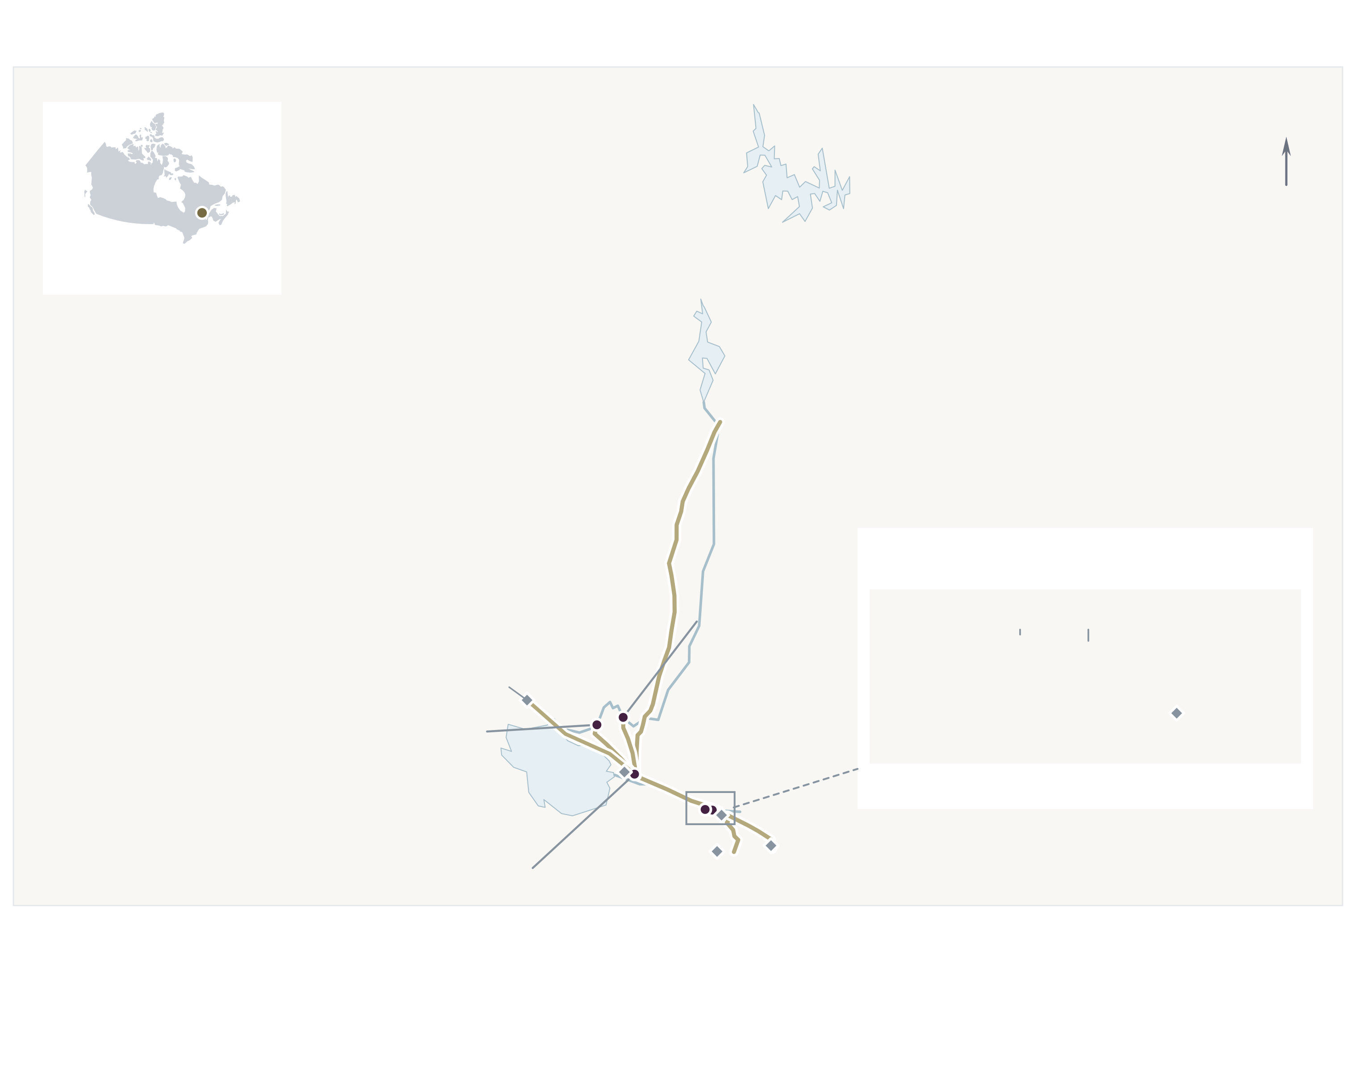
RIO TINTO / ASSET PROFILE
PUBLIC-SOURCE PROFILE
Canada Power
Large-scale captive hydroelectric platform
Saguenay–Lac-Saint-Jean generation, reservoirs and transmission supporting Rio’s Quebec aluminium operations
~3.1 GW
6
884 km
~2.1 GW
Saguenay installed capacity
Hydroelectric stations
Saguenay transmission
Average output equivalent
Saguenay hydro system
Generation portfolio
Generation, generalized corridors and selected loads
 | Asset | MW | Commissioned | Key characteristic
 | Shipshaw | 1,172 | 1943 | Includes 225 MW unit (2012)
 | Chute-des-Passes | 833 | 1959 | High-head / 195 m maximum
 | Isle-Maligne | 448 | 1926 | Modernization through 2032
 | Chute-à-la-Savane | 245 | 1953 | 34.5 m hydraulic head
 | Chute-du-Diable | 224 | 1952 | 33.1 m hydraulic head
 | Chute-à-Caron | 222 | 1931 | 48.8 m hydraulic head
 | Total | 3,144 |  | Six hydro stations / Quebec
N
1
Lac Manouane
2
SAGUENAY, QC
3
Passes-Dangereuses
4
Q U É B E C
2
Chute-des-Passes
5
833 MW
6
Péribonka River
SAGUENAY DETAIL
Chute-du-Diable
5
Chute-à-Caron
Shipshaw
Dolbeau-Mistassini
6
1
Shipshaw includes its 2012 addition | Original station commissioning dates shown
Chute-à-la-Savane
4
0
5 km
Arvida / AP60
System profile & operating characteristics
Alma
Plant locations · hydraulic channels omitted
Lac Saint-Jean
SYSTEM PROFILE
CAPTIVE DEMAND
0
50 km
Isle-Maligne
3
Saguenay loads
Arvida / AP60 · Grande-Baie · Laterrière · PLS-Dubuc
•
33 dams / water-control structures
•
~90% of Rio’s Quebec smelter power needs
Hydro station
Aluminium / load
Lake / reservoir
•
44 units / 4 Hydro-Québec interconnections
•
Five wholly owned smelters in the region
Transmission
River
Site / label leader
•
~73,800 sq km watershed
•
Key loads include Alma and Arvida / AP60
OTHER CANADIAN HYDRO
Kemano / BC Works: 896 MW | Nechako Reservoir | ~80 km transmission to Kitimat smelter
16 SEP 2026 | 2
Notes:
SOURCES AND CAPACITY BASIS
Rio Energie Electrique station inventory
https://energie.riotinto.com/energie-electrique/installations/
Shipshaw 947 + 225 MW = 1,172; Chute-des-Passes 833; Isle-Maligne 448; Chute-a-la-Savane 245; Chute-du-Diable 224; Chute-a-Caron 222. Table sums to 3,144 MW. Corporate Saguenay page separately cites 3,131 MW, hence the ~3.1 GW headline. Average output ~2.1 GW is a historical average equivalent, not firm capacity or a dated actual production figure.
System overview: 884 km of lines, 33 dams/regulating structures, 44 groups, four Hydro-Quebec interfaces, approximately 90% of Quebec smelter electricity requirements
https://energie.riotinto.com/energie-electrique/
Watershed and upper-reservoir context
https://energie.riotinto.com/gestion-hydrique/bassins-hydrographiques/
Regional industrial loads
https://www.riotinto.com/en/can/canada-operations/saguenay
Isle-Maligne modernization
https://www.riotinto.com/can/news/releases/2025/rio-tinto-invests-to-modernise-century-old-hydroelectric-power-plant-in-quebec
Kemano context, excluded from Saguenay metrics
https://www.riotinto.com/operations/canada/bc-works
Transmission corridor source: Rio's 2025-28 vegetation-maintenance map, visually checked again for this revision
https://energie.riotinto.com/wp-content/uploads/2025/04/carte-globale-annee-de-traitement-2025-a-2028-vegetation.pdf
The source colors denote treatment years, NOT voltage classes. Routes here use one gold family; not an electrical single-line or full asset inventory. The Dolbeau-Mistassini branch is generalized from the same published source. No Hydro-Quebec interface or additional dam is arbitrarily pinned; those remain counted in the profile at right.
MAP BASIS
Generation coordinates carried from the prior sourced deck: Shipshaw 48.4483,-71.2153; Chute-des-Passes 49.84023,-71.16633; Isle-Maligne 48.57713,-71.63479; Savane 48.75353,-71.83964; Diable 48.7807,-71.69748; Caron 48.45065,-71.2538. Source location references: https://www.gem.wiki/Shipshaw_hydroelectric_plant ; https://mapcarta.com/W908822933 ; https://mapcarta.com/W143637579 ; https://mapcarta.com/fr/W184094773 ; https://mapcarta.com/W171599031 ; https://mapcarta.com/fr/W22819761
Where main-map plant positions crowd, small source-coordinate points remain in the base and short leaders join editable numbered badges. The downstream inset uses its own local projection; Caron remains west of Shipshaw. It is a location-only detail, NOT a hydraulic channel or water-flow diagram. Alma and Arvida/AP60 are selected point loads, other labels are operating-area context. Capacity/profile fields outside the map are unchanged. Reservoir polygons are regional GSHHG reference outlines, not surveyed/current operating water levels.
HYBRID MAP ARCHITECTURE — 17 SEPTEMBER 2026
This version supersedes prior map-editability claims. Each map contains exactly ONE embedded opaque RGB PNG at 600 dpi for the geographic base, coastline/lakes/rivers, transmission corridors, contextual site/load/port/storage symbols, short anchor leaders, locator geography and location-inset backgrounds. No editable shoreline, lake, river or transmission freeforms remain in the map panel. Only numbered circles, text/capacity labels, compact legend elements, scale bars and simple inset/legend borders are editable native PowerPoint objects. Map-base image placement is explicit and locked against accidental movement/resizing; overlays are in slide coordinates, not nested transforms.
GEOGRAPHIC AND DESIGN LIMITATIONS
Regional cartographic overview of generation, principal corridors and selected loads; not a surveyed map, complete electrical/hydraulic inventory, legal title exhibit or transaction perimeter. Projected points and generalized route geometry have different accuracy. Main-map scale is computed from the projection; the inset has its own scale. GSHHG intermediate-resolution polygons and WDBII context were distributed with Basemap; waterbody simplification does not certify full contemporary reservoir extents. Basemap attribution: https://www.soest.hawaii.edu/pwessel/gshhg/ and https://www.ngdc.noaa.gov/mgg/shorelines/shorelines.html . Locator geography: Natural Earth public-domain boundaries, https://www.naturalearthdata.com/ .

Slide 3
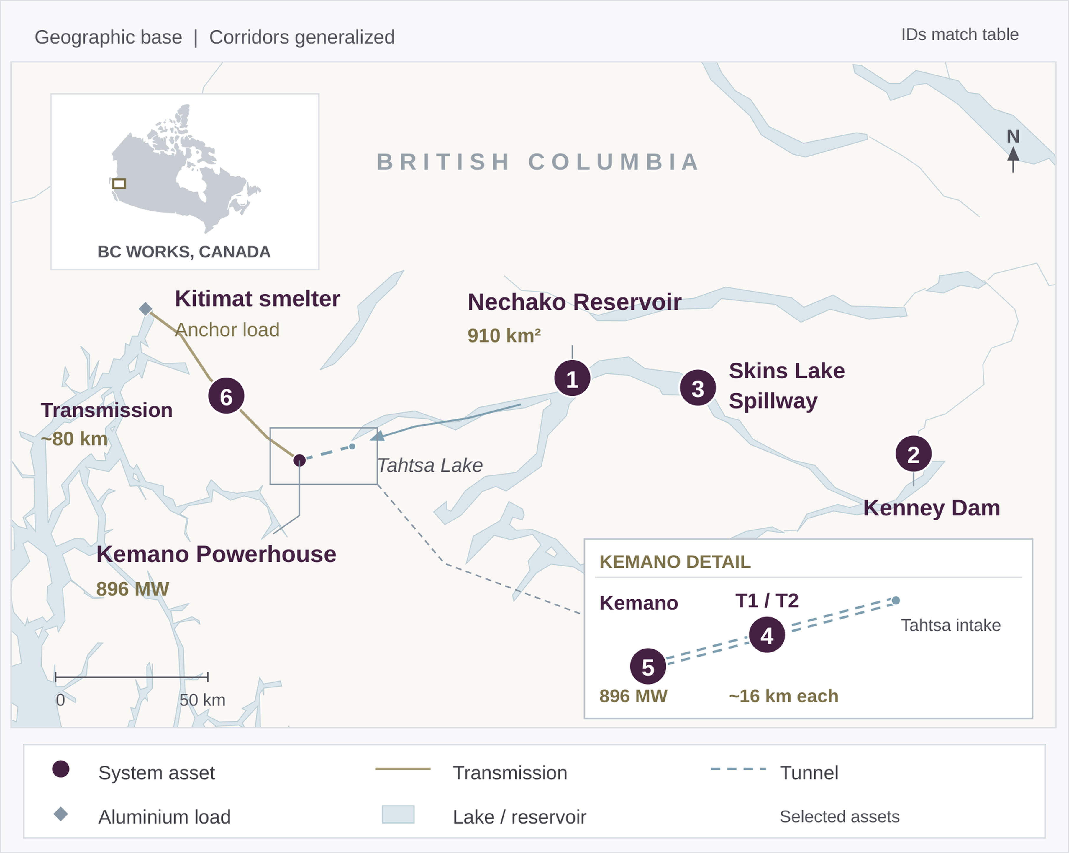
R
I
O
T
I
N
T
O
/
A
S
S
E
T
P
R
O
F
I
L
E
PUBLIC-SOURCE PROFILE
BC Works
Integrated, mission-critical hydroelectric platform
Nechako Reservoir, Kemano generation and transmission supporting Rio’s Kitimat aluminium smelter
896 MW
8
~80 km
5.1 TWh
Installed capacity
Generating units
Kemano–Kitimat transmission
2025 Kemano generation
BC Works hydro system
Hydro system assets
Asset
Scale
Role / key characteristic
1
Nechako Reservoir
910 km²
Regulated storage for Kemano
2
Kenney Dam
97 m high
Impounds Nechako Reservoir
3
Skins Lake Spillway
1 spillway
Controls downstream releases
4
Kemano T1 / T2 tunnels
~16 km each
Redundant water conveyance
5
Kemano Powerhouse
896 MW
Underground high-head hydro
6
Kemano–Kitimat line
~80 km
Delivers power to Kitimat smelter
T2 adds redundant water conveyance and maintenance flexibility, not generating capacity.
System profile & operating characteristics
SYSTEM PROFILE
CAPTIVE DEMAND
•
Reservoir-fed, high-head hydroelectric system
•
Primary power source for Kitimat smelter
•
Twin tunnels provide conveyance redundancy
•
~406 kt of aluminium produced in 2025
•
Hydrology governs output and surplus exports
•
Surplus generation sold to BC Hydro
KEMANO T2
Commissioned 2022 | C$600mm announced investment | Tunnel redundancy and maintenance flexibility
17 SEP 2026 | 3

