Slide 1
Estimating
Mike HARRIS OX:AGILE CONFERENCE 2018

Slide 2
Plan
Introduce myself
Establish what we understand by the word Estimate
Discuss why estimating is hard
Discuss what we can do
Sum up

Slide 3

Me
Mike Harris, 47
Software Engineering Lead
Elsevier since 2017
SSRN
Degree 1989 to 1993 (Computing for Real-Time Systems)
Import/Export business 1993 to 1995
Web agency 1999 to 2010
Spain 1999 to 2006
Cat, wife, two stepsons, several guitars, bouzouki, Transit van, a ZX80, and an Osbourne 1.
From Somerset; likes decent scrumpy cider

Slide 4
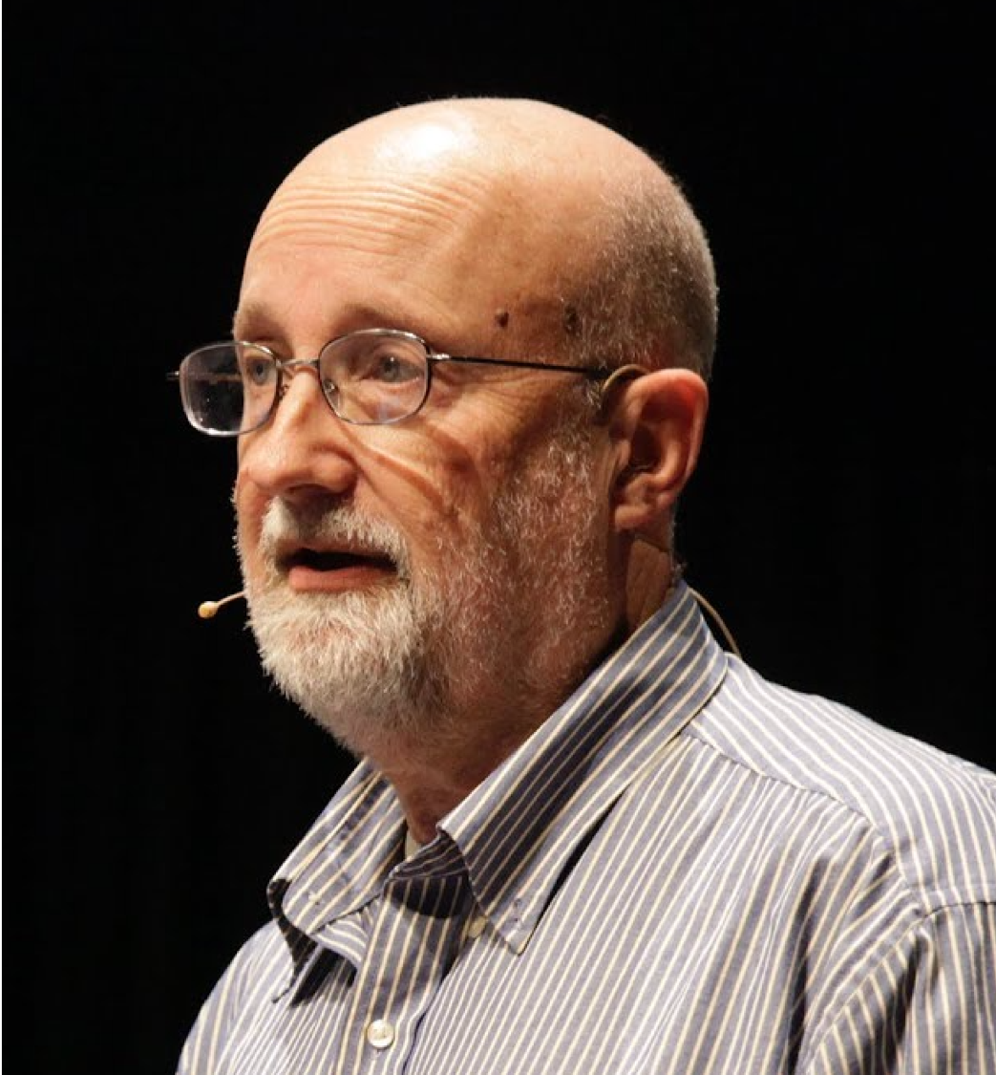
Woody Zuill
Attributed to the #NoEstimates
A hashtag to explore the topic
Questions how useful estimates are
Asks if there are other options
Advocates the use of the 5 Whys
Also invented mob programming
http://zuill.us/WoodyZuill/

Slide 5
Exercise
What do WE understand by the word estimate?

Slide 6
Results
With any luck we mostly defined it as a guess.
Some of us may have tried to qualified the guess with words like best and educated.

Slide 7
Estimating is simple
When we know what we’re estimating

Slide 8
when we are estimating work that:
is small
is simple
has well understood requirements
we’ve done before
we’ve done often
doesn’t touch legacy code
we may be able to quite accurately estimate how long it will take

Slide 9
But estimating is often hard
LIKE REALLY HARD

Slide 10
Estimating can be hard because:
Tasks are large
Tasks are involved
We’re estimating work we’ve never done before
We don’t fully understand the work we’re estimating
Or we don’t have all the information about
With vague or incomplete requirements
That touches legacy code
That depends of external resources and deliverables

Slide 11
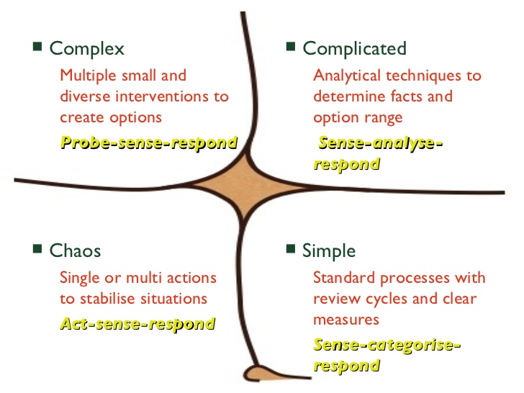
Cynefin
But the work is
often here
In Software Engineering As in Life We’re often dealing with the Complex or the Complicated Things are not as simple as we might hope
We may think the work is
here
Notes:
Cynefin = Habitat Decision making device
1999 by Dave Snowden
Whilst working for IBM

Slide 12
So how long will it take?
SURELY I MUST KNOW BASED ON MY EXPERIENCE?!

Slide 13
But based on my experience I know…
That if I estimate, I will be…
Putting my finger in the air
Guessing the length of an unknown piece of string
Taking a random guess
Maybe even providing deceiving information

Slide 14
#NoEstimates
Because IT’S too Dishonest TO GIVE AN ESTIMATE TO SOMEONE

Slide 15
Stakeholders who need to know
Scrum Masters
Project Managers
Product Owners
Account Managers
Financial Directors
Customers
Users
Marketing

Slide 16
How to satisfy stakeholders
Wing it
Flex quality
Flex something else

Slide 17
Winging IT
LET’S TELL PEOPLE WHAT THEY WANT TO HEAR AND HOPE FOR THE BEST

Slide 18
Winging it estimating tactics
Double all time estimates
Triple all time estimates
Double hourly rate
Hack something together to deliver what the customer wants
Work overtime (paid or unpaid)
Put extra pressure on people to deliver
Implement systems of measurement to ensure the team delivers

Slide 19
Flexing Quality
BECAUSE WE JUST GOTTA GET IT DONE

Slide 20



The Quality Pyramid
Quality
₽

Slide 21
How we can flex quality?
Stop doing test driven development
Stop doing code reviews and QA
Stop doing pair programming (two people will do twice as much work)
Spike a solution, then put it into production
Save time by not abstracting interfaces
Save time with closely coupled code
Copy and paste to completion
Don’t do continuous integration; it takes too long

Slide 22
The Quality Flexing Cycle
Pressure to Deliver
Flex Quality
Increase Legacy
Code
Increased Code Complexity
Estimating Is Hard

Slide 23
The Quality Flexing Pipeline
Flex Quality
Write Legacy
Code
Increase Technical Debt

Slide 24
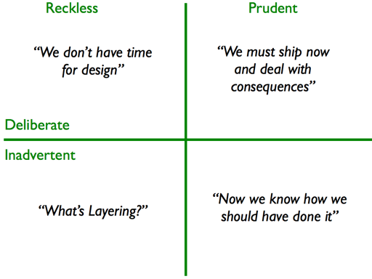
Technical Debt
Technical debt quadrant - Martin Fowler
Notes:
Call option – is that a buyer and seller have a contract by which the buyer has the right to buy a certain quantity of a certain commodity at a certain price at a certain time. Unhedged – means that no instruments have been put in place as a contingency against possible loss when the call option is exercised.

Slide 25
Technical Debt
It’s about knowing what the risks are
Keep a Tech Debt Wall
Note down any technical debt you accrue as you develop
Consider the risk of postponing resolution vs the cost of sorting now
Don’t engineer the future: resolve in the next iteration
Regularly review the Tech Debt Wall
Categorise the debt on the wall
Take highest risk technical debt into backlog and resolve

Slide 26
Tech Debt Wall example

Slide 27
Seriously?
SURELY THERE HAS to be ANOTHER WAY

Slide 28
Help me to help you
It’s not about bending over backwards
But rather it’s about helping customers with their expectations
It’s about letting people know the truth
About reality
So that they can plan
So that there are fewer surprises

Slide 29
What we should flex
Time?
Cost?
Scope?

Slide 30
Estimating tactics
We can get better at estimating

Slide 31
Don’t Estimate Time
IF YOU DON’T KNOW WHAT IT IS YOU DON’T KNOW HOW LONG IT WILL TAKE

Slide 32
Estimate Complexity
Because you have a pretty good idea HOW complex IT IS

Slide 33
Example of relative estimating using
Tshirts or fibinacci, etc

Slide 34
We CAN only estimate relative complexity
We SHOULD only measure work done
We SHOULD only flex cost, time, or scope

Slide 35
Measuring
Do not count the sum of relative complexities: this doesn’t tell you anything
Count the amount of work done

Slide 36
Measuring
Count the amount of complexity delivered

Slide 37
What does this tell me
It tells me…
The sum of how complex we thought things were
Which tells me…
Maybe how pessimistic or optimistic we were?
Or perhaps…
How good we were at estimating last time
Depending on…
How complex (unknown) or simple (known) the last batch of work was
Which in essence…
Tells me nothing, and…
Is useless

Slide 38
Measuring
Count the amount of WORK DONE

Slide 39
Work Done (Stories Completed)
It’s what we did
It’s what we delivered
It’s measurable
It tells us if we took in too many stories
Too big stories
We can measure velocity

Slide 40
Burn Up not Down
MOST PROJECTS DON’T HAVE A FIXED SCOPE

Slide 41
Summary
Estimating is often hard
Our work is often complex
Estimates are guesses
Accurate estimates are lies
Estimating time is foolish
Estimating time involving external dependencies is dishonest
Estimate complexity
Measure work done
Flex time, cost, or scope before quality
Take on technical debt knowingly and with intelligence

Slide 42

Thank You
Mike Harris . SSRN . Elsevier . https://ssrn.com . m.harris@elsevier.com @MBrinsleyHarris . 01865 XXX XXX . 07811 671 893

