Slide 1
AWS: You WILL be assimilated
Mike Harris

Slide 2
AWS is
On demand
Pay-as-you-go
Service Orientated Architecture
Delivered via the Internet
Providing PaaS (Platform-as-a-Service)
and SaaS (Software-as-a-Service)
A competition of Microsoft Azure, Google Cloud,

Slide 3
AWS: A history
Launched in 2002
First public service in 2004: SQS (Simple Queue Service)
AWS platform launched in 2006 with EC2, S3 and SQS
More than 70 services as of 2017
2017 revenue predicted to be $13,000,000,000 US

Slide 4
AWS: Some figures
A data centre (DC) contains between 50,000 & 80,000 systems
An Availability Zone (AZ) contains between 3 and 10 DCs
A Region contains between 2 and 6 AZs (London has 2 AZs, Frankfurt 3, and Oregon 6)
There are 16 Regions as of Autumn 2017
There will be 22 Regions by end of 2019 (Bahrain will have 3AZs and be online in 2019)
That’s a hell of a lot of computers!

Slide 5
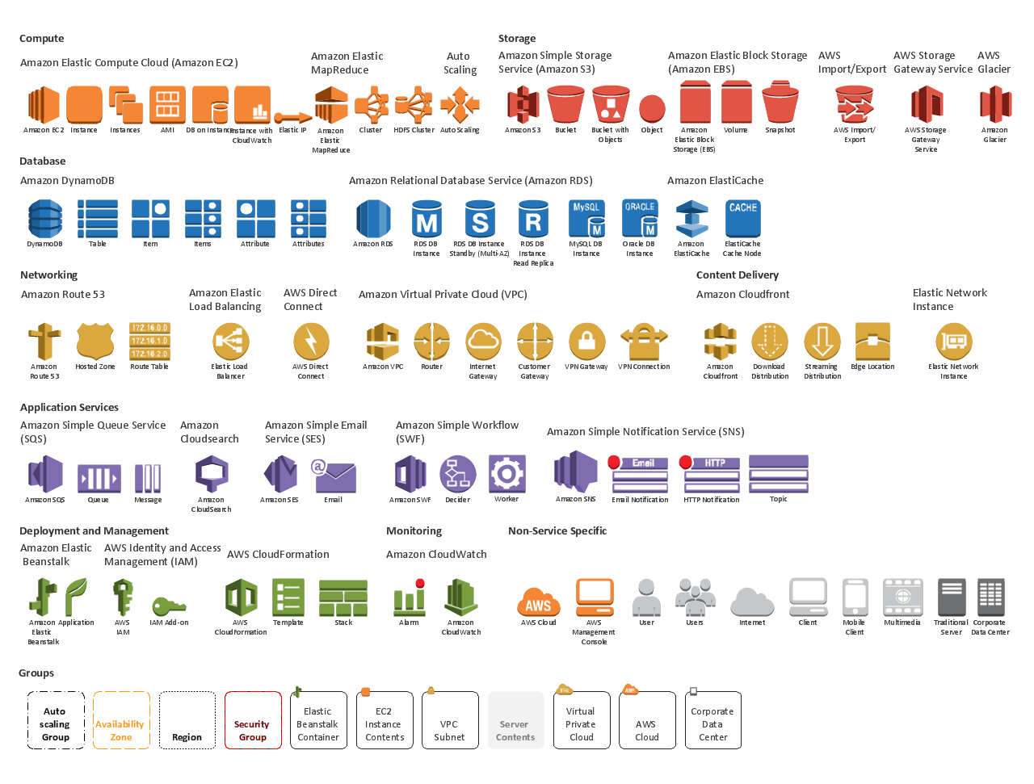
AWS: Services

Slide 6
AWS: Data Storage Options
EC2 EBS volumes
S3
Glacier
VTL – Virtual Tape Library
VTS – Virtual Tape Shelf
Storage Gateway
iSCSI bridge
Replace fileservers and tape

Slide 7
Getting data onto Amazon
Transferring Terabytes of data into the cloud takes time
Slow and unreliable over the Net
Costly in time and money for upload traffic
AWS provide a service called Snowball to help with this.

Slide 8
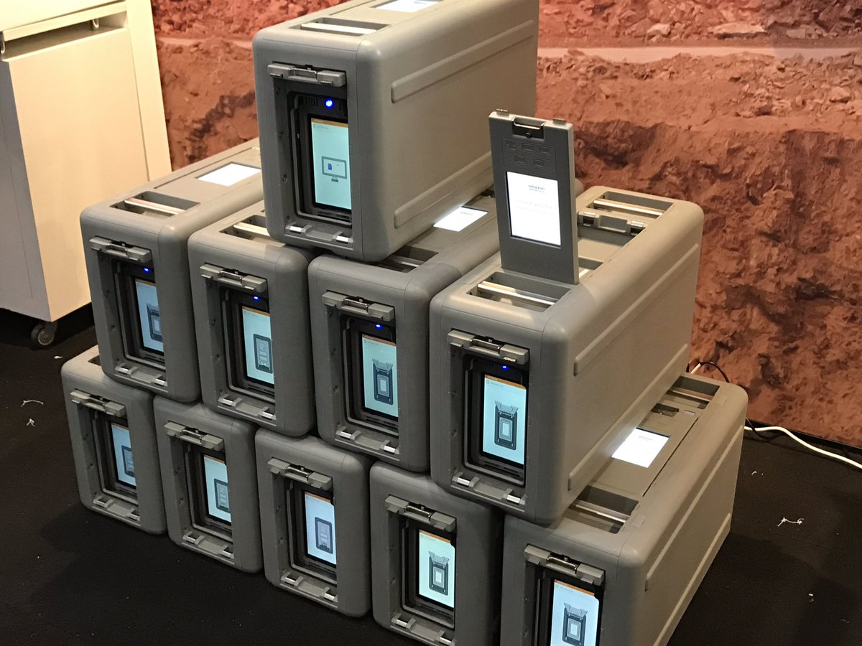
Snowball and Snowball Edge
Snowball is a 50TB NAS
Snowball Edge is a 100TB NAS
It’s posted to you
You fill it up
It literally posts itself back!
Show video

Slide 9
Snowmobile
For bigger quantities data
We’re talking petabytes (1,000,000 GB)
Snowmobile provides you with 100PB of storage
Transfer an exabyte onto 6 snowmobiles in 6 months
That’s 1,000,000 TB of data
That’s Government or Bank-sized quantities
Off it goes to AWS….

Slide 10
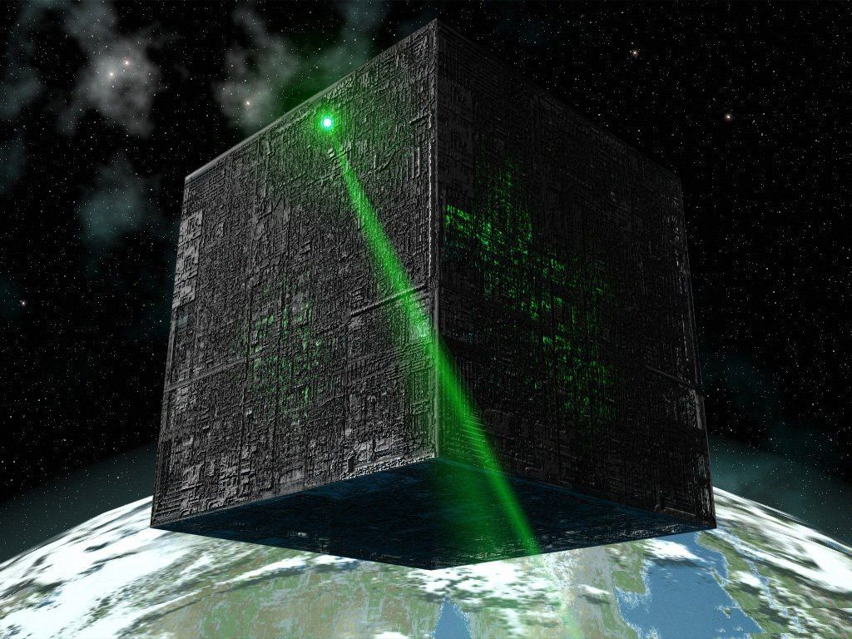
But there’s no Snowmobile out of AWS….
August 2014 Amazon get DoD-wide provisional authorisation
In 2015 Amazon reported:
1,000,000 active customers
In 190 countries
Including 2,000 government agencies
5,000 educational institutions
17,500 non-profit organisations

