Slide 1

Being a better programmer
Writing Clean Code COBOL

Slide 2
“Writing clean code is what you must do in order to call yourself a professional. There is no reasonable excuse for doing anything less than your best.”
Robert C Martin

Slide 3
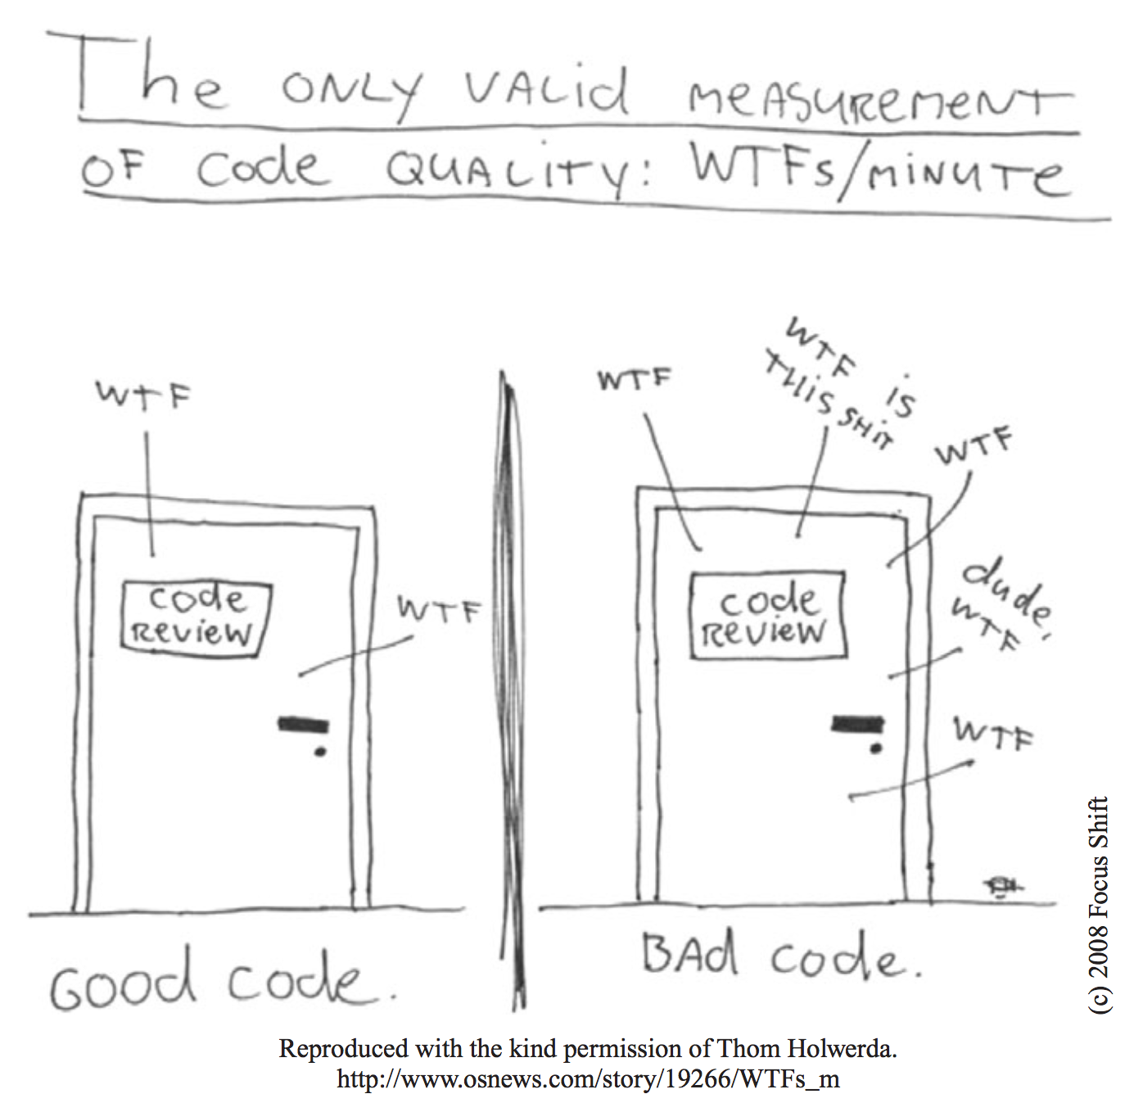
Code Hell

Slide 4
Code Hell - Examples
int d; // elapsed time in days
public List<int[]> getThem() { List<int[]> list1 = new ArrayList<int[]>();
for (int[] x : theList)
if (x[0] == 4) list1.add(x);
return list1; }
int a = l; if ( O == l )
a=O1; else
l=01;

Slide 5
Real World Code Hell Example
# get the count of rows in the database
# $x is the row count going forwards
my $arrayref = $sth->fetchall_arrayref;
$sth->finish;
my %label_hash;
foreach (@{$arrayref}) {
$label_hash{$_->[0]} = $_->[1];
}
# next line gets the values but first sorts by the values in the hash
# not the keys themselves. Ref: Perl Cookbook P.144
my @values = sort { $label_hash{$a} cmp $label_hash{$b} } keys %label_hash;
if (scalar @values eq 0) {
return $query->b($APP_OPTIONS{'text_no_admins_available'});
} else {
return $query->popup_menu(-name => 'admin_id',
-values => \@values,
-labels => \%label_hash,
);
}

Slide 6
Another Code Hell Example
# get the count of rows in the database
# $x is the row count going forwards
my $arrayref = $sth->fetchall_arrayref;
$sth->finish;
my %label_hash;
foreach (@{$arrayref}) {
$label_hash{$_->[0]} = $_->[1];
}
# next line gets the values but first sorts by the values in the hash
# not the keys themselves. Ref: Perl Cookbook P.144
my @values = sort { $label_hash{$a} cmp $label_hash{$b} } keys %label_hash;
if (scalar @values eq 0) {
return $query->b($APP_OPTIONS{'text_no_admins_available'});
} else {
return $query->popup_menu(-name => 'admin_id',
-values => \@values,
-labels => \%label_hash,
);
}
Random old comment
Badly named variables
What is label_hash?
What’s the point of this?
Useful comment?
What does this mean?

Slide 7
You’re not just a coder or a hacker but a professional so get out of the zone and craft your code

Slide 8
Code for your fellow programmers
Write clean code so that your fellow programmers will be able to read and understand it easily.
Write clean code so that your fellow programmers will be able to maintain and extend it easily.
Write tests for your clean code so that your fellow programmers will know what it does and can change it with confidence.

Slide 9
Code for yourself
Write clean code that you will understand when you come back to it six months later.
Write clean code that you feel proud of and will still feel proud of six months later.
Write tests for your clean code so that you can extend it or refactor it easily.
Write clean code because you’re a professional and you love your craft.

Slide 10
Clean Code Principles
Use MeaningfulNamesForYourVariables
Write small functions that do one thing only and have no side-effects
Avoid excessive comments, avoid comments
Abstract your data into structures or objects
Provide error handling, raise exceptions
Write unit tests for your code
Write your code, then refactor it; refactor it again

Slide 11
Clean COBOL

Slide 12
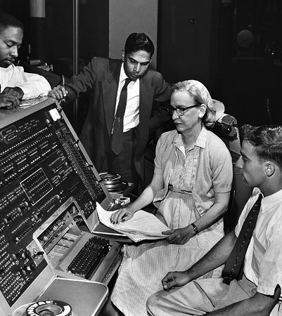
What is COBOL?
COmmon Business Orientated Language
(Completely Obsolete Business Orientated Language?)
“Invented” by Grace Hopper, who was the inventor of FLOW-MATIC.
Standardised between 1959 and 1960 by our friends at the Pentagon by the group CODASYL.
One design goal was to be platform and proprietor independent.
Another goal was that it should be readable by managers, business people and not just computer scientists.
Originally an ANSI standard, now ISO with latest specification in 2014!

Slide 13
COBOL pros & cons
It's arguably very well adapted to its domain of finance and mass data processing.
It's verbose and this helps readability of code and thus is said to be self-documenting.
It's very stable. With the exception of OO additions, the last major change was in 1985. This makes it also very maintainable.
It runs across many, many platforms and OSes.
It's relatively simple as a language.
It's nonproprietary.
It has powerful file, string and numerical handling functions built in.
Legacy code base is very stable with almost no new bugs being introduced.
There's a LOT of legacy code, which is spaghetti-like (but then there's a lot of JavaScript like that!)
OO is still not fully supported in all versions.
It's not suitable for a lot of applications, such as embedded programming.
It has a lot of reserved words, which could be a good thing depending on your viewpoint.
Structured programming is possible, but it may feel 'clunky' compared to other languages.
Best IDE is MicroFocus, but this is commercial software – then again the best

Slide 14
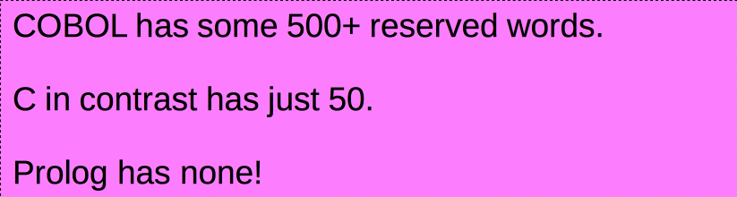
COBOL Features: 500+ Reserved Words!
ABS, ACOS, ANNUITY, ASIN, ATAN, BYTE-LENGTH, CHAR, COMBINED-DATETIME,
CONCATENATE, COS, CURRENCY-SYMBOL, CURRENT-DATE, DATE-OF-INTEGER,
DATE-TO-YYYYMMDD, DAY-OF-INTEGER, DAY-TO-YYYYDDD, E, EXCEPTION-FILE,
EXCEPTION-LOCATION, EXCEPTION-STATEMENT, EXCEPTION-STATUS, EXP, EXP10,
FACTORIAL, FORMATTED-CURRENT-DATE, FORMATTED-DATE, FORMATTED-DATETIME,
FORMATTED-TIME, FRACTION-PART, HIGHEST-ALGEBRAIC, INTEGER,
INTEGER-OF-DATE, INTEGER-OF-DAY, INTEGER-OF-FORMATTED-DATE,
INTEGER-PART, LENGTH, LENGTH-AN, LOCALE-COMPARE, LOCALE-DATE,
LOCALE-TIME, LOCALE-TIME-FROM-SECONDS, LOG, LOG10, LOWER-CASE,
LOWEST-ALGEBRAIC, MAX, MEAN, MEDIAN, MIDRANGE, MIN, MOD,
MODULE-CALLER-ID, MODULE-DATE, MODULE-FORMATTED-DATE, MODULE-ID,
MODULE-PATH, MODULE-SOURCE, MODULE-TIME, MONETARY-DECIMAL-POINT,
MONETARY-THOUSANDS-SEPARATOR, NUMERIC-DECIMAL-POINT,
NUMERIC-THOUSANDS-SEPARATOR, NUMVAL, NUMVAL-C, NUMVAL-F, ORD, ORD-MAX,
ORD-MIN, PI, PRESENT-VALUE, RANDOM, RANGE, REM, REVERSE,
SECONDS-FROM-FORMATTED-TIME, SECONDS-PAST-MIDNIGHT, SIGN, SIN, SQRT,
STANDARD-DEVIATION, STORED-CHAR-LENGTH, SUBSTITUTE, SUBSTITUTE-CASE,
SUM, TAN, TEST-DATE-YYYYMMDD, TEST-DAY-YYYYDDD, TEST-FORMATTED-DATETIME,
TEST-NUMVAL, TEST-NUMVAL-C, TEST-NUMVAL-F, TRIM, UPPER-CASE, VARIANCE,
WHEN-COMPILED, YEAR-TO-YYYY IDENTIFICATION DATA DIVISION SECTION GREATER LESS SET STRING UNSTRING EVALUATEWHEN IS THEN IF END PROGRAM FUNCTIONPICTURE

Slide 15
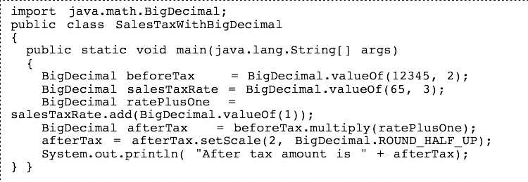
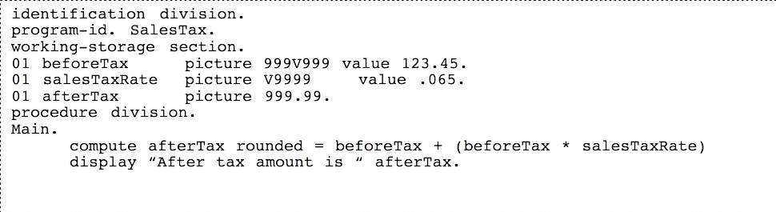
COBOL Features: Legibility

Slide 16
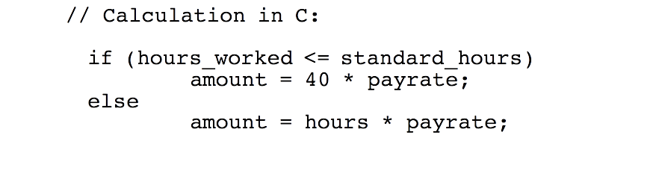
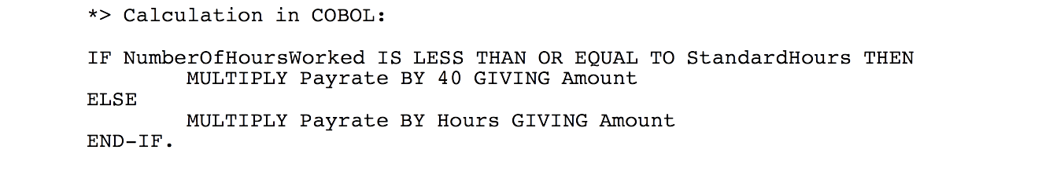
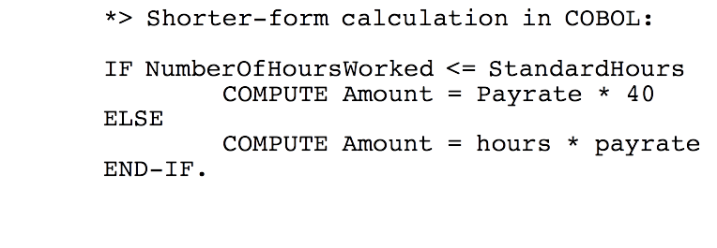
COBOL Features: Verbosity

Slide 17
But doesn’t COBOL suck?
Well yes, perhaps it does.
It’s really, really old.
There’s some horrendous code out there. Lots of use of GO TO and other spaghetti code techniques.
It predated structured programming, object oriented programming. A lot of code lacks sub-programs, functions or classes.
But times have changed, and perhaps bad programmers are wont to blame their tools?

Slide 18
Clean COBOL example
https://github.com/mikebharris/
https://github.com/OpenCobolIDE/
https://sourceforge.net/projects/open-cobol/

Slide 19
Summary
Become a better programmer, be a professional and craft your code.
Read Bob Martin’s Clean Code and The Clean Coder. Read them again.
Write tests.
Bad code can be written in the latest and greatest trendy new Google language; good code can be written in an old dinosaur of a language.
COBOL doesn’t suck as much as you might have thought.

Slide 20
Next Time….
Agile ALGOL-60
Procedure GenerateTalk(numSlides):
integer numSlides;
begin
integer slideNumber;
for slideNumber:= 1 step 1 until numSlides do
if slideNumber< numSlides then
begin
generateNewSlideFromOldSlides(slideNumber);
end
else
begin
generateFinalSlideWithMikesDetails(slideNumber);
end
end GenerateTalk

Slide 21
Thank you.
07811 671 893
mike.harris@leanbytes.co.uk
http://leanbytes.co.uk
https://mbharris.co.uk
http://uk.linkedin.com/in/mbharris
https://github.com/mikebharris/

