Slide 1
It’s XP, stupid!
Mike Harris

Slide 2
Affiliations
Software Engineering Lead – SSRN, Elsevier, RELX
Director & Co-founder – XtreamLab
Member & Co-founder – Bristol Wireless
Co-Founder – HacktionLab

Slide 3
The Plan
Frame where this comes from
Introduce eXtreme Programming
Place XP in the Agile sphere (differentiate from Scrum, Lean, etc)
Explain the core parts of XP
Review XP with Scrum, and Scrum without XP
Review XP with LSD, and LSD without XP
Review XP with Waterfall, and Waterfall without XP
Summarise that if you’re not doing XP, you’re not really being Agile

Slide 4
Experience
Degree in Computing for Real-Time Systems in 1993
On and off software engineer since then
Developed CMS systems through the nineties and noughties
Used pretty much the methodology I learnt at Uni: “adapted agile waterfall”.
Heard about XP in the mid-noughties; dismissed it!
Finally started to learn about it in 2013: converted
Have since evangelised it wherever I’ve worked in software development teams

Slide 5
Why this talk?
The point is that if you’re not doing XP then it doesn’t matter what methodology you’re using to manage the project, you’re not writing good software.

Slide 6
Why this talk?
This slide should be about rolling onto/speaking to people about projects with some different project examples:
ITX: Scrum with almost no XP
SSRN: Rituals around estimating
Evise: again Scrum as the solution with a few tips to XP
PWG:
Loop

Slide 7
What is XP?
A brief recap of eXtreme Programming

Slide 8
What is XP
A brief history
XP in relation to Agile, Scrum

Slide 9
What is XP: Values
Communication
Simplicity
Feedback
Courage
Respect
Others

Slide 10
What is XP: Principles
Humanity
Economics
Mutual Benefit
Self-Similarity
Improvement
Diversity
Reflexion
Flow
Opportunity
Redundancy
Failure
Quality
Baby Steps
Accepted Responsibility

Slide 11
What is XP: Practices
Co-Located
Whole Team
Informative Workspace
Energised Work
Pair Programming
Stories
Weekly Cycle
Quarterly Cycle
Slack
Ten-Minute Build
Continuous Integration
Test-First Programming
Incremental Design

Slide 12
Case Study: SSRN
We practised lots of XP:
TDD
Blah
Our Tech Lead and founding architect left
Within weeks we were able to have done a complete hand-over
All developers had some knowledge of every part of the software
We made a smooth transition to a new tech lead (me), loosing another developer at the same time, and taking on a new developer
No balls were dropped

Slide 13
Case Study: ITX

Slide 14
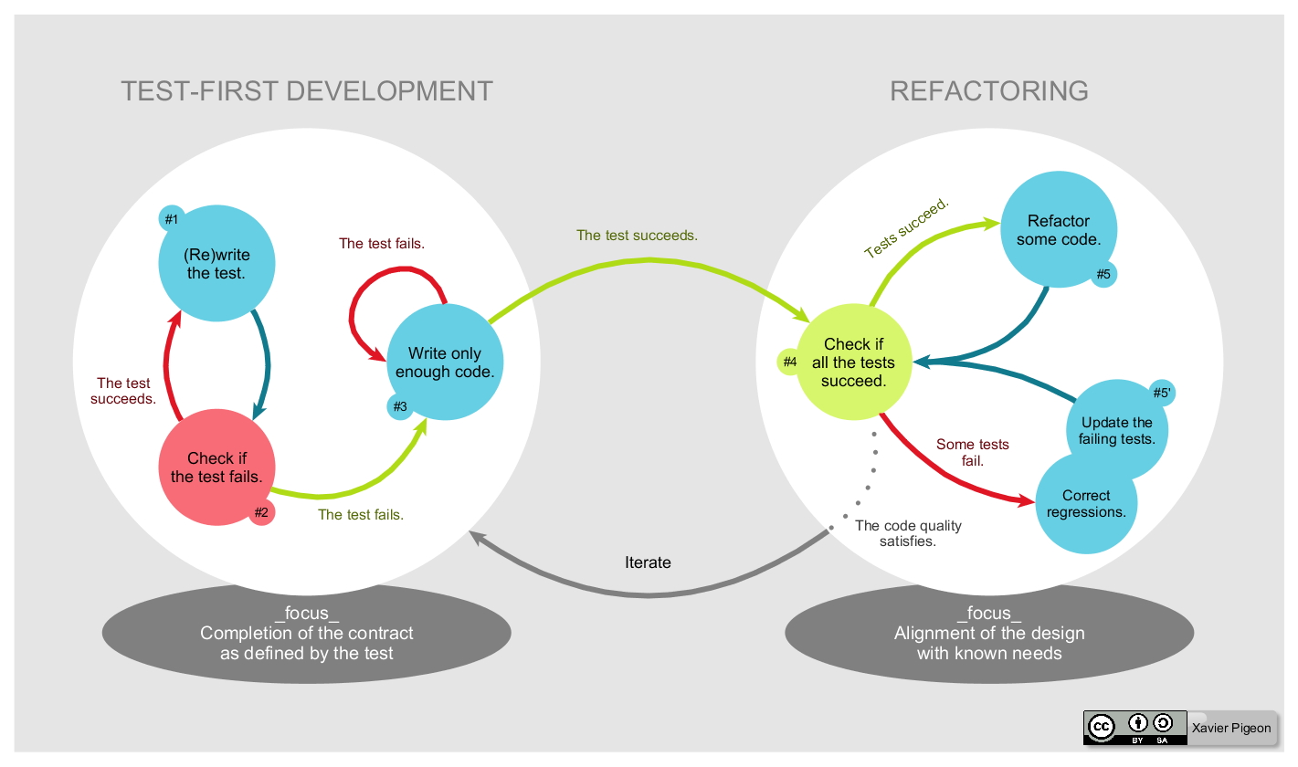

Slide 15
XP++
Eight development practices your team should be doing

Slide 16
Hybrid XP: Practices you should be doing
Pair Programming
Test First Programming
Test Right Programming
Continuous Integration
10-minute Builds
Emergent Design
Developers do (Automated) DevOps
Test Database Schemas
Domain Driven Design
Using Version Control

Slide 17
Hybrid XP: Pair (or Mob) Programming
Two (or more) people share the keyboard
One is the driver, one is the navigator
Taking it in turns to be the driver
Swapping when it feels right
Or every 10-20 minutes (whatever works)
Taking breaks when it feels right (and people need to)
Breaking off to avoid ‘mob googling’
Rotating on and off on longer stories

Slide 18
Hybrid XP: Test-First Programming
Write a test
Then write the code to make the test pass
Refactor the code and ensure the test still passes
Repeat

Slide 19
Hybrid XP: Test-Right Programming
Test at the most appropriate level of the test pyramid
Ensuring that all code is tested once
Unit tests are faster than high-level behavioural tests
Don’t write unnecessary tests (for example defensive programming)
Be careful of your code coverage tools; they may mislead

Slide 20
Hybrid XP: 10-Minute Builds
Make sure your builds

Slide 21
In Summary
The point is that if you’re not doing XP then it doesn’t matter what methodology you’re using to manage the project.

Slide 22
Thank You
Mike Harris . mbharris.co.uk . mike@mbharris.co.uk . m.harris@elsevier.com

Slide 23
We’re all doing Agile nowadays aren’t we? We’ll all delivering software in an Agile way. But what does that mean? Does it mean sprints and stand-ups, Kanban even? But what about Extreme Programming? If as a development team we’re not using pair programming, test driven development, continuous integration, and other XP practices, then we’re not really doing Agile software development.
With real-world examples from my professional experience, I’d like to look at why the current trend of companies and projects adopting Scrum, calling themselves Agile, but not transitioning their development to XP, is a recipe for disaster. I’d like to cover the main practices of XP as well as other good practices, such as version controlling, automated devops and deployment tooling, emergent design and domain driven design, can really help a team deliver quality software, whether they’re doing two-week sprints, ,Kanban, or even Waterfall.
I am a software engineer with experience of management of IT and software development teams using Agile, XP, and Lean methodologies. I have worked with Free Software (aka Open Source Software) since the early nineties continue to promote, advocate and employ Free/Libre and Open Source Software (FLOSS) where appropriate.
Having worked as a software engineer, systems administrator, development team technical lead, IT director, and Agile product owner, I am currently the software engineering lead for SSRN working for Elsevier, where we practice XP, Lean and Agile daily, on cool new microservices platforms, and tangling legacy monoliths. I founded HacktionLab and co-organise the bi-annual event BarnCamp.

