Slide 1
Keeping it Simple
Mike Harris

Slide 2
Minimum Viable Product (MVP)
From World of Product Development.
An MVP “is a product with just enough features to gather validated learning about the product and its continued development.”
Used in Lean (Manufacturing, Software Development, Start-Up)
Defined by Frank Robinson, and popularised by Steve Blank, Mary and Tom Poppendieck, and Eric Ries.

Slide 3
Example
(Learning the lesson)

Slide 4
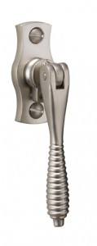
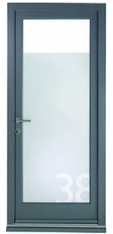
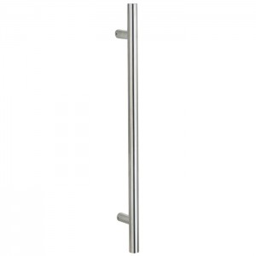
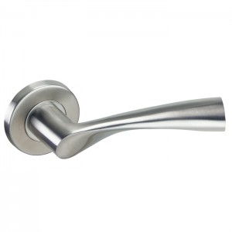
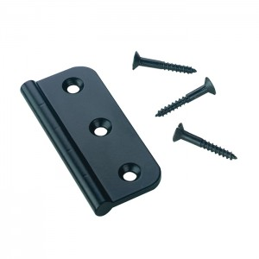

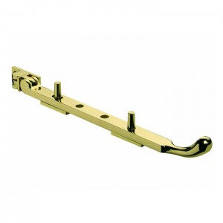
The requirement
Customers need to order spare parts: We need an on-line Parts Shop.
We don’t have a system at the moment, it costs us money; we need a computerised solution.
It’s going to be great. Let’s do it!

Slide 5
The “Solution”
We did the work “on the side”, created a “separate lane” on our Kanban board.
We contracted in a developer who did the work using a framework that wasn’t at the time our core strategic technology.
The developer did a good job and we delivered a Parts Shop.

Slide 6
Dreams vs Reality
(a lesson for the PO)
“It’s something everyone is asking for.”
Some people asked for it. Salespeople were keen to please those people. The solution was not even appropriate for a major group of customers.
“We’ll save ourselves time and money.”
It cost time to implement and time to manage. We probably lost money in the short term.
“We’ll sell a lot of product; it’s going to be big!”
We sold a handful of units a month. It may have been cheaper to give them away for free!
“It’s top priority; drop everything and do it.”
There were other things of higher priority; “fitting it in” was a mistake (PO slaps himself).

Slide 7
A new requirement
(Applying the lesson)

Slide 8
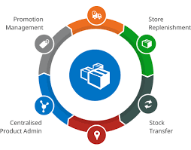


The new requirement
“We’re finding it hard to
manage the stock for the Parts Shop.”
“It’s going to become more of a
problem; we need to act.”
“We need a computerised
system for stock control.”

Slide 9
Information gathering
So how many items are we selling currently?
Less than ten a month.
What is the current trend in growth?
Since it’s launch 9 months ago, no growth trend noticeable.
How many people are having to manage the shop and warehouse stock?
One person, very part-time.
How many potential users are there?
One
What is your budget?
Isn’t this something that IT should pay for?

Slide 10

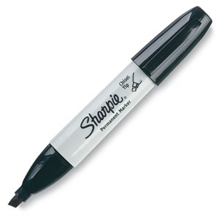
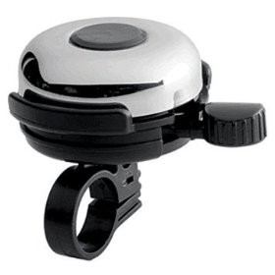
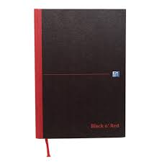
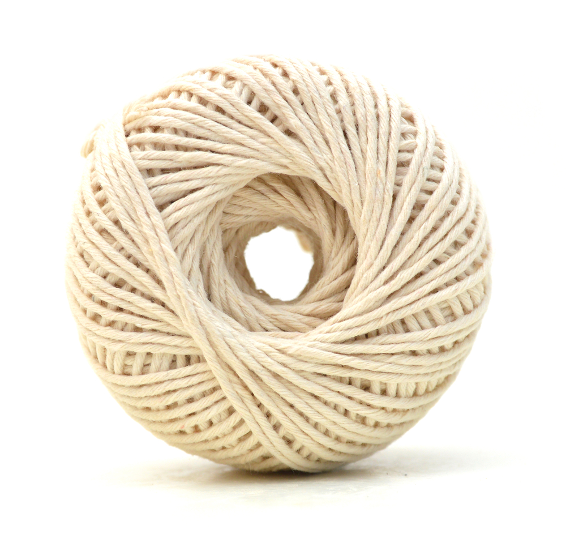
The Minimum Viable Product

Slide 11
Another requirement
(Applying the lesson again)

Slide 12
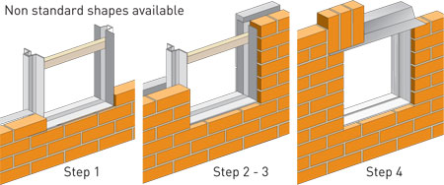
A different requirement
There’s these things we have to sell that everyone wants. We need to sell them.
Other people are selling them, but we’re not; we’re losing revenue.
They’re really, really
cool. Look, I have a
sample one here!

Slide 13
The Detail
They’re not off the peg items, they are made to measure.
There’s a relatively complicated formula for calculating how much you need.
They actually retail for very little; the profit margin is much, much lower than for our core products.
The products are quite different from our core products; they don’t fit easily into our supply and invoicing chain.
We don’t actually know how many people really want to buy them from us.

Slide 14
The Minimum Viable Product
We produced an A4 product information leaflet to give to customers.
We produced a set of guide prices on paper for customers and staff to use.
We trained a single member of staff in quoting for and ordering the items.
We provided a telephone number and email address for customers to order them.

Slide 15
The Result
Nobody ordered any of them from us!
Well maybe over the first six months we sold one or two.
Customers continued to buy them from their previous suppliers.
Our largest and most profitable accounts didn’t really need to buy them anyway.
We saved lots of time and money in wasted product development.
Software developers could continue to work on products that did deliver value.

Slide 16
How can we apply these lessons
as developers?

Slide 17
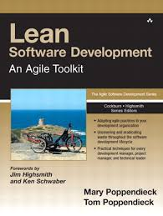
Lean Software Development
Eliminate waste
Amplify learning
Defer decisions
Deliver as fast as possible
Empower team
Build in integrity
See the whole
- Lean Software Development by Mary and Tom Poppendieck

Slide 18
Techniques we can use
Test Driven Development
Emergent Design
Domain Driven Development
Microservices
Pair and Mob Programming
Continuous integration
Continuous delivery

Slide 19
The Summary
The MVP may be much more minimum than you think.
When proving a start-up concept aim to do as little work as possible, so as not to waste time, money, effort, and inspiration.
Just because we’re ‘technologists’ it doesn’t mean a digital solution is the best MVP. A pencil is also a technology.
Try to talk the customer down. People start believing their own hype and get carried away.
Customers can be empowered to realise their own solution.
Apply Lean, Agile and XP techniques to deliver working software fast and get feedback.

Slide 20
Thank You
07811 671 893
mike@mbharris.co.uk
https://mbharris.co.uk
http://uk.linkedin.com/in/mbharris
https://github.com/mikebharris/
(c) Mike Harris under GNU FDL 1.3

