Slide 1

Котлин : Kotlin
A very quick intro

Slide 2

Kotlin
Released in 2011 – v1.0 in 2016
Developed by JetBrains
They make IntelliJ, WebStorm, PyCharm, RubyMine, etc.
Under Apache 2.0 Licence
Named after an Island off the coast from St Petersburg
Runs on the JVM
Statically types and using type inference
Now on version 1.2
I think it has the best bits of Java, Scala, Groovy, and C#
Support for command line, IntelliJ, Android and Eclipse, Emacs, Gradle

Slide 3
Some examples
Things Kotlin does that Java doesn’t

Slide 4
Data classes
data class Customer(val name: String, val email: String)
- gives you getters, setters, toString(), equals(), hashCode(), copy(), destructuring methods out of the box
data class Person(val name: String, val age: Int)
val mike = Person(“Mike Harris”, 47)
val youngerMike = mike.copy(age = 21) val (name, age) = youngerMike println(“Although Mike is older now, he was once $age”)

Slide 5
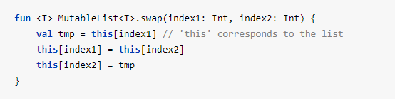
Extension functions

Slide 6
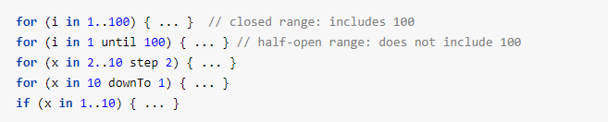
Range expressions

Slide 7
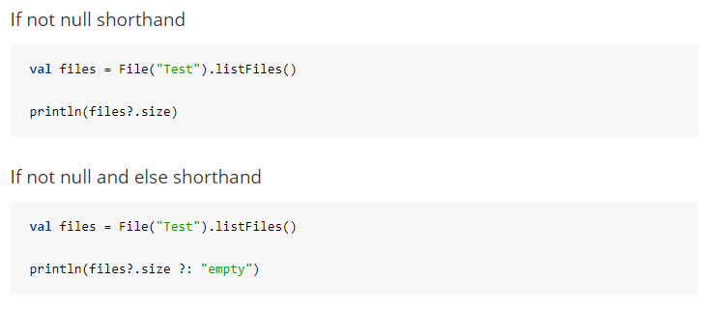
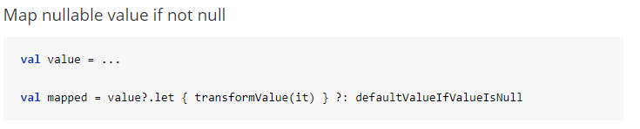
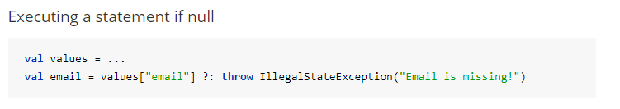
Safe navigation & safe coalescing

Slide 8
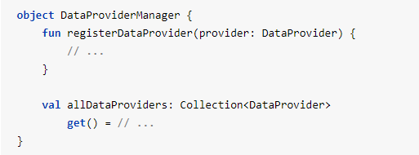
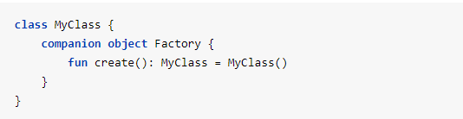
Object declarations
Singletons

Slide 9
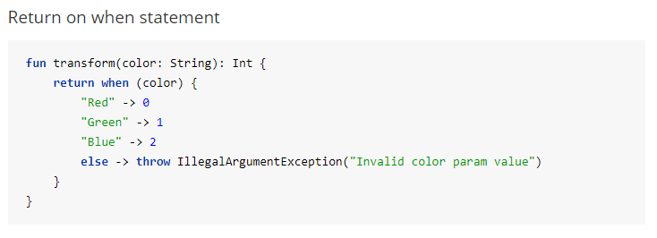
When

Slide 10
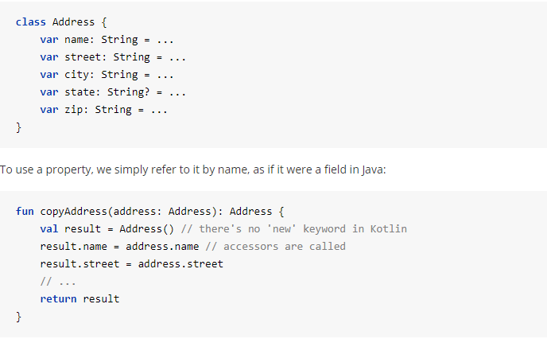
Properties

