Slide 1
Intro to Java + AOP
Java Introduction and Basics of Aspect Oriented Programming

Slide 2
Java Programming Language
Class based and Object Oriented
No scripting, has to be contained within some object structure
Can set entry point of application to given class to start a program
Strongly Typed
Application code is complied to bytecode that can be run on any machine that has a JVM (Java Virtual Machine)
This makes it easier to distribute applications across different architectures since its only half-complied and the JVM takes care of the final compilation at run time

Slide 3
You Need Java Installed
Works similar to a lot of other languages in that you need an interpreter (JVM) on the machine to run the code.
python, ruby, java, node, browser’s are programs that interpret the code you write and execute commands
Disadvantages for JIT (Just in Time Compilation) is that the compilation occurs at runtime adding extra execution time.
Advantages is that you can ship one application that will work on any machine with Java installed

Slide 4
Installing Java
Via Brew: brew cask install java
Installing Brew: https://brew.sh/
Online: https://www.oracle.com/technetwork/java/javase/downloads/index.html
Go to latest version
Sign up with Oracle
Download and Install

Slide 5
IntelliJ IDEA CE
Using IntelliJ IDEA to develop and demonstrate the examples in this presentation
CE Free to Use
Also develop Android Studio, RubyMine, WebStorm, PyCharm…
https://www.jetbrains.com/idea/download/#section=mac
IDEA Ultimate includes support for other languages like JS making is easier to switch between JS and Java if needed
https://spring.io/tools
Includes tools/plugins for Eclipse, Atom IDE, or Visual Studio

Slide 6
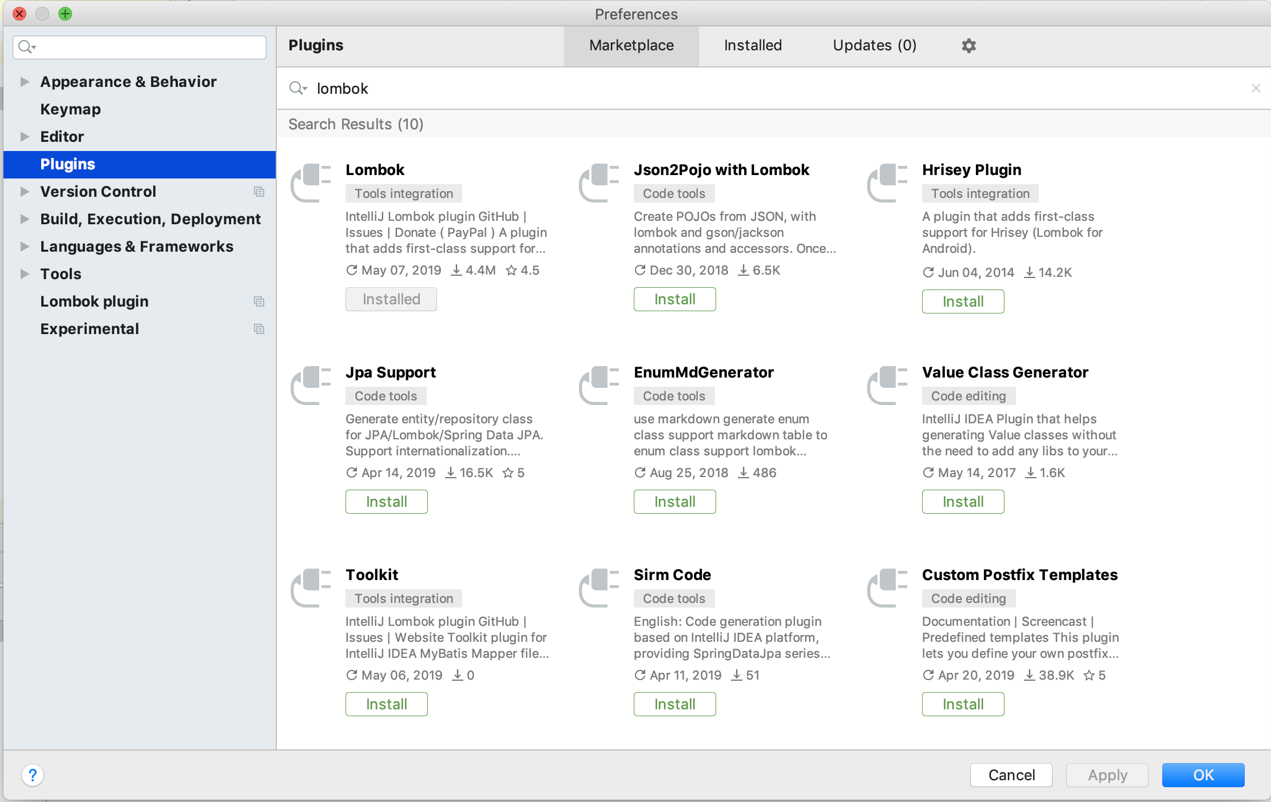
Install Lombok Plugin/Restart IDE

Slide 7
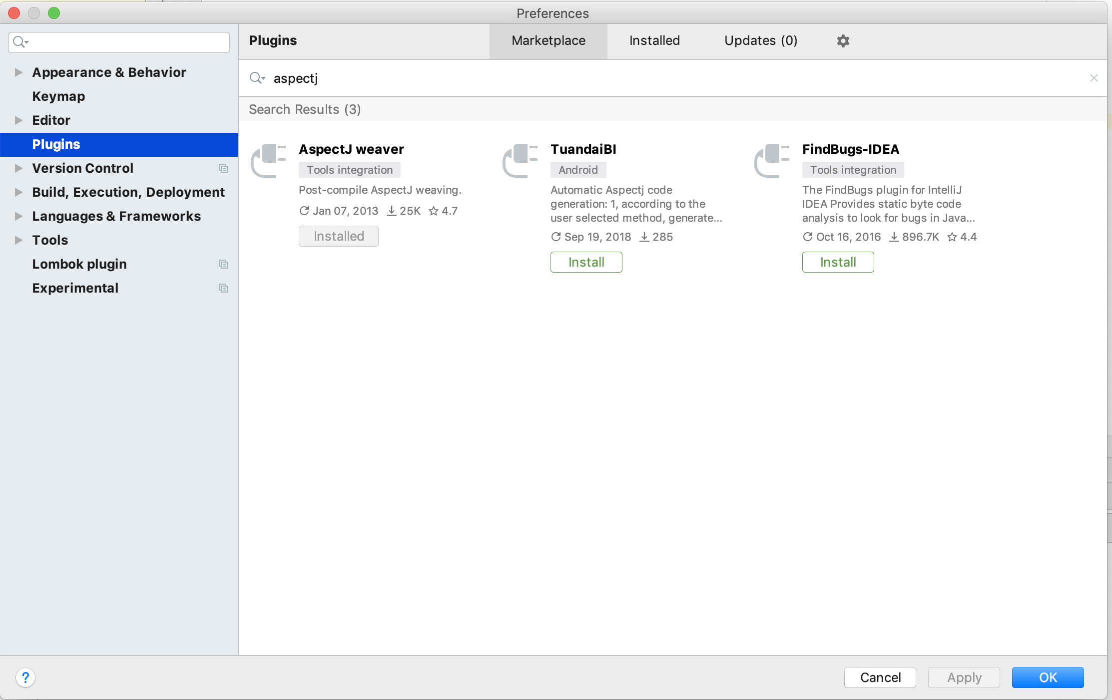
Install AspectJ Plugin/Restart IDE

Slide 8
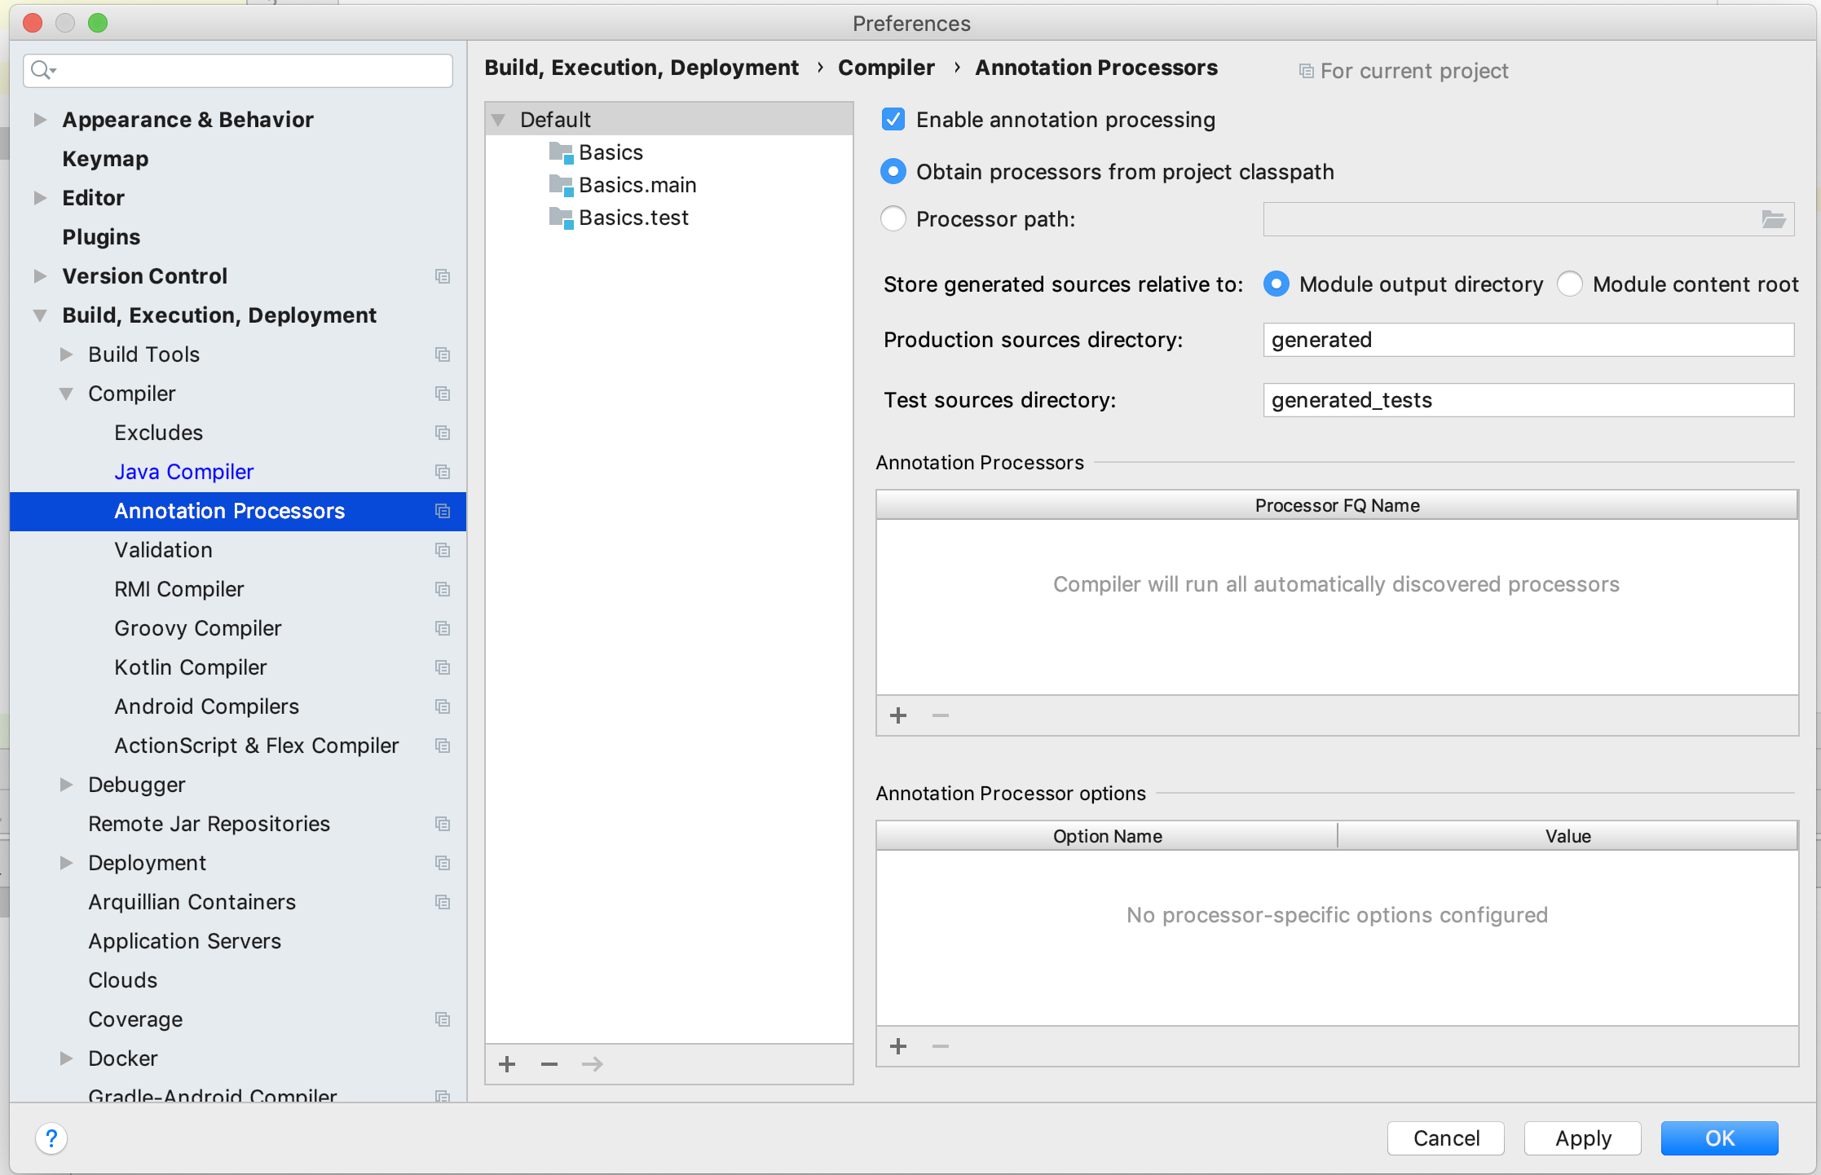
Enable Annotation Processing

Slide 9
Differences Between Java + JS
There’s no var, const, let for setting variables
Example: String value = “test”;
JS: let value = “test”;
There is no func, function, def for defining methods
Using () and {} block will be the difference between properties and methods
There’s no const keyword, final is how you set constants
final modifiers also prevent overriding on classes/methods/properties when final is declared with them
Example: final String value = “test”;
JS: const value = “test”;
Everything has to be a class
Single quotes represent characters and double quote represents strings

Slide 10
Java Values, Types and You
Values are strictly typed
Values can’t just be values ☹ and also cannot be inferred
Inferred = type is figured out by compiler
let name = “Bob” // String vs String name = “bob”;
In Java, you cannot assign an Integer to a String, you need to convert it first
Example:
Integer testInteger = 1;
String testString = String.valueOf(testInteger);

Slide 11
Strict Typing
Advantages
Disadvantages
Fast failure of issues within code/syntax
Refactor code with confidence
Between IDE intelligence and auto-completion
Reduce issues involved in untyped variables
Larger development overhead
Errors in IDE can be opaque and hard to follow
Generic types take longer to implement then a dynamically typed language would

Slide 12
Java Types
Primitives
Non-Primitives
byte
short
int
long
float
double
boolean
char
Class
Integer
Double
String
Array
HashMap
(similar to object key, value pairs)
dictionary, hash are some other names for this

Slide 13
Using Primitives vs Non-Primitives
For introductory use: don’t use primitives
Except for (int i = 0; i < size; ++i)
IDE also will let you know you can use a primitive instead
Primitives cannot be null, have no instance methods, and only perform faster in specific scenarios
Use non-primitives for defining values
String, Integer, ArrayList, Double

Slide 14
Loops/If/Else/Switch/Exceptions
Looping is basically the same as JS
while, for are two types of loops you can use
break stops and exits the loop block
continue skips the rest of the current loop block and continues loop
If/Else works the same except for ===
=== doesn’t need to exist
Switch works the same
try/catch work about the same
In typed languages you are catching a given exception class, not generic error
methods that throw exceptions need to be marked as such
Exception java class is the top parent of all exceptions, if you want to catch them all, you would catch them with Exception

Slide 15
Interfaces
Contracts for classes to implement
Only describes contract, doesn’t implement any blocks
Interfaces help guide behavior of similar classes
Also given that Java is strictly typed, in order to use many different classes we would use an implemented interface or parent class to achieve polymorphism
Interfaces also help with testing. If you specify a interface as a dependency you can create a mock class implementing that interface and use it to test the target

Slide 16
Abstract Classes
Classes that can require children extending this class to implement defined abstract methods/properties
Similar to interfaces with additional implementation code
Interfaces only define contract and doesn’t have any implementation code (blocks)
abstract keyword is required before a class you want to be abstract
Also you need to prefix any method/property with abstract if those need to be implemented by children
Abstract classes can access those abstract properties/methods within itself allowing children to redefine behavior of the abstract class based on how they set those properties or methods

Slide 17
Enums
Declarative way of describing choices in code
Better than using strings which have ability to be misspelled
Similar to JS enums but don’t have to have values
Also declared different using enum keyword
Easier to navigate choices and map dependencies
Can also have custom values too

Slide 18
Packages
Way to namespace and group code
Packages are created using folders
“com.appname.models” corresponds to “./com/appname/models”
Use public modifier to export classes for use outside of a given package
Would be similar to export in JS

Slide 19
Modifiers
public
accessible by all
protected
only accessible within member and children
private
only accessible within member
final
const for value
final declared on method, property, class cannot be overridden
static
class var, not instance. same across all objects
abstract, synchronized, volatile

Slide 20
Generics
Generics allows a type or method to operate on objects of various types while still strict typing
Created to reduce code bloat/errors and provide abstraction layer to deal with different possible types
Generics are declared with the <> syntax
Generics can also be bounded to a given implementation (class, interface, etc…)
Advantages of Generics
Code reuse
Type safety is still included

Slide 21
POJOS
Means “Plain Old Java Objects”
Private model properties
Public getter/setter methods
Originally a fair amount of boiler plate code (which IDE’s also help with)
Lombok: https://www.baeldung.com/intro-to-project-lombok
Library uses annotations to automatically create getters and setters so you don’t have to create them
Compile “Weaving”, alters code as its building
Generates methods from a given property
(firstName, lastName) => (getFirstName(), setFirstName(String firstName), getLastName(), setLastName(String lastName))

Slide 22
Testing
In most complied languages include Java, testing code exists outside the main codebase and imports application code into it
Tests and folder structure mimic each other (easier for importing packages)
Don’t use assert keyword (doesn’t give feedback on value differences), use an Assert library
Dependency Injection is the preferred and recommended way of testing components

Slide 23
Lean on IDE
IDE intelligence + autocomplete is recommended for Java and Spring development
There are a lot of libraries in a ton of different places
IDE’s can automatically help you import the libraries you want
Annotation processing allows you to flag and change code dynamically
Breakpoints in IDE are easy to use and help reveal information at a given point
Java can also have boilerplate heavy code, IDEs can help ease that

Slide 24
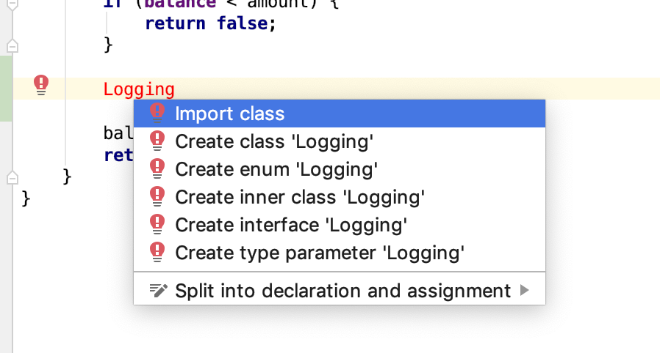
IDE Importing
If red text exists can use IDE to find dependencies
Hover over text in question
option + enter will open menu
choose which library to import

Slide 25
Aspect Oriented Programming
Decoupling concerns of application to improve modularity

Slide 26
Enabling AspectJ in IDE
Download and install plugin for AspectJ for your given IDE
IntelliJ: Preferences -> Plugins -> Search for AspectJ in market place
Download, install, and restart IDE
Enable annotation processing (@ symbols identify and changes/adds code at compile/runtime)
IntelliJ: Preferences -> Build + Exec -> Compiler -> Annotation Processing -> Enable
Add dependency to Gradle, Maven or other dependency management system
Can also download jar, import into project, and use but versioning wouldn’t be automatically managed

Slide 27
AOP Definitions
Aspect: A modularization of a concern that cuts across multiple objects. Each aspect focuses on a specific crosscutting functionality
Join point: A point during the execution of a script, such as the execution of a method or property access
Advice: Action taken by an aspect at a particular join point
Pointcut: A regular expression that matches join points. An advice is associated with a pointcut expression and runs at any join point that matches the pointcut

Slide 28
What is AOP?
Allows for separation of cross cutting concerns
Operates by adding functionality to already existing code (observing)
In this example we will be using the library AspectJ
AspectJ can be used with Spring to enable Spring AOP
Can target singular/multiple actions with an Aspect
This allows you to execute code without modifying existing application code

Slide 29
AOP Diagram

Slide 30
Examples of Cross Cutting Concerns
Business rules
Caching
Data validation
Domain-specific optimizations
Logging
Performance/Error Monitoring
Internationalization and localization which includes language localization
Information security

Slide 31
AOP Design
Advantages
Disadvantages
Reuse of classes and aspects, thanks to modularity
Modularizes cross-cutting concerns improving code maintainability and understandability
Add behavior to existing code without modifying
Runtime overhead when using some constructs, e.g. cflow
Coupling may not be obvious in code base without IDE
Doesn’t work well with other libraries that do post-compile time weaving (Lombok ☹)

Slide 32
Sources
https://www.w3schools.com/java/
Used resource to figure out which subjects in Java to discuss
https://aboullaite.me/understanding-jit-compiler-just-in-time-compiler/
https://www.baeldung.com/java-generics
https://www.baeldung.com/intro-to-project-lombok
https://www.baeldung.com/aspectj
http://javagalleog.blogspot.com/2016/03/gradle-and-aspectj.html
https://www.techiedelight.com/measure-elapsed-time-execution-time-java/
https://www.baeldung.com/spring-aop-advice-tutorial

Slide 33

Introduction to Java + AOP Repository
https://github.com/mikeblatter/intro_java_aop
Contains all the examples used in this presentation
Thanks!

