Slide 1
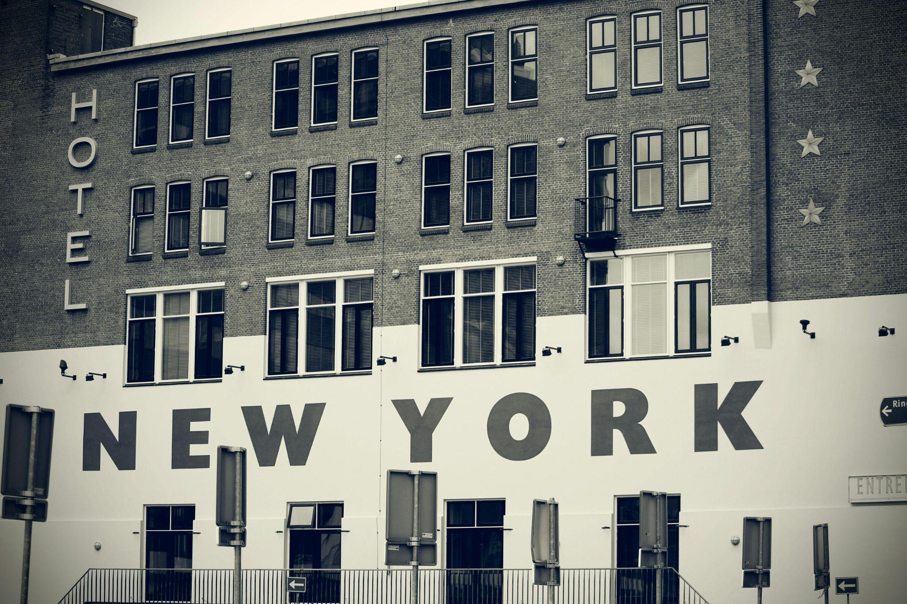
Hotel Booking Analysis
Presentation By: Michael Boateng Mensah

Slide 2
Overview
The dashboard provides insights into occupancy trends, cancellation rates, booking patterns and revenue generation
Each is segregated by market segment, customer type, room type or country.
Highlighted Key Metrics
Total revenue generated
Monthly booking trends
Booking cancellation rates
Total bookings recorded
Repeat vs. New Customer Ratio

Slide 3
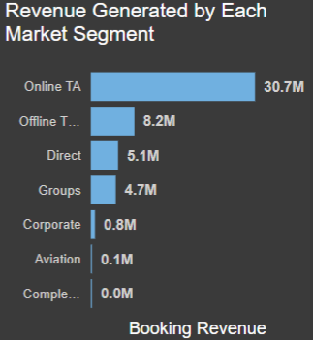
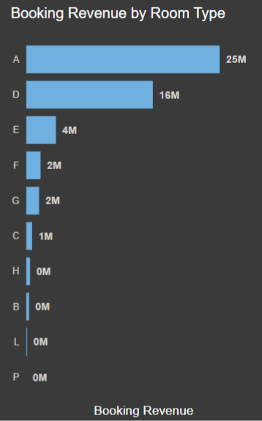
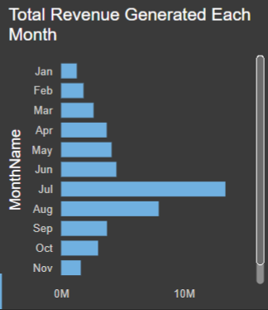
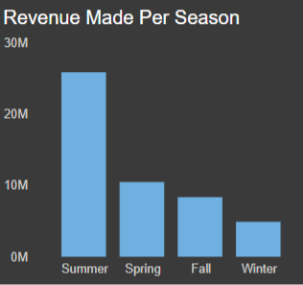
Revenue Generation
Over 60% of the revenue generated was from customers who booked through online travel agents.
Room type A was the room type that generated the most revenue even though being one of the least priced.
Summer was the season which generated the most revenue, with a peak revenue of about $15 million in July

Slide 4
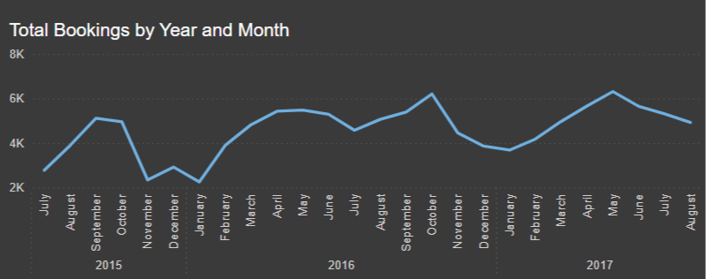
Monthly Booking Trends
In 2015, booking peaked in the month of September
In 2016, booking peaked in the month of October
In 2017, booking peaked in the month of May
Bookings seem to typically be maximum during the fall season
They are the lowest in the winter season

Slide 5
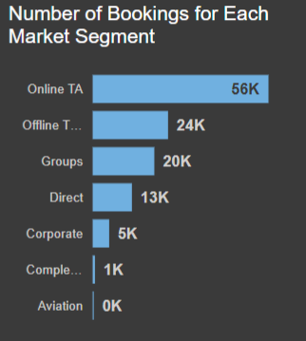
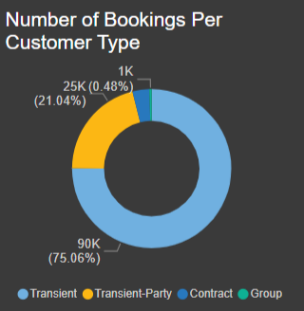
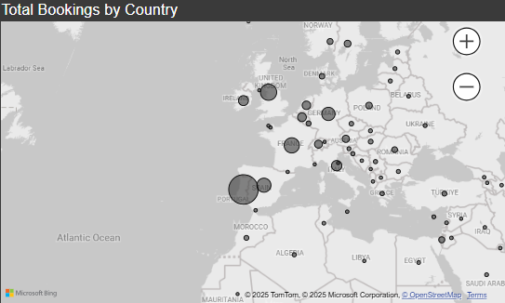
Bookings Recorded
Online travel agents booked the most customers about 30% of the entire bookings
Transient customers forms the largest of the hotels customer base, representing 75% of all bookings
Europe and especially Portugal dominated the bookings

Slide 6
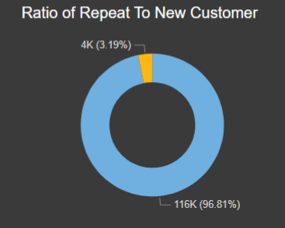
Repeat Vs. New Customers
New customers formed a large proportion of the customer base
The ratio of repeat customers to new customers is calculated to be 3.3%

Slide 7
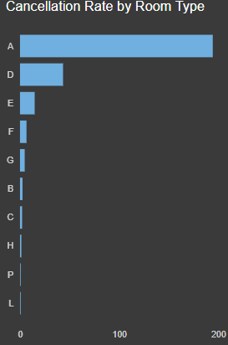
Cancellation Rates
Room Type A had the most cancellations.
It accounted for over 75% of the entire booking cancellations.
Room D and Room E came in 2nd and 3rd at 13.8% and 4.3% respectively.

Slide 8

Observations
Seasonal trends show high revenue during summer and lower during winter, suggesting fluctuating demand.
Room Type A generates the highest revenue but also shows an extremely high cancellation rate (76.04%).
Seasonal trends and varying lead times present an opportunity for improved forecasting.

Slide 9

Recommendations
Implement dynamic pricing models that adjust rates based on seasonal demand and occupancy levels.
Offer bundled packages or promotions during low-demand periods (winter) to stimulate bookings.
Enhance your online booking platform with personalized offers and a seamless user experience.
Align resource allocation (e.g., staffing levels, marketing spend) with forecasted demand to maximize operational efficiency.
Implement stricter cancellation policies (e.g., requiring deposits or non-refundable options).

Slide 10
QUESTION?

Slide 11
THANK YOU!

Slide 12
Hotel Booking Analysis

