Slide 1
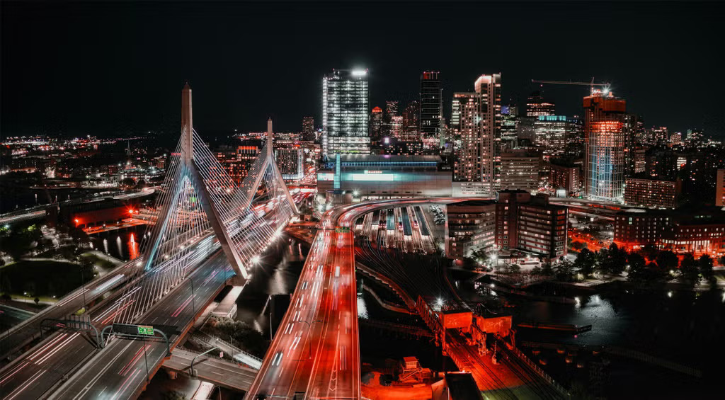
Boston AI/ML User Group Meeting
Mar 20, 2025

Slide 2
Agenda
Group overview
  Purpose:
    Place to discuss AI/ML at any level (newbie to PhD).
    Making connections with others.
15-25 minute talk
  Al Cole (VP @ Redis)
Networking (as long as you want or 8:30 😁)

Slide 3
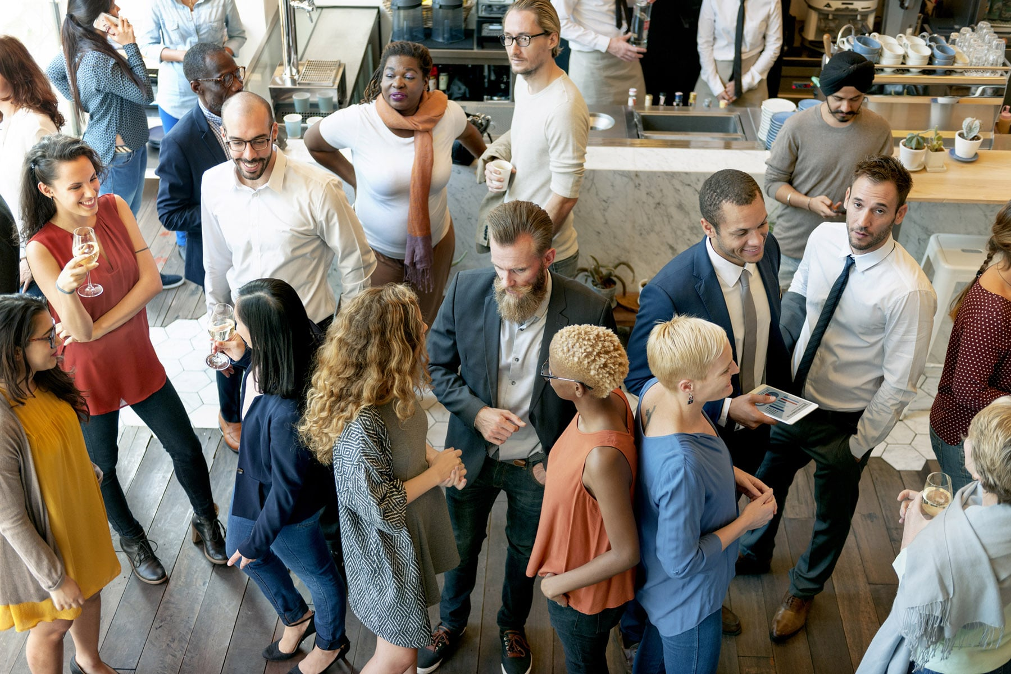
Networking time
Caveat for the below items
”If you’re comfortable”
  Trying to get food sponsor.
  Group picture would help
  me pitch to sponsors.
  Round the room intros:
    Who are you?
    AI interests?
    Looking for anything specific?
      Topic/subject?
      Collaborators?
      Study buddy?
      To hire for some role?
      Etc.

Slide 4
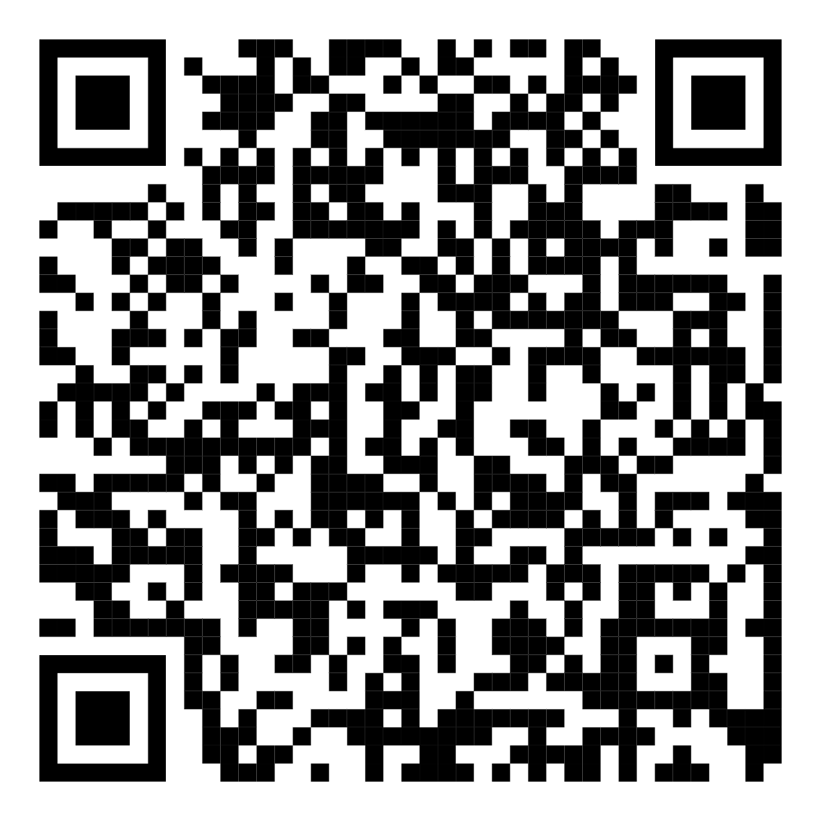
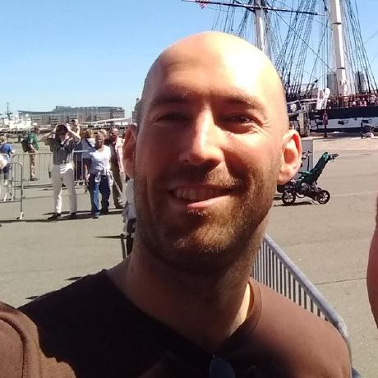
If you want to connect
LinkedIn
URL

