Slide 1
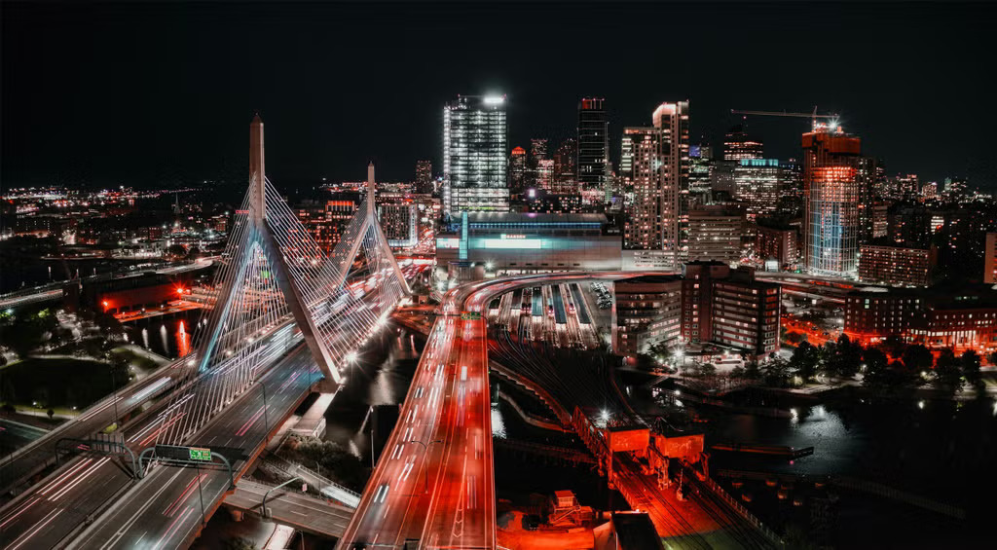
Boston AI/ML User Group Meeting
April 2, 2025

Slide 2
Agenda (detailed)
6pm - Attendee arrival / Networking
7:15pm - Introductions
7:30pm - Talk 1
  Brenda Flynn: What's cooking at Kaggle?
8:00pm - 10 minute break
8:10pm - Talk 2
  Michael Boensel: Workflows for GenAI Image Creation
8:30pm - Wrap-up and closing remarks (attendees escorted out of the building)
9pm All attendees have exited the building.

