Slide 1
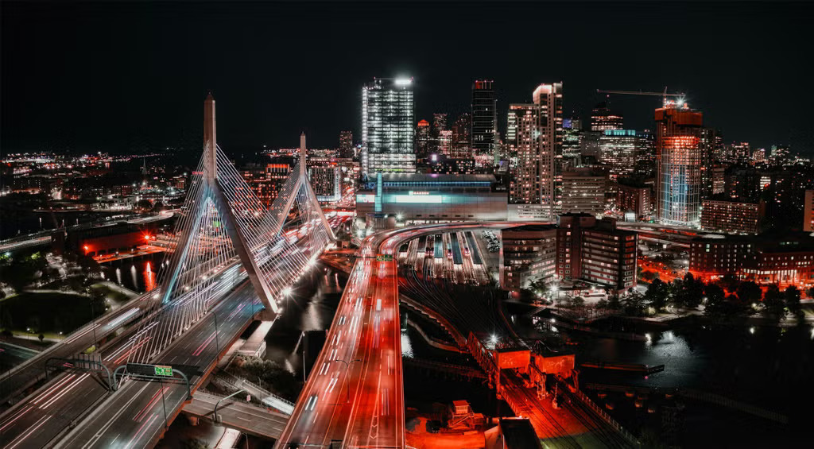
Boston AI/ML User Group

Slide 2




Slide 3
Agenda
Group overview
  Purpose:
    Place to discuss AI/ML at any level (newbie to PhD).
    Making connections with others.
Talk
Networking (as long as you want or 8:30 :) )

Slide 4
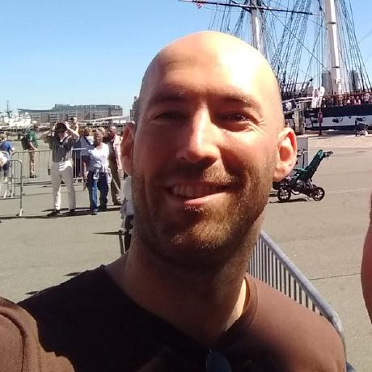
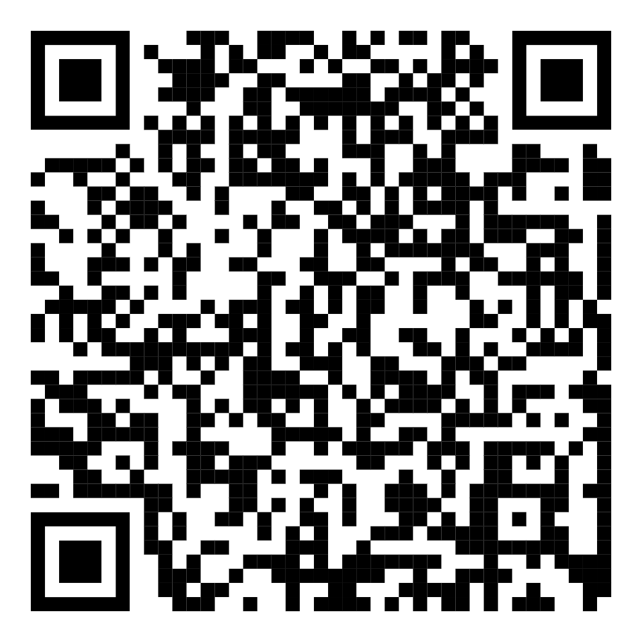
Who am I?
SW Dev at Lincoln Lab 2019-2025
Rapidly failing startup 2025-?
Interested in Gen AI
  “When will this take my job?”
LinkedIn ===>

Slide 5
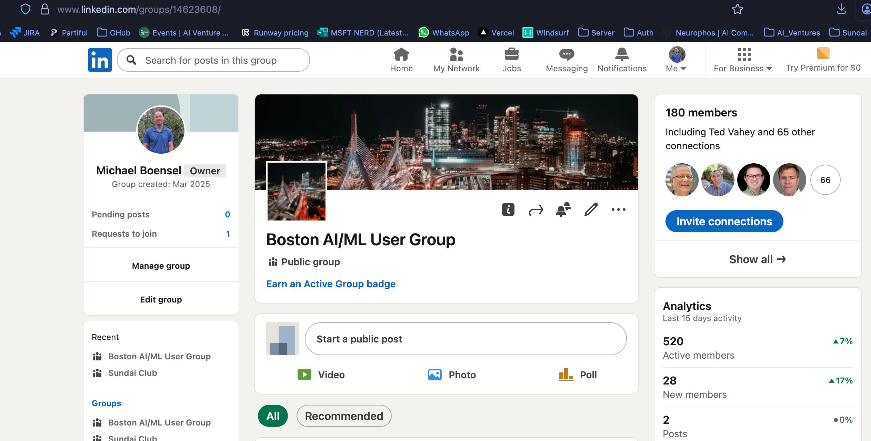
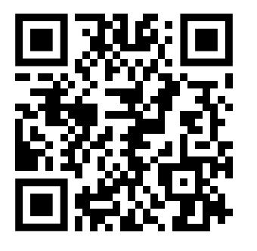
We’ve got a LinkedIn Group

Slide 6
Who are you?
(Reminder for me, post talk)
Around the room
Rapid fire
Helps with discoverability
Who you are + what are you looking for?

