Slide 1

Boston AI/ML User Group

Slide 2
Agenda
Group overview
  Purpose:
    Place to discuss AI/ML at any level (newbie to PhD).
    Making connections with others.
10-15 minute talk
Networking (as long as you want or 8:30 :) )

Slide 3

Who am I?
SW Dev at Lincoln Lab
Interested in Gen AI
  “When will this take my job?”

Slide 4
Who are you?
Helps me to tailor the talk
Show of hands:
  Tech?
    Devs/ML/Data Scientists/etc.?
    Years of experience?
  Who plays video games?
    Any experience w/ game development?

Slide 5

Stop me at any time
If you have ?s, others probably do too
I’ll let you know if its too much

Slide 6
Goal
Present some research (not mine!) and explain why:
1. Its cool!
2. Its useless!
3. You should care (the broader applicability/take-aways)

Slide 7
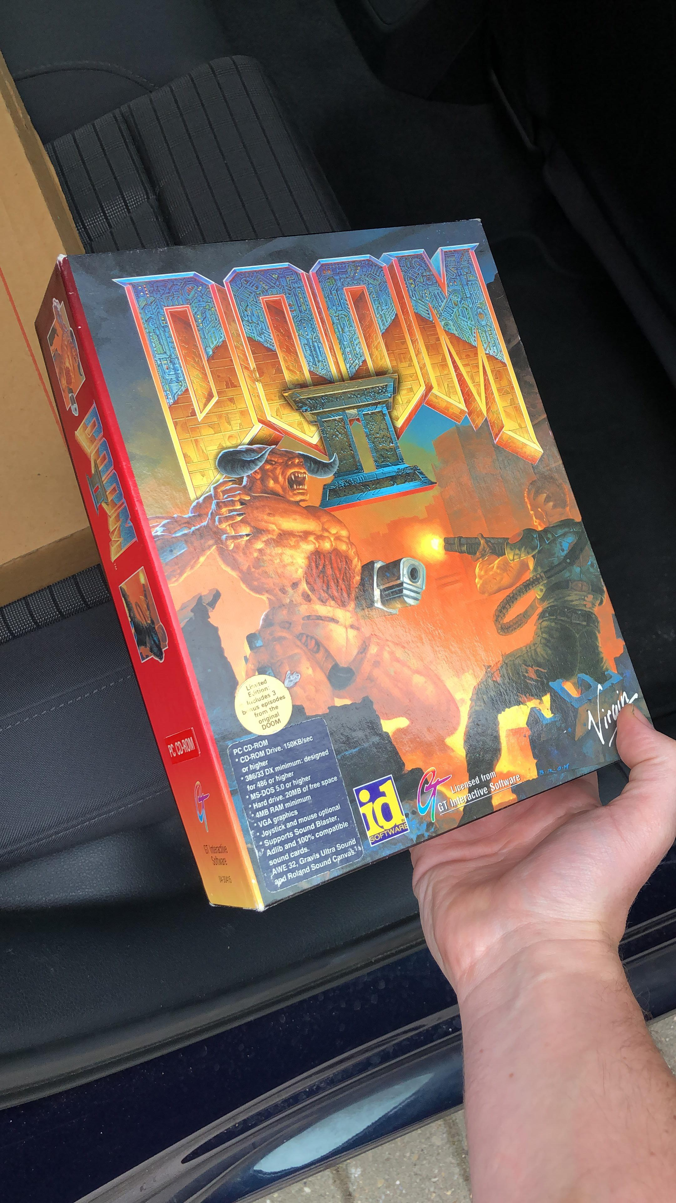
Doom 2
Very popular + successful 90s game
Open sourced afterwards (mods)
Inspired many game devs
Occupies a lot of mind share
“Runs on a toaster”

Slide 8
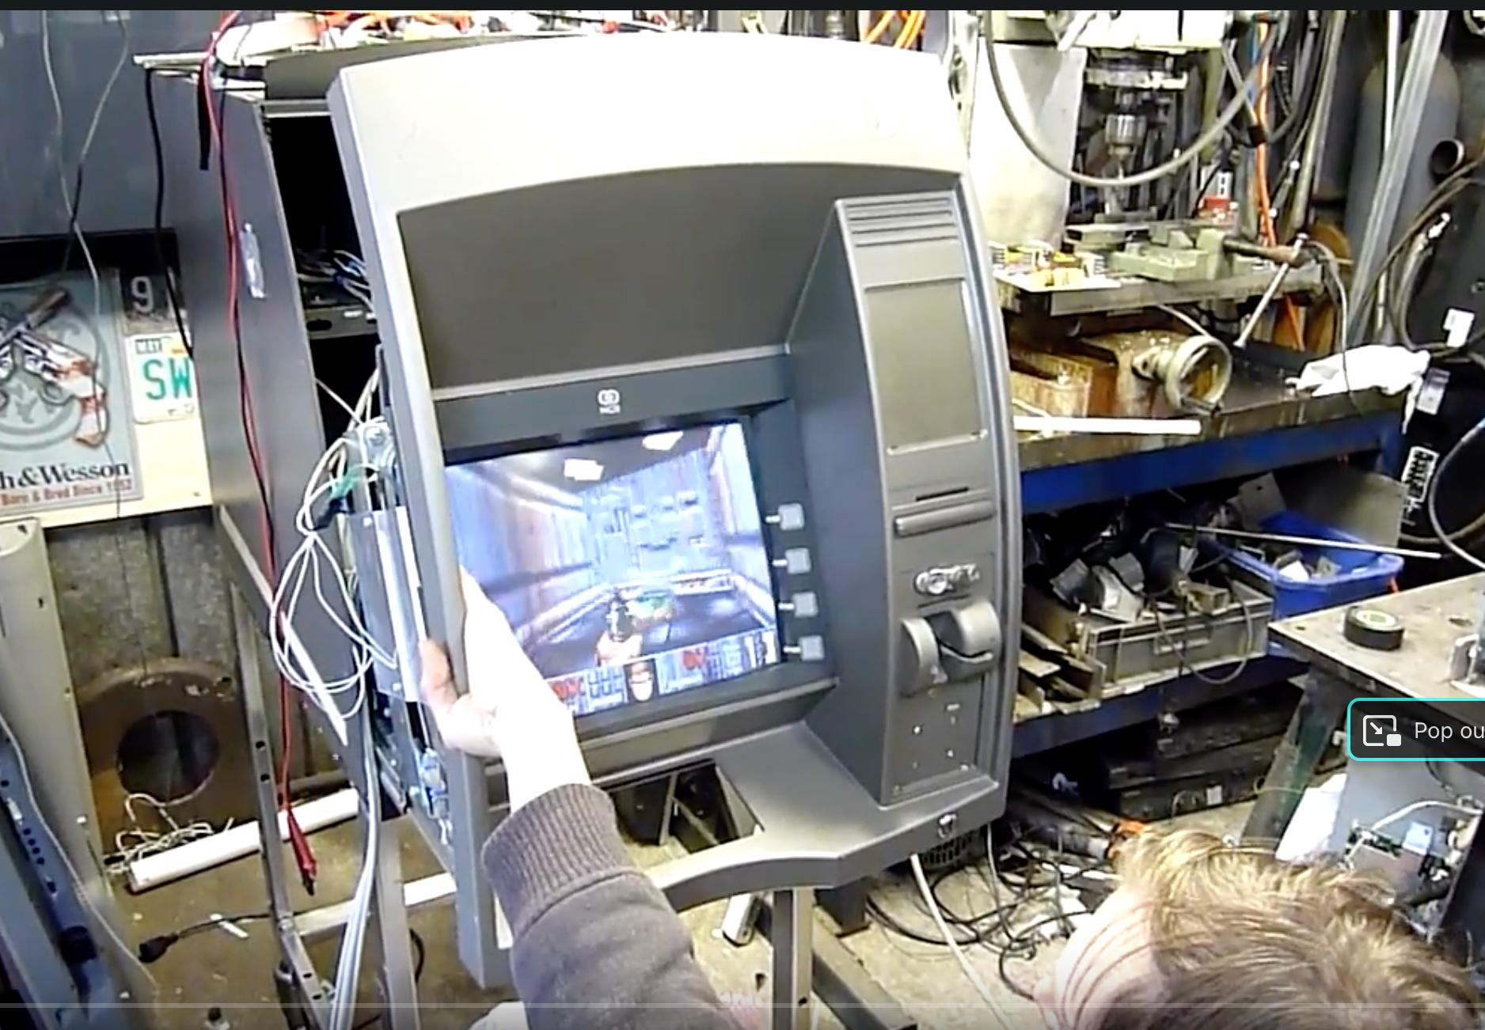
“Toasters”

Slide 9
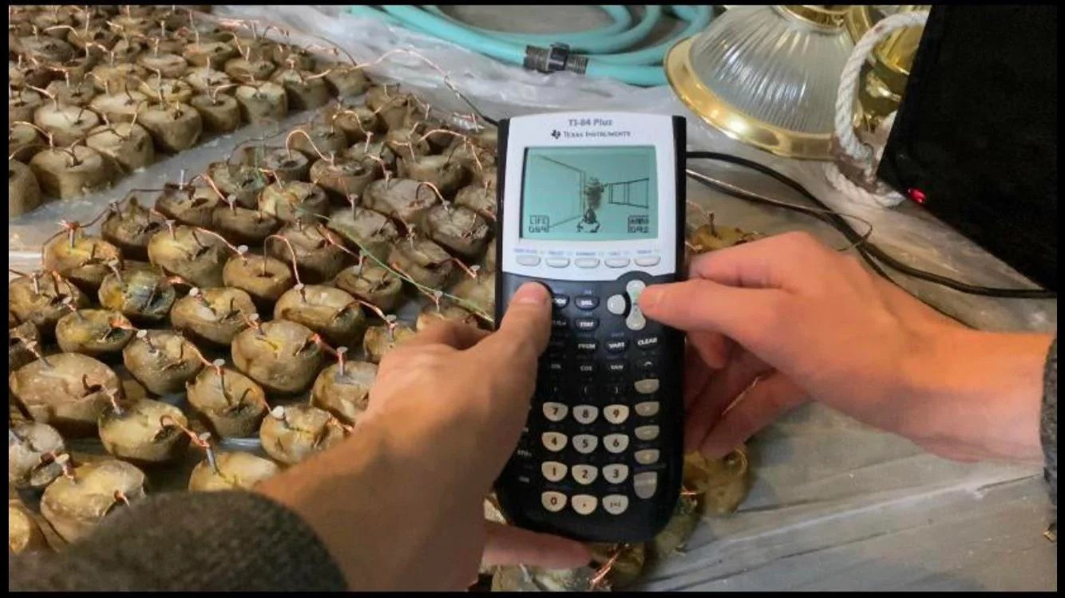
“Toasters”
So…. This is a thing. Hot bed of hacking.

Slide 10
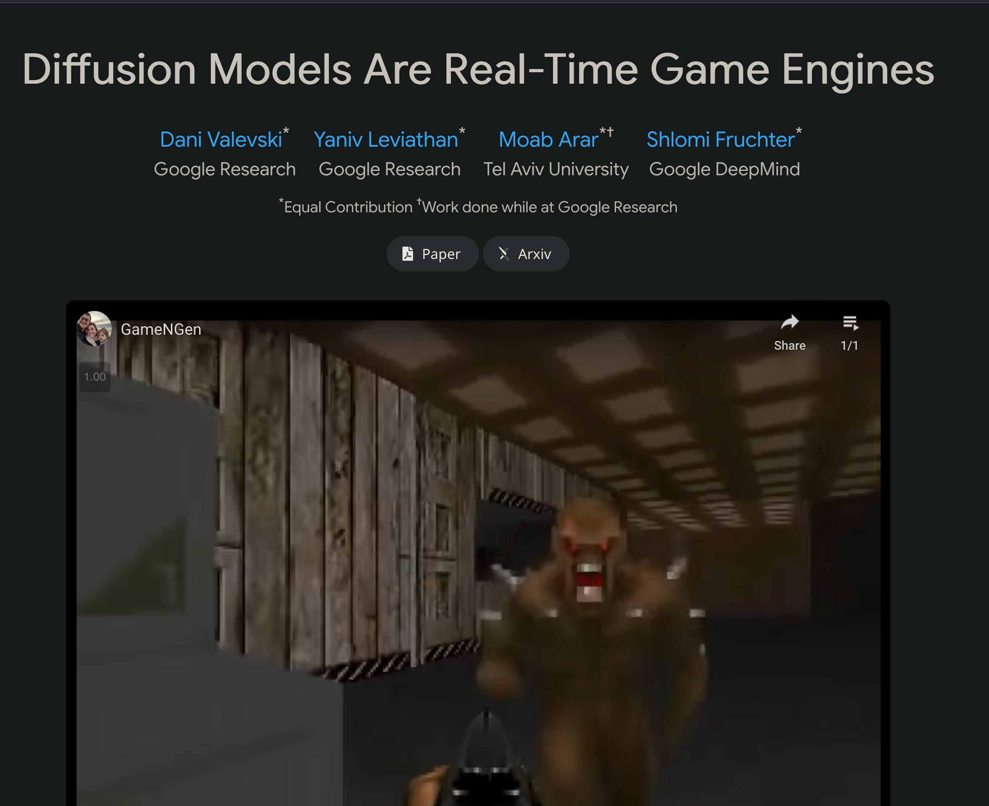
Doom via Diffusion
Just by observing
gameplay it can
simulate it!
Playable!

Slide 11
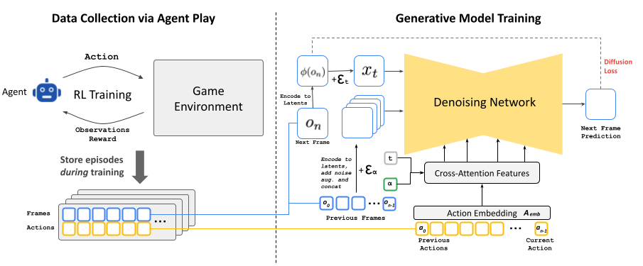
Doom via Diffusion (2)
We aren’t going to spend much time on the tech, instead focusing on why we’d want this (or not)

Slide 12
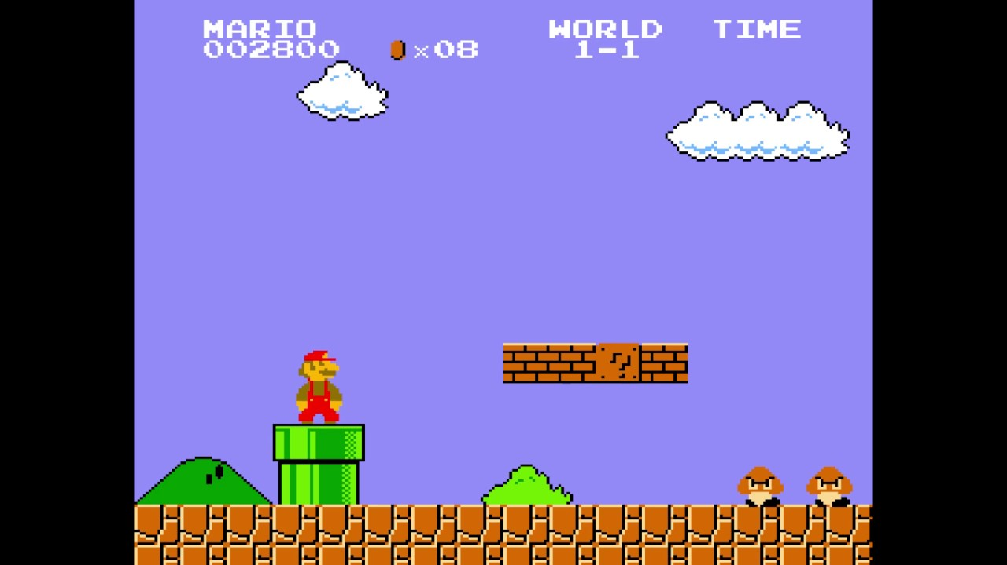
Game Engines?
Collision detection
GFX
Gravity
“Universe simulators”
  Sometimes our universe,
  sometimes others
We will see one later

Slide 13
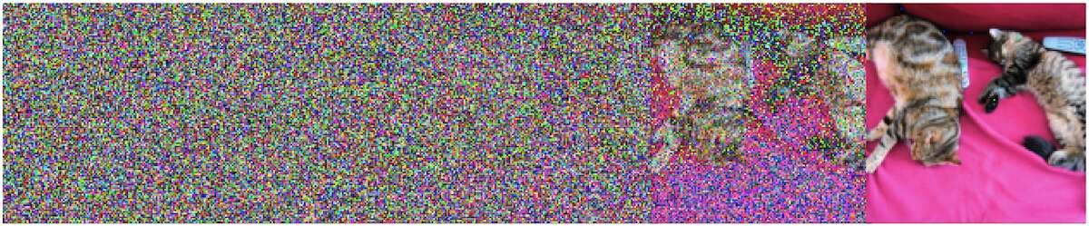
Diffusion Models?
Neural Nets
Capable of generating based on “Conditioning” input
  Ex: text → Image

Slide 14
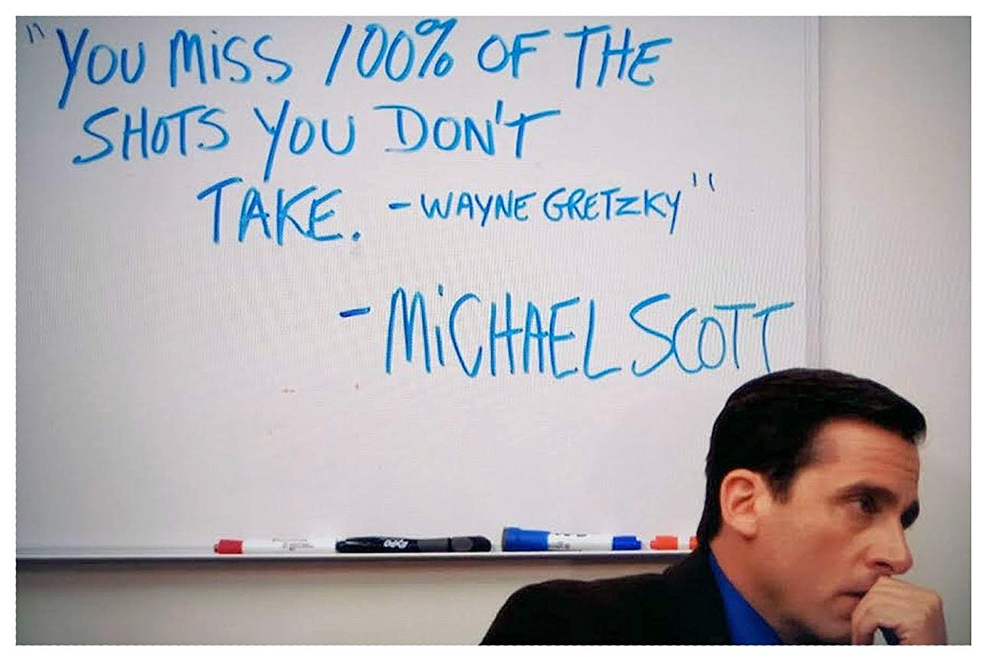
This is too good to be original...

Slide 15
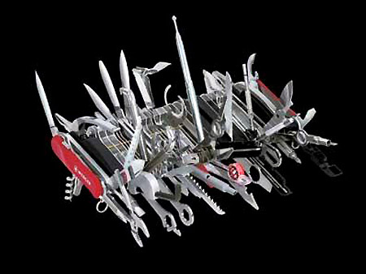
Neural nets are a universal tool!
They should NOT be used universally!

Slide 16
Neural nets are a universal tool!
With enough training/compute it can approximate anything
  But we don’t need approximations. We know exactly what gravity should be. Collisions. The location of items/players/etc.

Slide 17

Any Jurassic Park fans? Guesses?

Slide 18
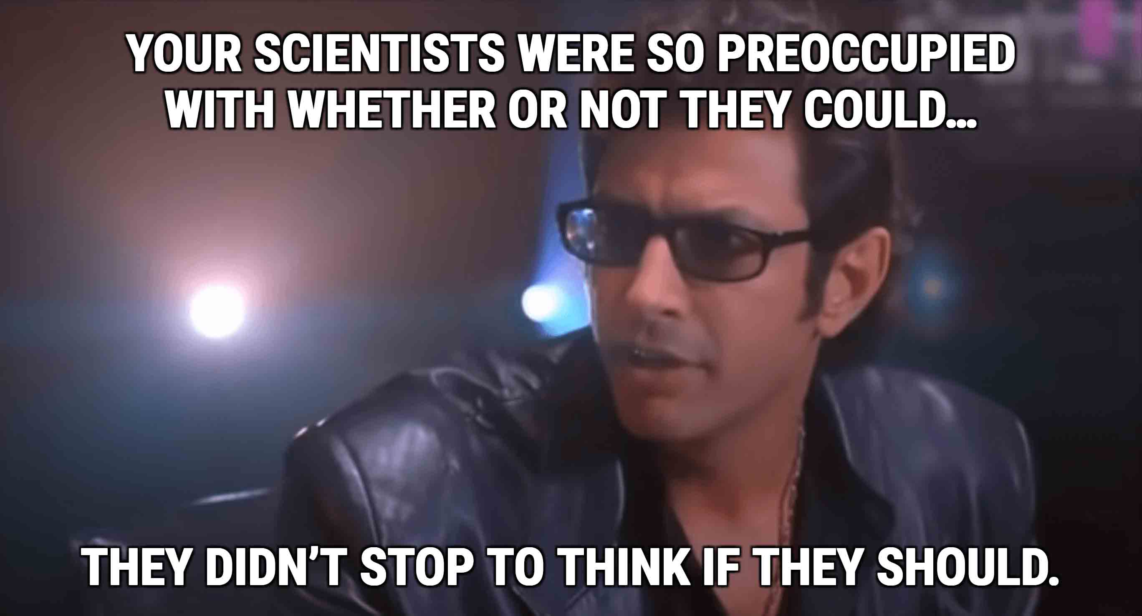

Slide 19

I swear this is real...
- Interesting
- Fun
- Smile when I see it
- Completely impractical

Slide 20
Hyperbolic News Coverage
I realize this is research
The researchers seem to understand the limitations
Popular news/tech does not

Slide 21
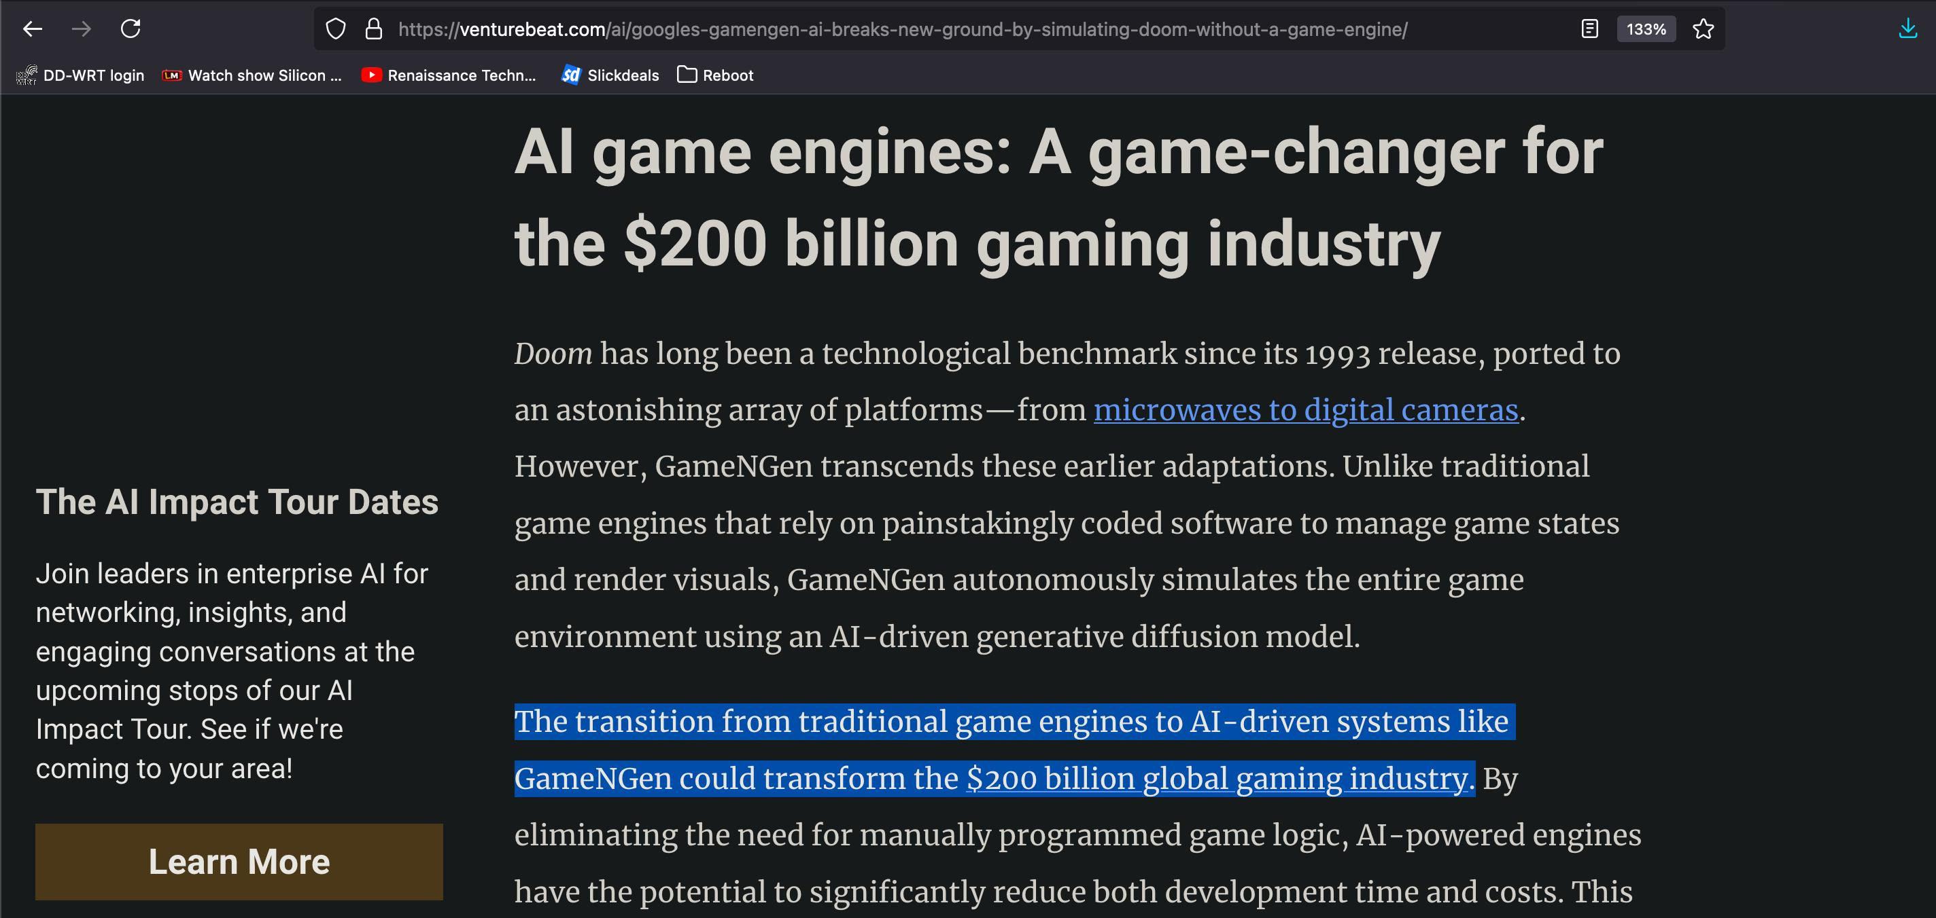
Hyperbolic News Coverage (2)

Slide 22
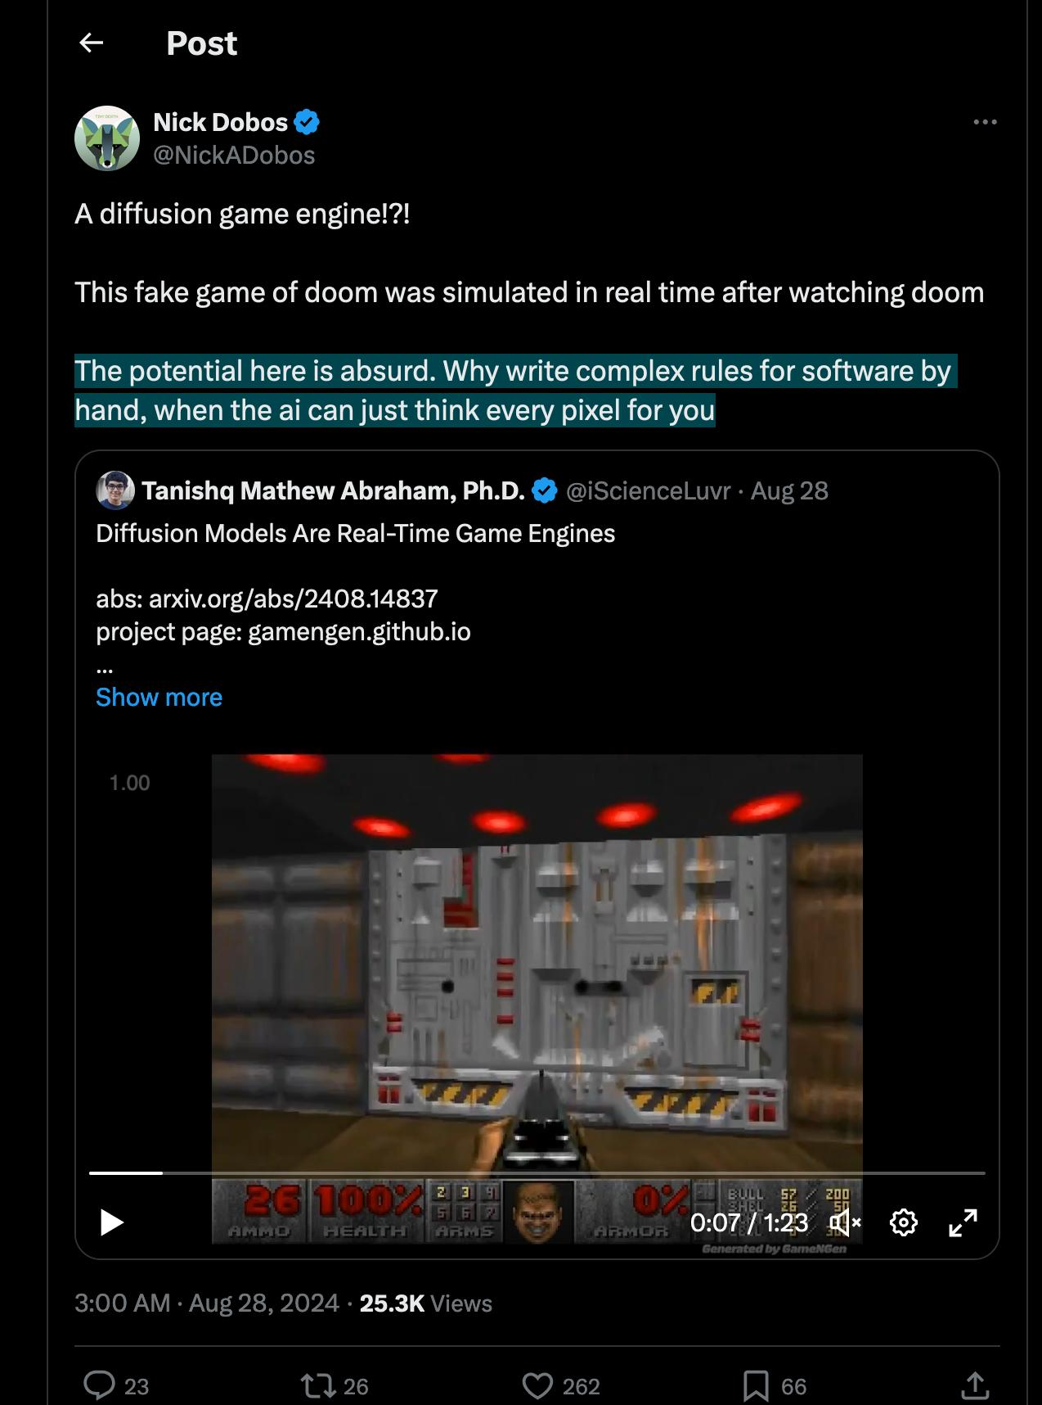

Slide 23
Wrong target!
Pixels (trying to do the whole thing)
Instead, utilize the tool. Produce its expected input. Have users rate. Train off ratings. Iterate.
  Orders of magnitude better power consumption
  No “fuzzy” simulation
  Simpler

Slide 24
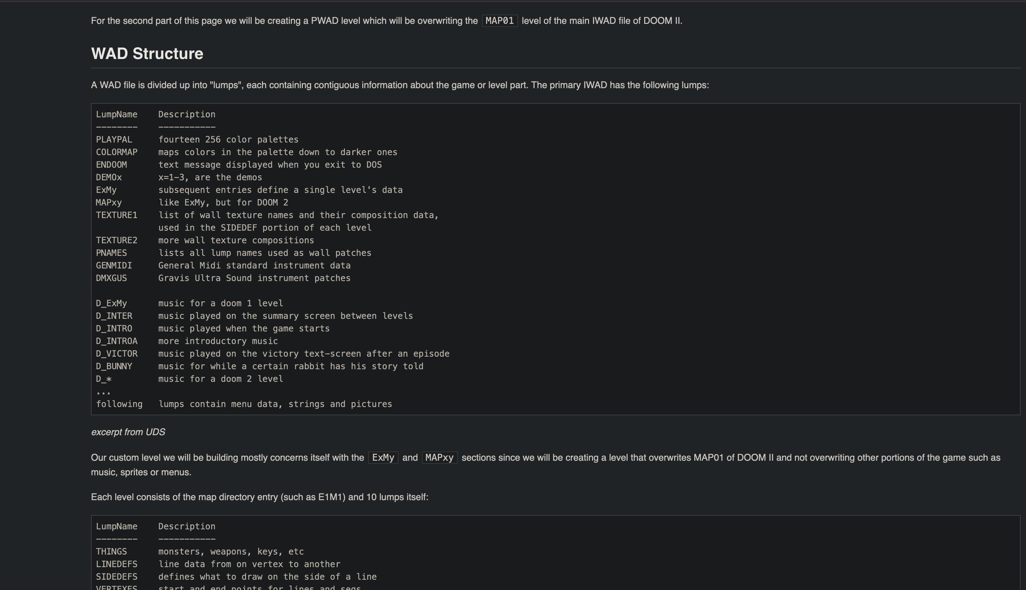
WAD
Well documented format for Levels
https://www.jordansavant.com/book/modding/doom/anatomy_of_a_doom_level_part_1_wad_structure.md

Slide 25
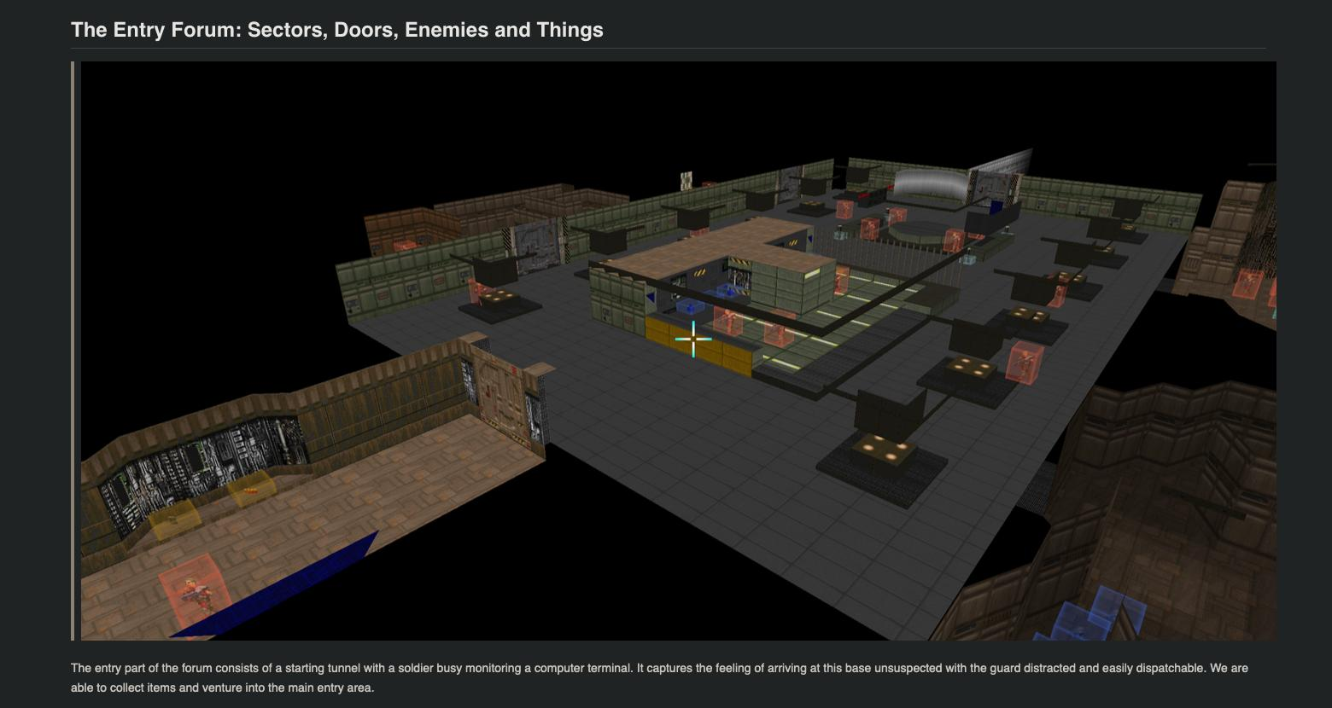
Not saying its friendly
- But there are level editors (https://www.jordansavant.com/book/modding/doom/anatomy_of_a_doom_level_part_2_creating_a_doom_level.md)
- And things are very ordered/structured and well defined (https://doomwiki.org/wiki/Thing_types)

Slide 26
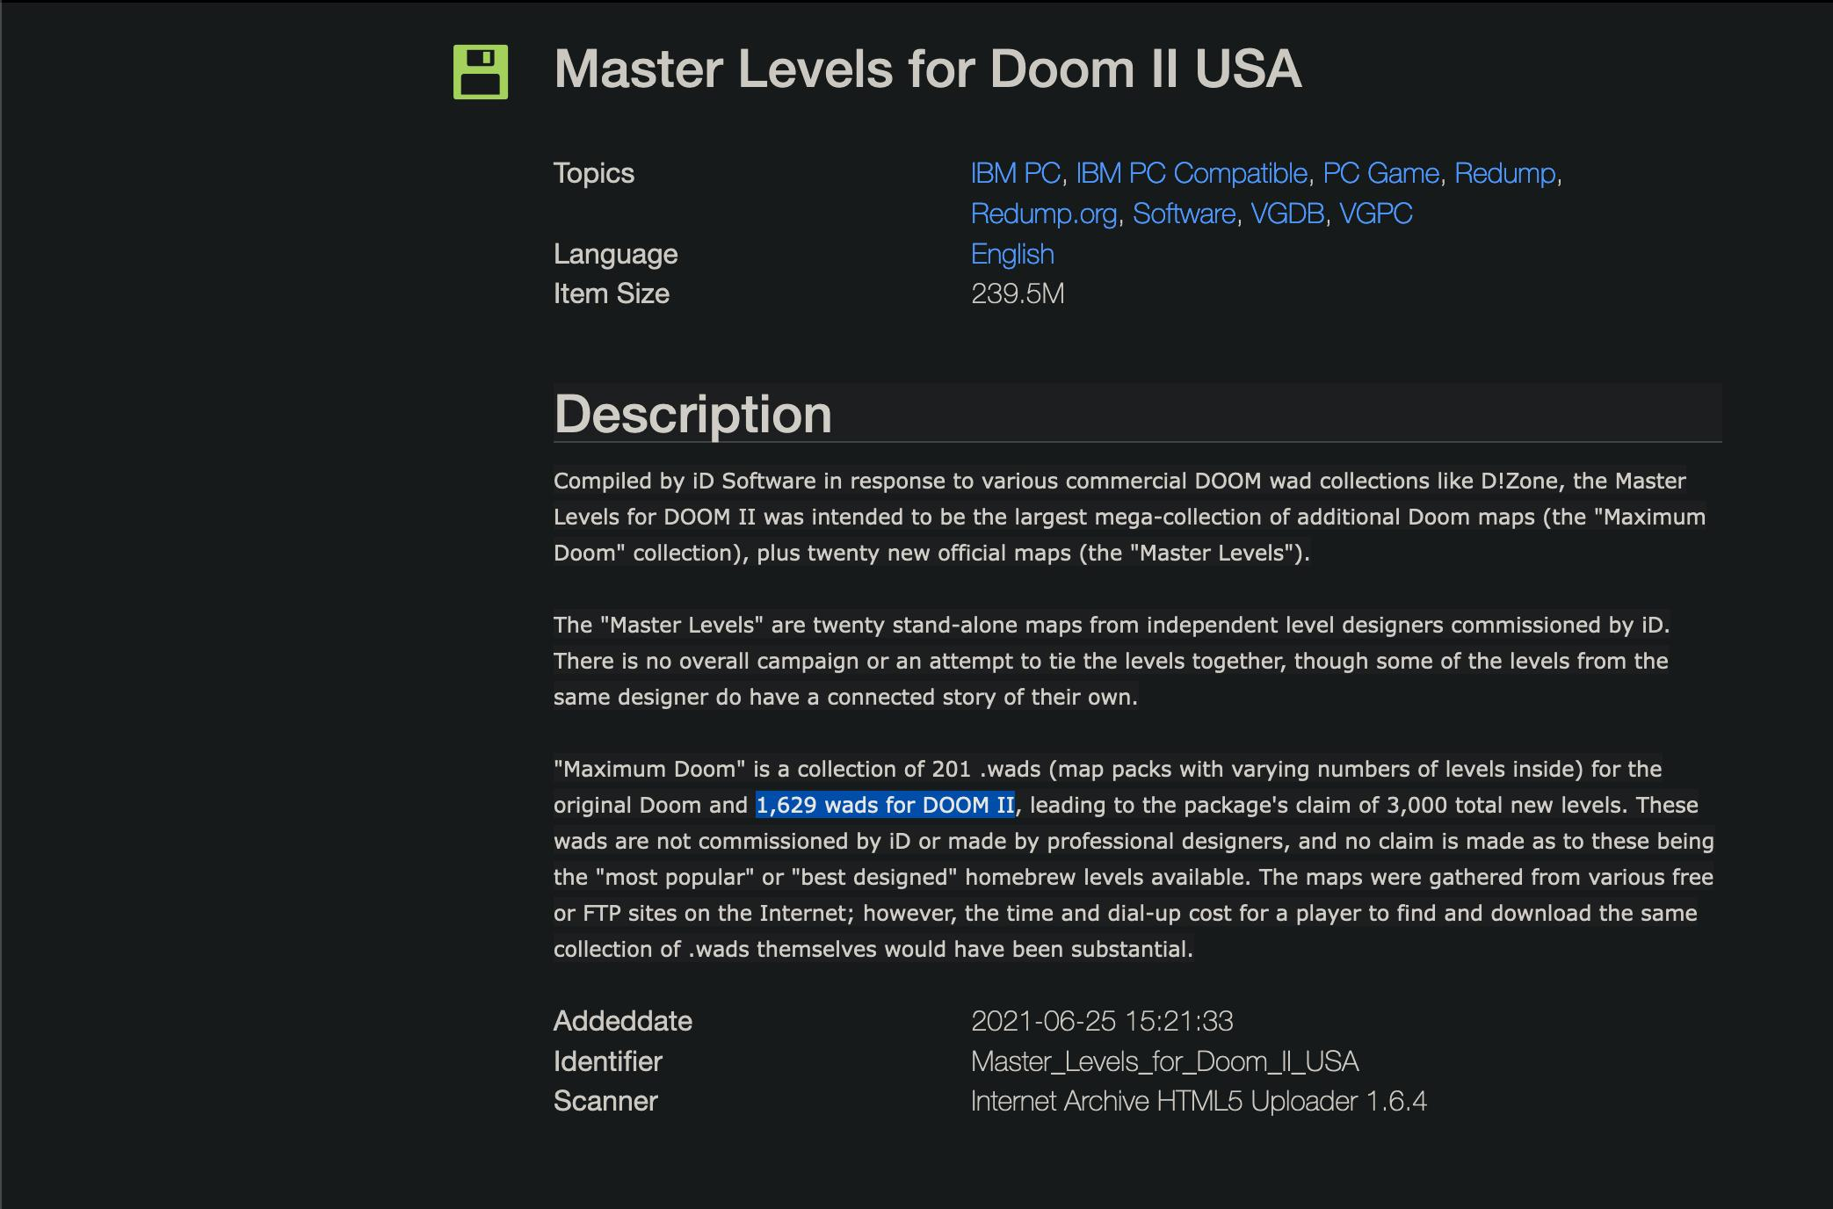
Levels (training data) are freely avail.

Slide 27
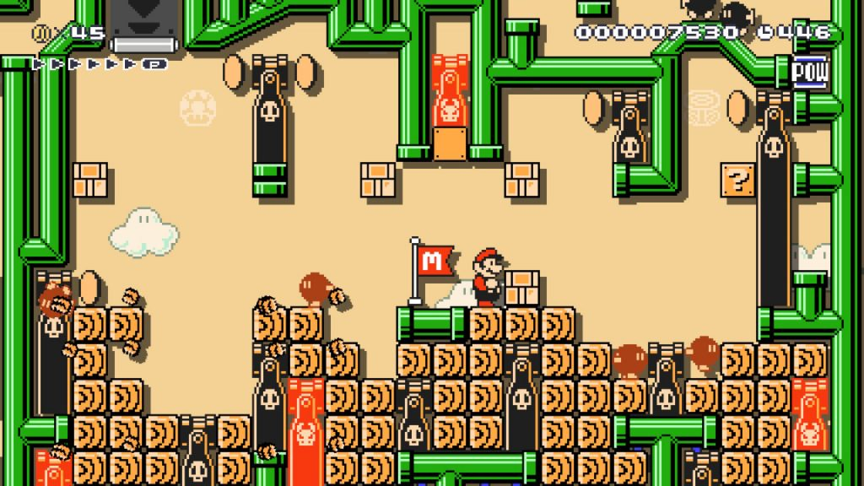
Mario Maker model
- Generate levels
- Have humans play them + rate
- Train on ratings
- Iterate

Slide 28
Takeaway….
- Pick the right tool for the job.
- We already have great tools in many domains
- Neural nets imitating (poorly) our great tools is not the way to go
- Instead use when creativity is desirable or tools are bad

