Slide 1
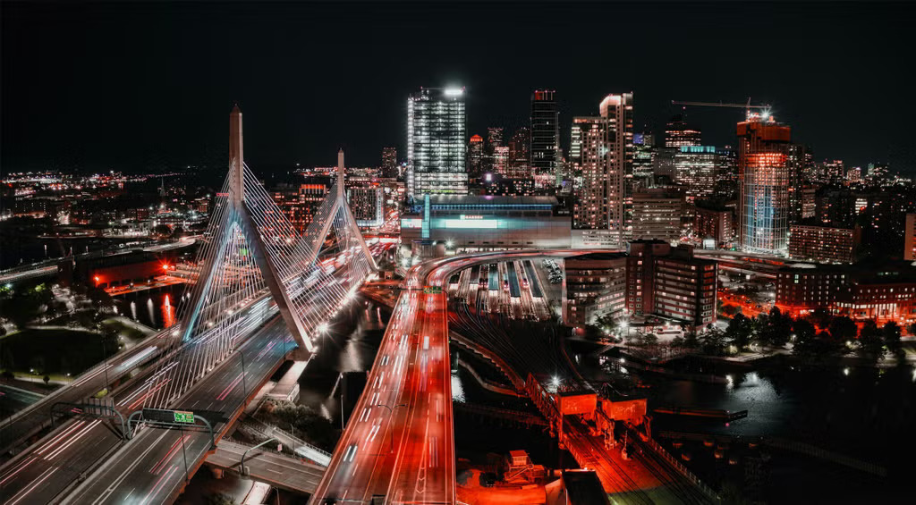
Boston AI/ML User Group Meeting
Jan 25, 2025

Slide 2
Agenda
Group overview
  Purpose:
    Place to discuss AI/ML at any level (newbie to PhD).
    Making connections with others.
10-15 minute talk
Networking (as long as you want or 8:30 😁)

Slide 3
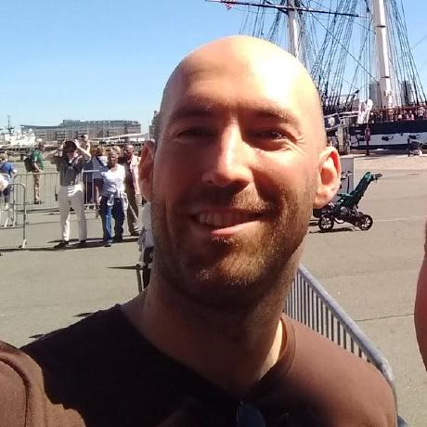
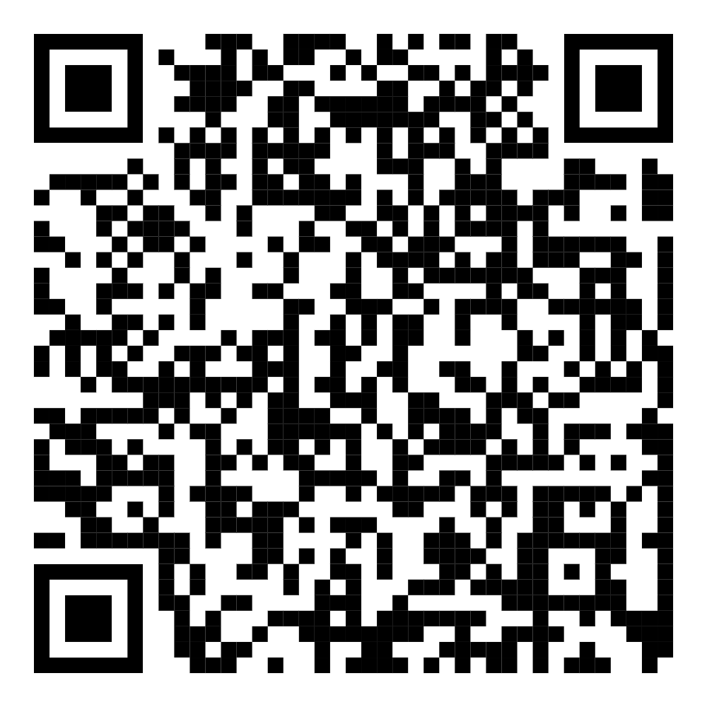
Who am I?
SW Dev
Interested in Gen AI
  Generally cool
  “When/will this take my job?”
LinkedIn
URL

Slide 4
Who are you?
Helps me to tailor the talk
Show of hands:
  Tech?
    Biz side?
    Devs?
    ML/Data Scientists?
    Years of experience?

Slide 5

Stop me at any time
If you have ?s, others probably do too
I’ll let you know if its too much

Slide 6
Self Hosting AI Model
(for Fun and Profit)

Slide 7
What is Self Hosting?
Running your own instance of some software
  Locally
  Cloud

Slide 8
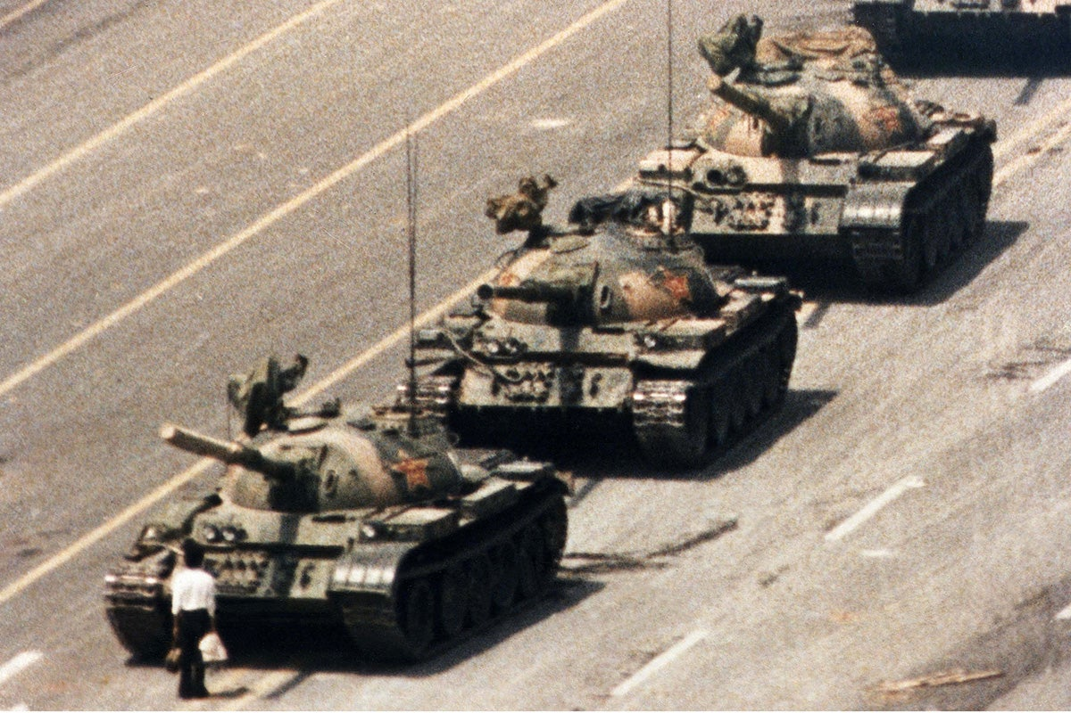
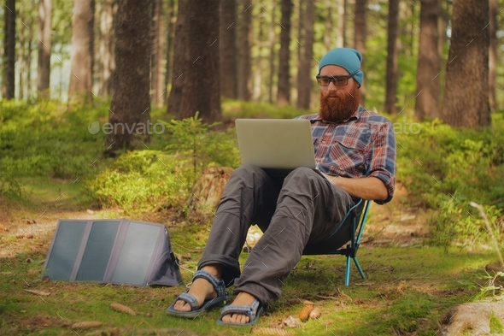
Why?
Freedom
  From censorship
    Sometimes you want to
    discuss things that aren’t
    polite conversation or
    are controversial)
  From needing an internet connection
Privacy
  Ex: Indexing personal journal.
Control
  You can interact, train, change behaviors, hack, etc. You own it vs renting it.
Cost savings?

Slide 9
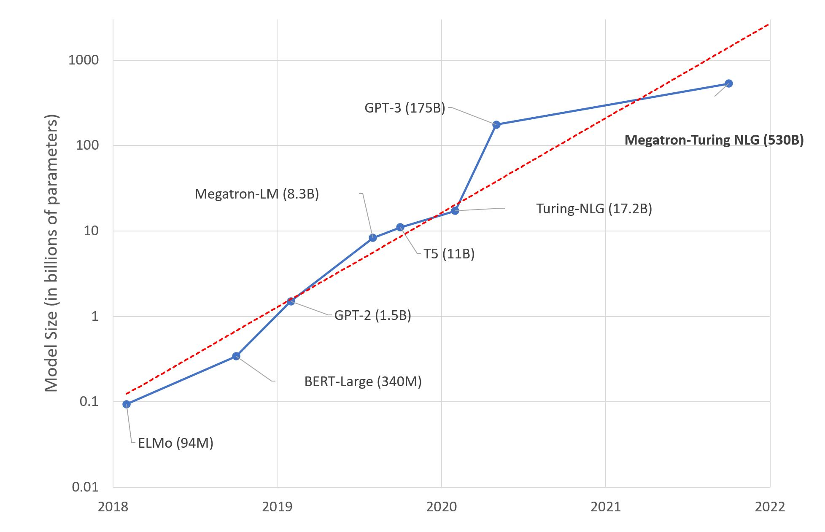
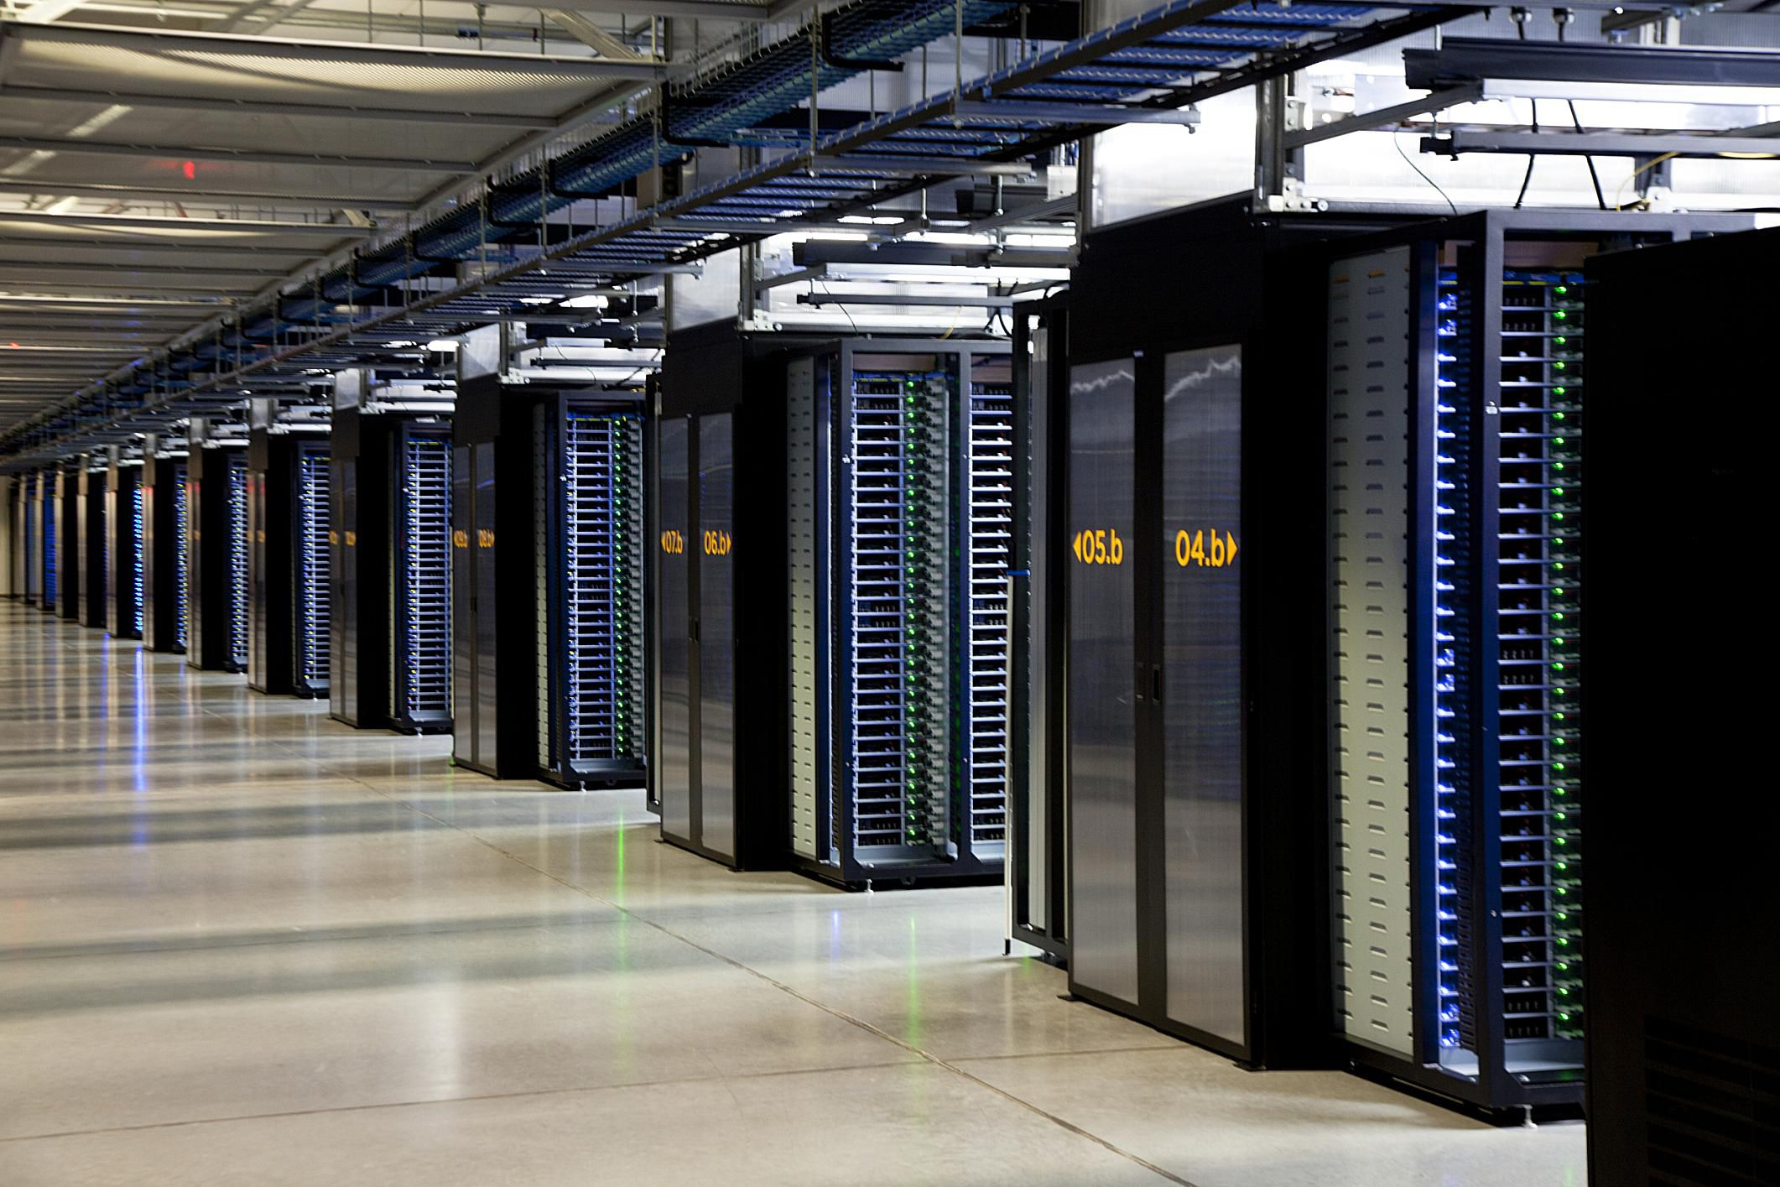
How?
Aren’t LLMs huge?

Slide 10
How do we measure Size?
Generally parameter count (aka # of weights)
Neural Nets are just a series of line segments
  More segments == more expressivity

Slide 11

How?
Smaller models are increasingly impressive
Enabled by:
  Getting better at training/
  designing Models
  Quantization
    Basically rounding
  Distillation
    Using a bigger/better model
    to train a smaller one
Sometimes good enough is

Slide 12
Quantization
Fancy term for rounding.
Sometimes we don’t need a lot of precision.
Shocking how well it works.
Analogy: Road trip mileage estimation
  Rough distance + MPG works.
  Don’t need to be accurate to the inch, foot, or even mile.

Slide 13
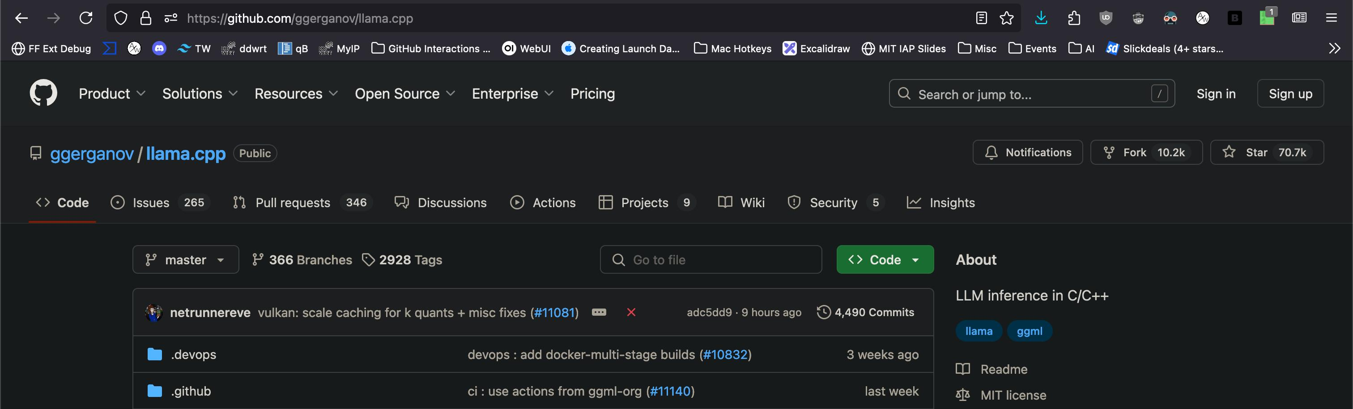
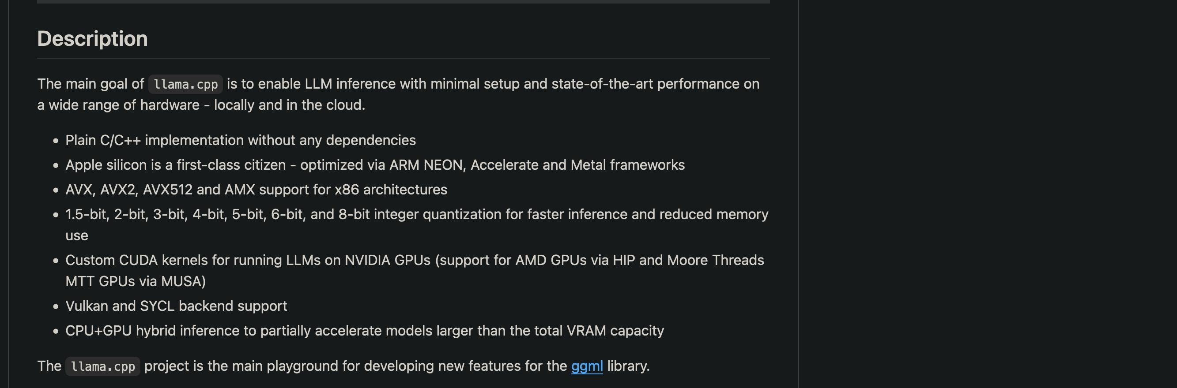
Enter llama.cpp

Slide 14
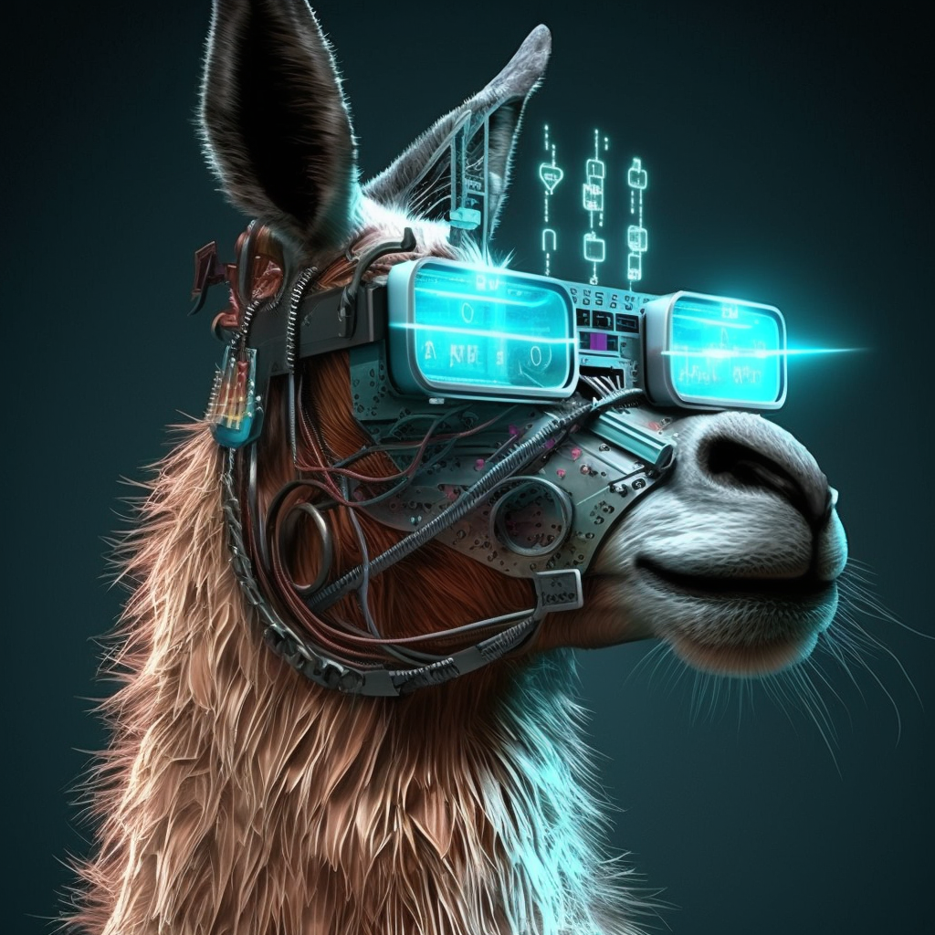

Why the Llama obsession?
LLM (Large Language Model) acronym fits into the word.
Nerds like puns and callbacks.
Alpaca (Stanford LLM)
Llama (Meta)
Ollama/llama.cpp

Slide 15
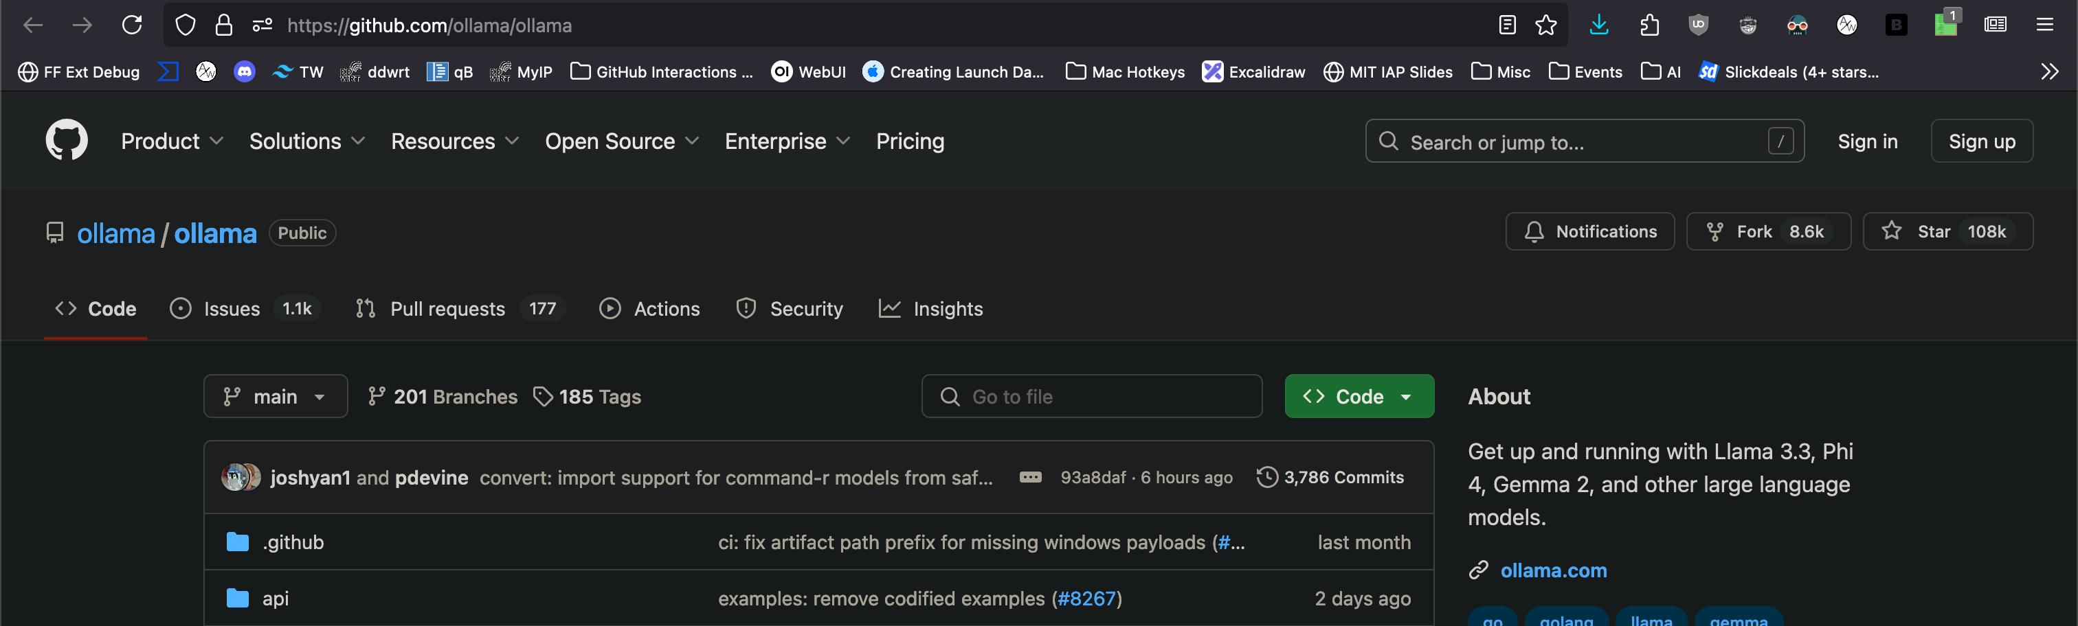
Enter Ollama
Nice packaging as a server.
Makes life easier.

Slide 16
Ollama usage
Install (https://ollama.com/download)
ollama ls
ollama pull <MODEL> (https://ollama.com/search)
ollama run <MODEL>
ollama ps
ollama serve + Firefox plugin

Slide 17
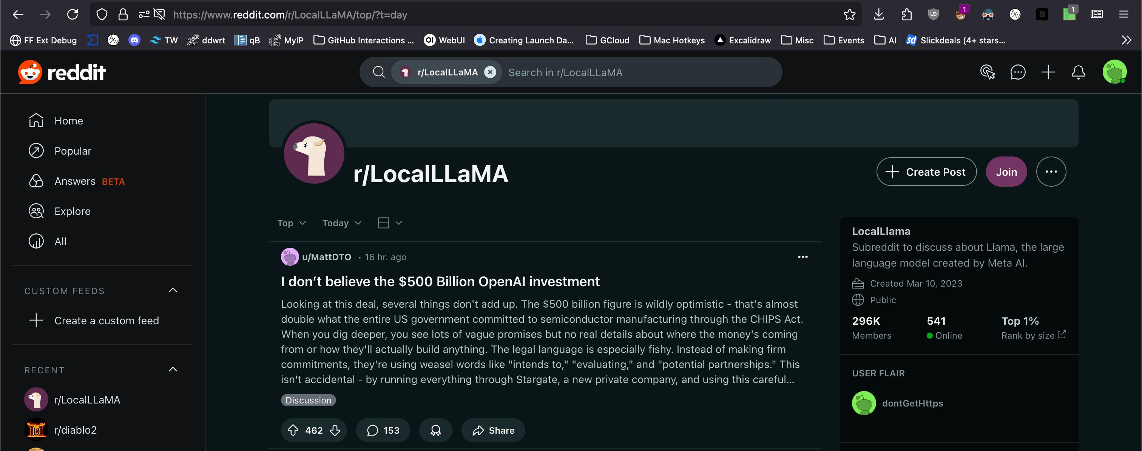
Resources

Slide 18
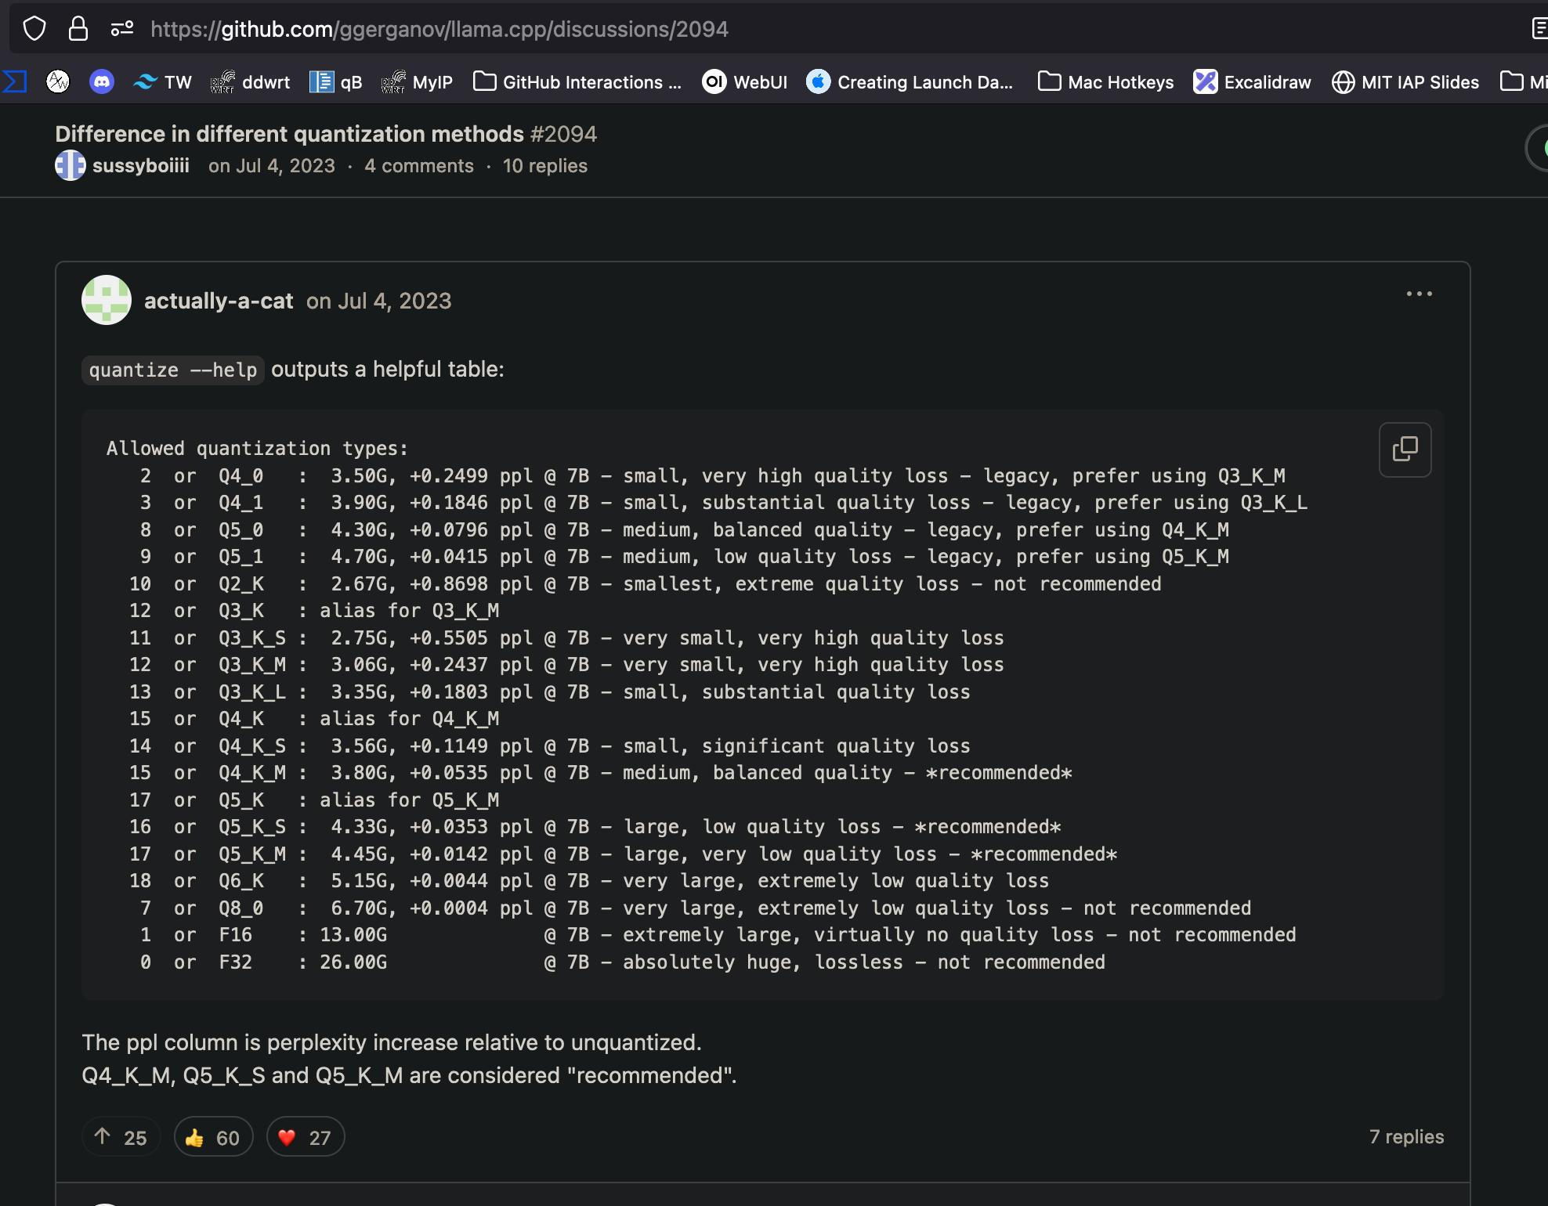
GitHub Issues

Slide 19
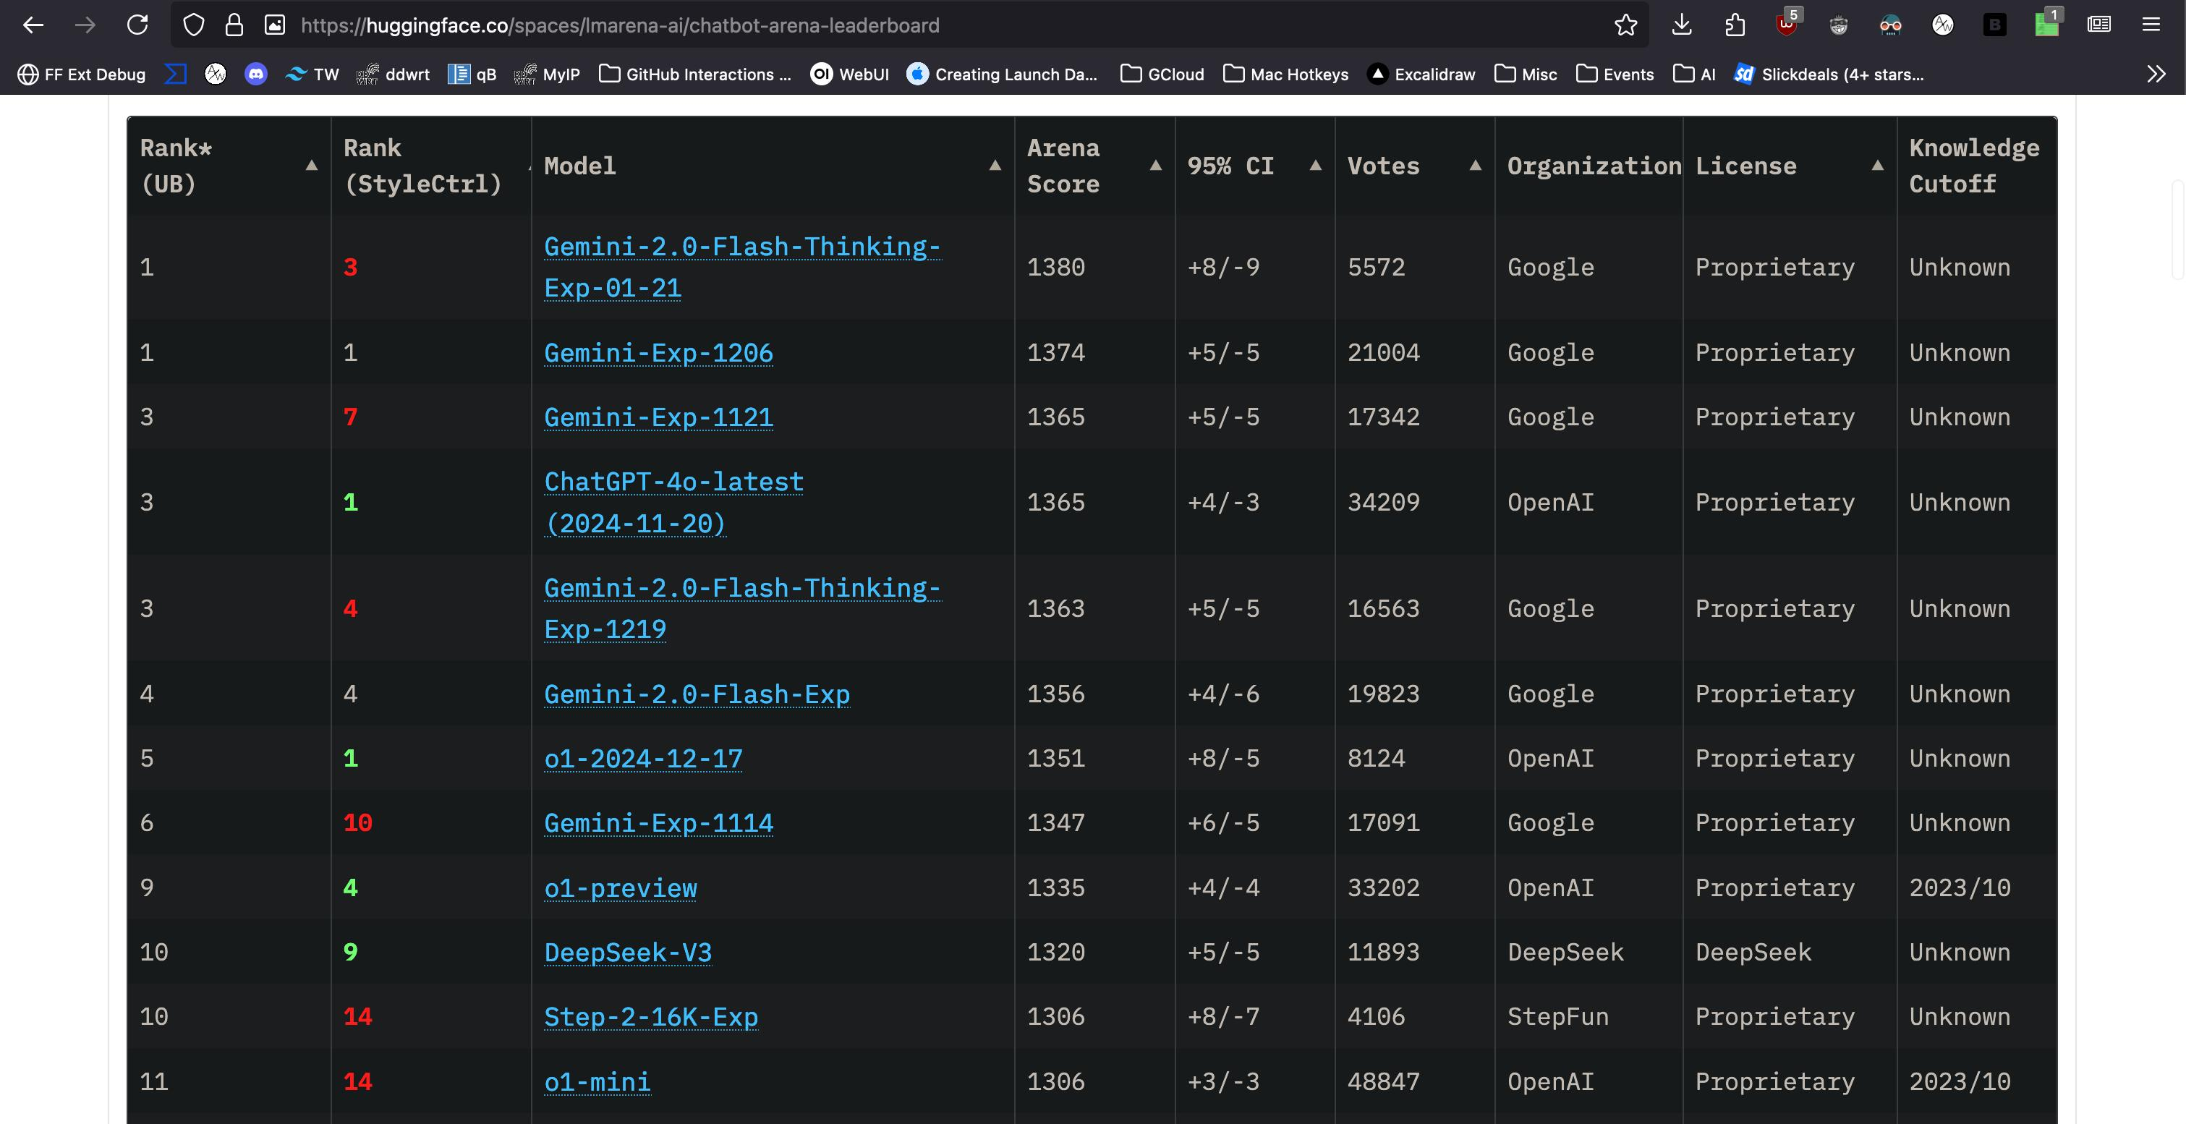
ChatBot Arena

Slide 20
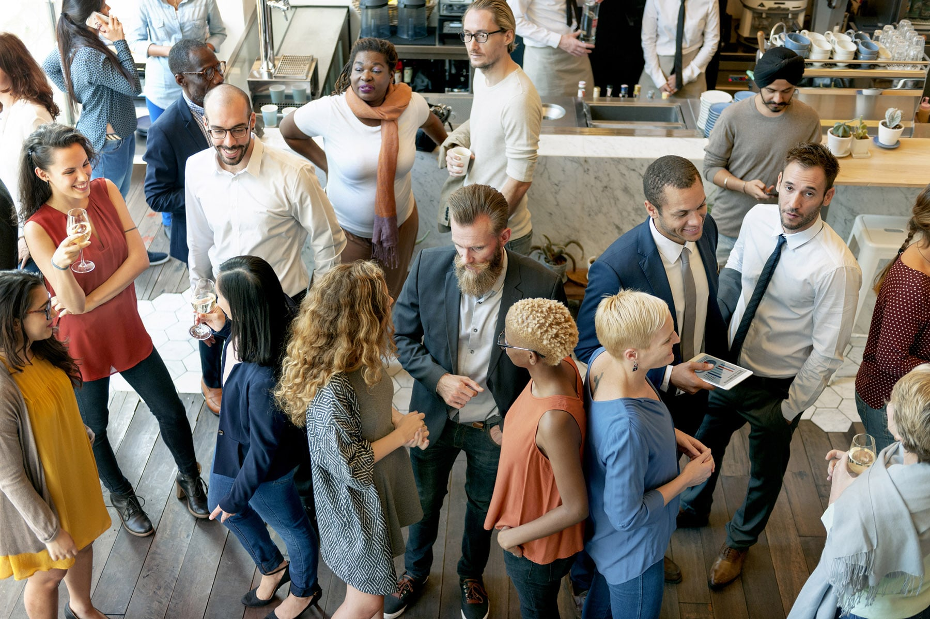
Networking time
Caveat for the below items
”If you’re comfortable”
  Trying to get food sponsor.
  Group picture would help
  me pitch to sponsors.
  Round the room intros:
    Who are you?
    AI interests?
    Looking for anything specific?
      Topic/subject?
      Collaborators?
      Study buddy?
      To hire for some role?
      Etc.

