Slide 1
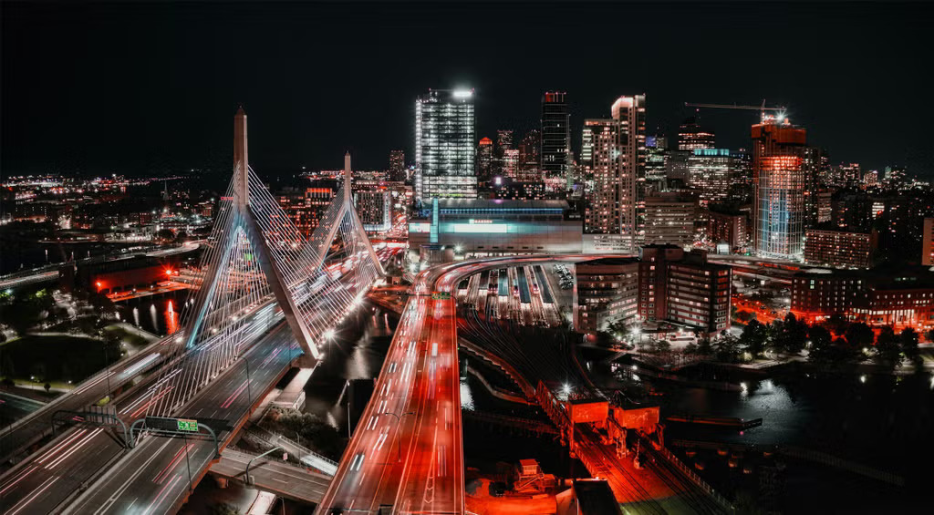
Boston AI/ML User Group

Slide 2




Slide 3
Agenda
Group overview
  Purpose:
    Place to discuss AI/ML at any level (newbie to PhD).
    Making connections with others.
Talk
Networking (as long as you want or 8:30 :) )

Slide 4
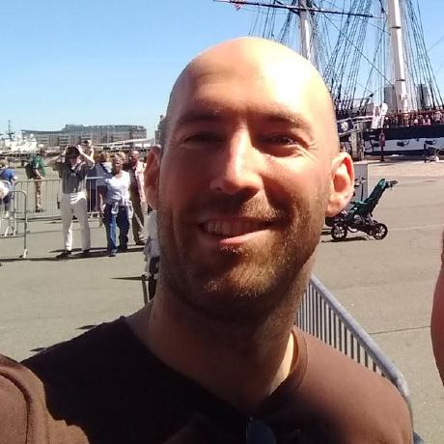
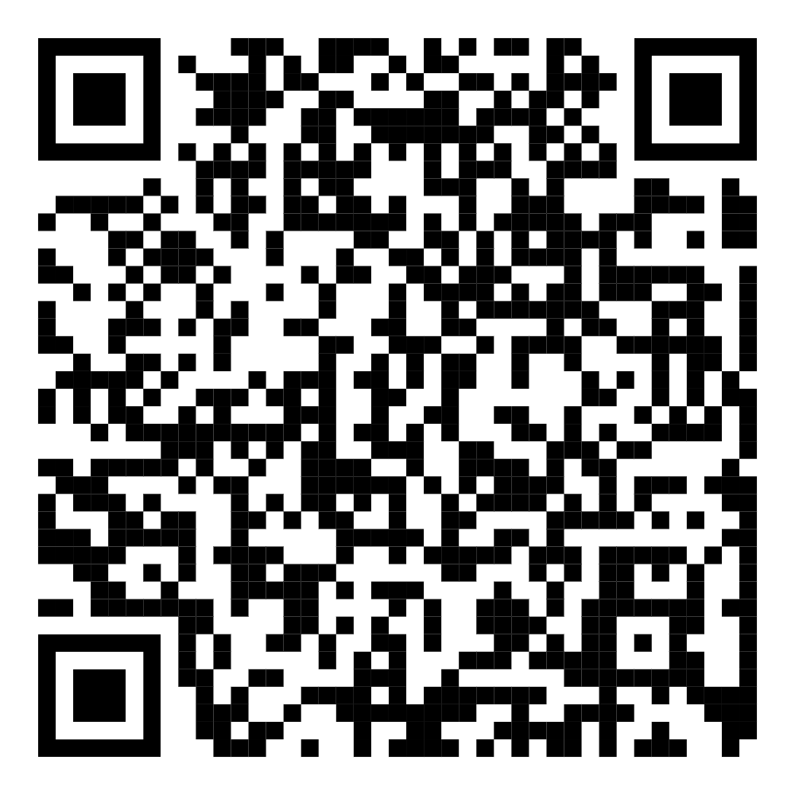
Who am I?
SW Dev
Rapid Prototyping at MIT-LL 2019-25
Rapidly failing startups 2025-?
Interested in Gen AI
  “When will this take my job?”
LinkedIn ===>

Slide 5
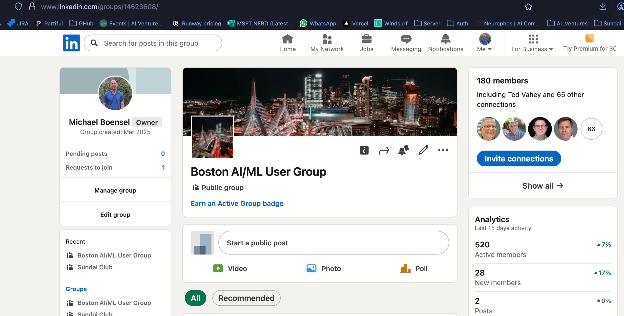
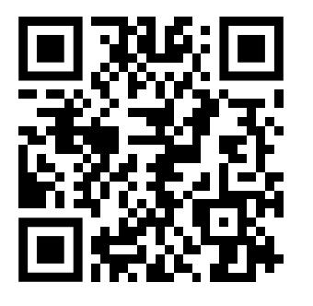
We’ve got a LinkedIn Group

Slide 6
Who are you?
(Remind me! Post talk)
Around the room
Rapid fire (<10 seconds)
Helps with discoverability for networking
Who you are + what are you looking for?

Slide 7
Katelyn is sick...
☹️

Slide 8
A practical assessment of the AI Landscape

Slide 9
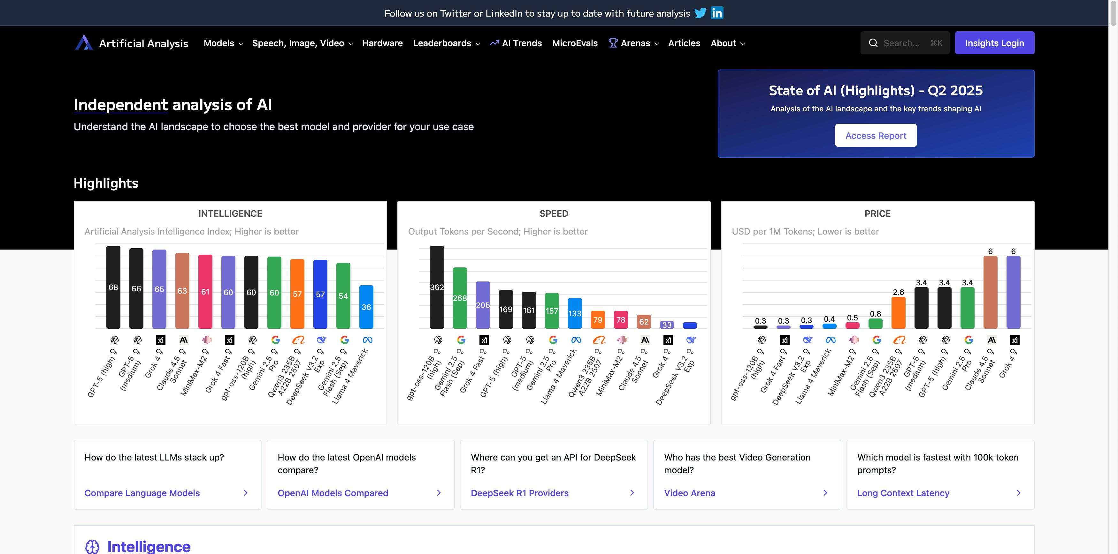
ArtificialAnalysis
Why?
  Huge, constantly shifting space.
  Need to have benchmarks
Model Walkthru
Model Provider Walkthru
Arenas

Slide 10
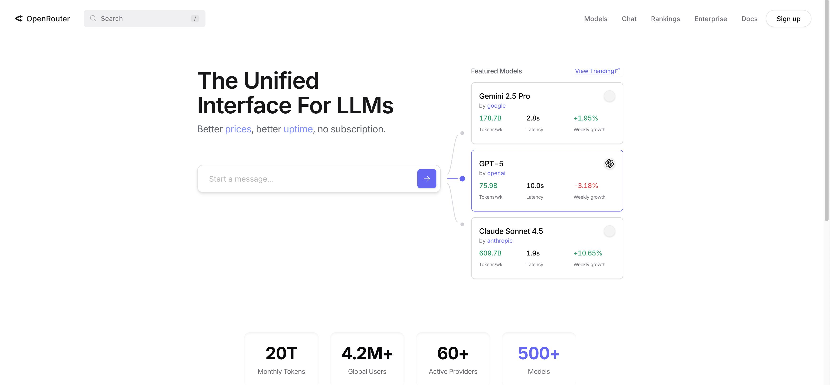
OpenRouter
Why?
  We know what’s “good”
  What’s actually being used
Why OpenRouter
  Meta layer
  Single billing point
  Fallbacks if a provider is down
  Routes to best available provider

Slide 11
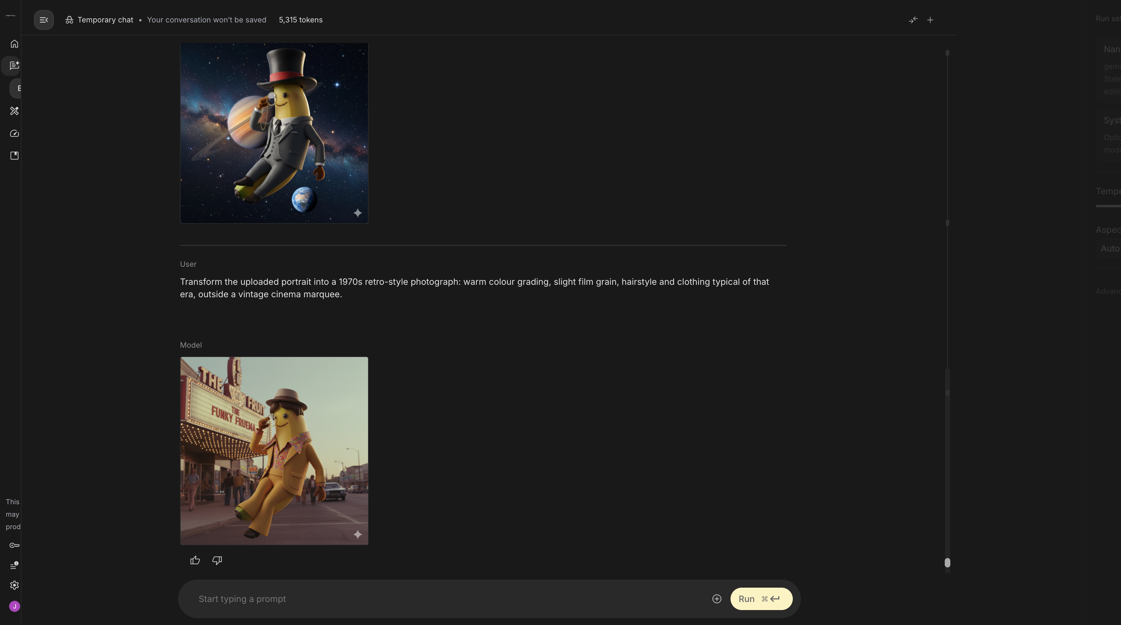
Nano Banana
Background
Style (GTA 5)
Clothing
Perspective
https://nanobanana.im/blog/30-best-nano-banana-prompts-2025
nanobanana-prompt.com

Slide 12
Questions?
Ask as we go please.

