Slide 1

Boston AI/ML User Group

Slide 2




Slide 3
Agenda
Group overview
  Purpose:
    Place to discuss AI/ML at any level (newbie to PhD).
    Making connections with others.
Talk
Networking (as long as you want or 8:30 :) )

Slide 4
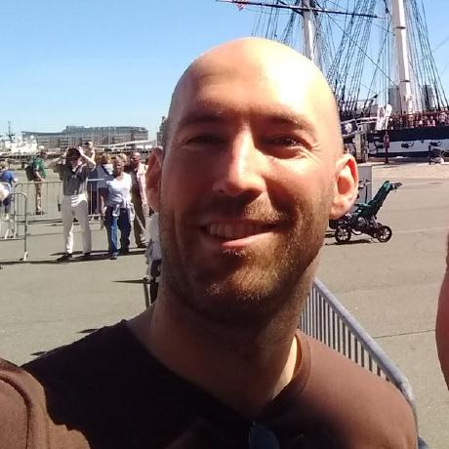
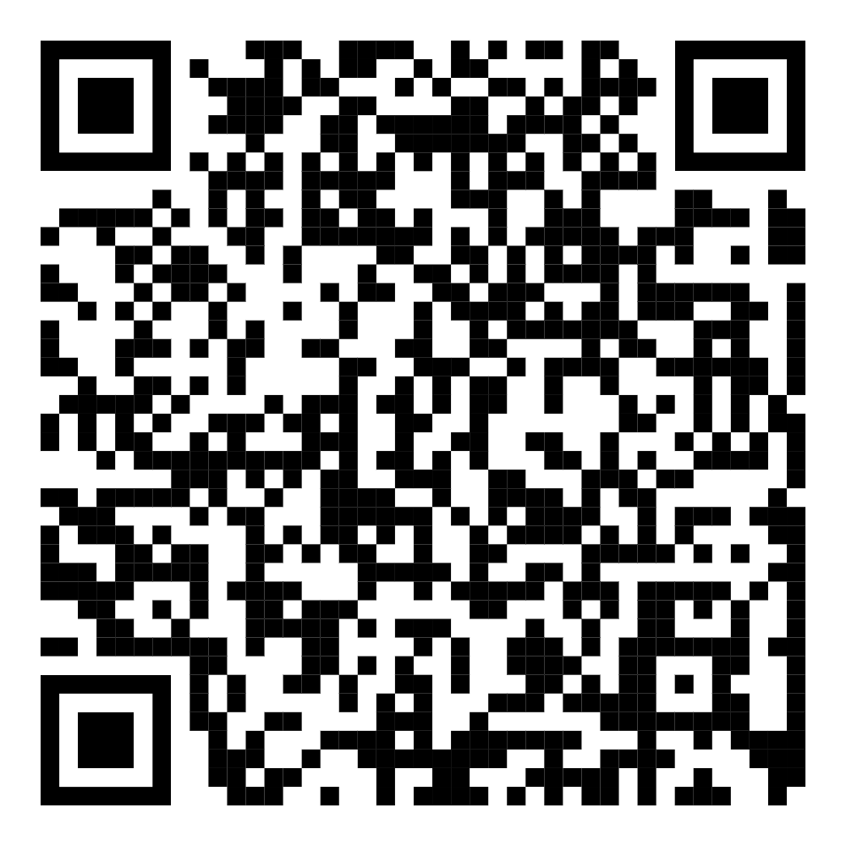
Who am I?
SW Dev
Rapid Prototyping at MIT-LL 2019-25
Rapidly failing startups 2025-?
LinkedIn ===>

Slide 5
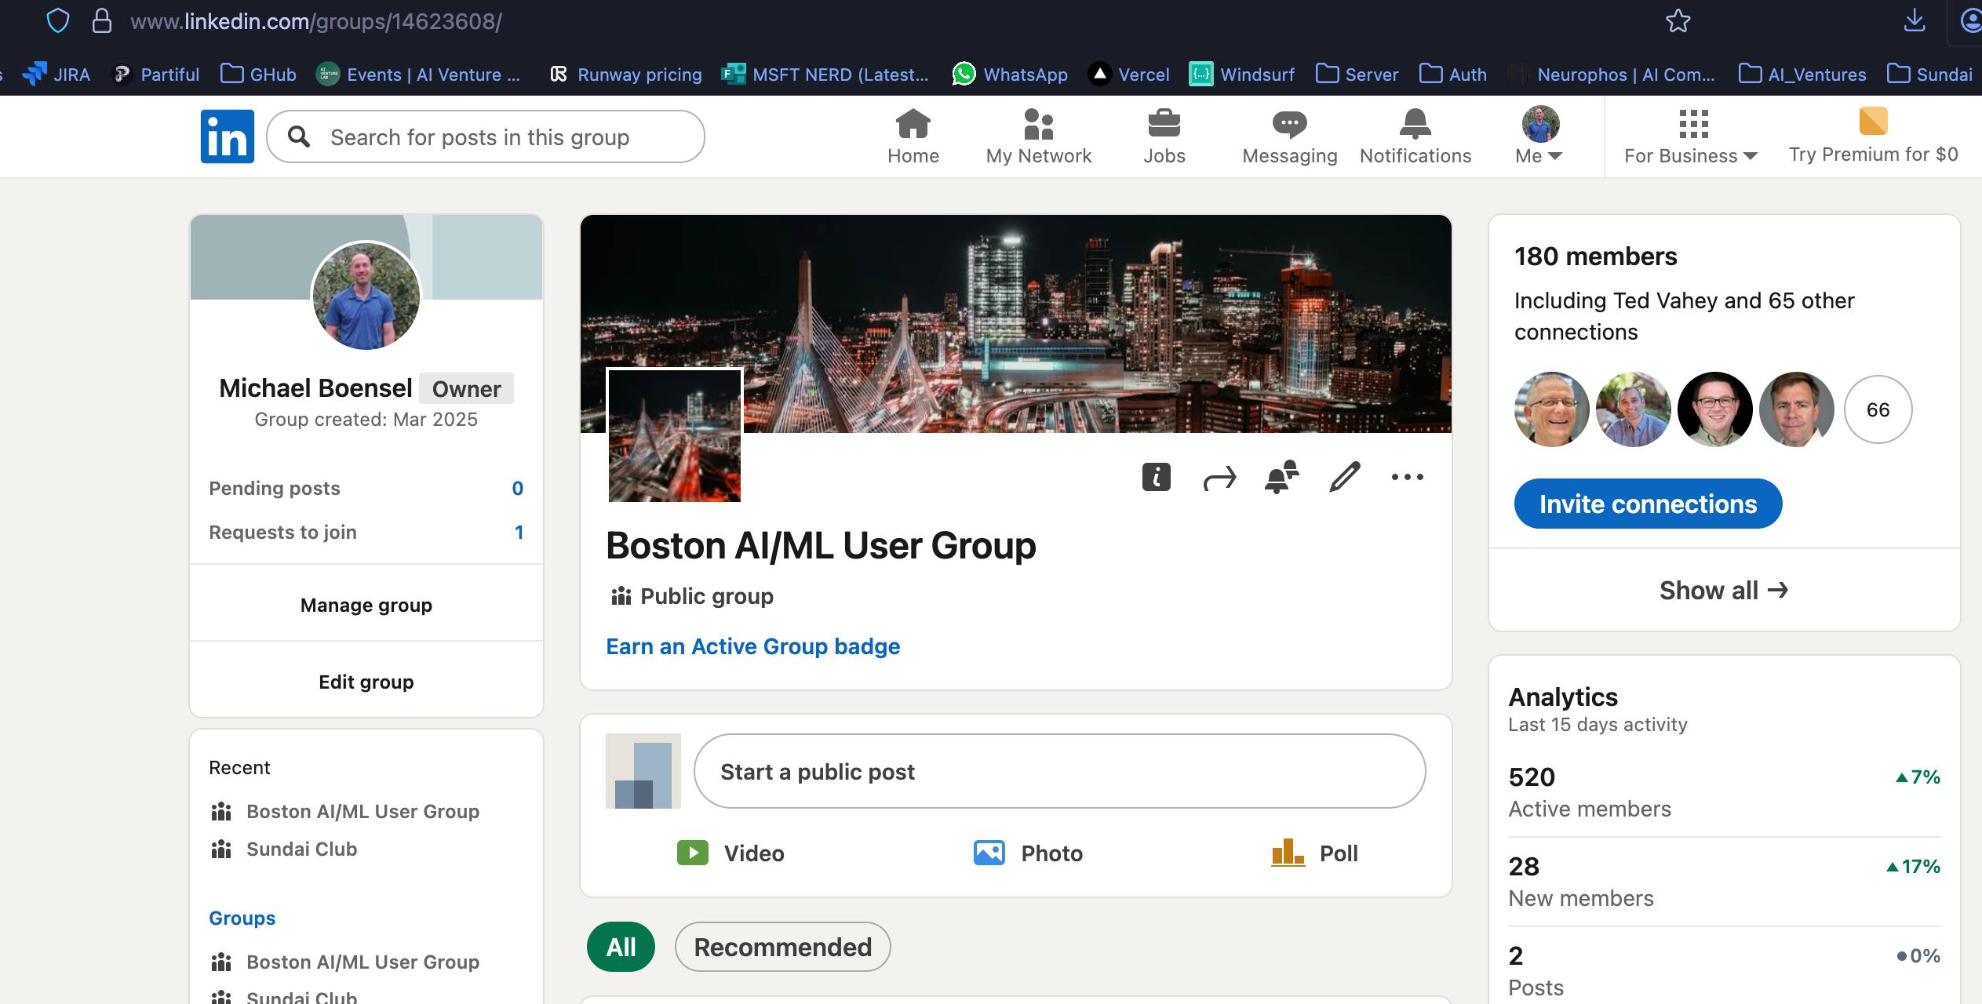
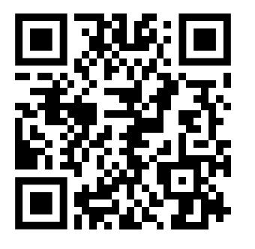
We’ve got a LinkedIn Group

Slide 6
Who are you?
(Remind me! Post talk)
Around the room
Rapid fire (<10 seconds)
Helps with discoverability for networking
Who you are + what are you looking for?

Slide 7
Jeff had an emergency...
☹️

Slide 8
Software Development in the Age of AI

Slide 9
AI or Die
AI Assistance (or full on Agentic Development) are table stakes now
  Massive potential speedups
  Many pitfalls
Baselining the audience
  Programming?
  Comfortable with code?
  Using AI?
  If so, what?

Slide 10

Today we’re going to use Cursor
IDE
Going to develop a “idea voting app”

Slide 11
Topics to cover
Basic interface overview
  Panes, NextJS dev server, prompting, etc.
“Whispering”
  Spoken word is much faster than typing
Change review (Diffs)
  Or vibe code for as long as you can
Git as a safety net
Cleaning things up as we go

Slide 12
Questions?
Ask as we go please.
I’m probably going to assume way too much and gloss over important info.

