Slide 1

Boston AI/ML User Group Meeting
April 2, 2025

Slide 2
Let’s start Demo’ing immediately
Video description anyone?
  Subject
  Action
  Style
  Etc.
Should take ~5 minutes

Slide 3

What are we doing today?
Exploring what’s possible

Slide 4

What are we doing today? (2)
Speedrunning thru some slides (will be posted), getting to demo’ing ASAP

Slide 5
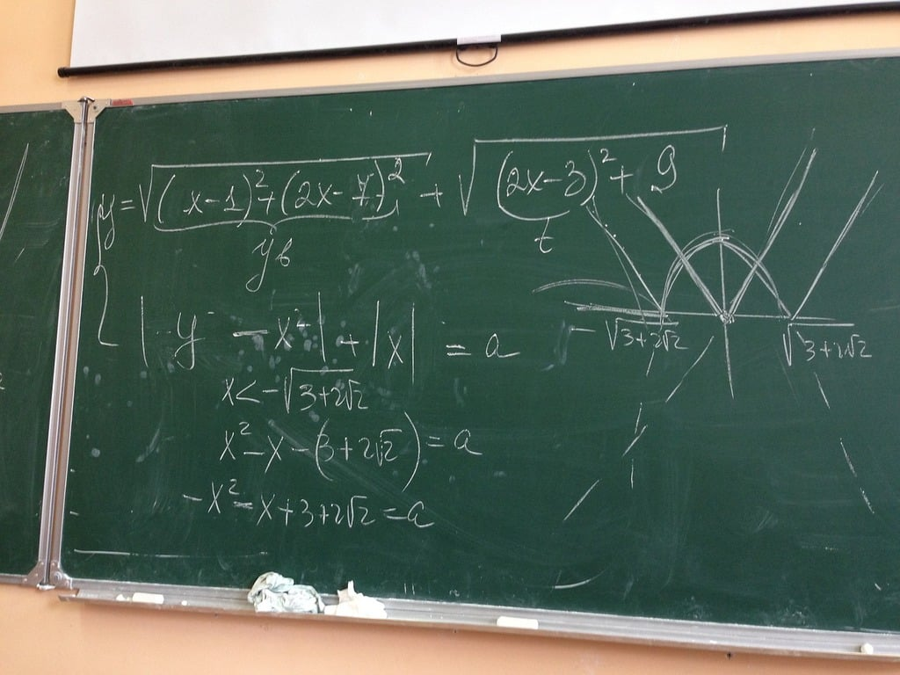
What aren’t we doing?
Any theory (touching on too many models to do any justice)

Slide 6


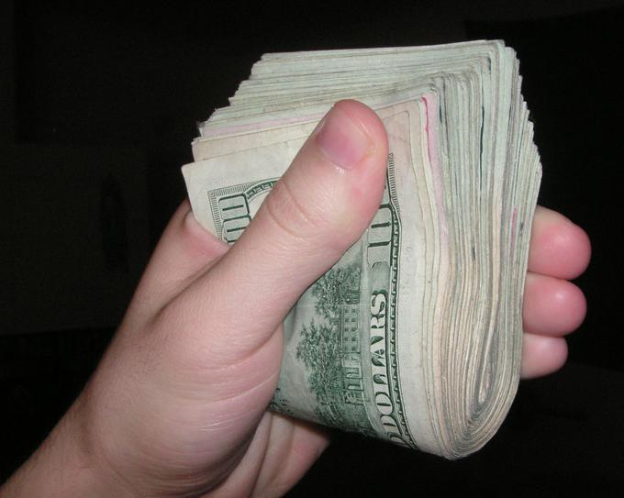
Why self-host?
Freedom
  From censorship
    Taboo or impolite subjects shouldn’t be
    banned
Privacy
  Ex: Indexing personal journal.
Cost savings (maybe)?

Slide 7
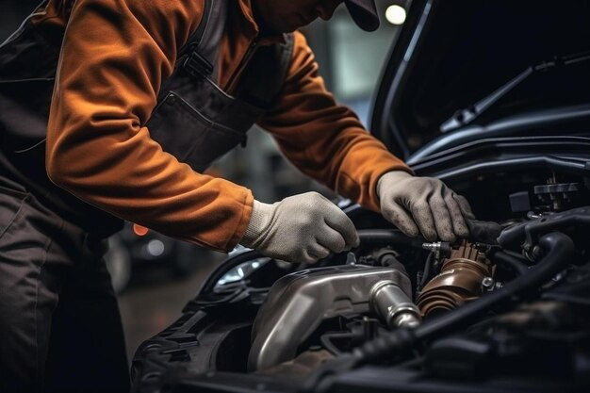

Why self-host?
Ability to tinker
  Train
  Change behaviors
  Hack
  Debug
Fun/Pride
  Owning vs renting

Slide 8

How?
Smaller models are increasingly impressive
Enabled by:
  Getting better at training/
  designing Models
  Quantization
    Basically rounding
  Distillation
    Using a bigger/better model
    to train a smaller one
Sometimes good enough is

Slide 9

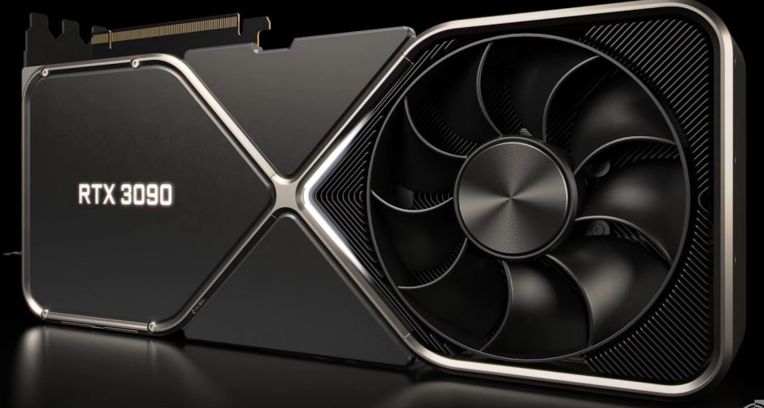
Our setup for demoing
SSH’ing into a box at home
Hardware
  Ryzen 3600 (released in 2019)
  Nvidia 3090 (beefy, but released in 2020)
  64 GB of RAM
Software
  Ubuntu
  ComfyUI

Slide 10


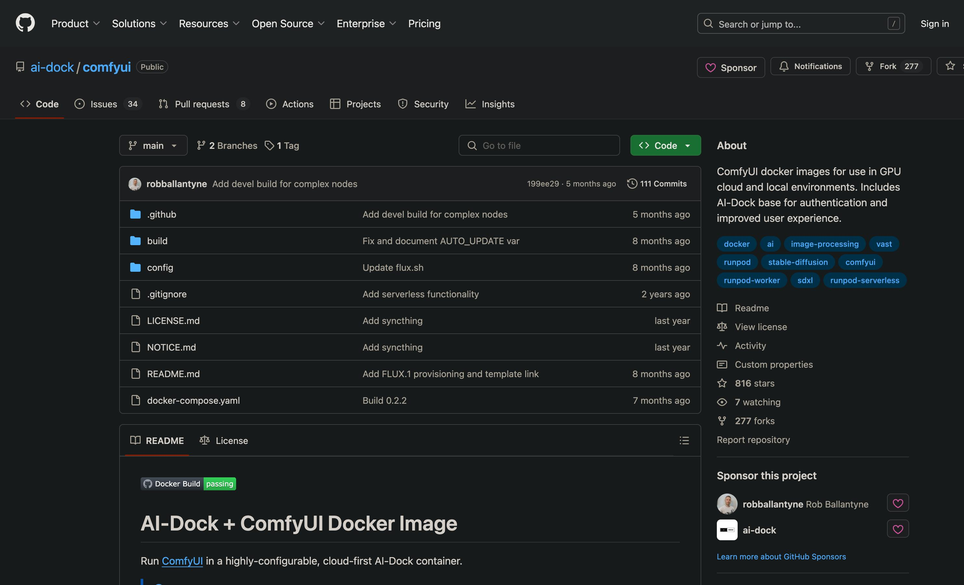
Don’t have to have physical HW
Easy enough to rent on the cloud
  Many compute providers
  SSH to get to your setup
Docker images
help w/ setup

Slide 11
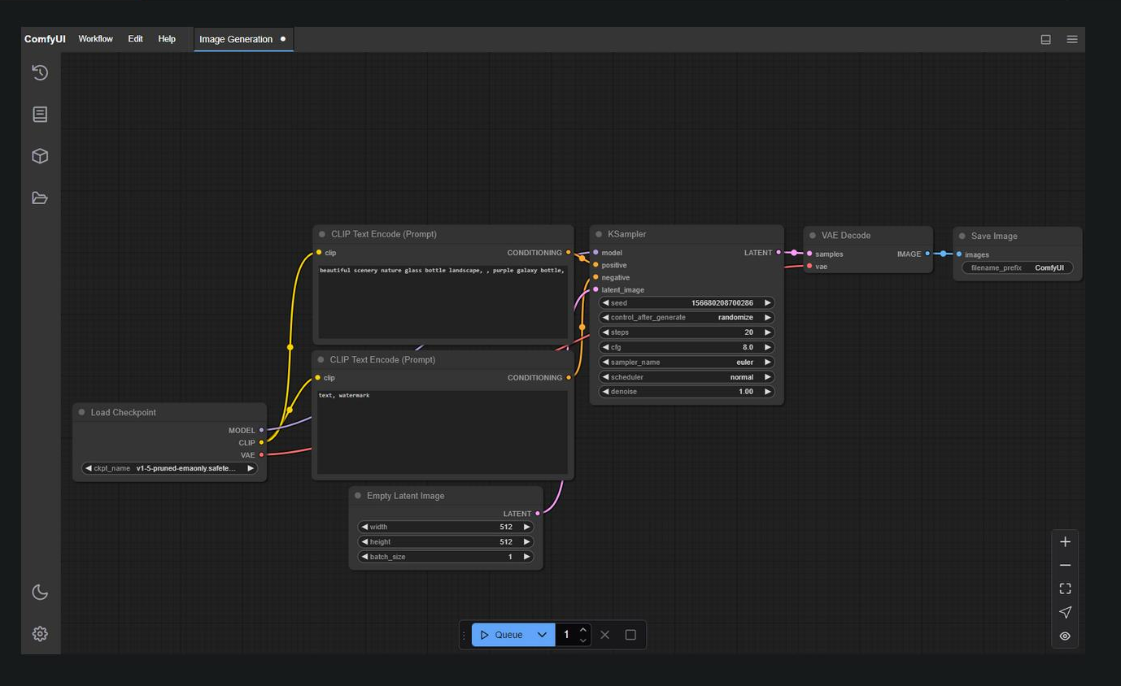
ComfyUI

Slide 12
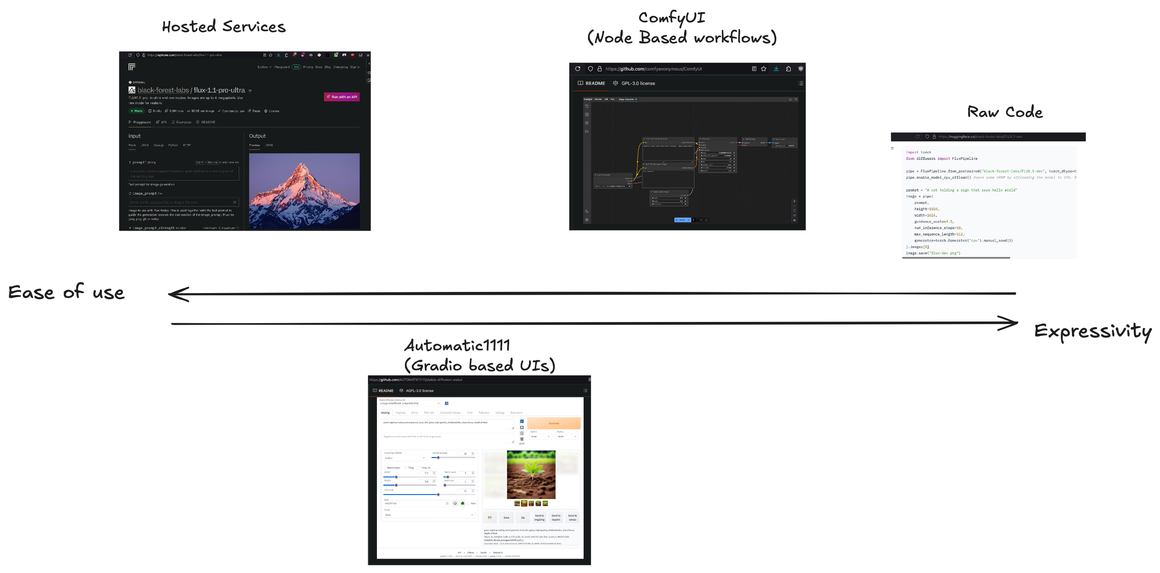
Why not just use code?
Spectrum of options

Slide 13
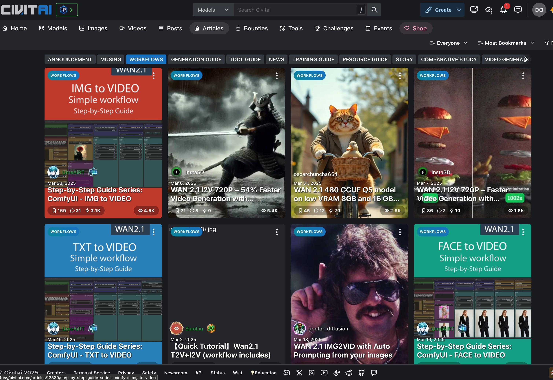
Why ComfyUI?
Nice abstraction from Code
Composable Nodes
Community
  Rapidly gets support for new Models/paradigms
  Has outlasted many other Frontends
  Workflows
    JSON file
    Can be embedded into generated artifact’s metadata

Slide 14
Workflows
Answers the fundamental question:
  How’d he do that?!?
    Prompt/Settings
    Overall composition
https://github.com/nerdyrodent/AVeryComfyNerd/blob/main/workflows/SD15/Reposer2.png
Exiftool

Slide 15
Some quick Image Gen review

Slide 16
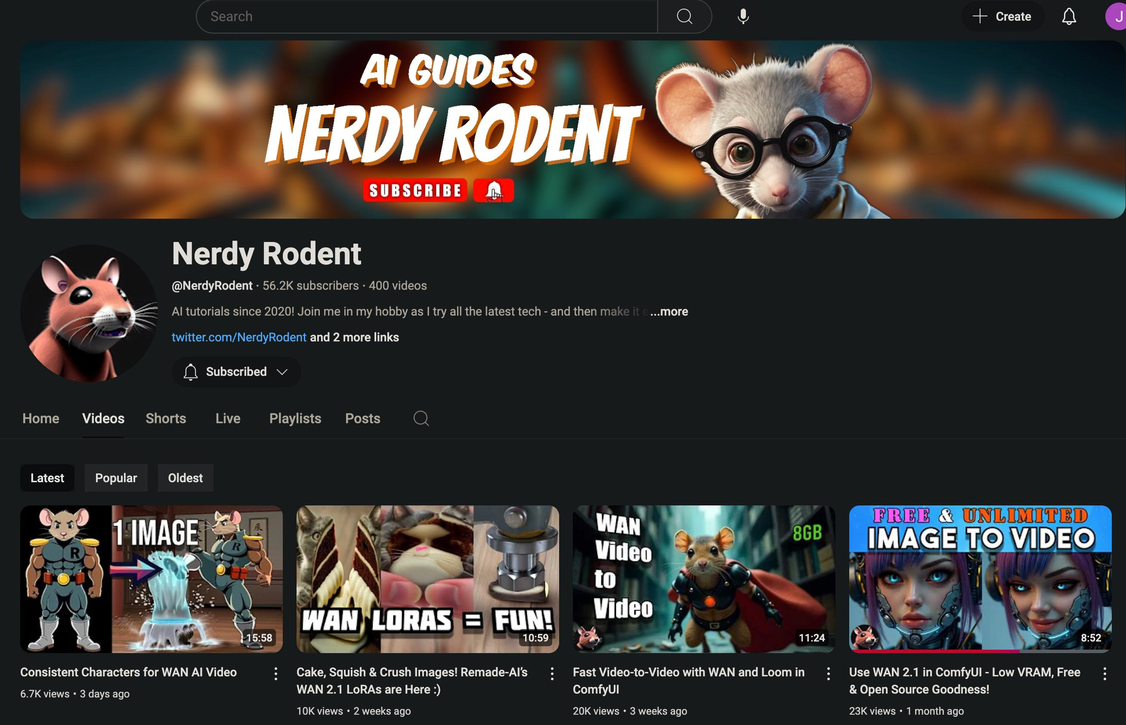
Resources
https://www.youtube.com/@NerdyRodent/videos
https://civitai.com/articles?view=feed&tags=127048
https://www.reddit.com/r/StableDiffusion/top/
https://comfyui-wiki.com/en

Slide 17


Questions?
LinkedIn URL

