Slide 1
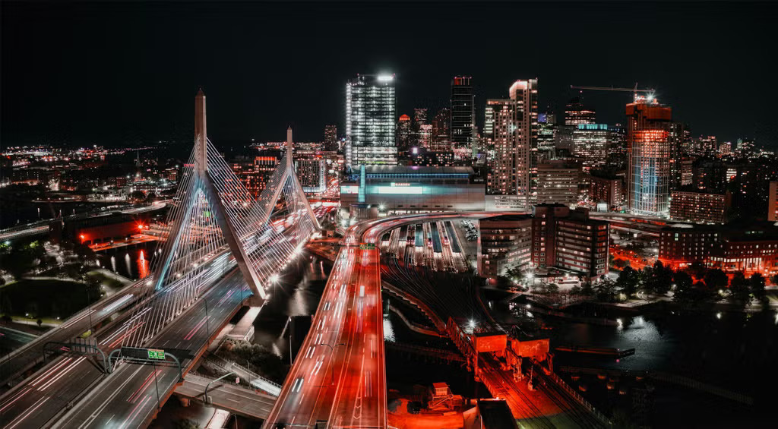
Boston AI/ML User Group Meeting
May 14, 2025

Slide 2
Agenda
6:30pm - Intro
6:35pm - Peter’s RL Talk
7:35pm - Networking
8:30pm - End of event

