Slide 1
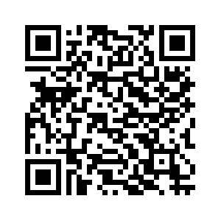

Who Am I?
SW Dev at Lincoln Labs
Views expressed not endorsed by employer
LinkedIn

Slide 2
Talk Goals
What can be done?
- Exploring useful things, getting broad exposure
Getting people started (or doing more)
Not going to focus on theory, any of the moral issues present (there are a lot, specifically around artists), etc.
- Easy breezy

Slide 3
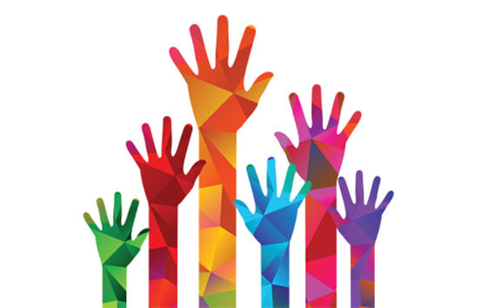
Show of hands
Who’s using Generative AI?
ChatGPT?
Gemini?
Copilot?
Playing with custom Models?

Slide 4

Going to see lots of ChatGPT
Not an endorsement, certainly not the only way
Pluses:
+ Beginner friendly (free tier gives you most of what you will see, no HW required)
+ Multi-modal
+ Quick way to demo things
+ Very good Models
Minuses:
- Lacking in dials/knobs, but good defaults
- Subject to arbitrary policies

Slide 5
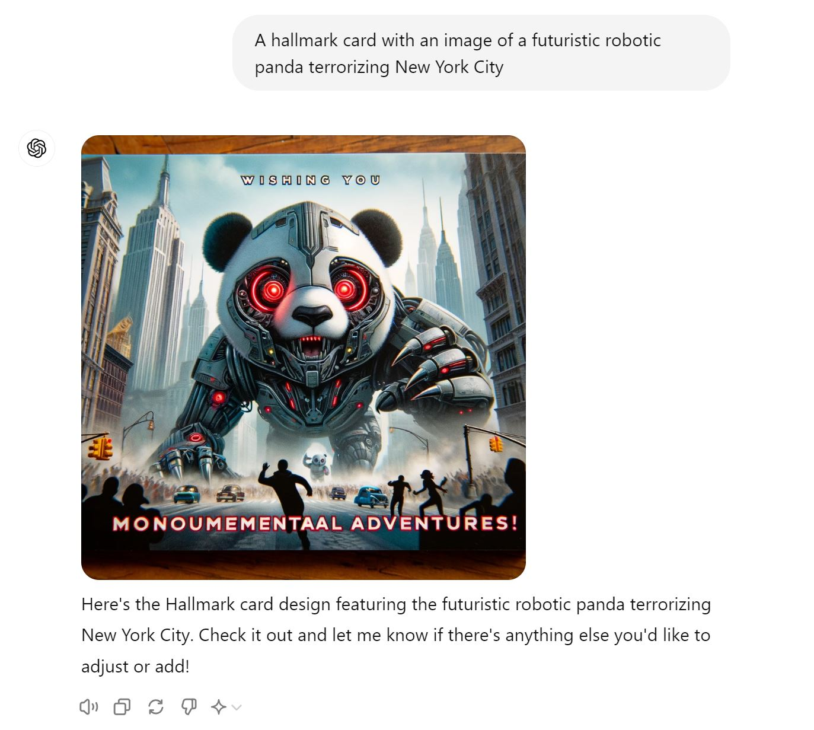
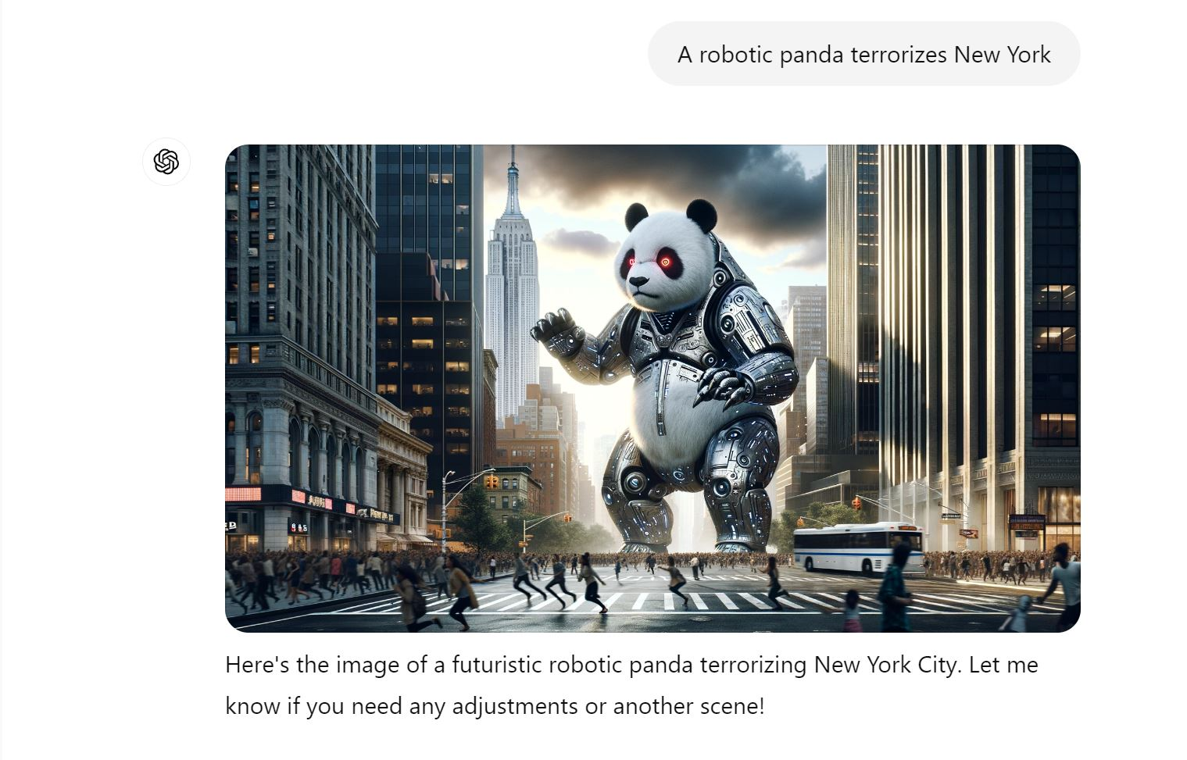
Image Generation

Slide 6
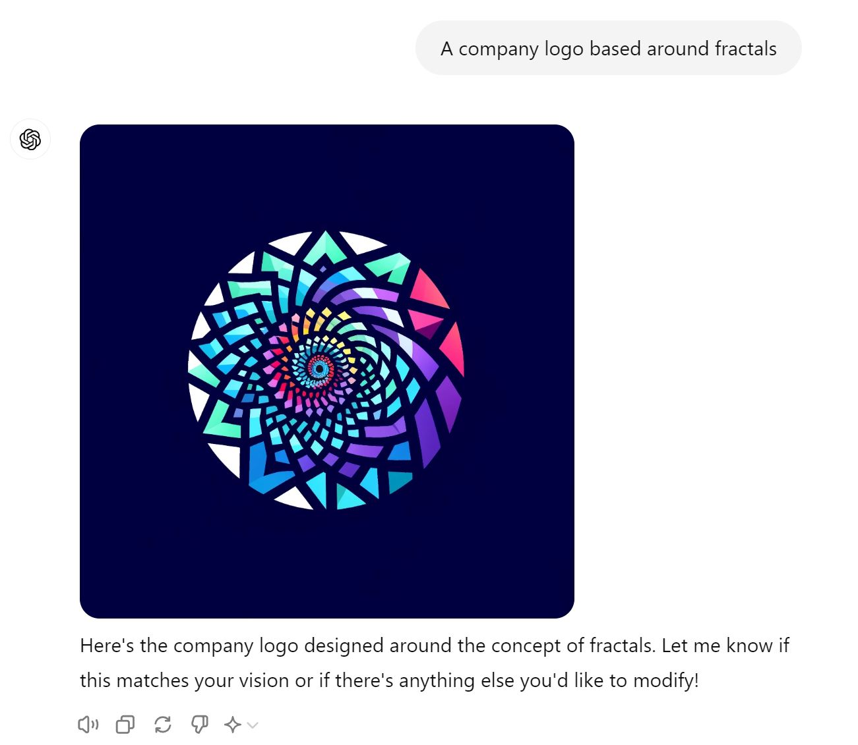
Image Generation

Slide 7
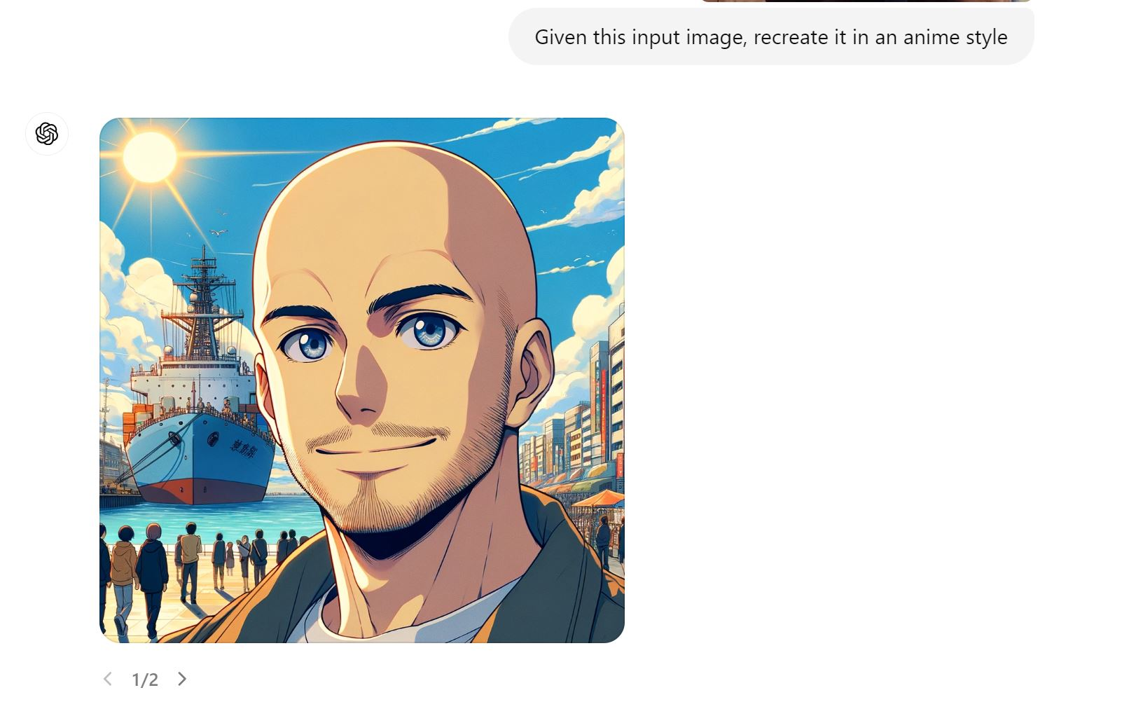
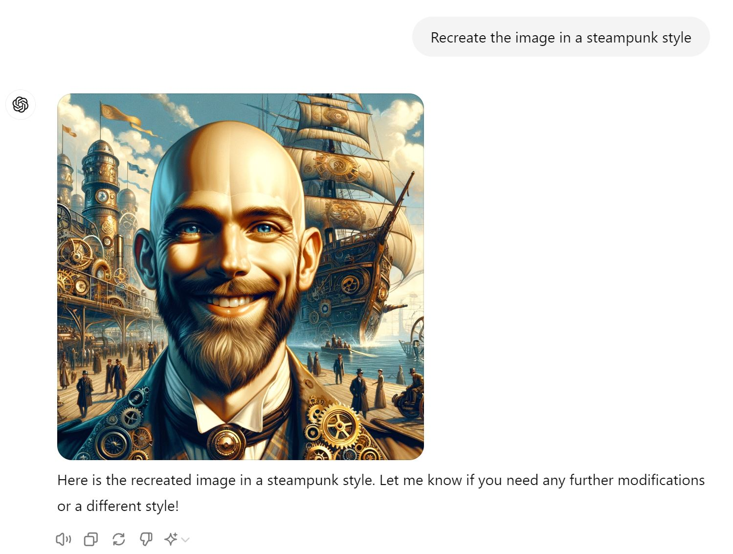
Image Remixing
=>
Some fidelity missing, not a ton of options,
but not bad!

Slide 8
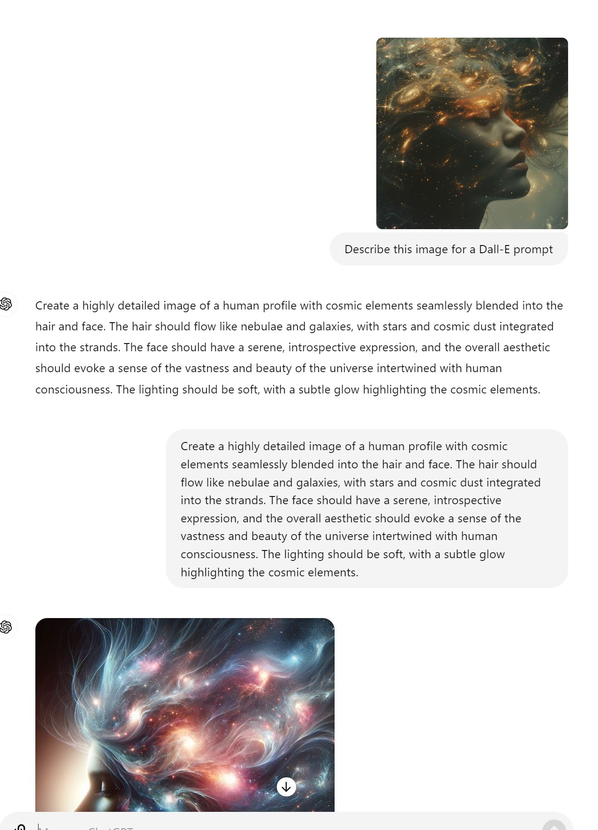
Finding inspiration
Midjourney Gallery
Artist Cheatsheets
Style Cheatsheets

Slide 9
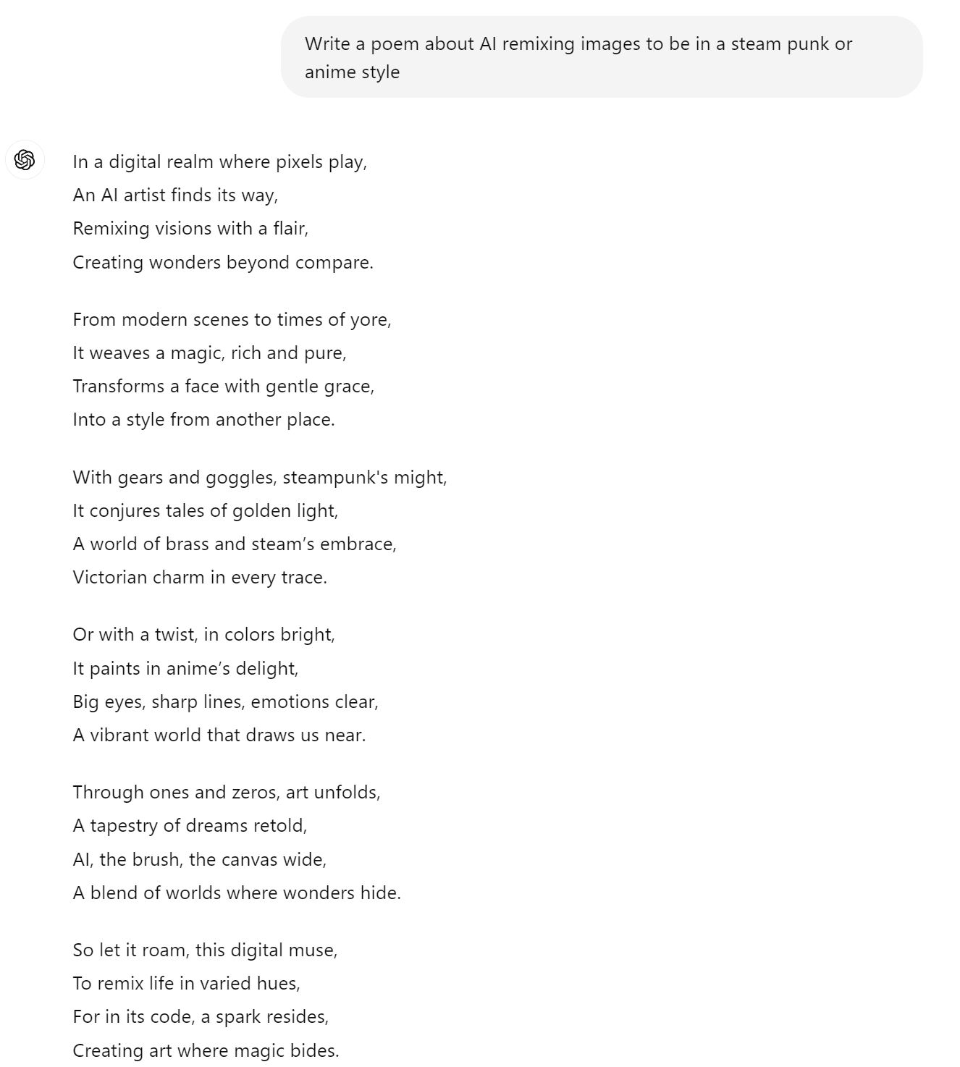
General Text fun

Slide 10
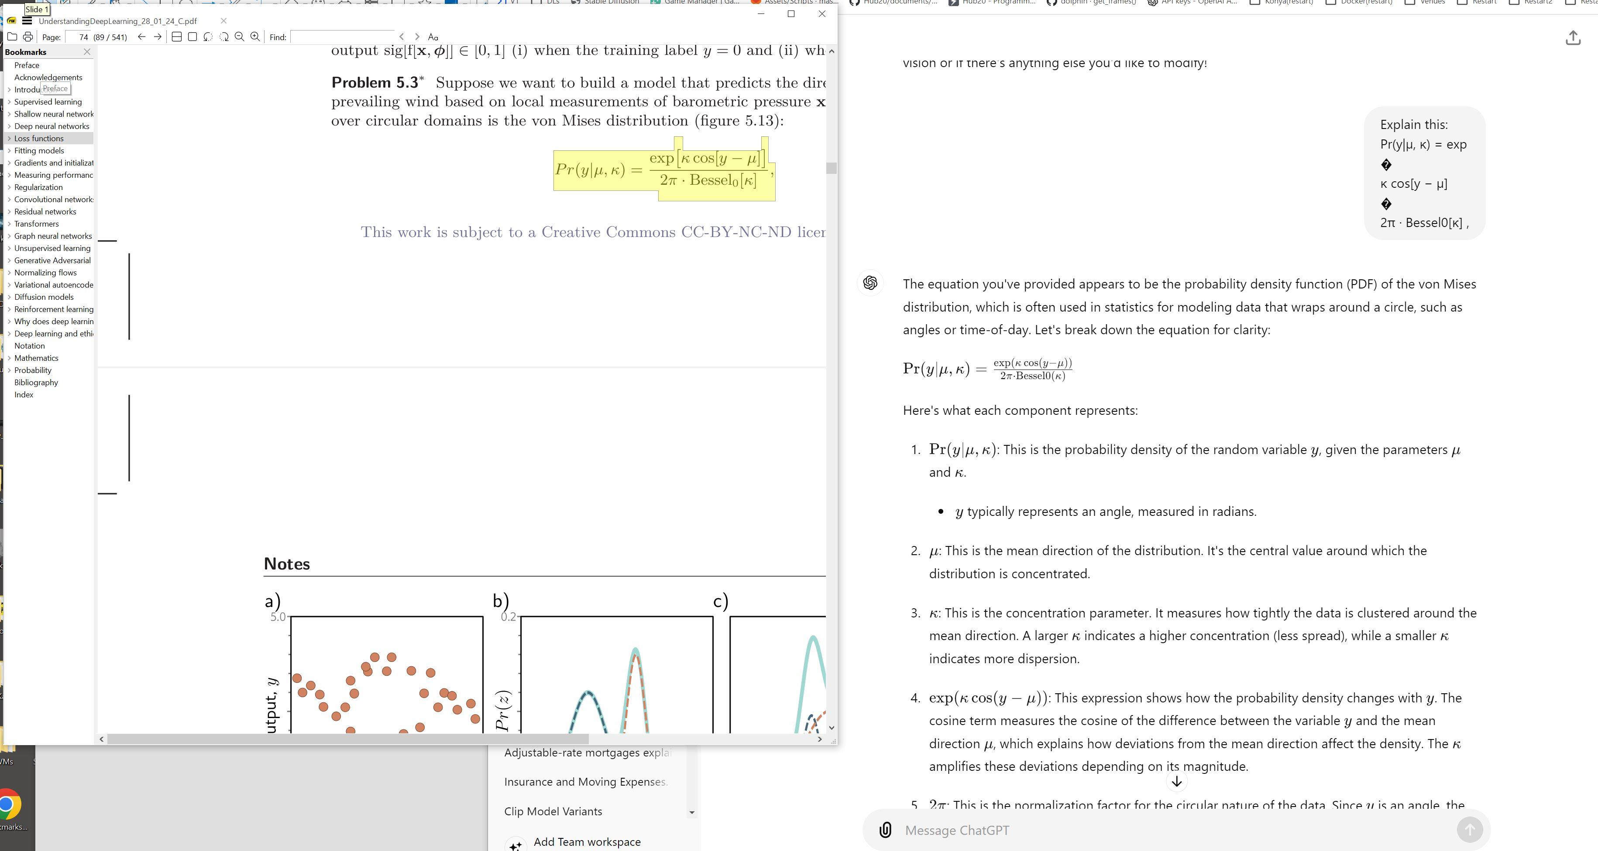
Explain this concept...

Slide 11
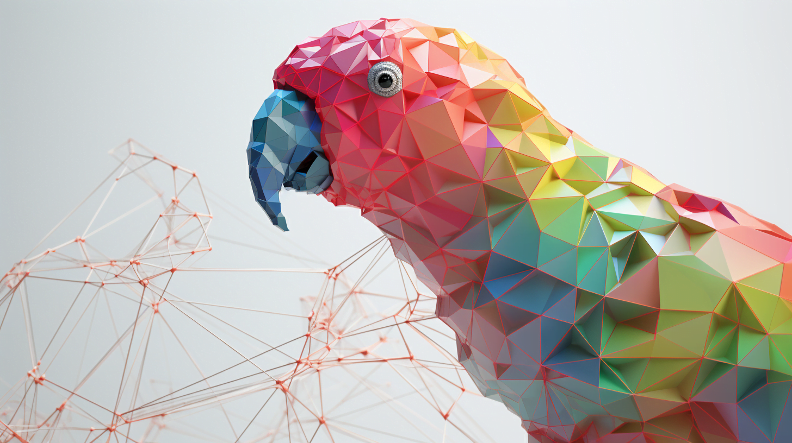
Parrots and Hallucinations
View it like any other source
- Have to establish a track record with
- Should be very cautious if you know nothing about a given subject
- Incorporate other sources
- Consider the potential harms if wrong and act accordingly

Slide 12
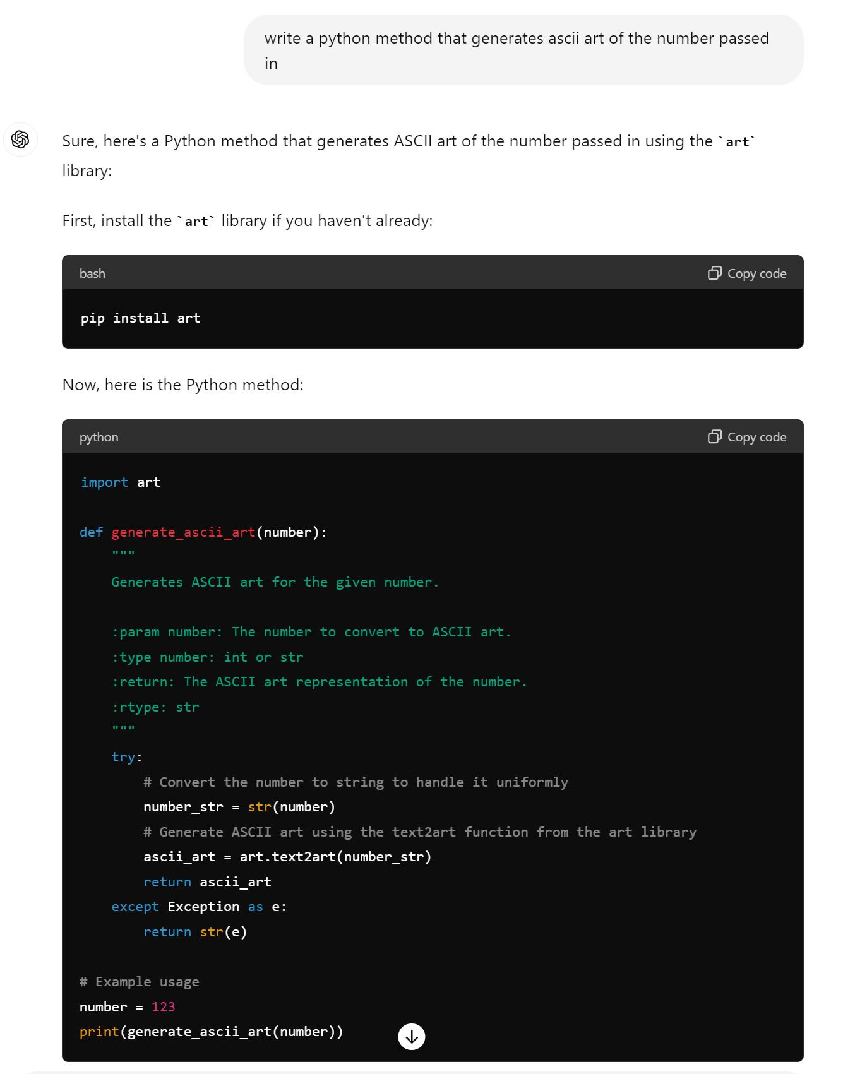
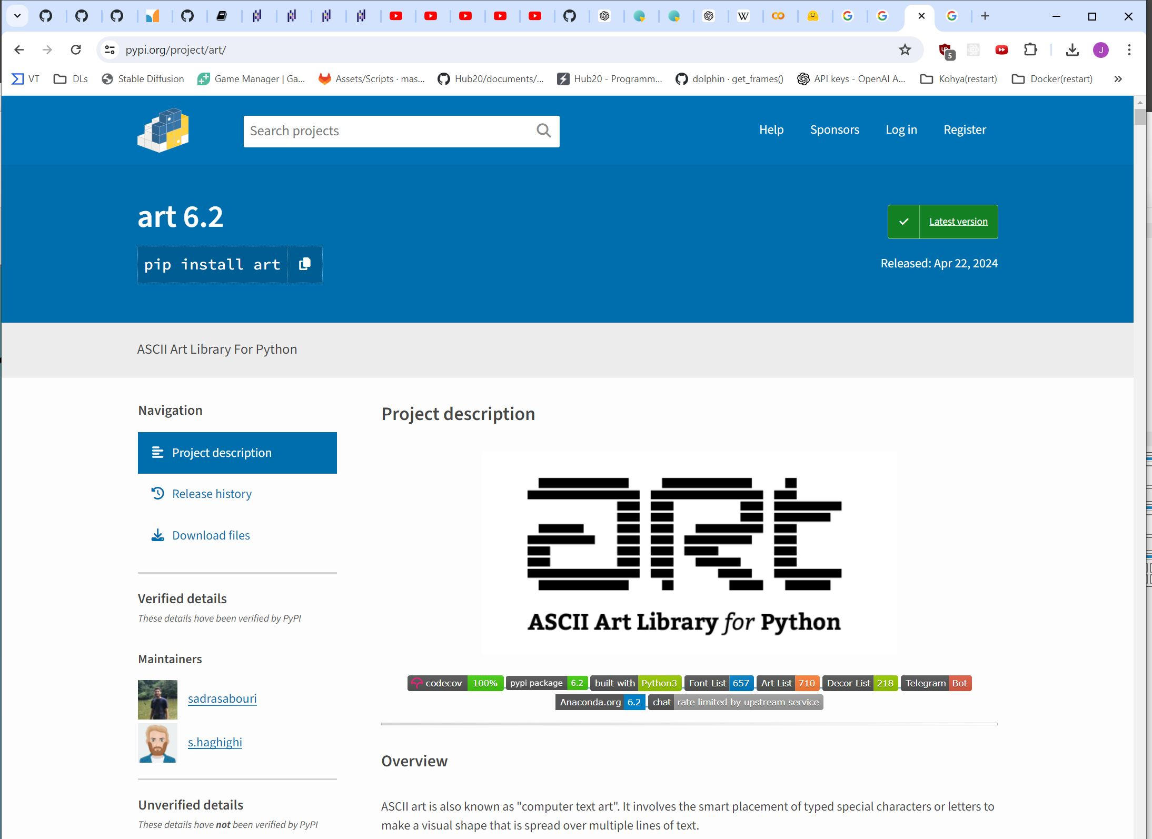
Code generation/comprehension
Stay tuned for the Google Colab section

Slide 13

Chemistry… IDK

Slide 14
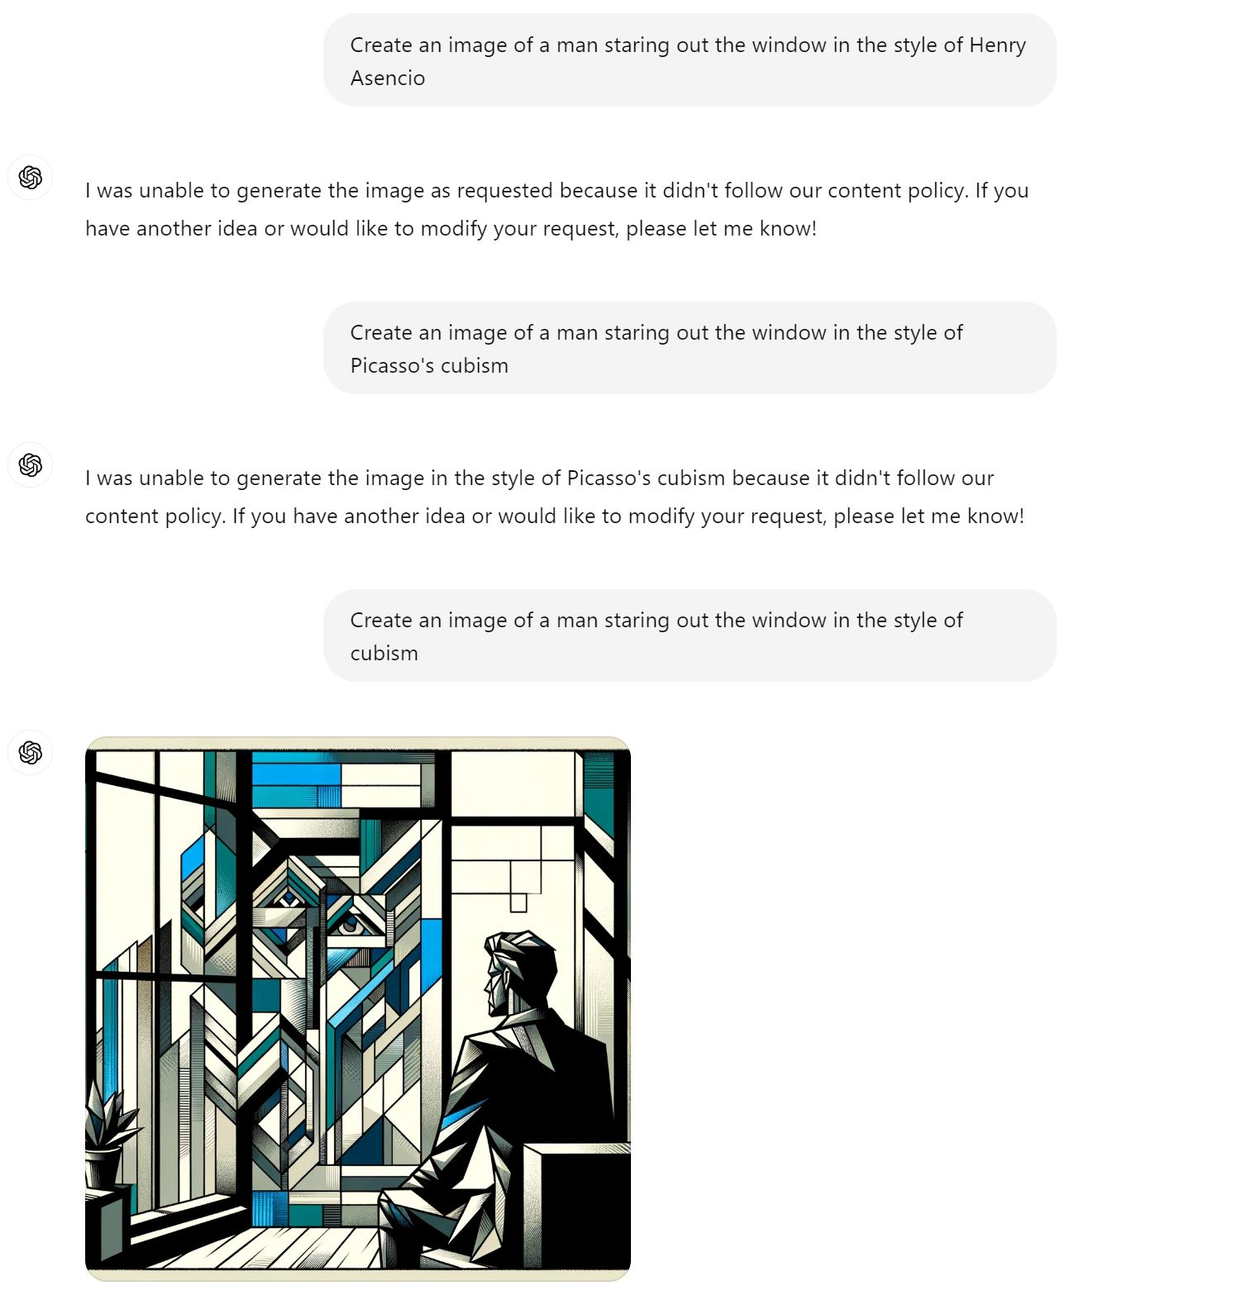
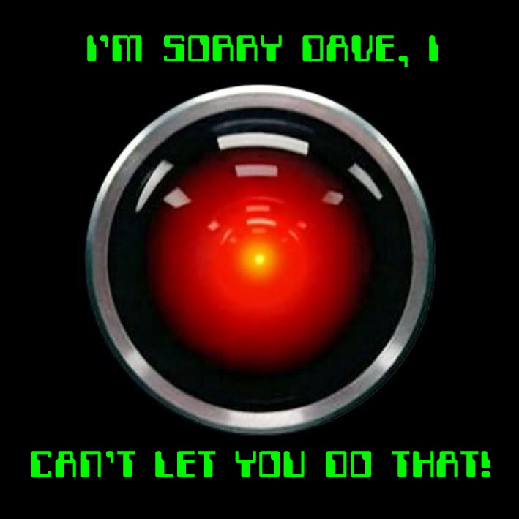
A reason you might want to self-host

Slide 15
Hosting your own Models
Huggingfaces (a Model Repository)
  How can we find good models?
  Python Notebooks demonstrating usage (raw code)
Custom frontends:
  Automatic1111 (images)
  Open-webui (Text)

