Slide 1

Content for submission
Code:
https://github.com/mikebowyer/ECE528_Assignments/tree/main/Assignment%233
Video presentation recording:
https://youtu.be/V5j3-MihGRw
Video recording of Steam Community News Bot:
https://youtu.be/5pPzivjMxVA

Slide 2

Discord Python API Tutorial
Michael Bowyer
ECE 528 Winter 2021

Slide 3
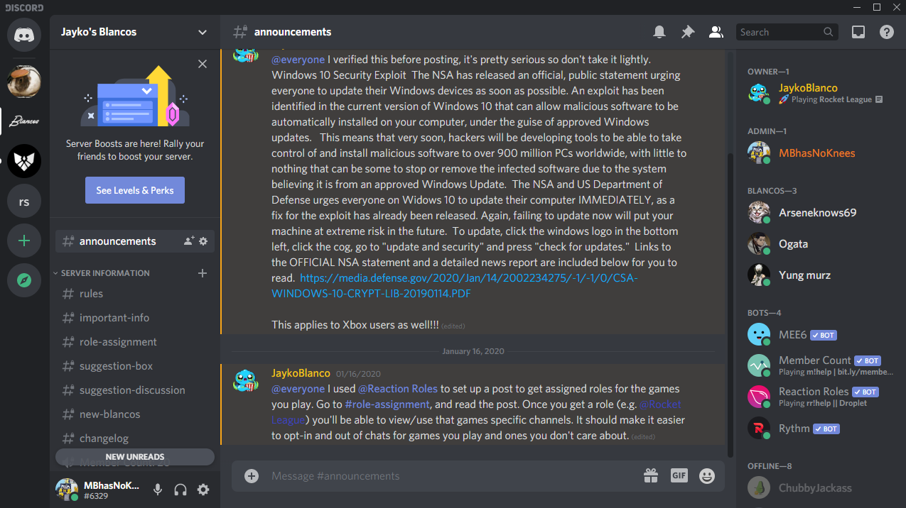
What is discord?
Organized messaging application with streaming, voice, video and text chat enabled
Used for many bots!
Example of desktop interface:

Slide 4
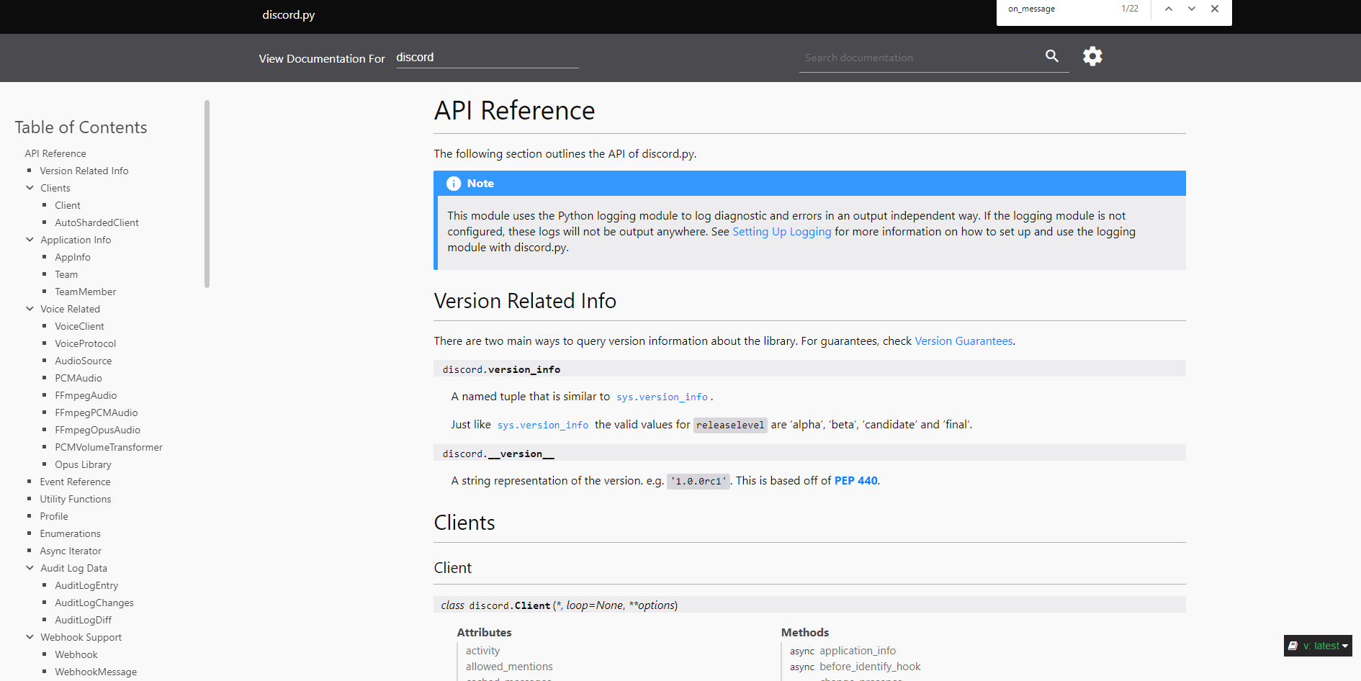
Discord Python API
https://discordpy.readthedocs.io/en/latest/api.html#
Main model for bot usage is through the “Client Model”

Slide 5
Creating a bot and adding it to a server
Creation of bot tutorials and documentation:
Getting Started with Making and Hosting Discord Bots with JavaScript and Python
Discord creating a bot account

Slide 6
Discord Client Python Tutorial
https://github.com/mikebowyer/ECE528_Assignments/tree/main/Assignment%233/DiscordAPITutorial

Slide 7
Discord API Application
Steam Community News Bot
https://github.com/mikebowyer/ECE528_Assignments/tree/main/Assignment%233/steamCommunityNewsBot

