Slide 1
Game of Thrones Analysis by Critic Review
Michael Brady and Austin Westfall

Slide 2
Introduction:
Our Goal:
Create a binary classifier to assign ratings to each season of Game of Thrones based on critic reviews
The Ratings are based on “Top Critic” reviews on Rotten Tomatoes

Slide 3
How the Code Works:
The Data was prepared into a vectorized array and fed into a trained network
The network was trained using IMDB training data and run for 4 epochs, using a batch size of 512
The Chosen reviews were the run through as test data and the output built our results

Slide 4
The Network:
Trained on IMDB Movie review database
Reviews were split into 50% positive and 50% negative
50,000 top reviews (Positive/Negative)
Only Used the top 10,000

Slide 5
By the Book:
Examples from 3.4 in the Textbook
Basics on how to prepare the data to be entered into the network
All data is encoded into an vector array

Slide 6
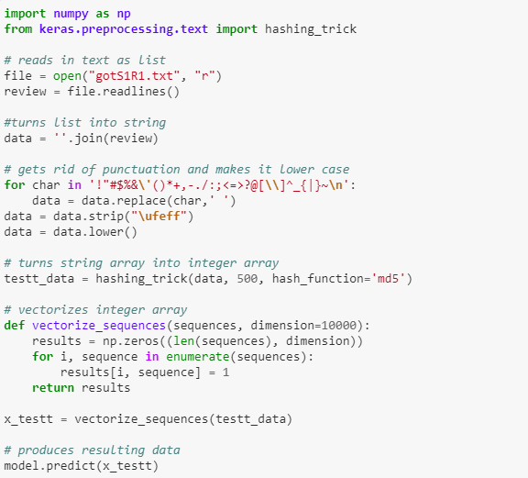
Input Data:

Slide 7
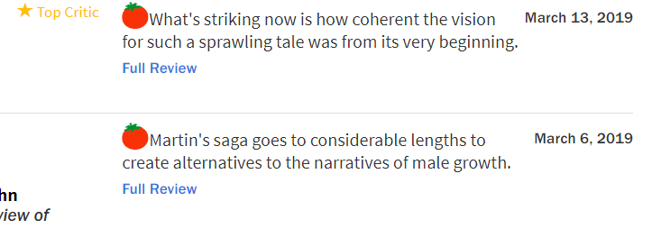
Critic Reviews:
Here is the format of the reviews used in the network
We pulled the full reviews of mainly people marked “top critic”

Slide 8
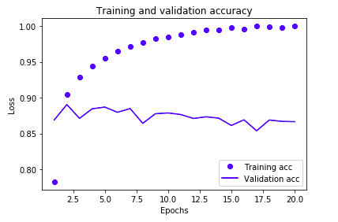
Results:
Our Training and validation accuracy using our network

Slide 9
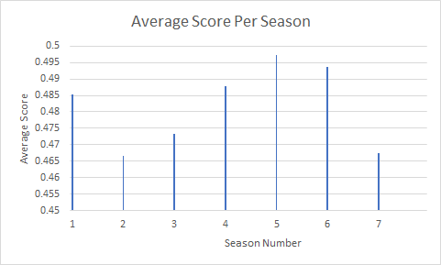
Results Cont:
Results for the review after run through the network

Slide 10
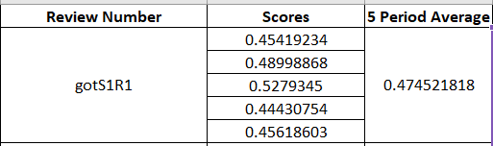
Problems:
After running all the data through the network, there was a clear average rating between .45 and .55 for all seasons
This contradicts the given scores by the critics we used
Its possible the network picked out words that do not represent a bad score and assigned in anyway

Slide 11
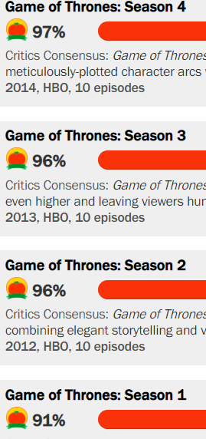
Conclusion:
The average scores we received showed that the base network we built was not that accurate despite the accuracy score relatively good.
More or less training/Number of Dense layers
Use different parameters for training
Different Activation/Loss Functions

Slide 12
Sources:
Critic Reviews came from the top critics is each season review section: https://www.rottentomatoes.com/tv/game-of-thrones
Examples used from our textbook: Deep Learning with Python by Francois Chollet

