Slide 1
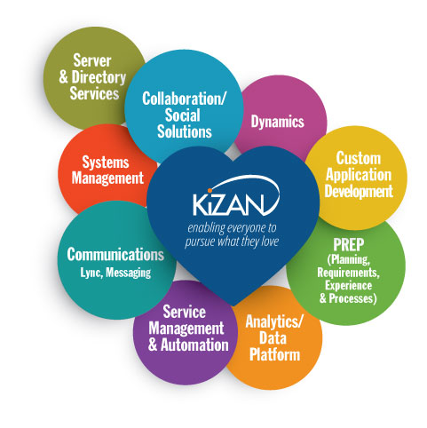
Welcome to the Azure Workshop
To be prepared for today’s Workshop, take a few minutes to review the following pieces of information.
We will begin at 9:15 AM! TRAFFIC, OH MY!
Open our OneNote:
http://tinyurl.com/azure-identity-workshop
Follow Chapter 0 of the instructions
WiFi: MSFTGUEST Username: mtcchiguest1, Password: P99e959w

Slide 2
Azure Identity
Workshop
Mike Branstein – Director, Application Development

Slide 3

About Mike
Speaker
CodePaLOUsa, Music City Code, DevUp, DogFoodCon
Global Azure Bootcamp, IoT Workshops
Author
NativeScript in Action
Developer
Web, mobile
DevOps, Build/Release Automation
Agile Coach
Brostein: brosteins.com

Slide 4
Welcome & Introductions
Notes:
Talking Points
I want to welcome everyone to our workshop on the Azure Identity Workshop. Today is going be an exciting day. You’ll have lots of hands-on practice working with Azure. We’ll be developing a centralized user profile service, where users can upload images that are stored in the cloud. As they’re uploaded, they’ll be analyzed by Microsoft’s Cognitive Services API to determine they’re safe for work. Then, we’ll use SignalR to be notified automatically of the image processing.
Let’s start by everyone introducing themselves, what you’re hoping to learn, and what you’ve done in the cloud before.

Slide 5
Practice Makes Perfect
You rarely get the chance to practice for practice’s sake
Azure and cloud architecture/development patterns can be confusing and are frankly “new” to many of us
It’s not what’s going to change, it’s when – and the answer is likely yesterday
Today
Cloud architecture
See an end-to-end solution
Hands-on practice
Get excited or inspired
Notes:
Talking Points
Aside from learning about the different technologies available to you, we’ve found that you rarely get the opportunity to practice developing or experimenting.
So, what do you need to be successful today?
The pre-requisites – if you haven’t looked at them yet, please do.
We’ll also be sharing an Azure subscription today, but everything you see here today can be done with either an Azure trial or the Azure credits you may have with MSDN.
Finally, we want you to have fun. We built this workshop because we enjoy the content, we’re passionate about building and making.

Slide 6

Azure Overview
Build Great Cloud Apps

Slide 7
Why use the cloud to build apps?

Slide 8
Scale
Inactivity
Period
Compute
On and off
t
Compute
Growing fast
t
Compute
Unpredictable bursting
t
Compute
Predictable bursting
t
Notes:
Applications and environments do not always need to be up and running for 24 hours, seven days a week.
Different workloads typically exhibit different usage patterns and it would be ideal if the underlying infrastructure could adjust automatically to conform to actual requirements.
According to industry reports, development and test infrastructure typically runs at a low utilization rate of approximately 20 percent, which leads to over-provisioning of costly resources when buying hardware exclusively for dev and test purposes.
In a nutshell: if you do not need the compute and storage resources all the time, you should not be forced to pay for them.
That is the beauty of cloud computing: cloud resources can scale based on actual demand. If resources are not needed they are simply switched off and de-commissioned. If they are needed again, then they are brought back, without delay.
Which of these patterns fit your business?

Slide 9

Leading the journey to the cloud
SAAS Solutions
Microsoft Dynamics
Enterprise Mobility
Microsoft Enterprise Mobility + Security
Microsoft Azure
Developer + App Platform
Visual Studio Family + Azure App Service
Data + Analytics
Cortana Analytics Suite
Internet of Things
Azure IoT Suite
Cloud Infrastructure
Azure + Azure Stack + Operations Management Suite
Notes:
Core Message: This answers the question of “What can we STOP providing?” This slide focuses on the different slices of work that could be off-loaded. The cloud isn’t an all-or-nothing, but it about finding a workload that makes sense to move, so you don’t have to incur the overhead.

Slide 10




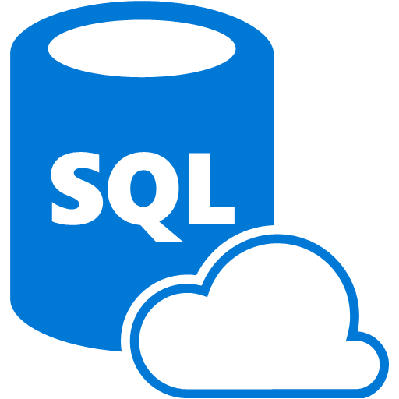



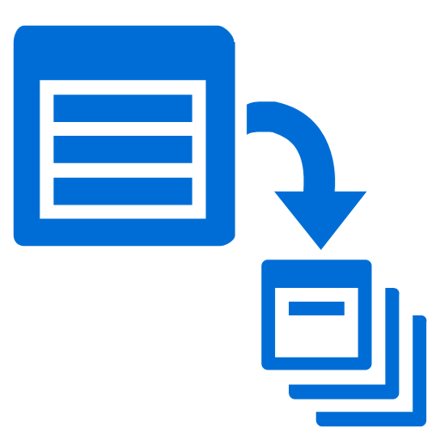


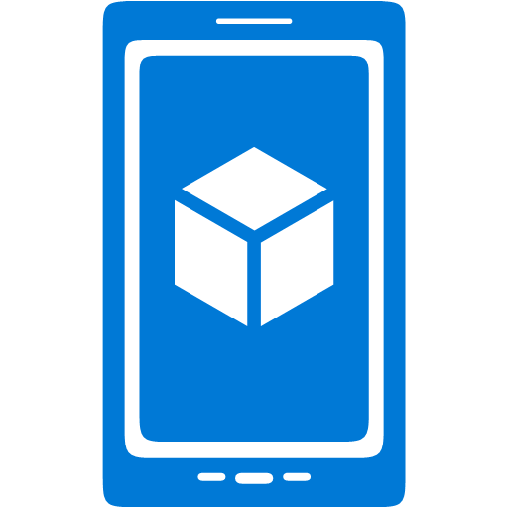




















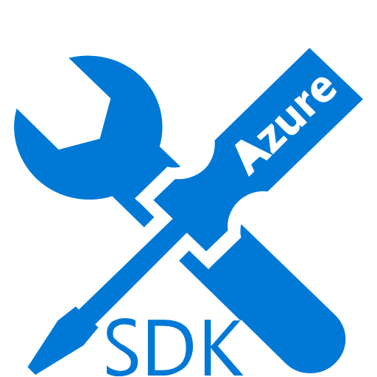



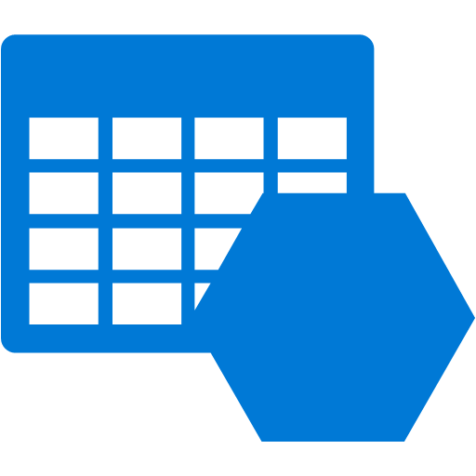









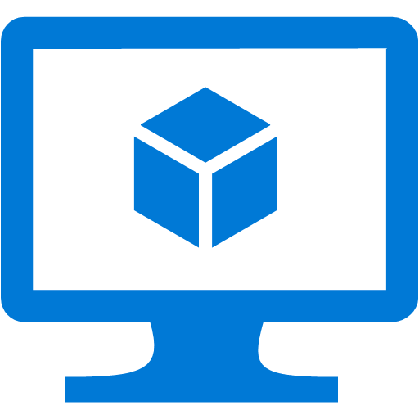








Platform Services
Security & Management
Services Compute
Web and Mobile
Data
Hybrid
Operations
Cloud
Services
Service
Fabric
Web Apps
API Apps
Portal
SQL
Database
Data
Warehouse
DocumentDB
Azure AD
Health Monitoring
Azure Active
Directory
Batch
RemoteApp
AD Privileged
Identity
Management
Mobile
Apps
Logic Apps
Redis
Cache
Azure
Search
Storage
Tables
Azure AD
B2C
Integration
Domain Services
Multi-Factor
Authentication
API
Management
Notification
Hubs
Storage
Queues
BizTalk
Services
Analytics & IoT
Backup
Automation
Hybrid
Connections
Service Bus
Developer Services
HDInsight
Machine
Learning
Stream
Analytics
Data
Lake
Operational
Analytics
Scheduler
Key Vault
Visual Studio
Azure
SDK
Data
Factory
Event
Hubs
Data
Catalog
Import/Export
Media & CDN
Store/
Marketplace
Media Services
Content Delivery
Network (CDN)
VS Online
App
Insights
Mobile
Engagement
Azure Site
Recovery
IoT Hub
VM Image Gallery
& VM Depot
StorSimple
Infrastructure Services
OS/Server Compute
Storage
Networking
Virtual Machines
Container
Service
BLOB Storage
Azure
Files
Premium
Storage
Virtual Network
Load Balancer
DNS
Express
Route
Traffic Manager
VPN Gateway
App
Gateway
Datacenter Infrastructure (30 Regions, 22 Online)
Notes:
Why this Slide:
It shows we have a very broad platform. It about BOTH IaaS and PaaS, that these work together. It shows that we continue to lead in world class IT capabilities and that there’s really nothing missing.
Key Points:
We have already seen how the Azure Platform is IaaS + Pass – but I want you to understand that this is a huge number of capabilities – IT building blocks if you will.
Every one of these blocks you provision anytime, self-service anywhere in the world 24x7. You pay for what you use, you can get more or less anytime and you can fully automate everything…
DON’T spent too much time on this slide – you are going to DEMO (aren’t you!!!)… DON’T go through each block…

Slide 11




























Azure Compliance The largest compliance portfolio in the industry
ISO 27001
SOC 1 Type 2
SOC 2 Type 2
PCI DSS Level 1
Cloud Controls Matrix
ISO 27018
Content Delivery and Security Association
Shared
Assessments
FedRAMP JAB P-ATO
HIPAA / HITECH
FIPS 140-2
21 CFR
Part 11
FERPA
DISA Level 2
CJIS
IRS 1075
ITAR-ready
Section 508 VPAT
European Union
Model Clauses
EU Safe Harbor
United Kingdom
G-Cloud
China Multi
Layer Protection Scheme
China
GB 18030
China
CCCPPF
Singapore
MTCS Level 3
Australian Signals
Directorate
New
Zealand
GCIO
Japan
Financial Services
ENISA
IAF
Notes:
Why this Slide:
Now you have finished the what is Azure section you want to do a few things – you want them to explain the trust model and give them some comfort they are not the first here – it’s a safe bet.
Key Points:
Azure Compliance makes it easier for first parties and end customers to fulfill their own compliance obligations across globally regulatory and industry standards.
Explain the FUNDAMENTAL TRUST model. These organizations (above) we let into our data centers and they attest that we do all the things on their list of controls. You (the customer) have to trust these organizations.
You still OWN much of the work to make your systems compliant – we have the platform and the capabilities – but you have to decide to use them (example you have to decide to encrypt virtual disks for your VM’s – or NOT).
Transition to NEXT Slide: Are you the first to do this… Of course not…

Slide 12


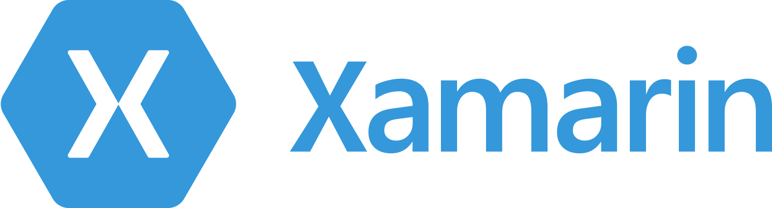




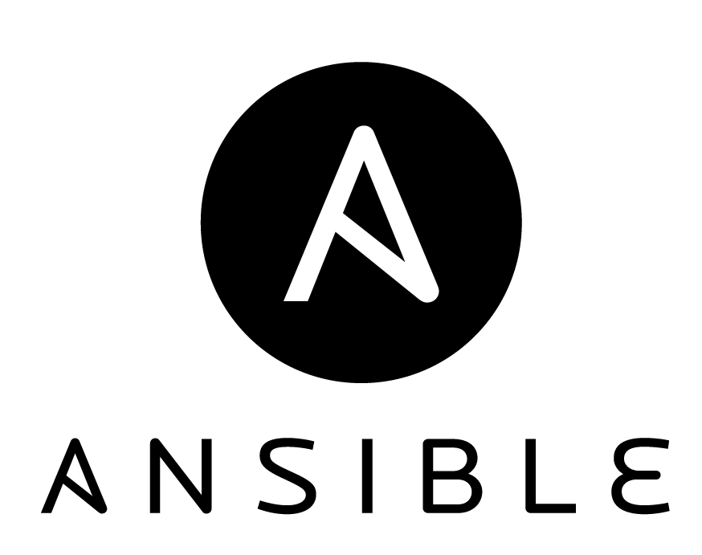






































Azure is an open cloud
DevOps
Clients
Management
Applications
PaaS &
DevOps
App Frameworks
& Tools
Databases &
Middleware
Infrastructure
Notes:
Points to make:
- Related to the compliance in terms of standards and certifications, we also provide integration and operations with other development/platform standards
Lead in: It’s not a Microsoft world anymore

Slide 13
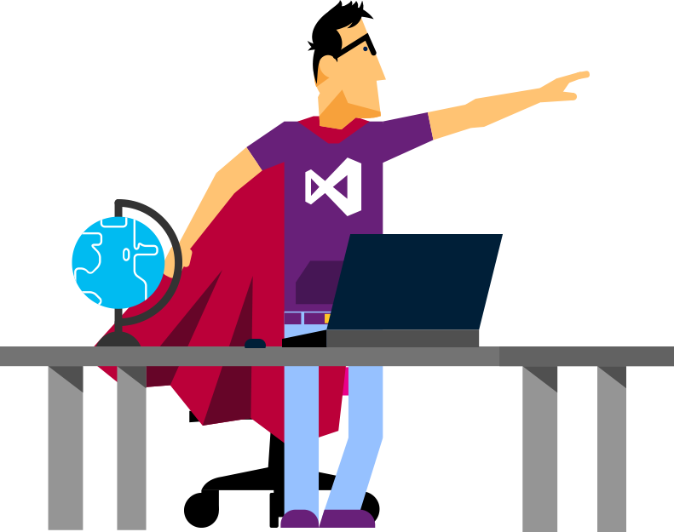

Let’s see…
Microsoft Azure
…in action
Notes:
Perform the demo: Logging into the portal and navigation

Slide 14
Getting Started
Chapters 1-3
Clone the source code from GitHub
Explore ASP.NET Identity
Replace data storage of Windows Identity with Azure Tables
Learn about Azure Storage Emulator and Storage Explorer to develop locally

Slide 15
Connecting your app to Azure
Chapter 4
Creating resource groups and deploying to a web app
Creating a storage account
Using storage explorer with the storage account
Update app to use Azure table storage

Slide 16
ASP.NET Identity custom fields
Chapters 5 & 6
Add a Biography to ASP.NET Identity
Create BLOB storage containers
Upload a profile picture to BLOB storage
Notes:
Different data storage types

Slide 17
Staging profile pictures
Chapters 7 & 8
Update BLOB containers to stage uploaded images
Create Azure functions
Activate Cognitive Services API
Scan profile pictures for safety
Notes:
Different data storage types

Slide 18
Asynchronous updates
Chapter 9
Use SignalR to notify a page when an image is updated
Notes:
Different data storage types

