Slide 1

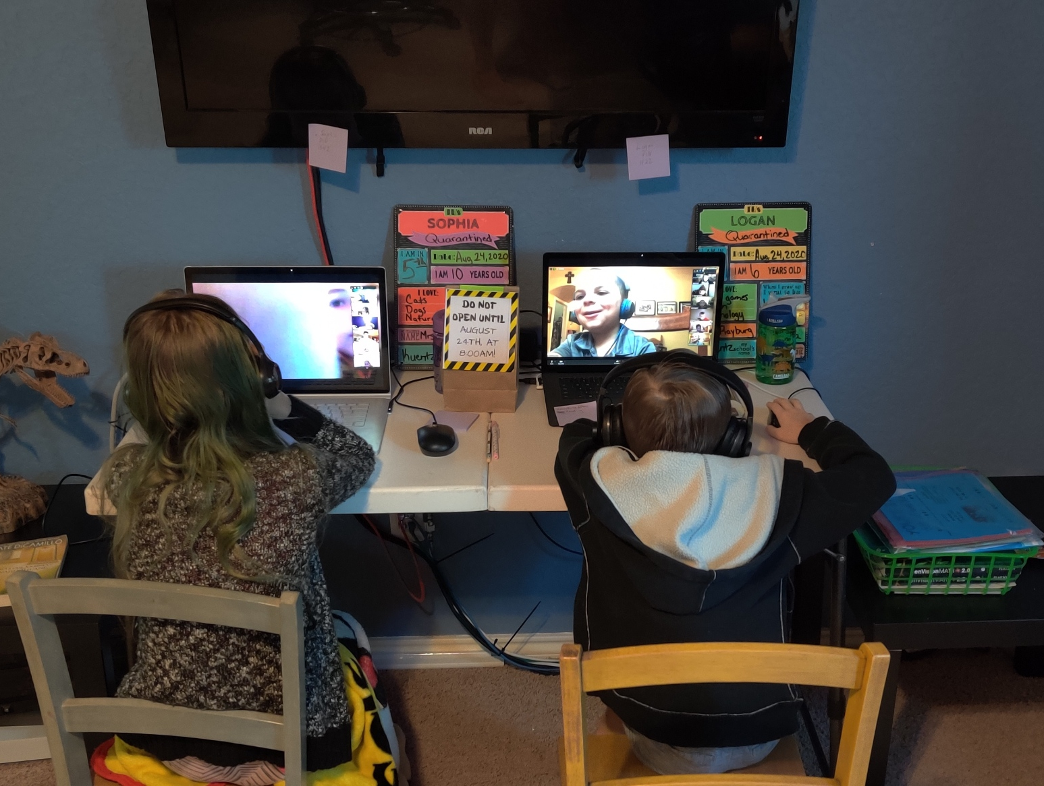
What is Our Hack
With COVID19 parents must juggle both working at home and helping their kids with school.
Our hack’s goal was to make helping the kids track school due dates and attending school video learning on time for each kid.

Slide 2
App Features
Get to Zoom Videos and Google Video Meetings on time
Set Timelines for study time prior to tests & quizzes
Track Due Dates for Kids Assignments
Trigger reminders via Monday.com Notifications

