Slide 1

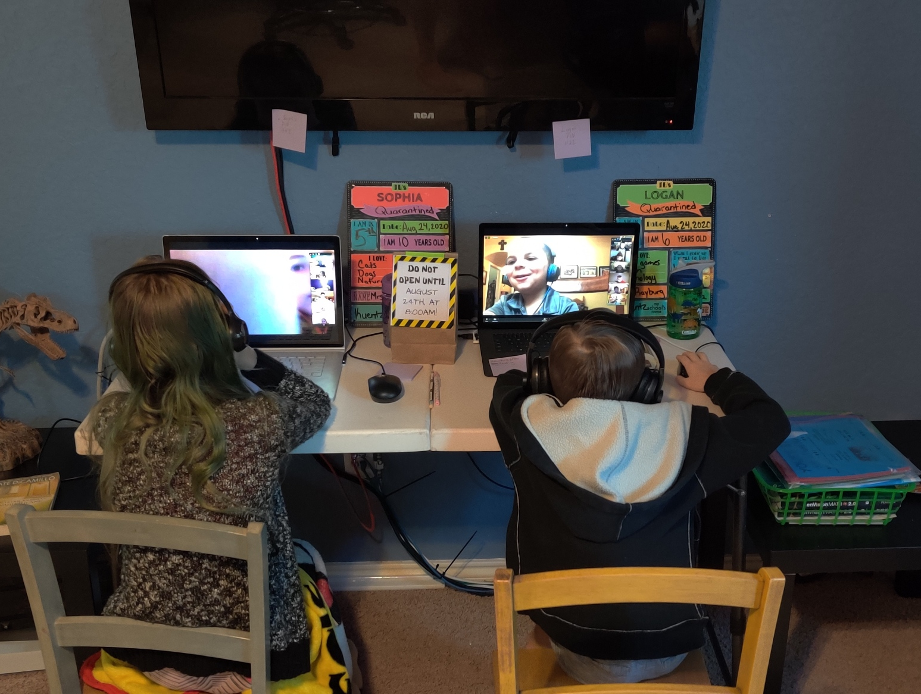
What is Our Hack
With COVID19 parents must juggle both working at home and helping their kids with school. Our hack’s goal was to make helping the kids with their homework easier.

