Slide 1
Twitter Bot Classificaton
Mike Chavez

Slide 2
Problem Domain
Automated users, or bots, on Online Social Networks (OSN) such as Twitter are getting more efficient in spreading malicious and false information.
They are also getting better at avoiding detection
A great deal of work done in this domain
Cresci 2017
Pew Research Center
Botometer (Indian University)

Slide 3
Why SHOULD YOU CARE?
Traditionally, hackers have been able to steal people's data which often a means to some greater end.
E.g. ransomware
Bots enable attackers to disseminate malicious info through OSNs which affords them the opportunity to influence much greater outcomes, such as elections which is in itself an end
Bots allow attackers to automate some of their work, rendering attacks more efficient and less expensive than before
Increasing the awareness of bots and providing users and OSN admins with tools to detect bots can help increase the cost of deploying effective bots, thereby at least mitigating the threat

Slide 4
Describing the Dataset
Dataset consists of 11 subsets of twitter users for training and two test sets
3,474 Real User Accounts
10,924 Bot Accounts
Bot accounts further divided into 7 subsets
991 accounts related to Italian mayoral election
3,457 accounts related to advertising campaign for gig app
464 accounts tweeting links to goods on Amazon.com
1,100 accounts tweeting URLs to malicious content
1,561 accounts tweeting URLs related to job offers
3,351 accounts that are fake followers, accounts that serve only to inflate other bots follower count
Test sets have 2,910 accounts and are split 50/50 between real users and bots

Slide 5
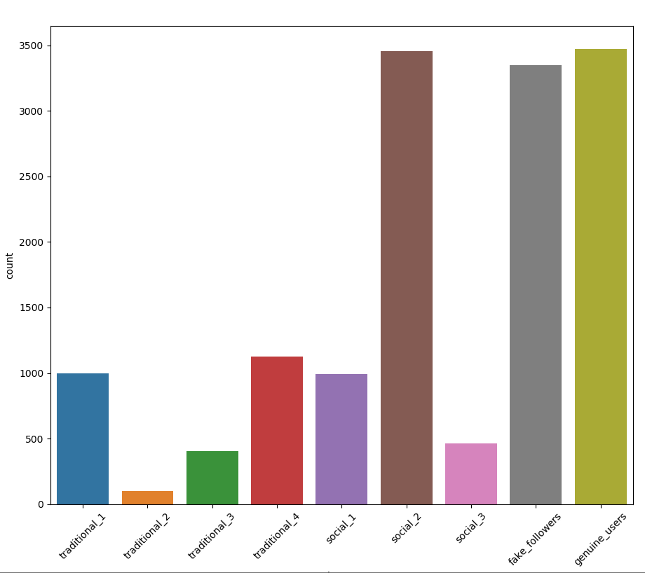
Distribution of the Dataset

Slide 6
Issues encountered in Cleaning Dataset
Issues w/ Cleaning the data
Data is fairly uniform
Need to concatenate 7 different files for spambots
Some boolean features used null for "false"
Some columns were misaligned, so had to be adjusted for concatenation
Issues w/ Understanding the data
Traditional vs social bifurfacation not well-defined by creator of dataset
No data dictionary; had to intuit from prior research using the dataset

Slide 7
How should it be evaluated?
From a quantitative perspective:
The model that will be built is a classification model
Either a user is a human or a bot
Tested against test sets
From a qualitative perspective:
Whatever the accuracy, the model will likely be biased due to small sample sizes

