Slide 1
Twitter Bot Classificaton
Mike Chavez

Slide 2
Problem Domain
Automated users, or bots, on Online Social Networks (OSN) such as Twitter are getting more efficient in spreading malicious and false information.
They are also getting better at avoiding detection
A great deal of work done in this domain
Cresci 2017
Pew Research Center
Botometer (Indian University)

Slide 3
Why SHOULD YOU CARE?
Traditionally, hackers have been able to steal people's data which often a means to some greater end.
E.g. ransomware
Bots enable attackers to disseminate malicious info through OSNs which affords them the opportunity to influence much greater outcomes, such as elections which is in itself an end
Bots allow attackers to automate some of their work, rendering attacks more efficient and less expensive than before
Increasing the awareness of bots and providing users and OSN admins with tools to detect bots can help increase the cost of deploying effective bots, thereby at least mitigating the threat

Slide 4
Describing the Dataset
Dataset consists of 11 subsets of twitter users for training and two test sets
3,474 Real User Accounts
10,924 Bot Accounts
Bot accounts further divided into 7 subsets
991 accounts related to Italian mayoral election
3,457 accounts related to advertising campaign for gig app
464 accounts tweeting links to goods on Amazon.com
1,100 accounts tweeting URLs to malicious content
1,561 accounts tweeting URLs related to job offers
3,351 accounts that are fake followers, accounts that serve only to inflate other bots follower count
Test sets have 2,910 accounts and are split 50/50 between real users and bots

Slide 5
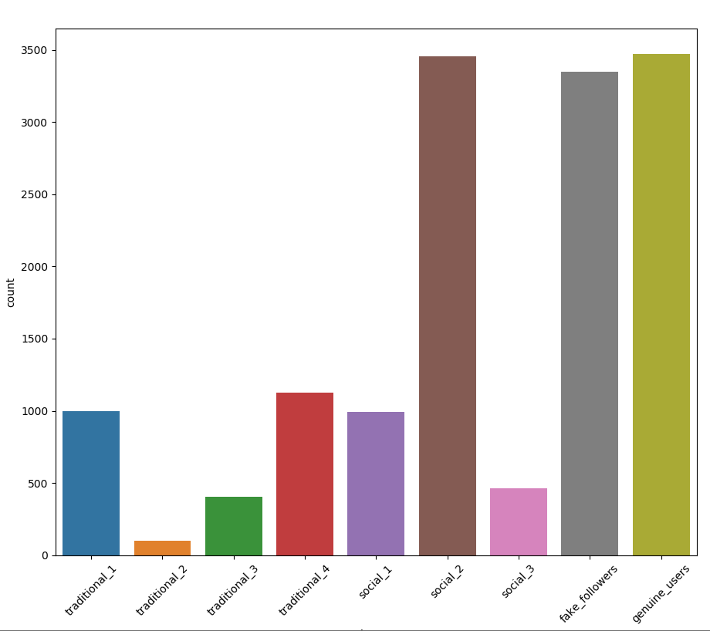
Distribution of the Dataset

Slide 6
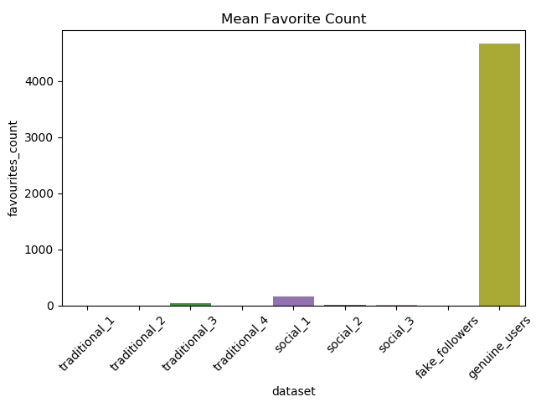
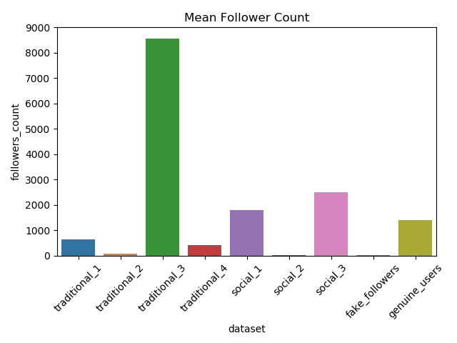
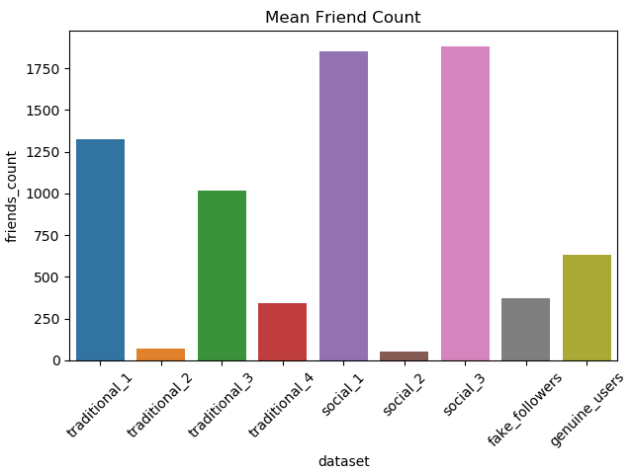
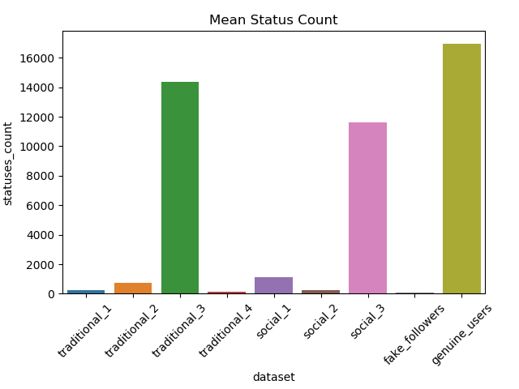
Key Feature Distributions

Slide 7
Feature engineering
All features needed to be derived into Boolean values
20x Friends to Followers Ratio
100x Friends to Followers Ratio
2x Followers to listed count
Is_in_a_list
Has name
Has default profile_image
Language_is_english
Has_never_favorited
Has_never_tweeted
Has_description
Has_profile_background_image
Has_less_than_20_followers
Geo_enabled

Slide 8
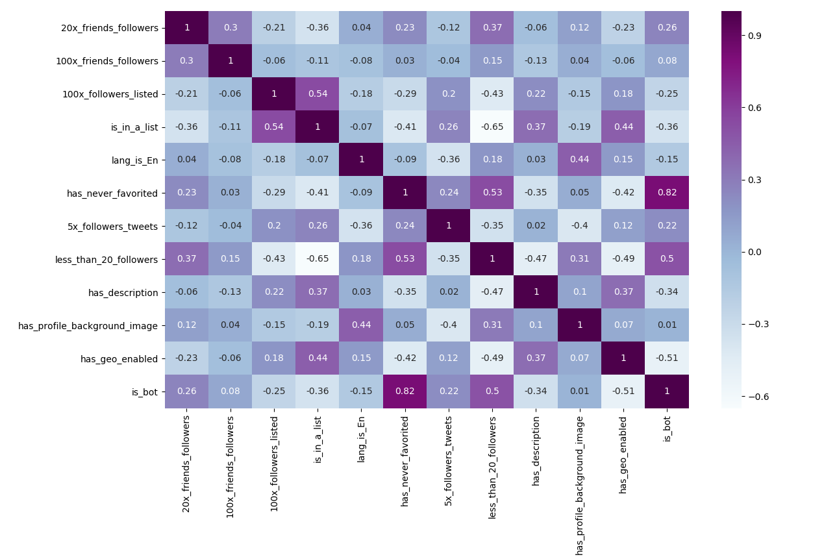
Heatmap of Derived Features

Slide 9
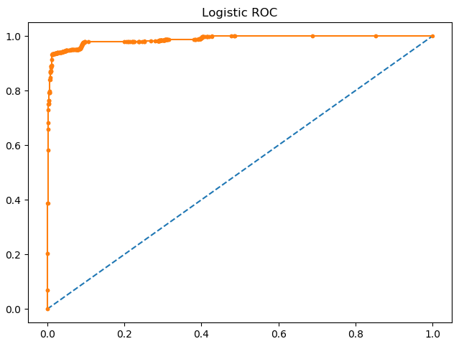
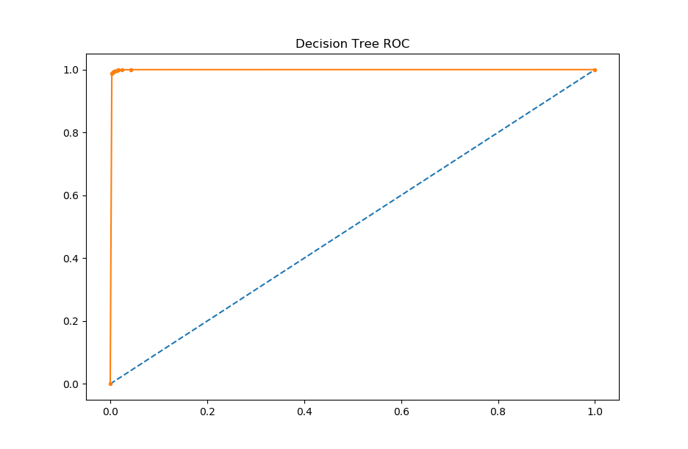
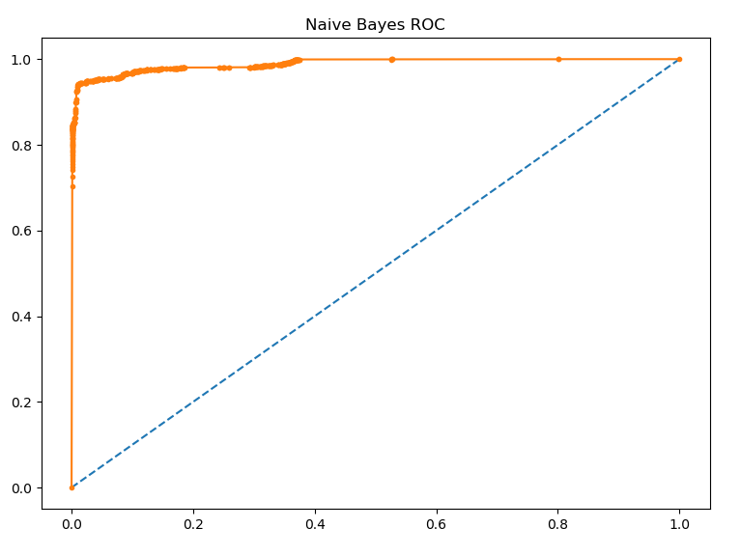
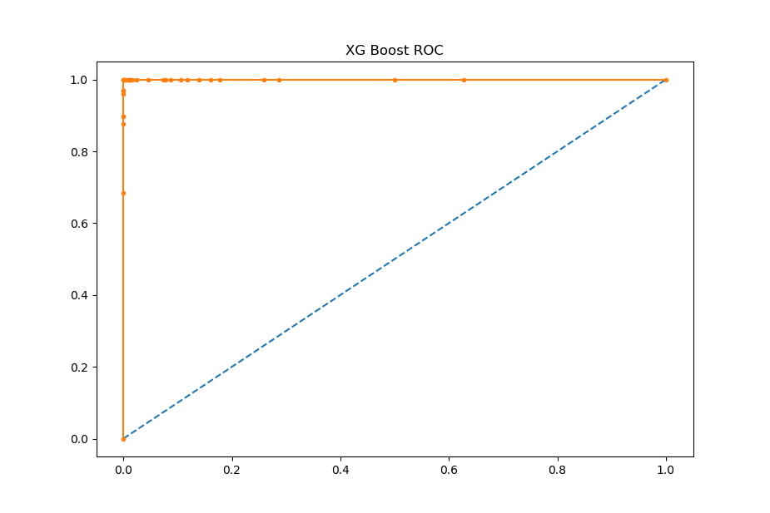
ROC Curves

Slide 10
Model Comparison
 | Logistic | Naïve Bayes | Decision Tree | XGBoost
Precision | 0.98 | 0.99 | 0.99 | 1.00
Recall | 0.94 | 0.96 | 0.99 | 1.00
F-Score | 0.96 | 0.91 | 0.99 | 1.00
AUC | 0.99 | 0.99 | 1.00 | 1.00

Slide 11
// ToDO
Code cleanup
Interpret models using shap values
Exploit invididual tweets
Find and test on novel dataset(s)
Unsupervised model(s) ?

