Slide 1
CS305 – Project SDN 2019 Fall
欧阳晖 11710106 Controller contribution: 33.334%
蔡永宁 11710802 Testing contribution: 33.333%
王炜皓 11710403 Architecture, Algorithm contribution: 33.333%

Slide 2
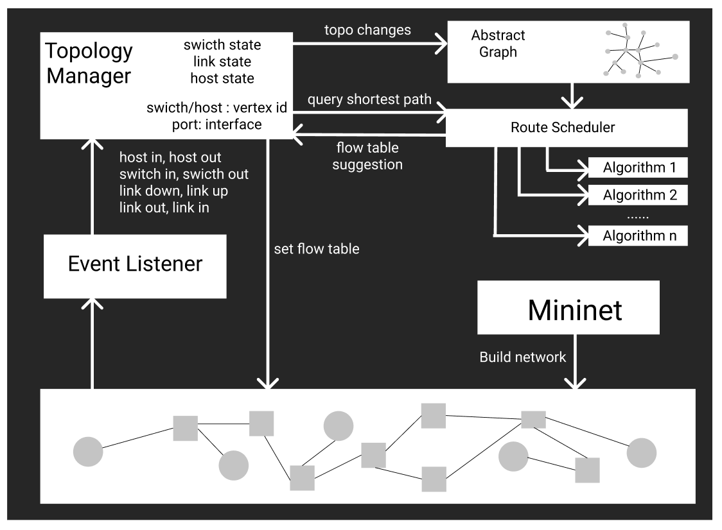
Architecture

Slide 3
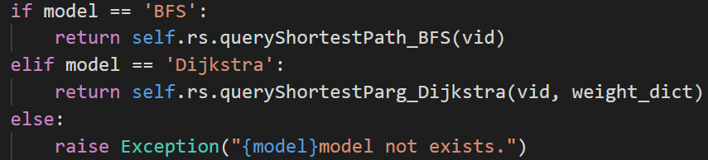
Algorithms
Spanning Tree – unweighted graph
Time Complexity for finding a spanning tree: O(n)
BFS – unweighted graph
Time Complexity for updating all flow table: O(n²)
Dijkstra – weighted graph
Time Complexity for updating all flow table: O(n²logn)

Slide 4
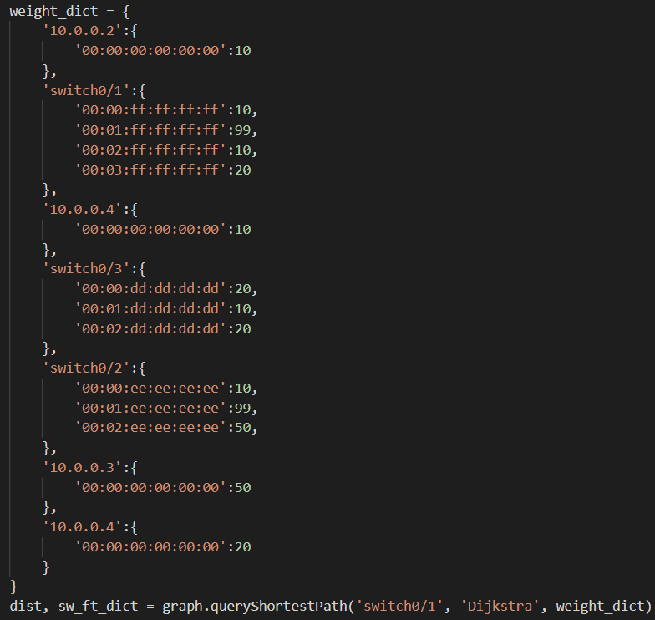
A simple test for the algorithm

Slide 5
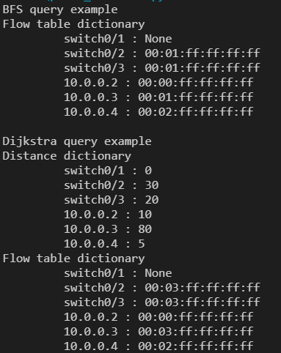
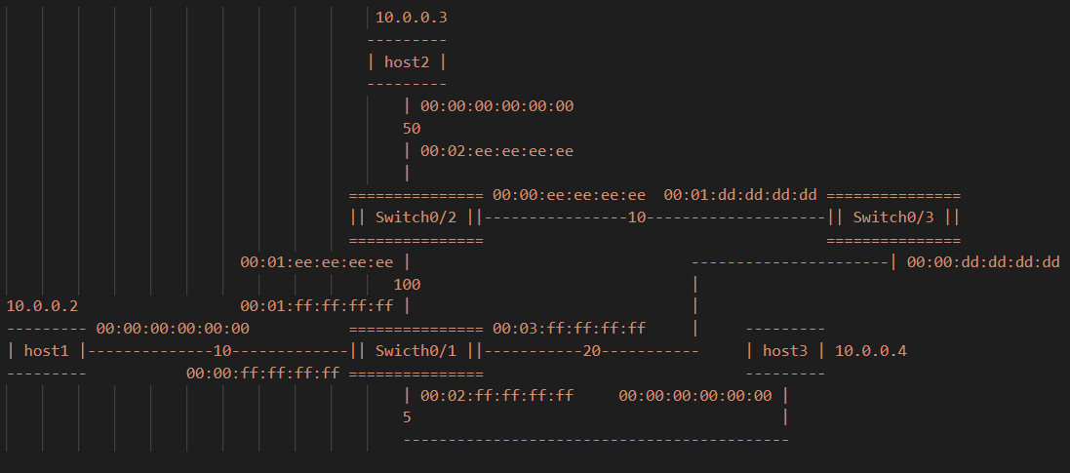
A simple test for the algorithm

Slide 6
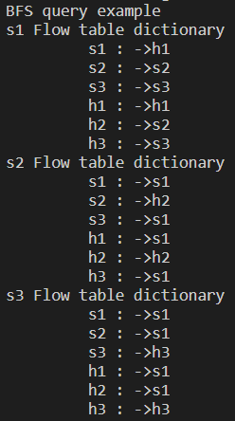

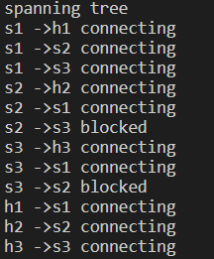
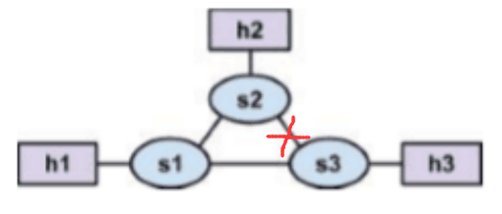
A simple test for the algorithm
Use spanning tree -> update spanning tree -> recompute shortest path

Slide 7
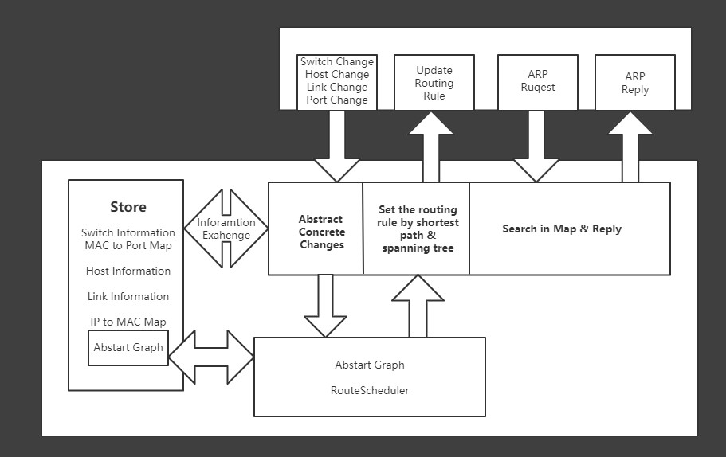
Controller

Slide 8
Testing
Demonstration
Basic Functions
single 5
linear 5
tree 2
assign1
triangle
mesh 5
someloops
Spanning Tree Test: Enable Flooding mode
Disable Spanning Tree,
Enable Spanning Tree

Slide 9
Thanks
Happy New Year

