Slide 1
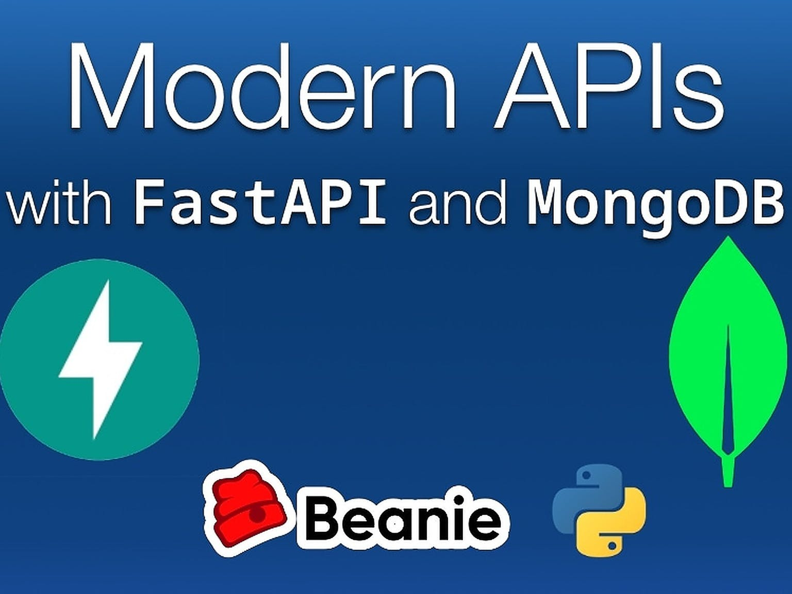
Python Typing (What, When, and How)
Modern APIs with FastAPI and MongoDB | A Talk Python Live Event © 2022

Slide 2
Python is a dynamic, type-free language (sorta)
running_max = None
def counter(items):
total = 0
# ...
return total

Slide 3
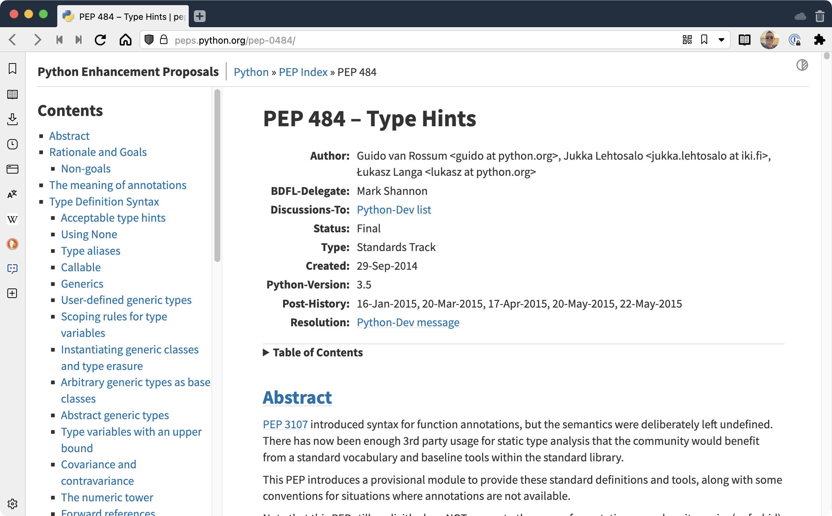
Until PEP 484

Slide 4
Demo: Type hints
Web API calling app

Slide 5
Remember our function without types?
running_max = None
def counter(items):
total = 0
# ...
return total

Slide 6
Type hints applied
running_max: Optional[int] = None
def counter(items: Iterable[Item]) -> int:
total = 0
# ...
return total

Slide 7
FastAPI makes heavy use of types
@app.get("/items/{item_id}")
def read_item(item_id: int, q: Union[str, None] = None):
return {"item_id": item_id, "q": q}

Slide 8
FastAPI makes heavy use of types
class Item(pydantic.BaseModel):
name: str
description: Union[str, None] = None
price: float
tax: Union[float, None] = None
@app.post("/items/")
async def create_item(item: Item):
return item

Slide 9
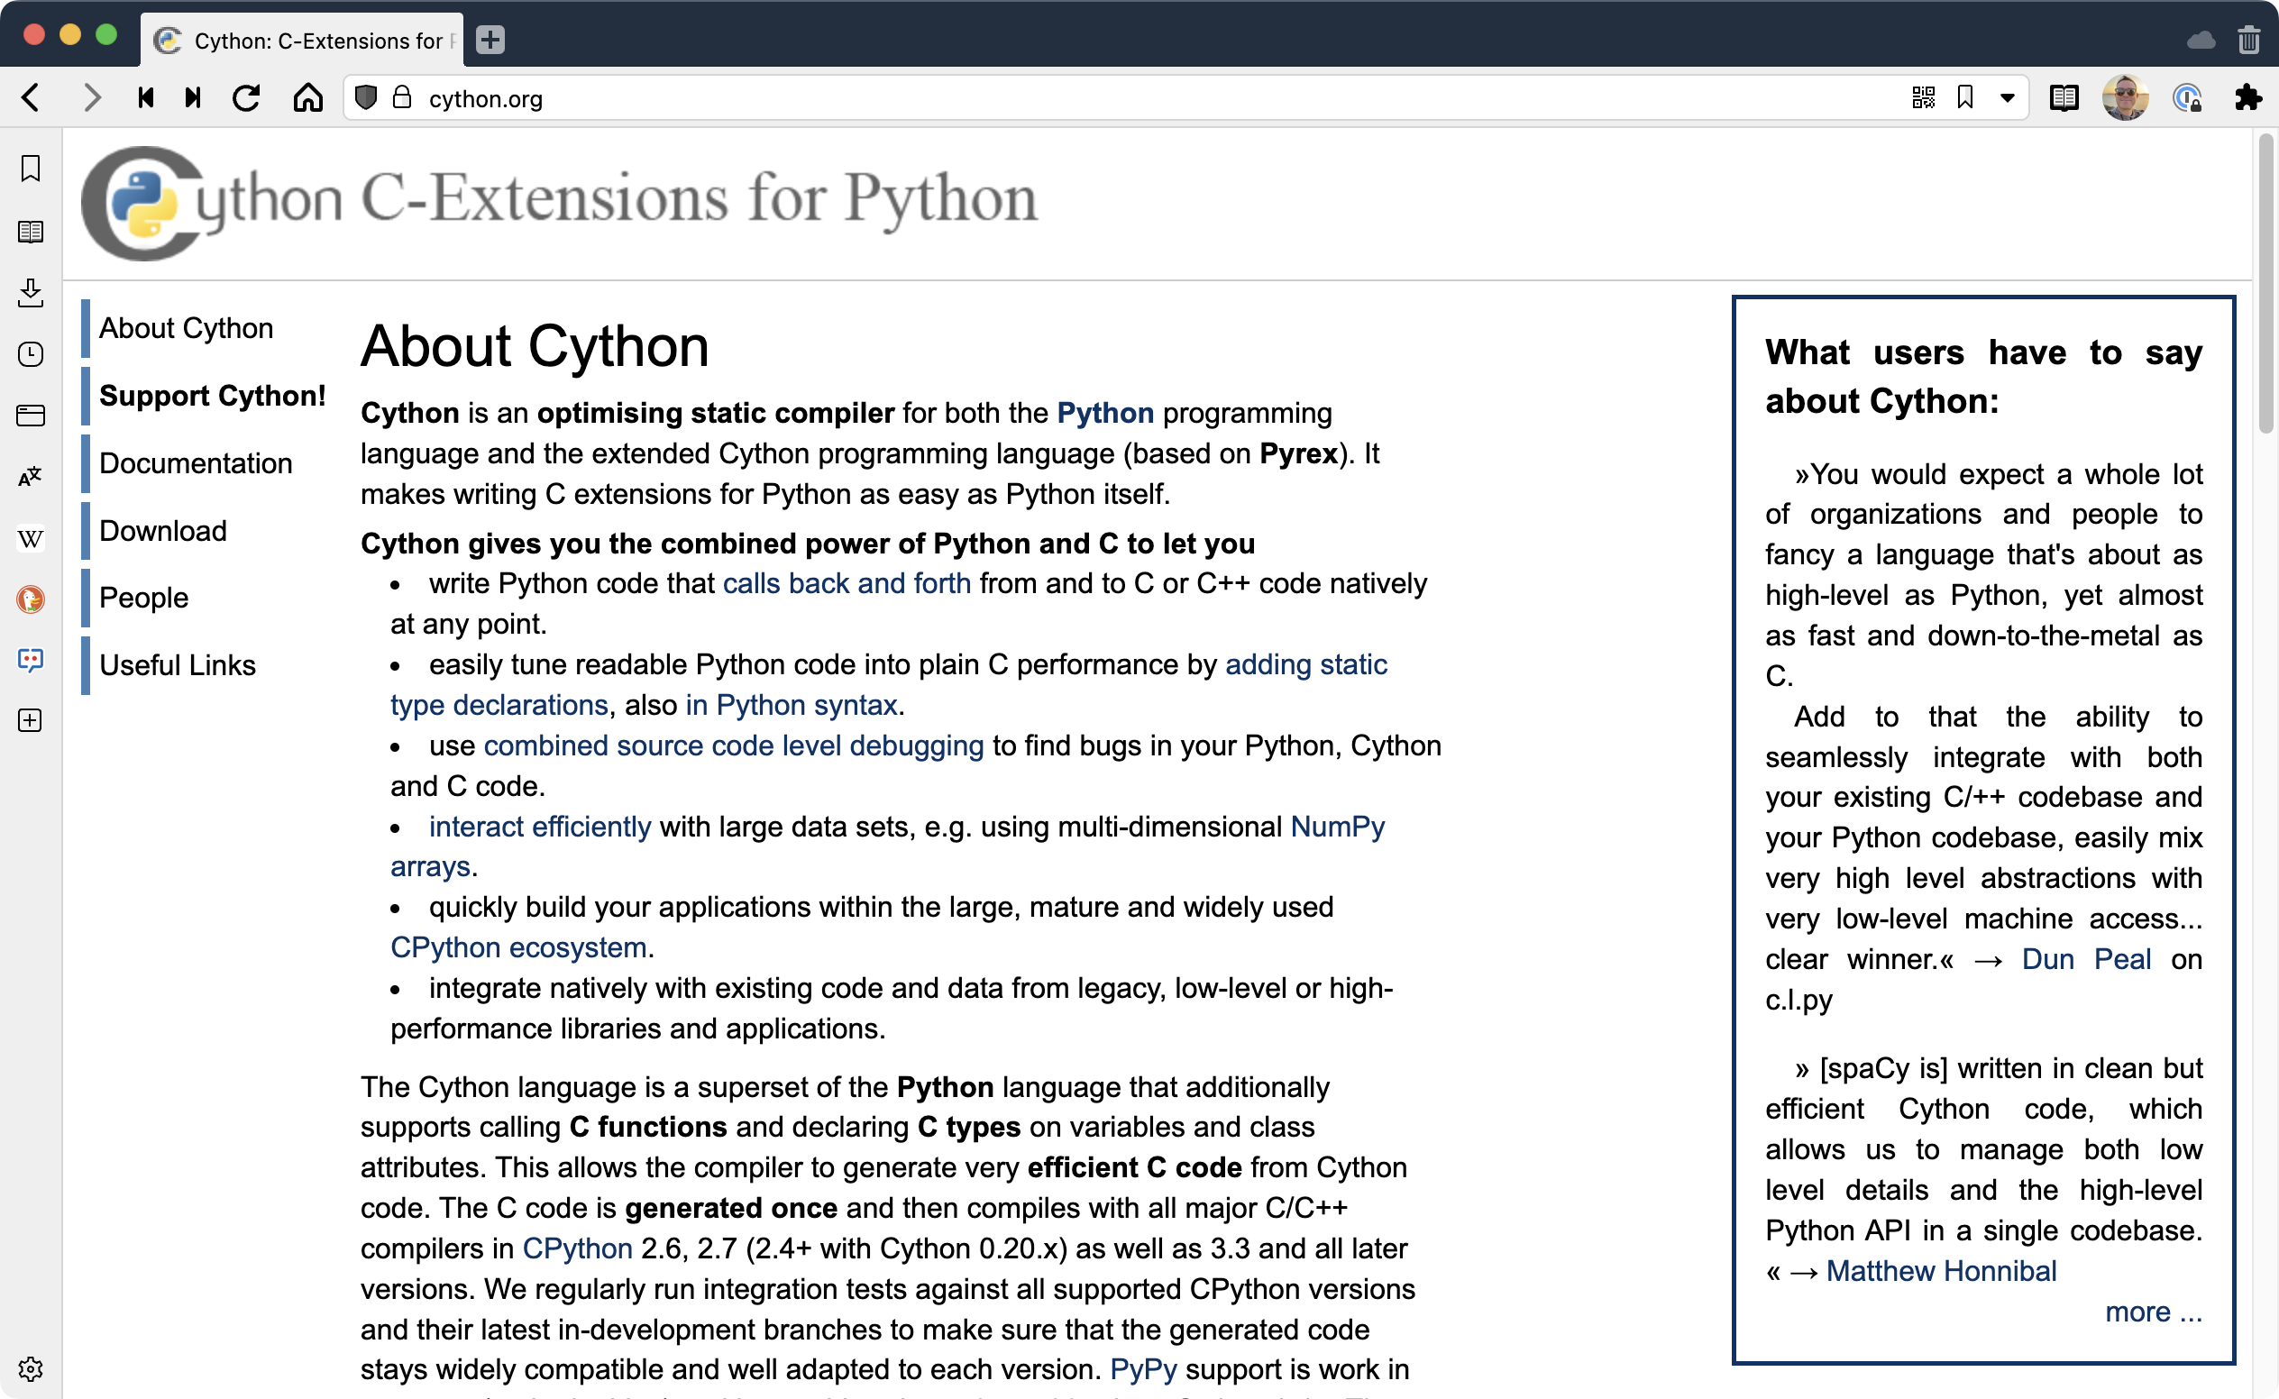
Python types also unlock performance

Slide 10
But we can write Python with Cython
Cython is an optimizing static compiler for the Python programming language. It makes writing C extensions for Python as easy as Python itself.

Slide 11
What does Cython look like?
# Pure Python
import math
def do_math(start: int, num: int):
dist = 0.0
pos = start
k_sq = 1000 * 1000
while pos < num:
pos += 1
dist = math.sqrt((pos - k_sq) * (pos - k_sq))

Slide 12
What does Cython look like?
# Cython
from libc.math cimport sqrt
def do_math(start: cython.int, num: cython.int):
dist: cython.float = 0.0
pos: cython.float = start
k_sq: cython.float = 1000 * 1000
while pos < num:
pos += 1
dist = sqrt((pos - k_sq) * (pos - k_sq))

Slide 13
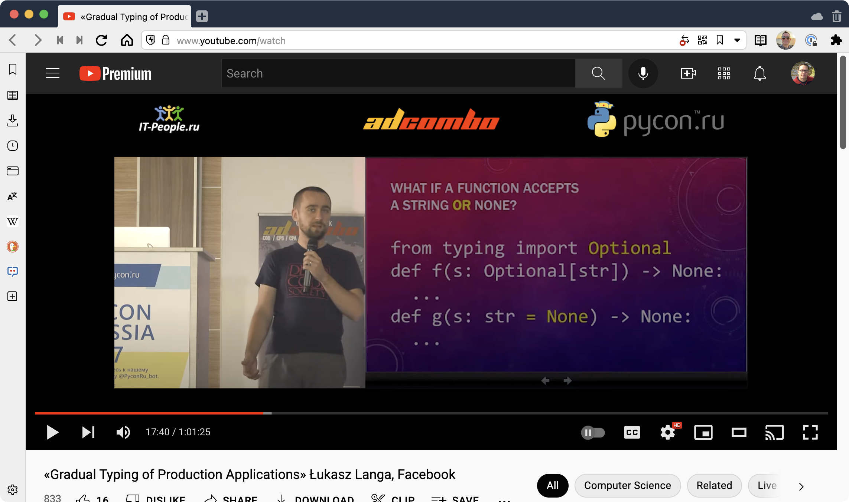
Typing is gradual
https://www.youtube.com/watch?v=Mn4AOttRmpI

Slide 14
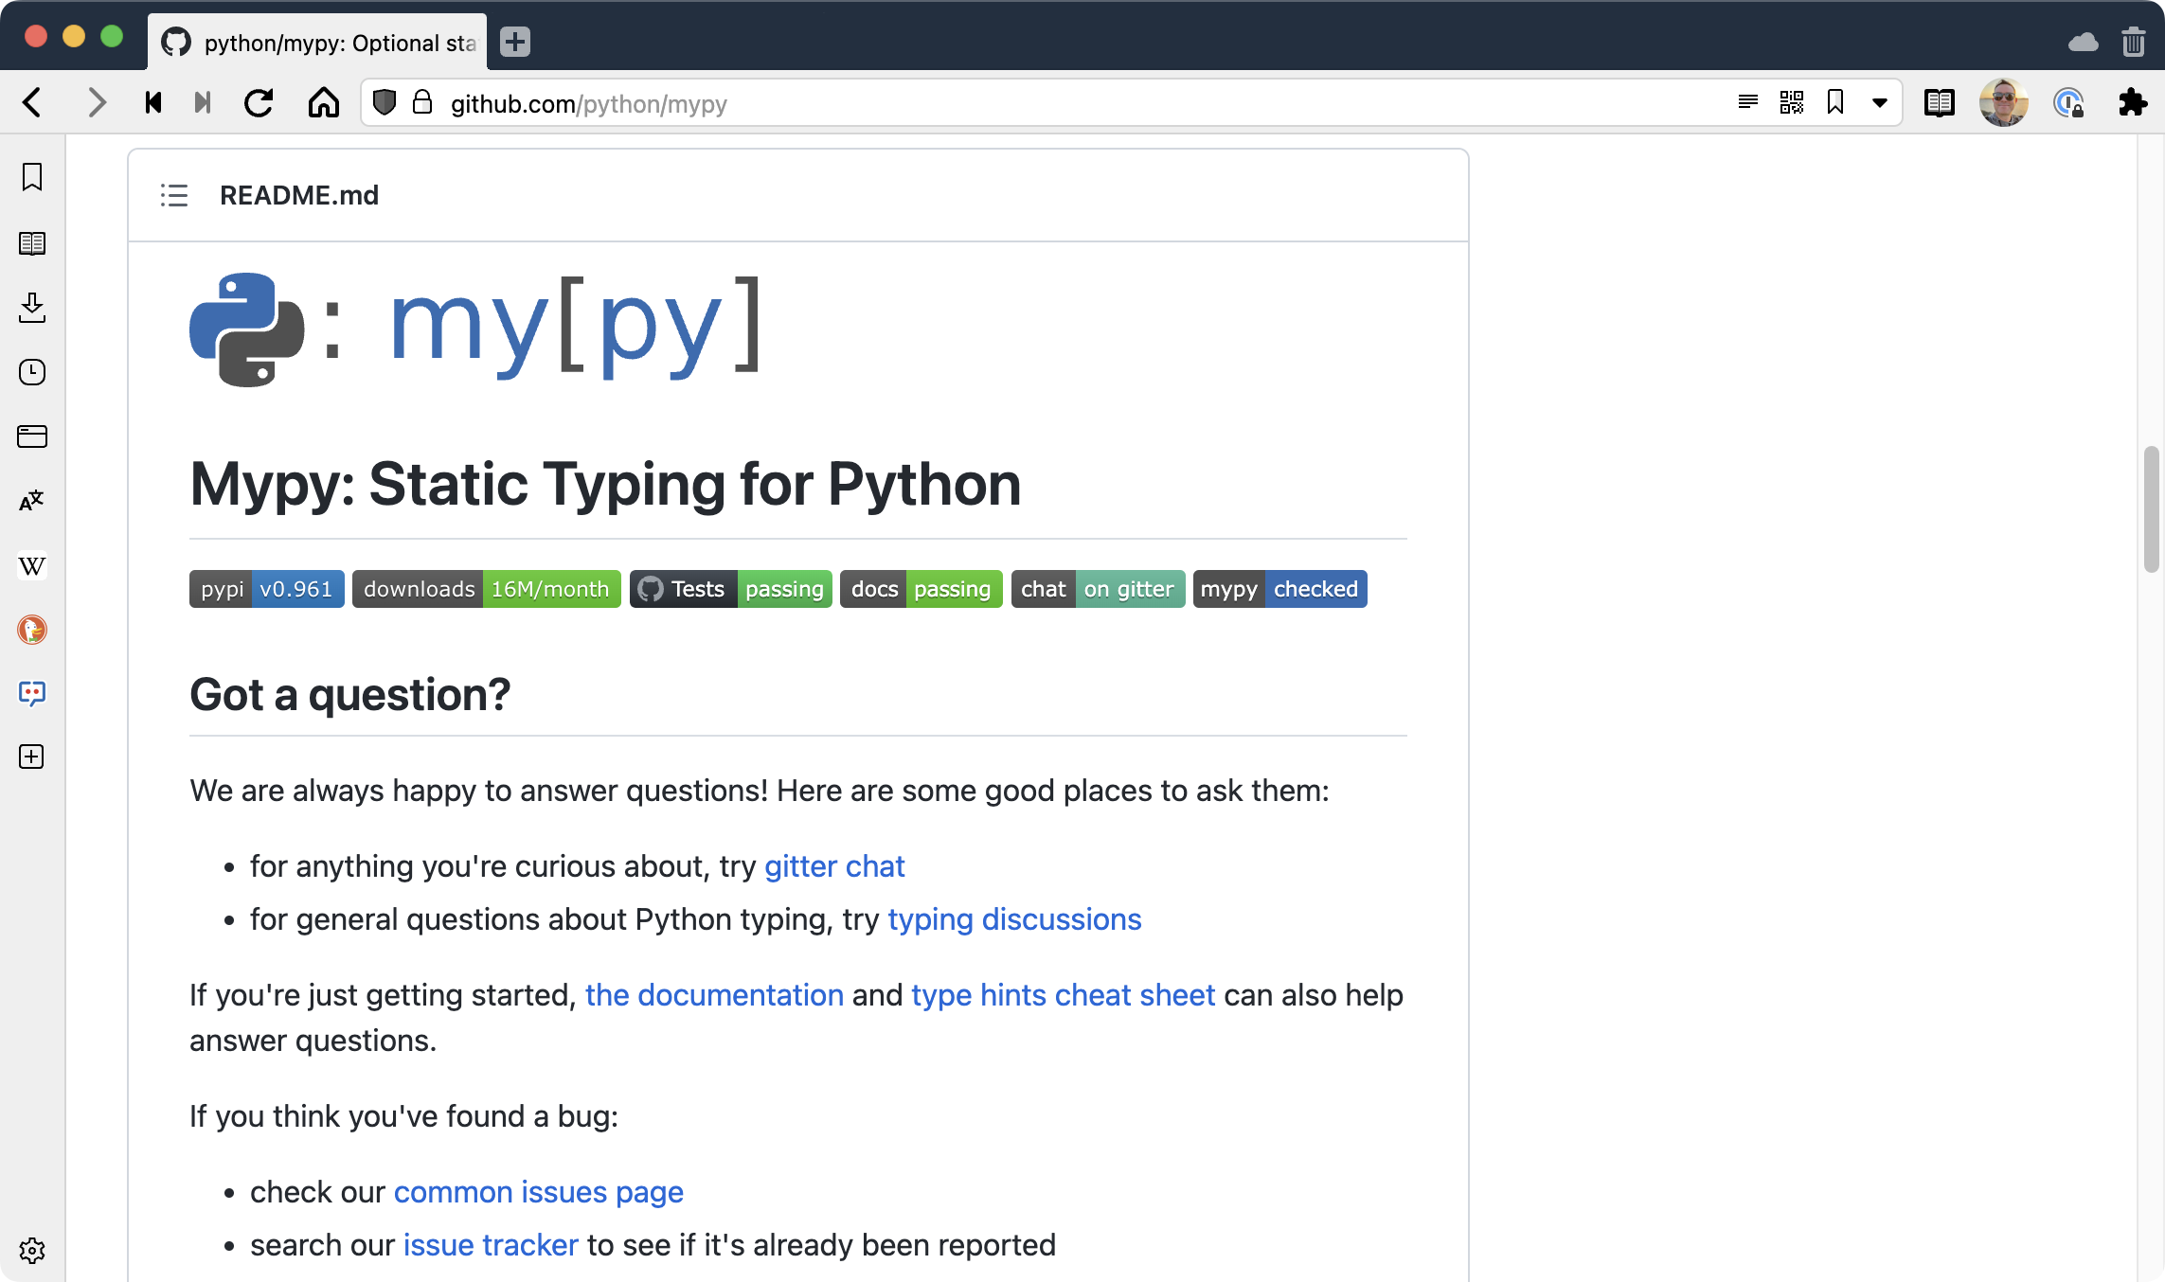
Validation with mypy

Slide 15
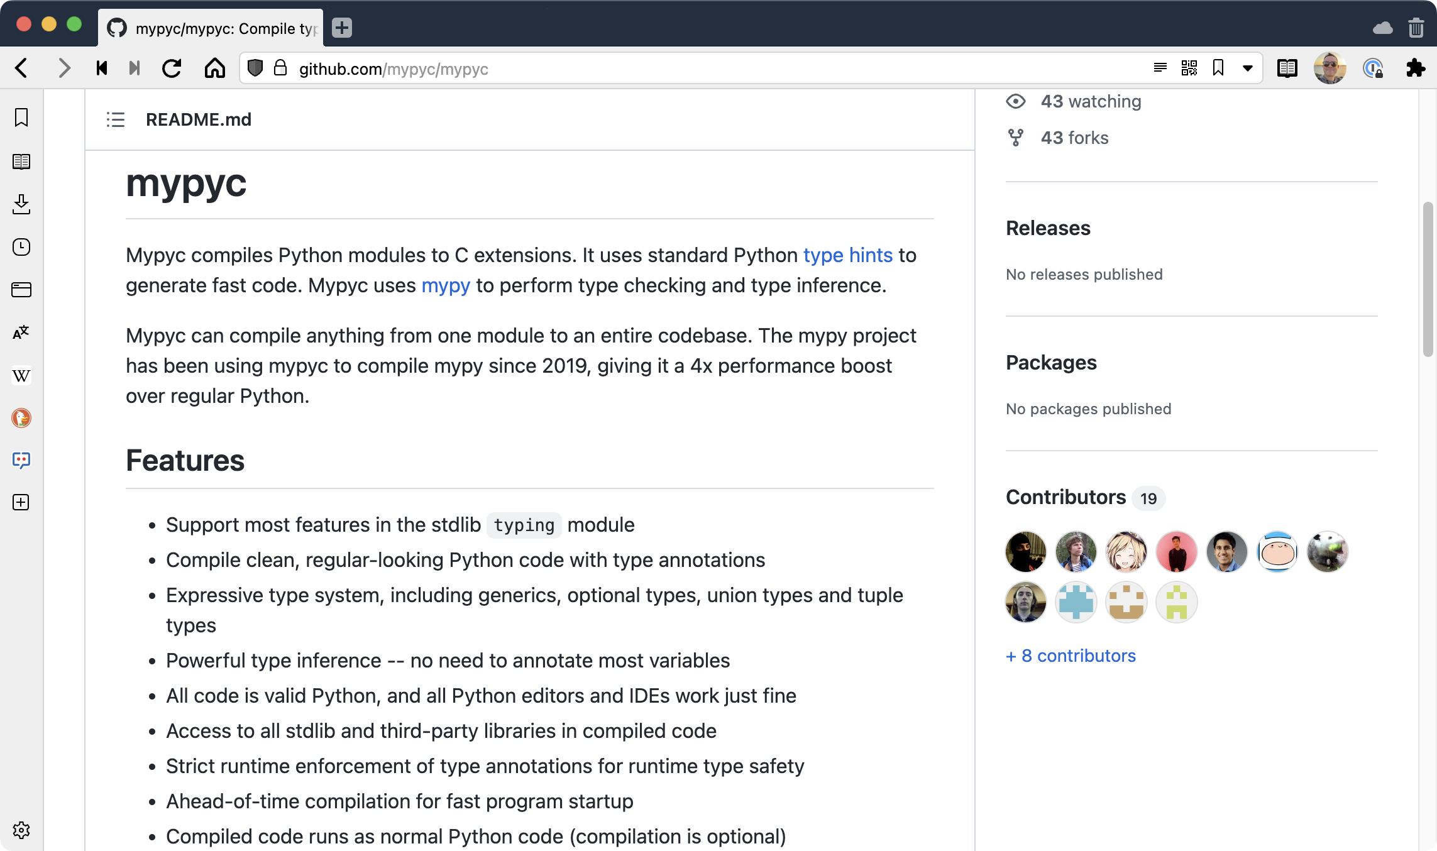
Speed ups with mypyc

Slide 16

Get the full story of typing at Instagram

