Slide 1
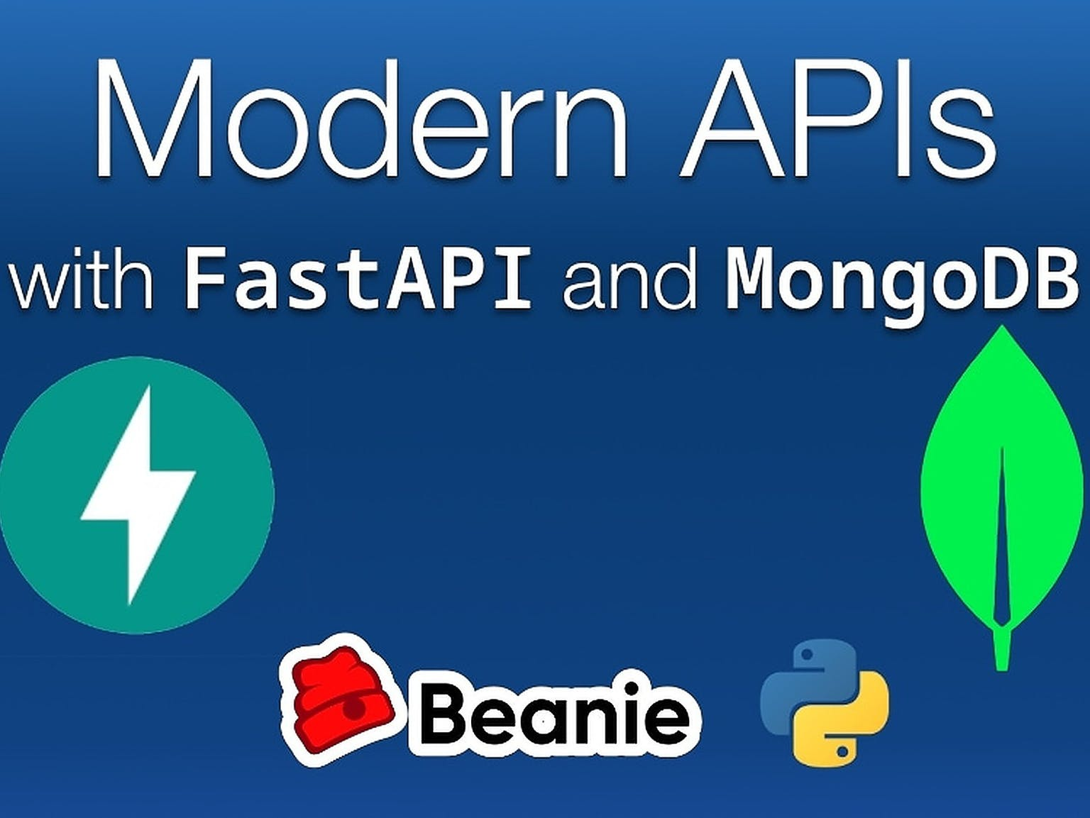
Pydantic Models
Modern APIs with FastAPI and MongoDB | A Talk Python Live Event © 2022

Slide 2
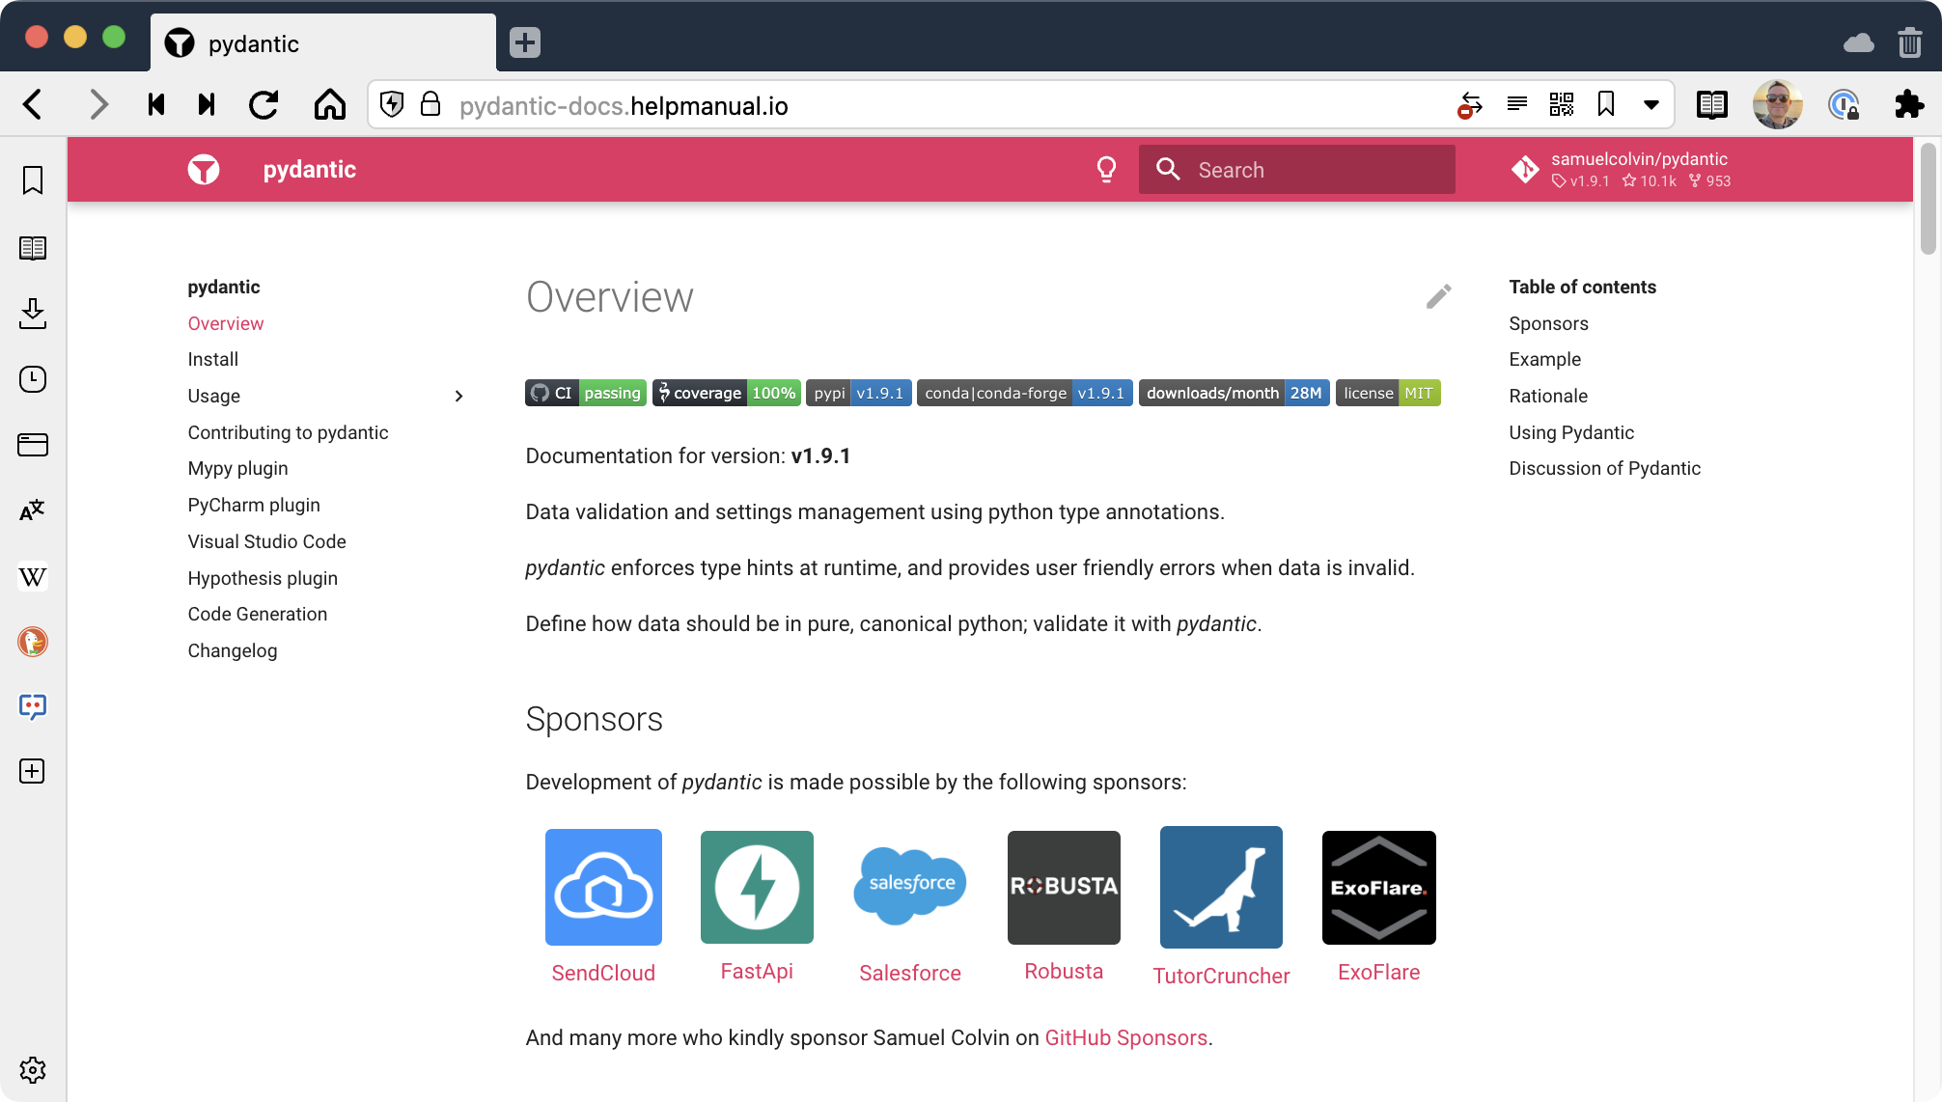
Pydantic

Slide 3
Get the plugins

Slide 4
Demo: Parsing PyPI data

Slide 5
Pydantic types
from pydantic import BaseModel
from typing import Optional
class Order(BaseModel):
item_id: int
created_date: datetime.datetime
price: Optional[float]
pages_visited: list[int] = []
order_json = {
'item_id': '123',
'created_date': '2002-11-24 12:22',
'pages_visited': [1, 2, '3'],
'price': 17.22
}
order = Order(**order_json)

Slide 6
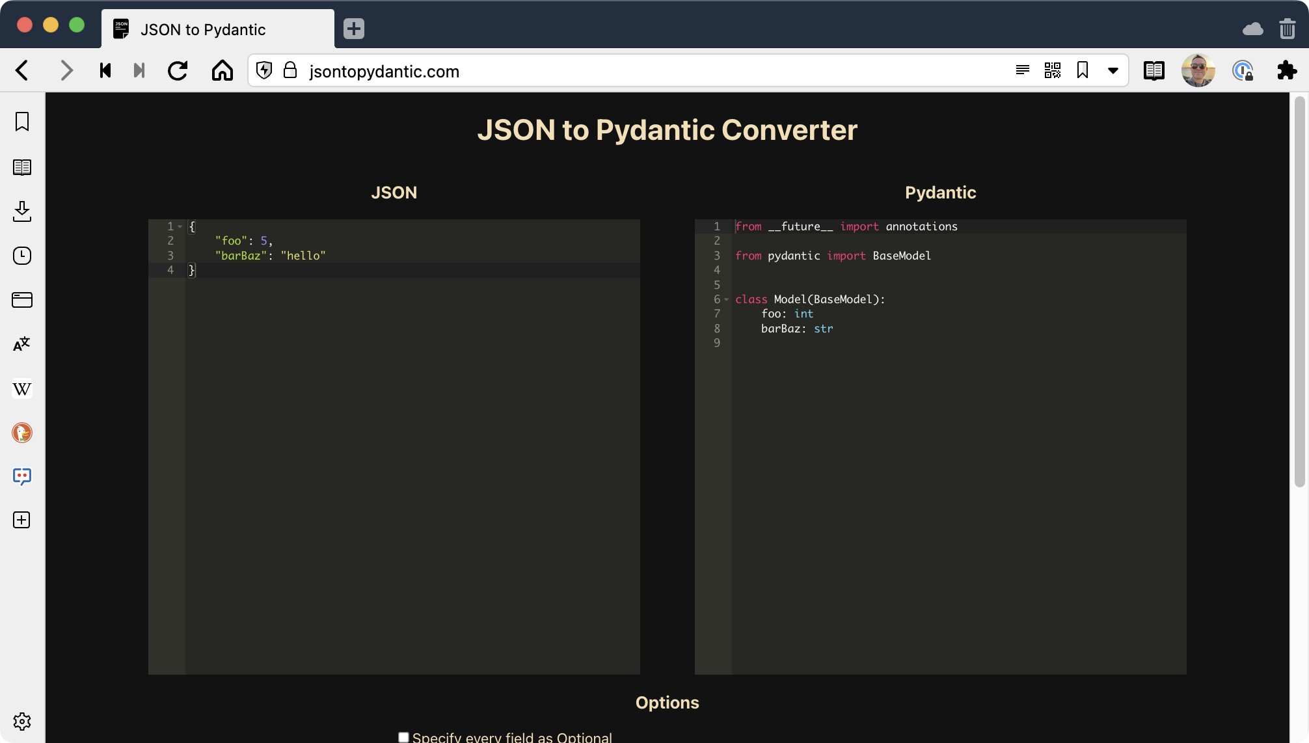
JSON to Pydantic Converter

Slide 7
Built on Pydantic: FastAPI
class Item(pydantic.BaseModel):
name: str
description: Union[str, None] = None
price: float
tax: Union[float, None] = None
@app.post("/items/")
async def create_item(item: Item):
return item

Slide 8
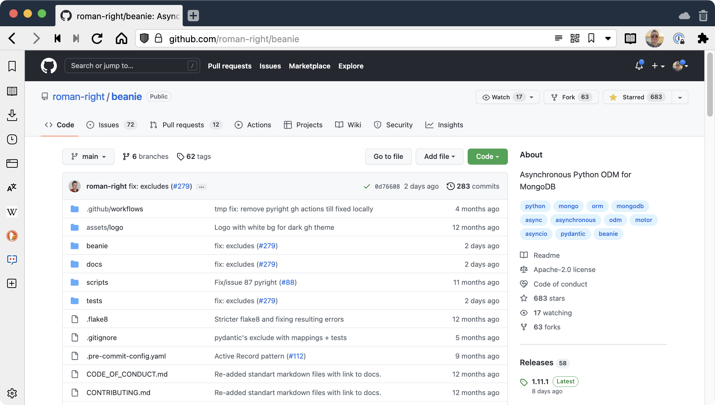
Built on Pydantic: Beanie

Slide 9
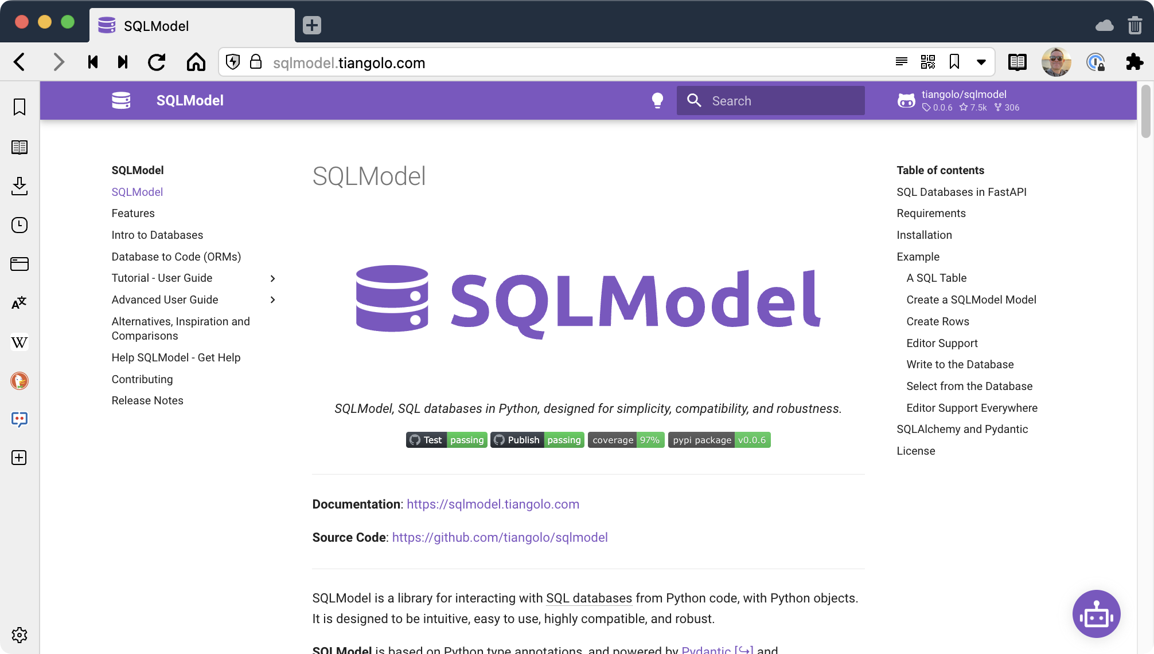
Built on Pydantic: SQLModel

Slide 10
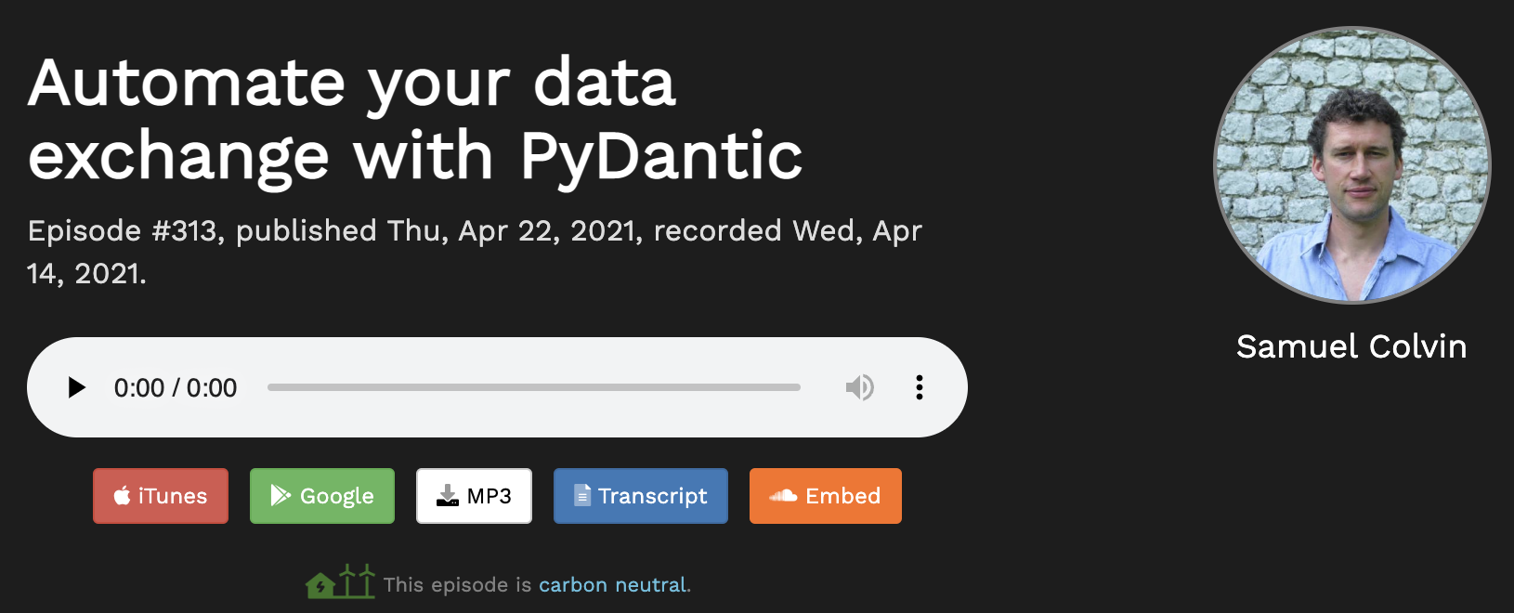
Get the full story on Pydantic
https://talkpython.fm/313

