Slide 1
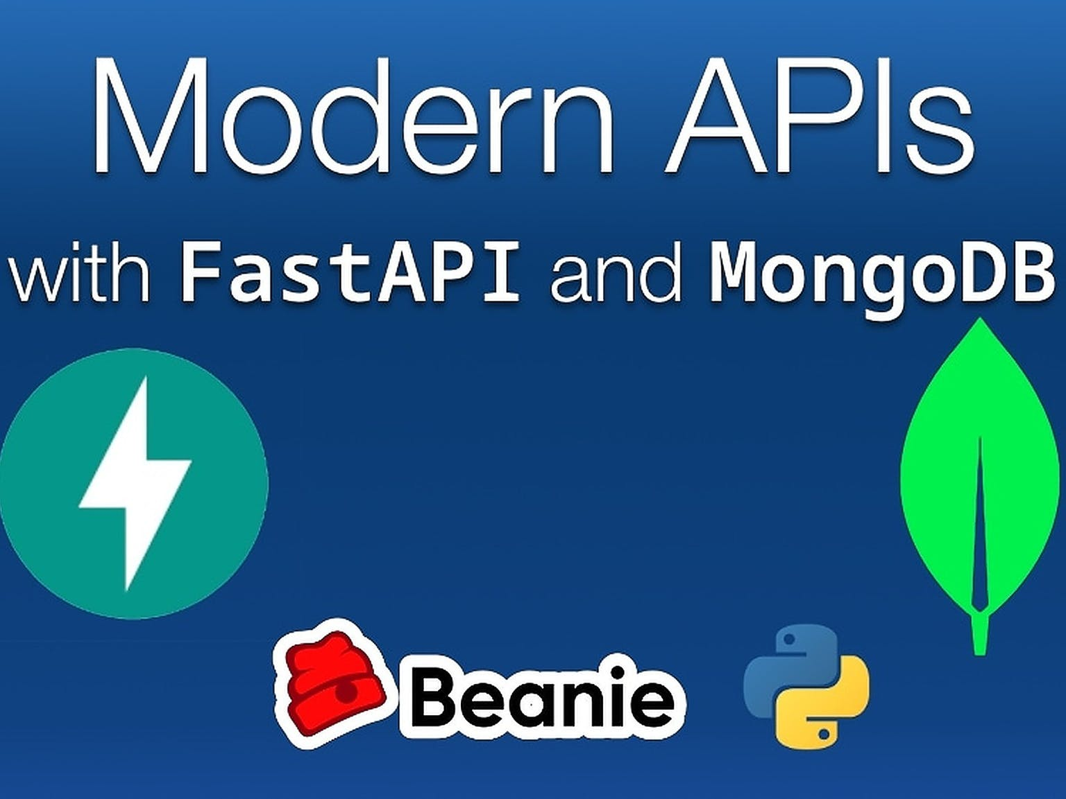
MongoDB and Beanie Foundations
Modern APIs with FastAPI and MongoDB | A Talk Python Live Event © 2022

Slide 2
Popular Deployments
http://www.sqlalchemy.org/organizations.html

Slide 3

ORM Building Blocks
image credit: fdecomite

Slide 4
Models: Classes
class Package(SqlAlchemyBase):
__tablename__ = 'packages'
id = sqlalchemy.Column(sqlalchemy.Integer, primary_key=True, autoincrement=True)
summary = sqlalchemy.Column(sqlalchemy.String)
size = sqlalchemy.Column(sqlalchemy.Integer)
home_page = sqlalchemy.Column(sqlalchemy.String)
releases = sqlalchemy.orm.relationship("Release", ...)

Slide 5
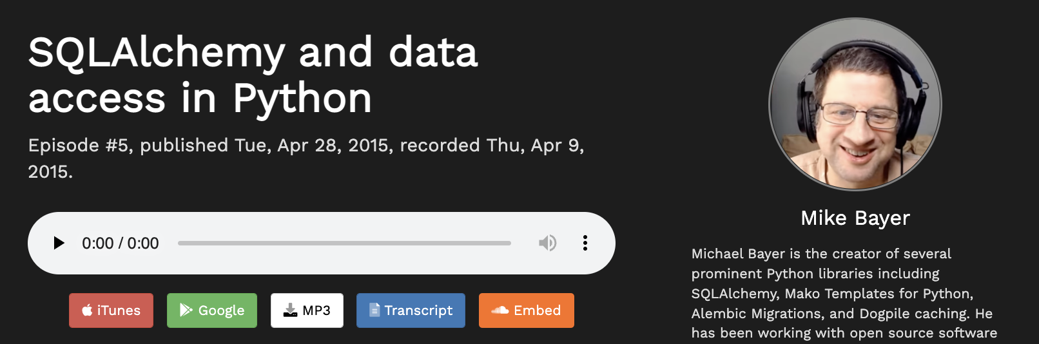
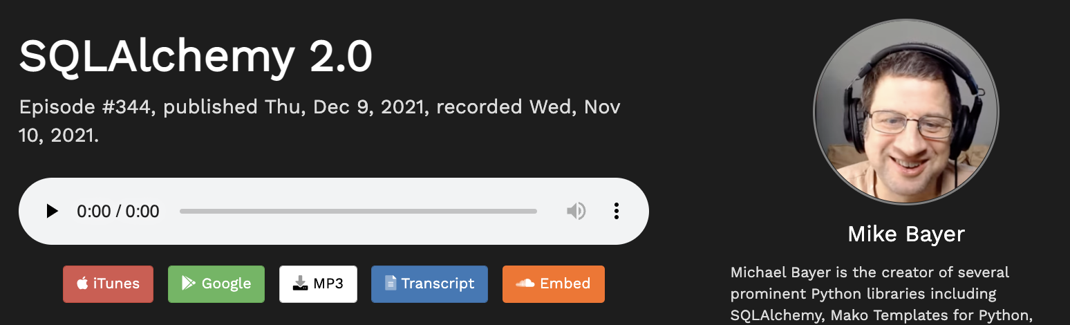
Get the full story

