Slide 1
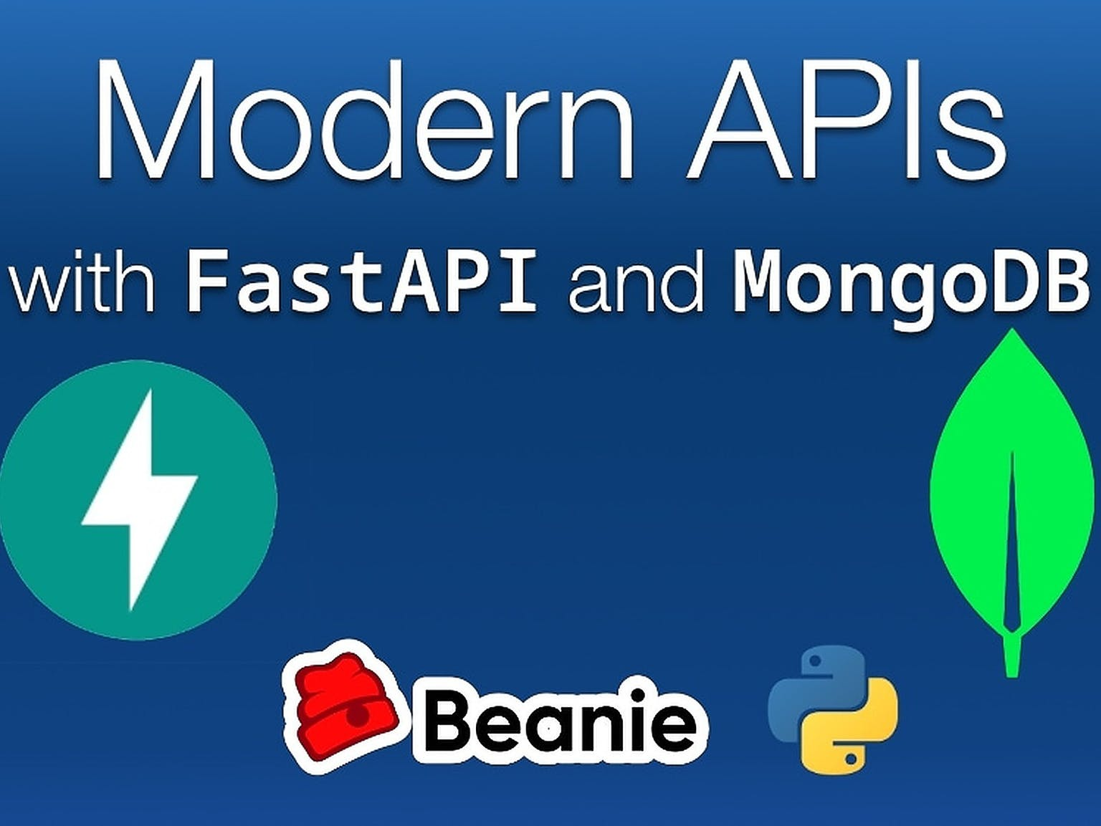
Building a realistic read-only API with FastAPI
Modern APIs with FastAPI and MongoDB | A Talk Python Live Event © 2022

Slide 2
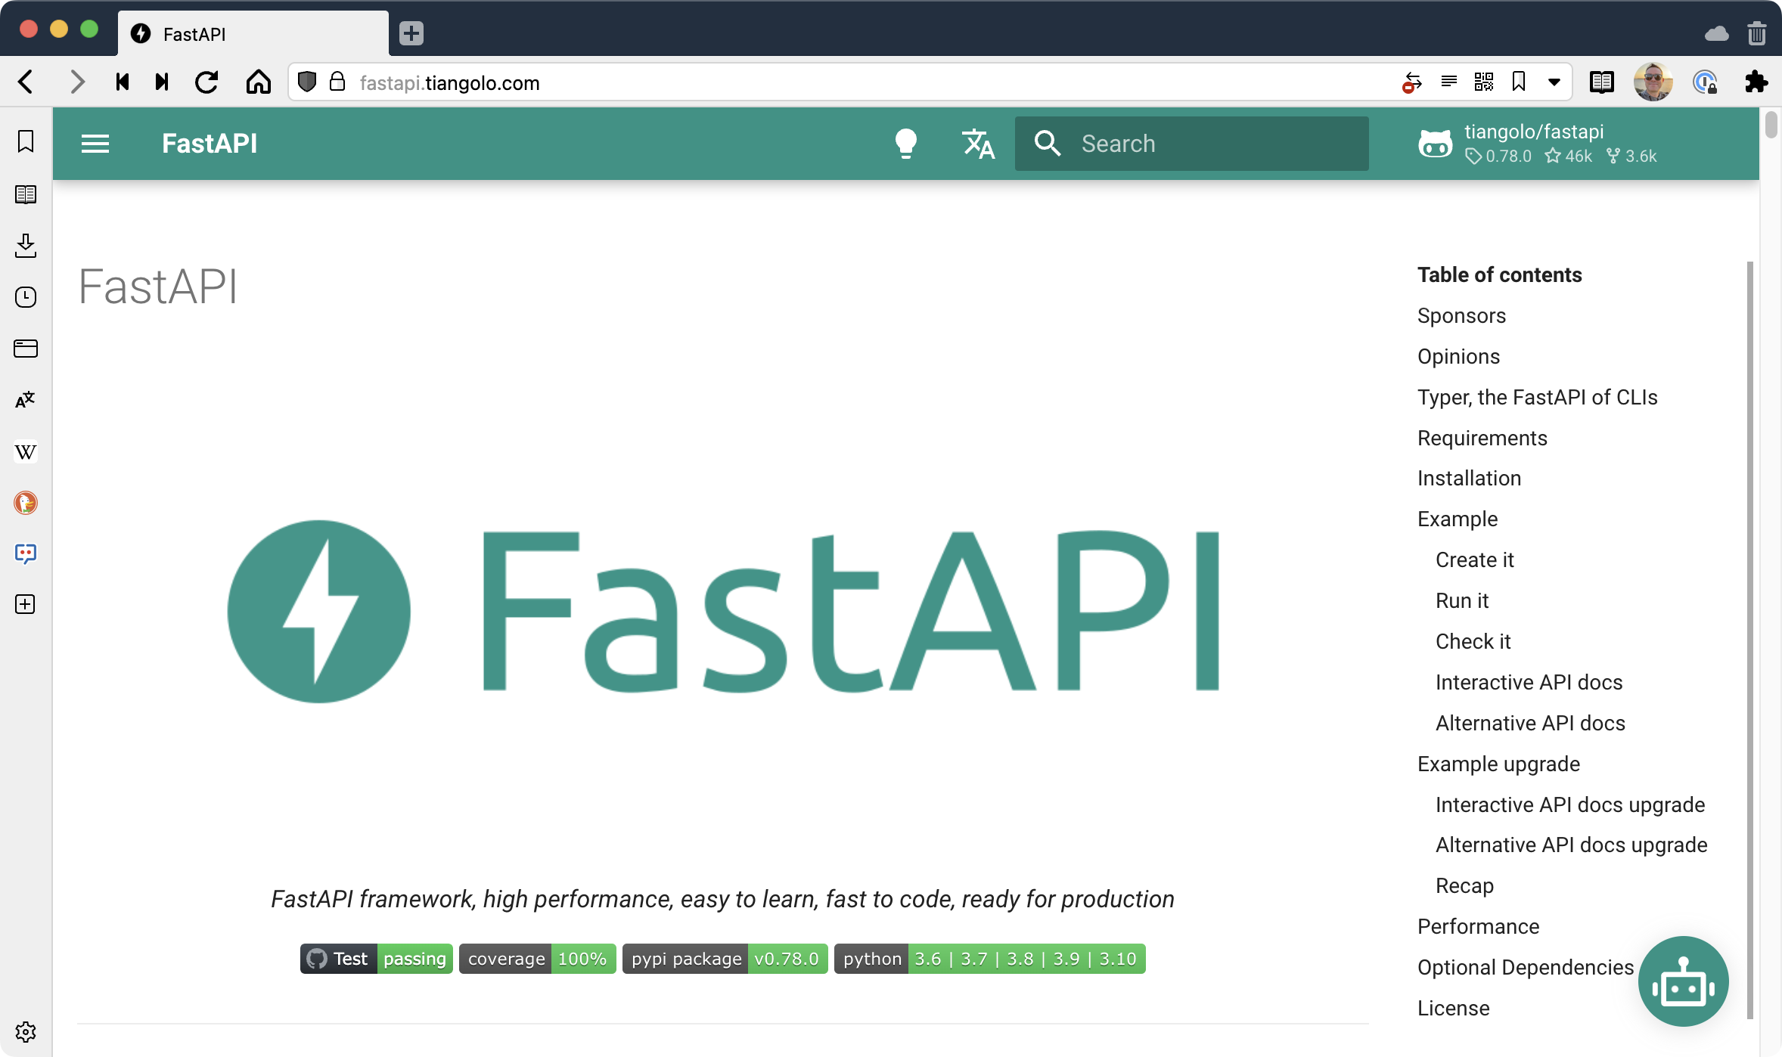
FastAPI
https://fastapi.tiangolo.com/

Slide 3

Why FastAPI
Fast to execute: Very high performance, on par with NodeJS and Go (thanks to Starlette and Pydantic). One of the fastest Python frameworks available.
Fast to code: Increase the speed to develop features by about 200% to 300%.
Fewer bugs: Reduce about 40% of human (developer) induced errors.
Intuitive: Great editor support. Completion everywhere. Less time debugging.
Easy: Designed to be easy to use and learn. Less time reading docs.
Short: Minimize code duplication. Multiple features from each parameter declaration. Fewer bugs.
Robust: Get production-ready code, with automatic interactive documentation.
Standards-based: Based on (and fully compatible with) the open standards for APIs: OpenAPI (previously known as Swagger) and JSON Schema.

Slide 4






FastAPI vs. *
54K
53K
3K
20K
6K

Slide 5
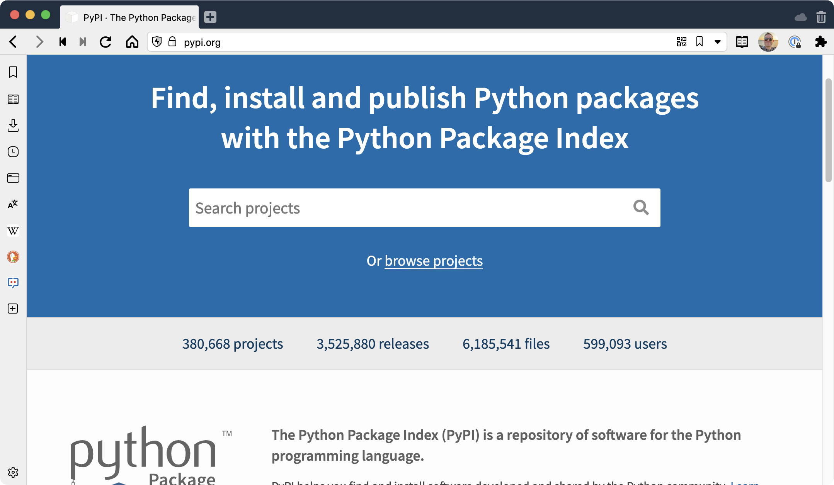
A more realistic API

Slide 6
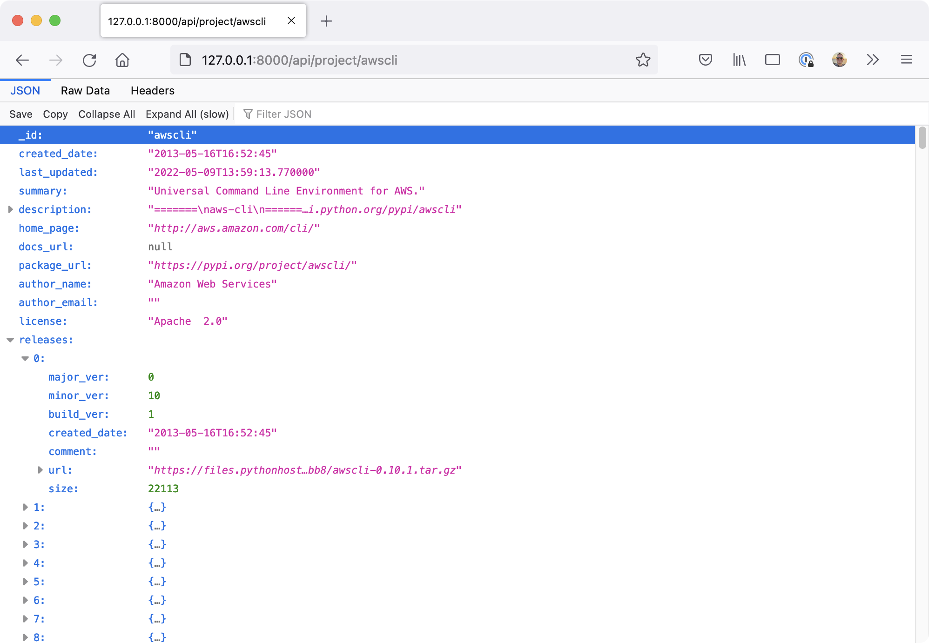
Well, here's the API

Slide 7
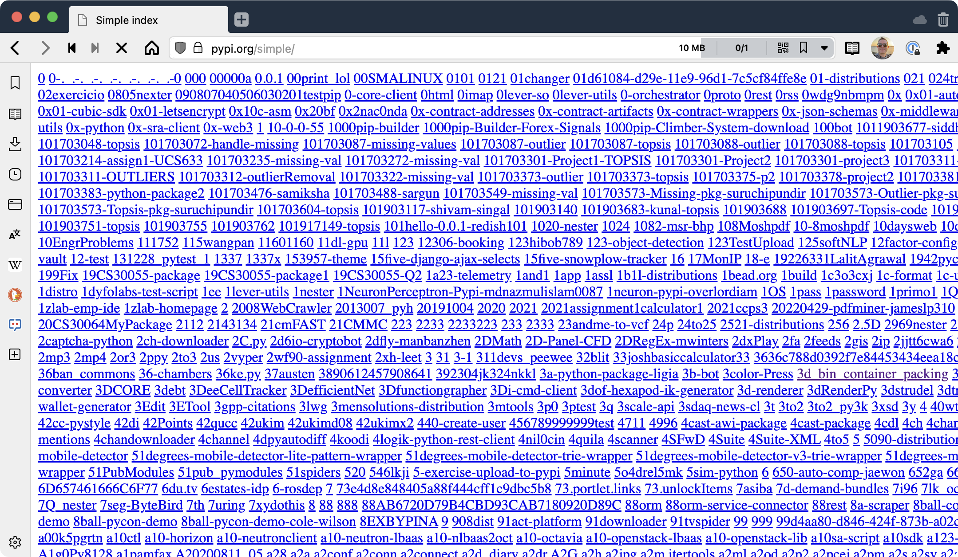
Where will we get the data?

Slide 8
Demo: create the empty site/app
api = fastapi.FastAPI()
@api.get('/')
def index(request: Request):
return "Hello world"
def init_db():
db_file = Path(__file__).parent / 'db' / 'pypi.sqlite'
db_session.global_init(db_file.as_posix())
def main():
init_db()
uvicorn.run(api)

Slide 9
Demo: make the home page
api = fastapi.FastAPI()
templates = Jinja2Templates(directory="templates")
@api.get('/')
def index(request: Request):
return templates.TemplateResponse('index.html', {"request": request})
def init_db():
db_file = Path(__file__).parent / 'db' / 'pypi.sqlite'
db_session.global_init(db_file.as_posix())
def main():
init_db()
uvicorn.run(api)

Slide 10
Demo: add static route and static data
api = fastapi.FastAPI()
api.mount("/static", StaticFiles(directory="static"), name="static")
templates = Jinja2Templates(directory="templates")
@api.get('/')
def index(request: Request):
return templates.TemplateResponse('index.html', {"request": request})
def init_db():
db_file = Path(__file__).parent / 'db' / 'pypi.sqlite'
db_session.global_init(db_file.as_posix())
def main():
init_db()
uvicorn.run(api)

Slide 11
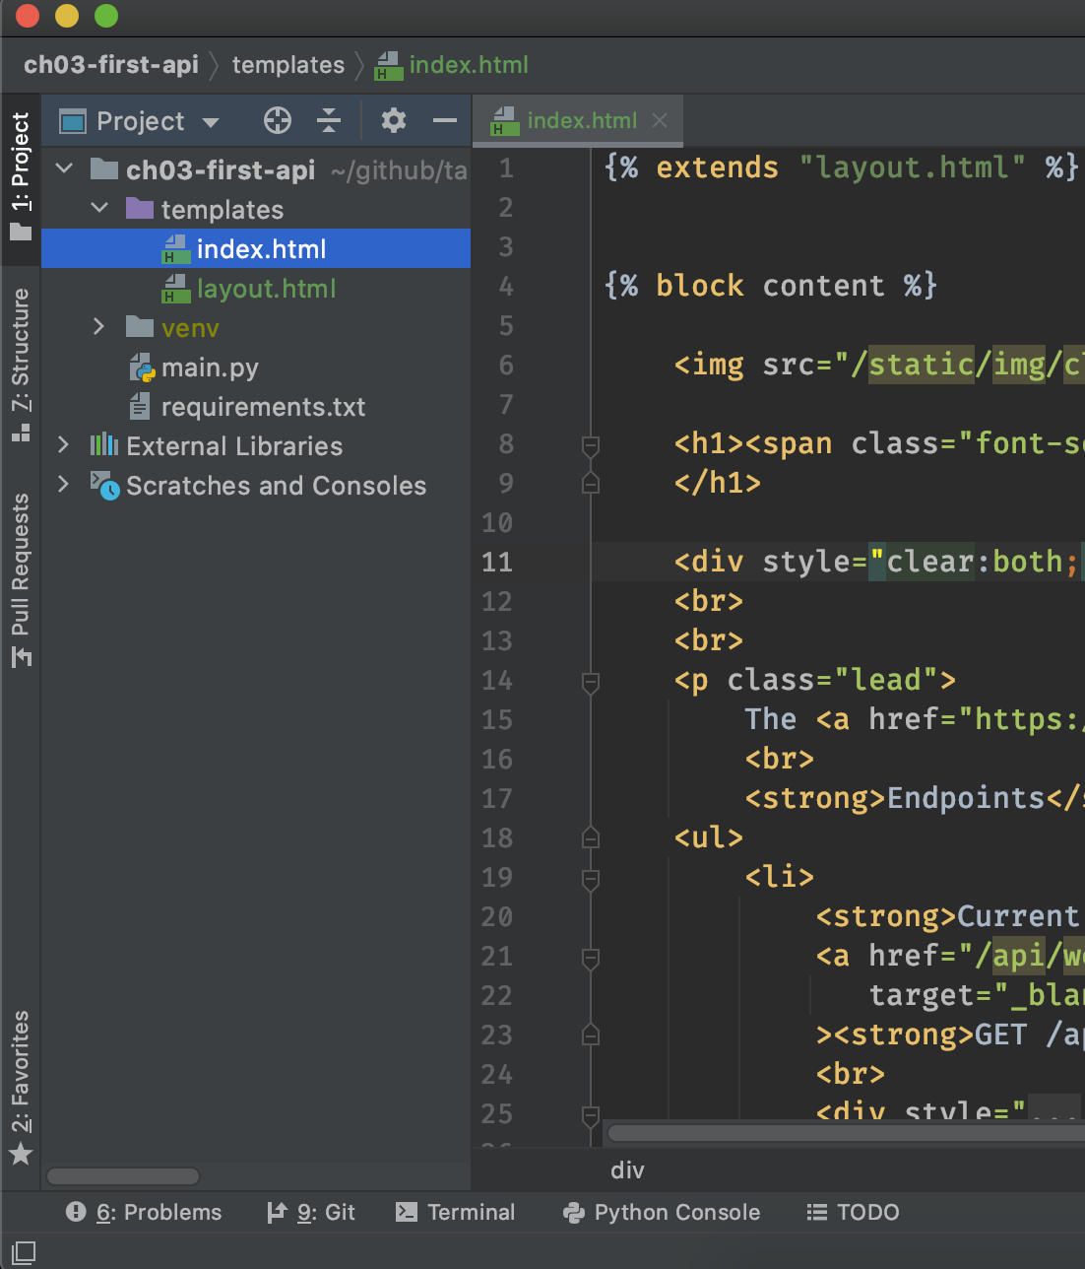
Rendering TEMPLATES
templates = Jinja2Templates(directory="templates")
@router.get('/')
def home(request: Request):
return templates.TemplateResponse(
'index.html',
{'request': request} )

Slide 12
Demo: Partitioning with routers

Slide 13
Building "real" apps
# api.py
import fastapi
router = fastapi.APIRouter()
@router.get('/api/weather')
def weather(...):
# ...
# home.py
import fastapi
router = fastapi.APIRouter()
@router.get('/', include_in_schema=False)
def home():
return {'name': 'Michael'}
# main.py
import fastapi
import api
import home
app = fastapi.FastAPI()
app.include_router(home.router)
app.include_router(api.router)

Slide 14
Demo: Add API endpoints for packages
/api/packages/count
/api/packages/details/{package_name}
/api/packages/search/{keyword}

Slide 15
CONCEPT: async view methods
import fastapi
router = fastapi.APIRouter()
@router.get('/api/packages/count')
async def count_packages():
count = await package_service.package_count()
return {'package_count': count}

Slide 16
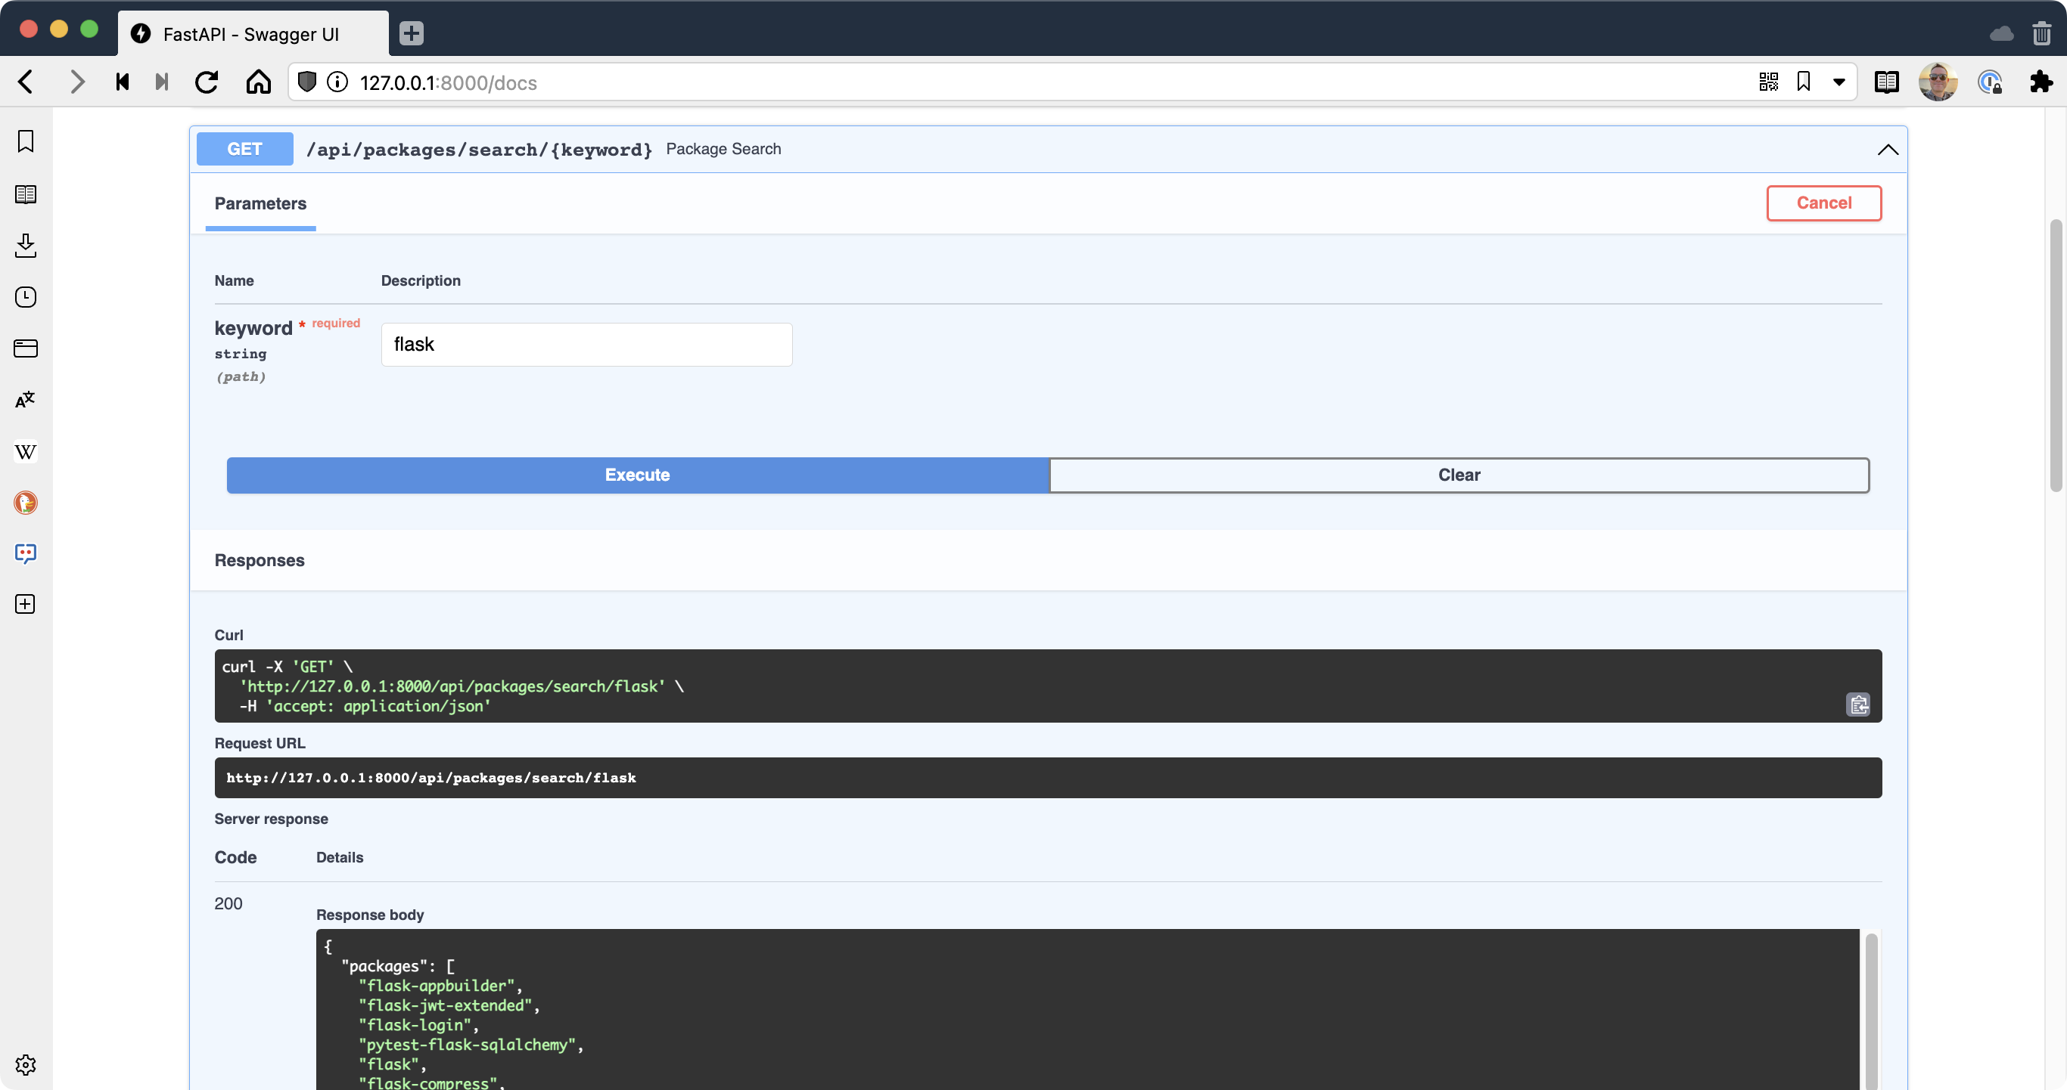
API Documentation

Slide 17
API Documentation
@router.get('/api/packages/count', response_model=PackageCountModel)
async def count_packages():
count = await package_service.package_count()
resp = PackageCountModel(package_count=count)
return resp.dict()
Set response_model to a Pydantic type.

Slide 18
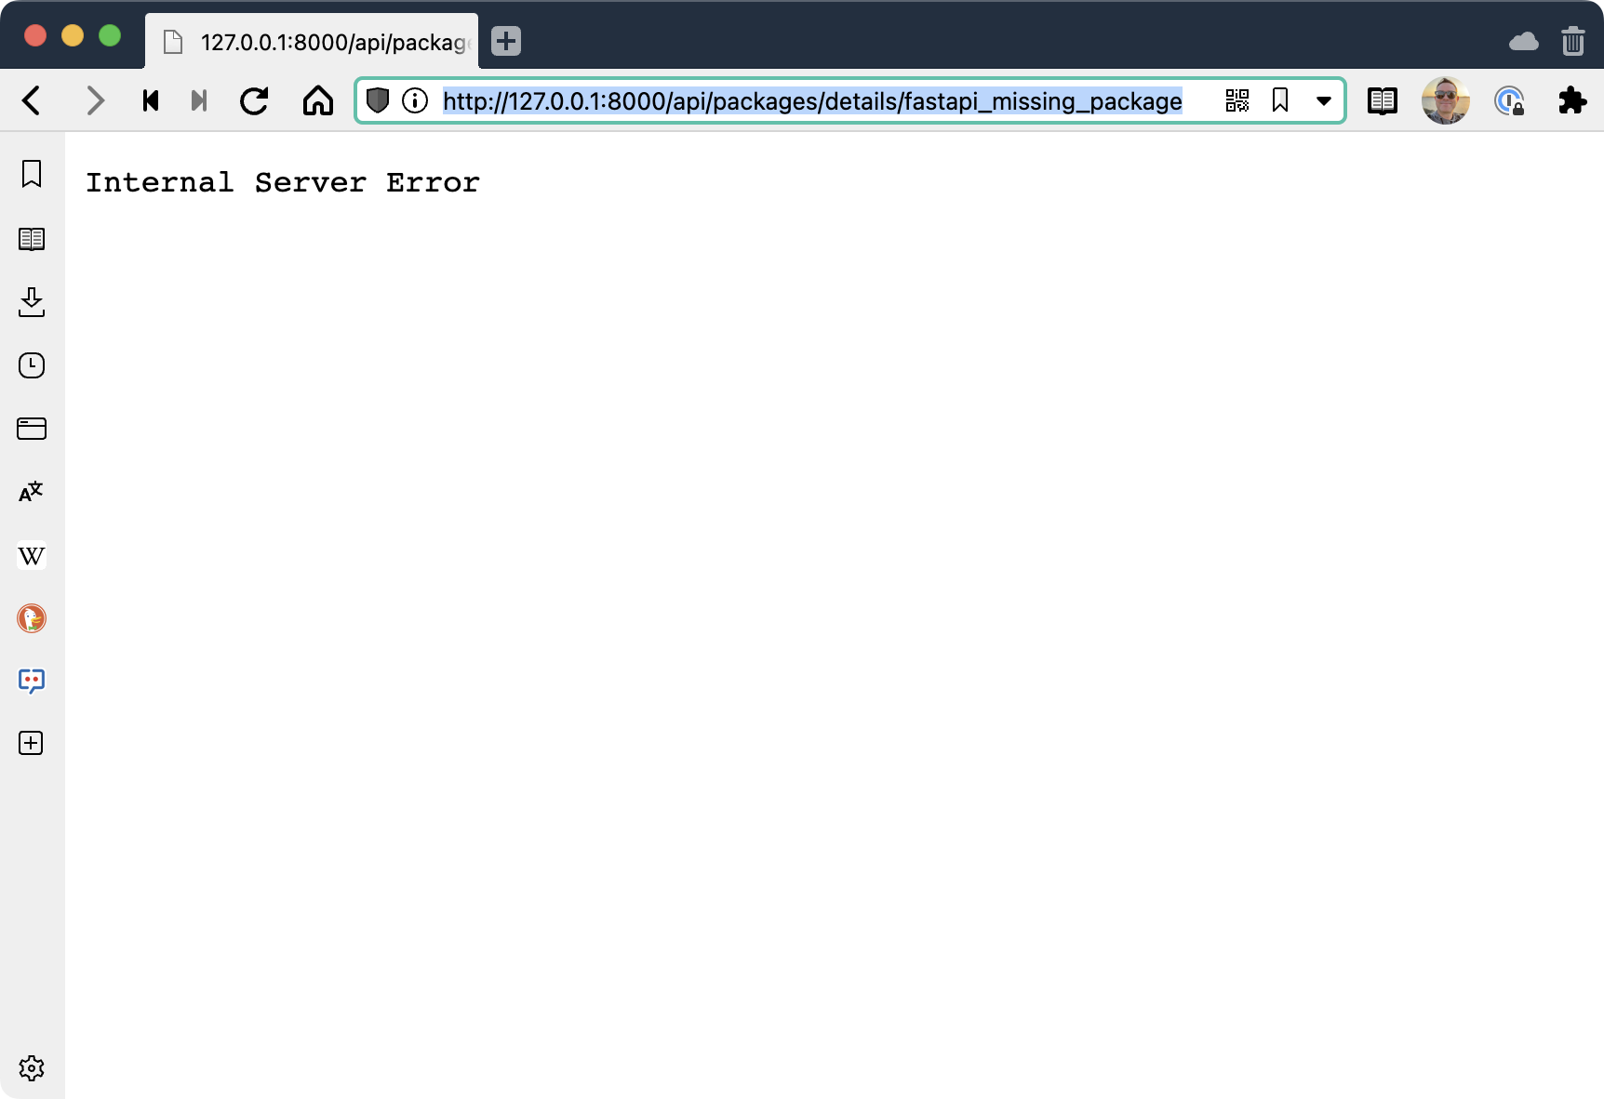
Status codes and responses

Slide 19
Status codes and responses
@router.get('/api/packages/details/{package_name}', response_model=PackageModel)
async def package_details(package_name: str):
try:
package = await package_service.get_package_by_id(package_name, include_maintainers=True)
if not package:
msg = f"Package with name {package_name} was not found."
return fastapi.Response(content=msg, status_code=404)
resp = PackageModel.from_orm(package)
return resp.dict()
except ValidationError as ve:
print(f"We ran into a problem converting DB data to models: {ve}")
return fastapi.Response(content=str(ve), status_code=500)

