Slide 1
Tradespace Exploration (TSE) Commercial Ship Case Study
Mike Curry
05 June 2018
Draper Proprietary

Slide 2
Overview of Tradespace Exploration (TSE)
Draper’s TSE capability enables the analysis of decision-making problems that have multiple objectives across all stages of the system lifecycle
What are underlying tradeoffs?
What do the best designs have in common?
What variables is the design sensitive to?
How does uncertainty affect design risk?
TSE provides a quantitative approach for decision-making with traceable rationale that can be more easily communicated with stakeholders
100
Cost & Configuration
Commitments
75
Knowledge
Cost Incurred
50
25
Management
Leverage
Concept
Development
Detailed
Design
Integration & Test,
Production
Use
Adapted from Blanchard & Fabrycky, 1998
Challenge: How can we identify good designs for a highly complex, multidimensional system such as a multi-mission commercial ship given uncertainty about the future?
Notes:
Overview:
1. This slide provides the technical case for tradespace exploration at a notional level.
TSE problems have multiple competing goals
They are widely varied in scope and application
Frequently applied during conceptual design, but applicable to all lifecycle stages
Provide quantifiable decision-making that is traceable
reduce uncertainty through increased upfront modeling
Make decisions when there is higher management leverage and lower commitments
Applied during all stages of the system lifecycle, but most frequently during early-stage concept development
Shifts development of knowledge and key insight to when changes are easiest and least expensive

Slide 3
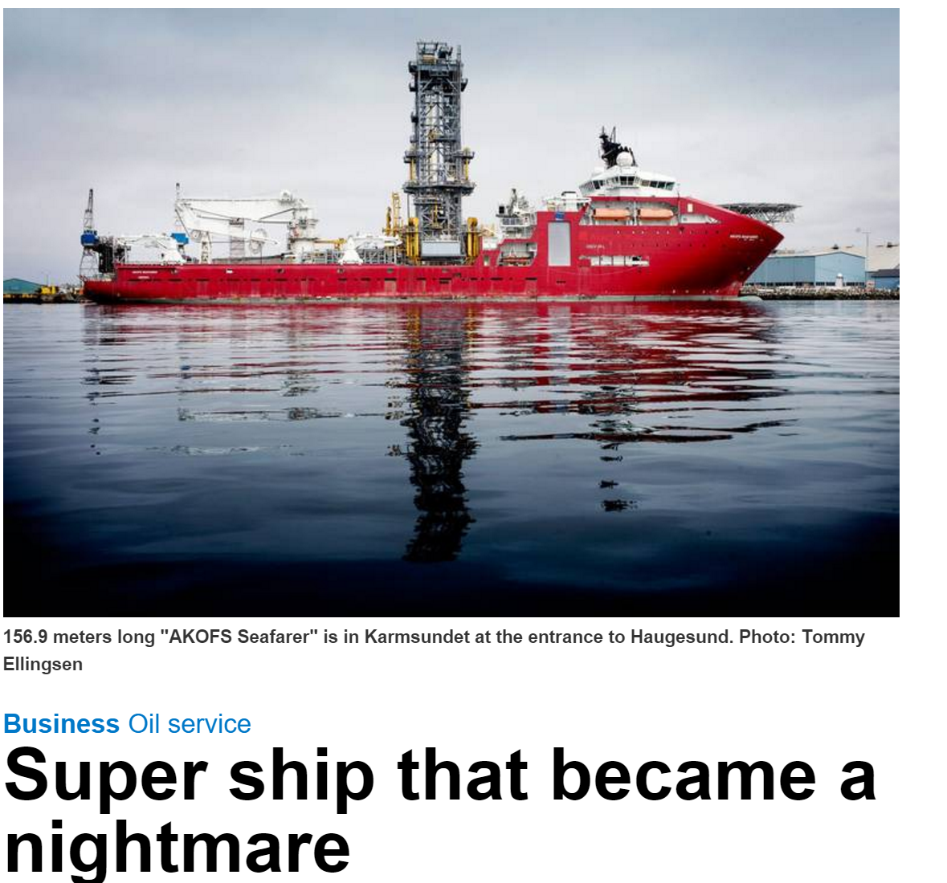
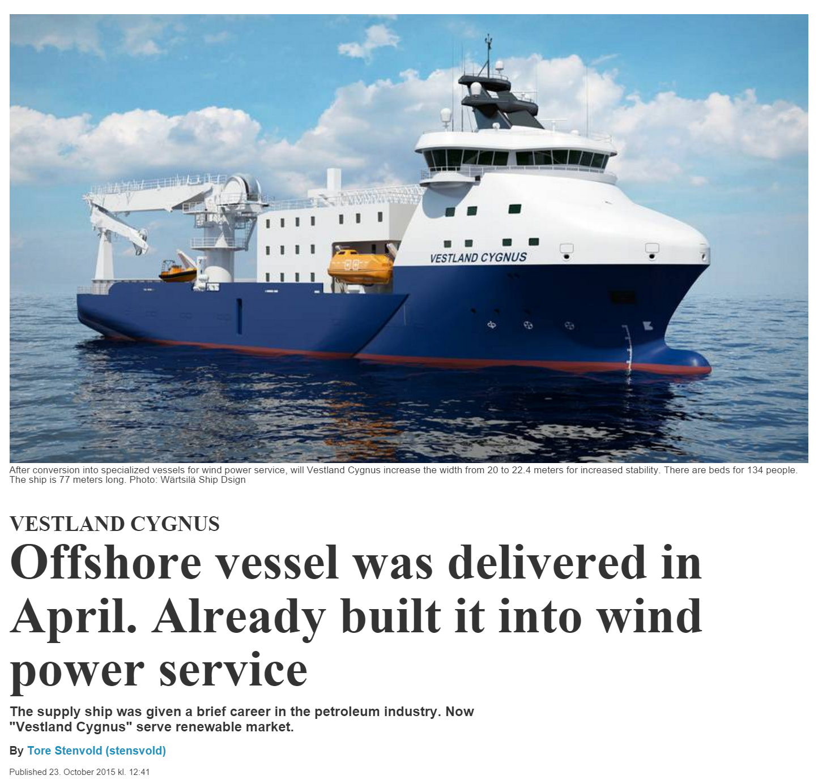
Commercial Offshore Ships
Case:
Offered in the spot market, after one year without any contracts.
Bad
Newbuild costs (2010):
Estimated $115M
Final 500M!
At order: Multi-purpose
Now: “Multi-useless”
AKOFS Seafarer
Case:
Originally delivered as an offshore supply vessel in 2015, but was immediately after delivery converted to a wind power service vessel.
Good
Original $37M
Retrofit $15M
Immediately repurposed for new mission
Vestland Cygnus
Notes:
The commercial offshore ship case study was developed in collaboration with MIT and SME’s from NTNU. The study focuses on the design of large ships that are primarily for applications like servicing offshore oil platforms, laying undersea cables, etc.
These ships have long development times and service lives which make them susceptible to future uncertainty, but this means they are exactly the type of design problem that is well-suited for IEEA.
Volatility in prices in world oil markets has motivated ship-builders to reexamine the way they design these multi-function ships and shown here are two recent examples of when things did and did not go well.
The first example is the Seafarer which was built as a very large multi-mission ship, but by the time it entered service, oil prices had collapsed and it went without a contract for over a year.
Because it was big and multi-functional it was expensive to operate, and oil was now less profitable so they started refering to it as a ”multi-useless” ship
The second example here, the Cygnus, tells the opposite story. It was originally developed as an offshore supply vessel, but after delivery it was immediately converted to a wind power service vessel to remain useful and profitable.
Since I’ve already covered a the space tug case study in some detail I’m just going to walk through a brief overview of this case to show how the IEEA framework can be generalized and scaled to examine it.
Notes:
The Seafarer is a Super advanced and expensive ship that, as of 2015 had been without a contract for one year.
With the recent collapse of the oil prices and offshore markets, we have the case of Vestland Cygnus.
Vestland Cygnus was originally delivered as an offshore supply vessel in 2015, but was immediately after delivery converted to a wind power service vessel.
This case illustrates the relevance of the proposed research topic.
Notes on scalability
Issues related to scalability can derive from four primary aspects depending on the nature of a particular case study [72]:
Amount of data
Dimensionality of data
Complexity of data
Dynamic data

Slide 4
Integrated Ship System Model
Decision variables
Hull Characteristics (Length, Beam, Width, etc)
Engine Characteristics (Power, Fuel)
Equipment Installed
Sea State
Characteristics
Performance Attributes
Stakeholder Needs
Hull Geometry
Mass
Stability Derivatives
Hull Mass
Available Deck
Area
Propulsion
Power
Mass Model
Equip.
Mass
Utility Function
Dead Weight / Useful Load
Hydro-Dynamics
Maximum
Speed
Eco
Model
Eco Friendliness Score
Cost
Model
Acquisition and Operations Cost
Combining each sub-analysis into an integrated system model enables us to conduct trades on the system-level variables of interest
MODM methods like utility theory allow us to evaluate all enumerated design on a common scale

Slide 5
Tradespace and Pareto Optimality
Running the integrated model for multiple permutations and levels of the design variables results in a large set of candidate alternatives (e.g. tradespace)
Occasionally only a subset of the possibilities within the decision space are important to consider for tradeoffs
This is the subset of all non-dominated points of the decision space
The solutions within this subset are dubbed Pareto Optimal solutions, and the entire subset is known as the Pareto frontier
If the requirements are adequately characterized, the designer wishes only to consider Pareto Optimal solutions
System alternatives can be examined in this way to identify the alternatives that balance the competing metrics that we are trading

Slide 6
Overview of Commercial Ship Case
Design Variable | Levels
Length [m] | [120, 150, 180]
Beam [m] | [20, 25, 30]
Depth [m] | [8, 13]
Installed Power [MW] | [15, 25]
Accommodation [persons] | [50, 250, 400]
Main Crane [tons] | [0, 400, 800]
Light well intervention tower [tons] | [0, 300, 600]
Moonpool | [no, yes]
Fuel Type | [MGO, Dual Fuel]
Dynamic Positioning | [no, yes]
Remotely operated vehicle | [no, yes]
Pipe-laying capability | [no, yes]
DFC Level | [0,1,2,3]
Scenario: A ship owner wants to target current and future contracts from customers with varying missions and preferences
Goals: Ensure profitability by providing value to customers, regardless of changing mission requirements, for as long as possible
Decision-maker is attempting to satisfy sets of preferences corresponding to different contracts in fluctuating oil markets
41,204 Design Alternatives
Performance Attribute
Speed [knots]
Deck Area [m²]
Dead Weight [tons]
Eco-friendliness
Expense Attributes
Acquisition Cost [$M]
Operational Costs [$M/yr]
Notes:
Following the first 5 processes from IEEA, the ship case study can be conceptualized in very much the same way as the space tug case…by defining key design variable, modeling their mapping to system performance and expense attributes, then enumerating the design space.
The key difference here is that the design space and epoch spaces for this case study were much larger. This case considered over 40K design alternatives compared to space tug which had 386.
Notes:
Goal is to ensure profitability and eco-friendliness.
Offshore ships, in contrast to traditional deep-sea cargo ships, are designed to provide special operational services typically related to the offshore oil and gas industry. This group of ships comprises platform supply vessels (PSV), inspection maintenance and repair (IMR) and offshore construction vessels (OCV), to mention a few. A recent period of high oil prices and deep sea petroleum discoveries has spurred the development of offshore oil and gas fields. Thus, there has been a growing need for offshore services, including well maintenance and intervention services with light, riserless technologies. OCVs have taken an increasingly large part in the development of these, in particular for the marginal fields, due to their price competitiveness. Additionally, the Deepwater Horizon oil spill in 2010 in the Gulf of Mexico has changed some of the focus for the offshore shipowners towards being able to provide various deepwater emergency and rescue operations. This strong market period has characteristically driven the design of offshore ships towards multifunctional, gold-plated and expensive solutions [12]. However, the recent oil price collapse of 2014 has had a significant impact on the offshore markets, rendering many of these multifunctional ships less competitive against cheaper, specialized ships. The current situation in the offshore industry serves as a good example of the importance of focusing on value robustness and operational flexibility as key factors for success in a highly volatile maritime industry [13,14].
Offshore ships are usually built either for a specific long-term contract or on speculation. A long-term contract may last 5-10 years, and these ships are often specialized for the particular mission. Ships built on speculation tend to be more multifunctional, to be able to take on different contracts. If these ships do not get any lucrative long-term contracts, they are often offered in the spot market to take on various short-term contracts. If a ship does not get a contract, it is idle for short periods or laid up over longer periods.
For the offshore ship, the various key performance indicators are estimated based on simple relations from the design variables, including speed, deck area, dead weight, acquisition cost and operational costs. Designs that violate the technical requirements in an epoch are rendered infeasible.

Slide 7
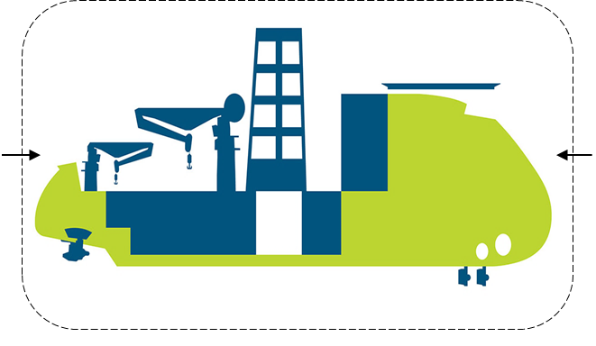
Epoch-space Characterization
Scenario: A ship owner wants to target current and future contracts from customers with varying missions and preferences
Each of the 96 epochs defined by:
(12) Mission types
(2) Contract rate and type [spot/term]
(4) Operational Areas
12 Possible Missions
Subsea installation & Construction
Inspection, maintenance and repair
Light well intervention
Offshore accommodation
Offshore cable laying
Offshore pipe laying
Offshore platform supply
Emergency response
Offshore mining support
Offshore aquaculture support
Field decommission support
Offshore wind support
Potential evaluation space: design x epoch ≈ 40K x 100 ≈ 4M evals
Contract
- Rate [kUSD/day]
- Type [day rate/6 mos to 5 yrs]
Mission requirements
Light well int. [tonnes]
Subsea module [tonnes]
Accommodation [POB]
Remotely operated vehicle
Deck area [m²]
Operational area
Gulf of Mexico
North Sea
Brazil
West Africa
Area information
Sea state (Hs) [m]
Water depth [m]
Notes:
A similar story with data scale is seen when we look at the epoch space
The key exogenous uncertainties that impact ship operations and how much value they deliver to stakeholders are the mission, contract type and operational area
Enumerating the combinations of these 3 factors results in 96 possible epochs.
To consider the different missions, contract types and areas of operation required the enumeration of 96 epochs
This means the number of design-epoch pairs was around 4 million. Much larger then the 6,000 or so for the space tug case.

Slide 8
Live Demo Here

Slide 9
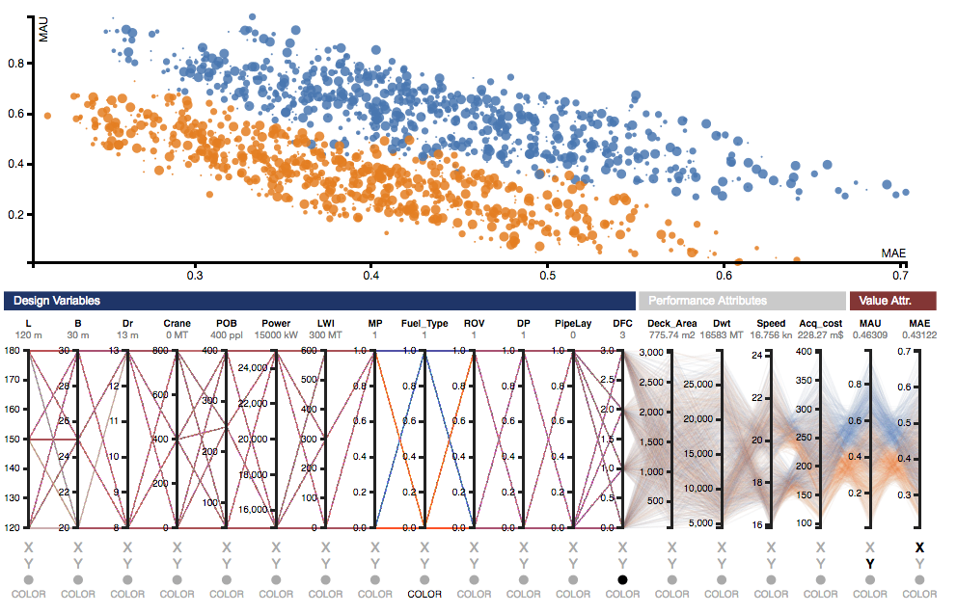
Single Epoch Analysis
Live Demo
Interactive scatterplot identical to previous case study
Some consideration made for scalability
Tradespace with color encoding mapped to fuel type
N= 41,204 designs
Epoch = i
(This is 1 of 96 epochs)

Slide 10
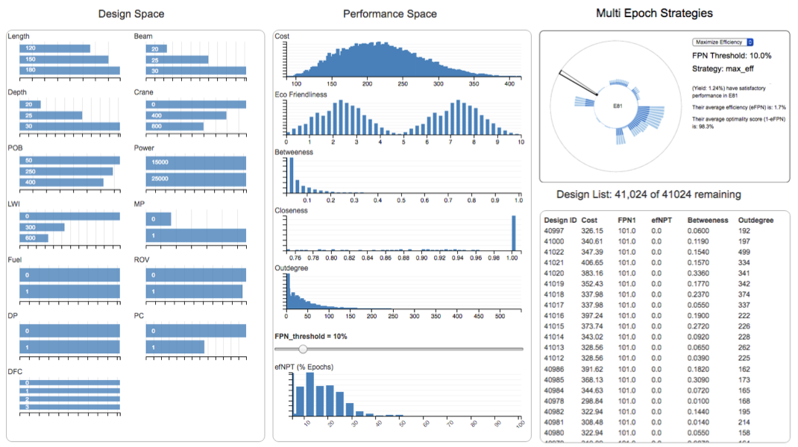
Multi Epoch Analysis
Live Demo
Multi epoch analysis looks at design behavior across all 96 epochs (e.g. scenarios)
Combination of online analytical processing (OLAP) and binned aggregation techniques used for more sophisticated interactive applications
Interactive Linked Bar/Row Charts
Details on demand reveal info on “problem epochs”
Aggregate performance across 4 million design-epoch pairs
Allows comparison changeability strategies
3 changeability strategies considered
Filtered subset of designs based on epoch performance
Few designs satisfy more than 50% of epochs for this optimality threshold and strategy

Slide 11




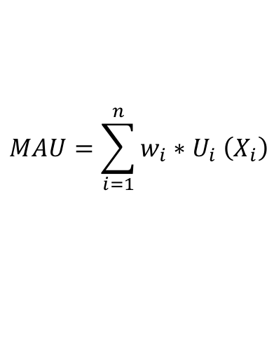






Multi Attribute Utility (MAU)
$$MAU=\sum_{i=1}^{n}{w_{i}{∗U}_{i}\left(X_{i}\right)}$$
Performance
Attributes
Stakeholder
SAU Functions
Weightings
Multi Attribute
Utility
$$U_{1}$$
$$∗$$
$$w_{1}$$
$$\left[\begin{matrix}X_{1} \\ X_{2} \\ ⋮ \\ X_{N}\end{matrix}\right]$$
Σ
$$U_{2}$$
$$∗$$
$$w_{2}$$
= $MAU$
…
$$U_{N}$$
$$∗$$
$$w_{N}$$
MAU allows us to evaluate all enumerated design on a common scale

Slide 12
Single Epoch Analysis
Interactive scatterplot identical to previous case study
Some consideration made for scalability
Tradespace with color encoding mapped to fuel type
N= 41,204 designs
Epoch = i
(This is 1 of 96 epochs)
Notes:
The single epoch analysis visualization was identical for this case study and reinforced many of the points derived from the previous case study.
Working with the folks from NTNU, this application helped uncover a lot of interesting details which revealed insights regarding the embedded assumptions of some of their legacy models which, in turn, helped us refine them, improve the analysis, and identify some interesting insights.
One example shown here, where color encoding is mapped to the fuel type design variable, shows how you can find out through visual exploration that the tradespace actually stratifies by that variable. This is the kind of insight you wouldn’t necessarily be able to discover without interacting with the data. (In fact, the Norwegians had not specifically noticed this behavior in their attempt to apply the prior RSC framework)
----
Scatter-plot color coded by “Fuel-type” design variable
The first analysis step in IEEA, Single epoch analysis, is equivalent to traditional tradespace exploration.
Large numbers of design candidates are enumerated using parameterized system models.
In this screenshot from the interactive application, cost vs utility for each design candidate is shown in the scatter plot and the user can interactively explore and control the representation of the other data dimensions including design and performance variables using the parallel coordinates
The goal is often to identify designs that are near Pareto efficient in terms of both the benefit and cost they provide. Closesness to the Pareto Front is operationalized through the FPN metric.
We could do this automatically by computing the FPN for each design and optimizing for both an FPN and cost constraint, but then a decision-maker would lose information about the underlying connections to design and performance variables.
Interactive visualizations like this one can be seen as a means for achieving better situational awareness during the decision-making process
Figure 3 illustrates the tradespace for the offshore ship design base case, that is the targeted contract with no technical requirements. Hence, at this initial stage, one can focus on understanding the dynamics of the underlying system. In this particular case study, the MAU only comprise one utility function, that is eco-friendliness, even though the figure indicates a multi-attribute utility function on a general basis. The interactive filtering can aid in visualizing the exploration process of understanding the relative significance of individual design variables, as illustrated. For instance, filtering by beam and length, one can see that relatively slender ships tend to contribute to low FPN values. However, this again makes a design less stable in the water, which restricts the possibilities of retrofitting heavy equipment on deck without intervening with the main hull. Further, one can directly see the trade-offs of adding DFC levels, as design points shift right in the tradespace with increasing DFC due to increased cost.

Slide 13
Multi Epoch Analysis
Multi epoch analysis looks at design behavior across all 96 epochs (e.g. scenarios)
Combination of online analytical processing (OLAP) and binned aggregation techniques used for more sophisticated interactive applications
Interactive Linked Bar/Row Charts
Details on demand reveal info on “problem epochs”
Aggregate performance across 4 million design-epoch pairs
Allows comparison changeability strategies
3 changeability strategies considered
Filtered subset of designs based on epoch performance
Few designs satisfy more than 50% of epochs for this optimality threshold and strategy
Notes:
Just as with the space tug example though, multi-epoch analysis is where we can start to better understand the behavior of designs across various alternative futures
In this case it was just a lot more data, the study examines 4 million design-epoch pairs as well as 3 changeability strategies which is obviously a lot of data.
The actual appearance of interactive tool is pretty much the same as with the space tug case even though there is a lot more data driving the display
This is because it is still all presented in a compact way, aggregated using OLAP, to keep interactive latency low and communicate information efficiently.
One example observation that can be made at this level of analysis is the very few designs satisfy more than half of epochs for this optimality threshold and strategy
An offshore ship may be seen as a movable flexible platform that can carry equipment that enables the ship to take on contracts of various types. The size of the platform may also change through, for example, elongation, but at a higher cost and duration, compared to more traditional equipment retrofits on deck. Single and multi-era analyses using interactive visualizations as shown in Figure 6 can aid in the assessment of different classes of changeability for the offshore design case. For brevity, this analysis is not discussed in this paper, but the interested reader is referred to previous demonstrations in prior case studies using IEEA [4] for further details.

Slide 14
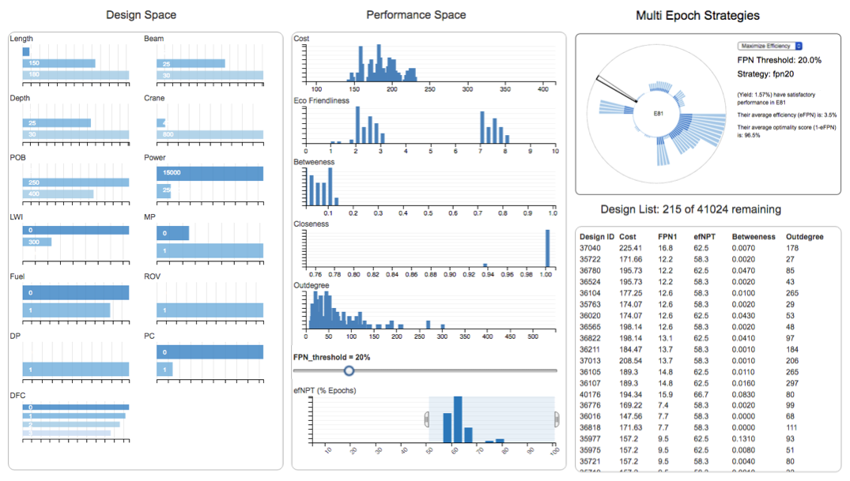
Multi Epoch Analysis
Multi epoch analysis looks at design behavior across all 96 epochs (e.g. scenarios)
Combination of online analytical processing (OLAP) and binned aggregation techniques used for more sophisticated interactive applications
Interactive Linked Bar/Row Charts
Satisfactory designs trend towards ones with larger deck area and stability
Details on demand reveal info on “problem epochs”
Allows comparison changeability strategies
Filtered subset of designs based on epoch performance
Relax optimality threshold
Filter for designs that satisfy most epochs
Notes:
But if I relax the constraint on optimality (in other words the allowable distance from the Pareto front that I’m willing to accept) and then filter for designs that satisfy most of the epochs (in other words a high Pareto trace)…
You see something interesting, the ships that do well tend to have a larger length, beam and depth…and if we dig into the details a little more we can show these designs to have larger deck areas and better stability across a lot more sea conditions.
This means when alternative futures occur these ships can use change options to swap out their deck equipment, but don’t require modifications to their hulls which can be costly and time consuming to execute.
This observation ties back to the “good” example of the Cygnus that I mentioned earlier.
The Cygnus had a lot of open deck area because it was essentially a cargo vessel, and its hull characteristics tended to make it stable and thus adaptable when the future played out in a way other than expected.
This is just one example that reinforces how interesting insights can be observed using IEEA tools when coupled with SME’s
----
An offshore ship may be seen as a movable flexible platform that can carry equipment that enables the ship to take on contracts of various types. The size of the platform may also change through, for example, elongation, but at a higher cost and duration, compared to more traditional equipment retrofits on deck. Single and multi-era analyses using interactive visualizations as shown in Figure 6 can aid in the assessment of different classes of changeability for the offshore design case. For brevity, this analysis is not discussed in this paper, but the interested reader is referred to previous demonstrations in prior case studies using IEEA [4] for further details.

Slide 15
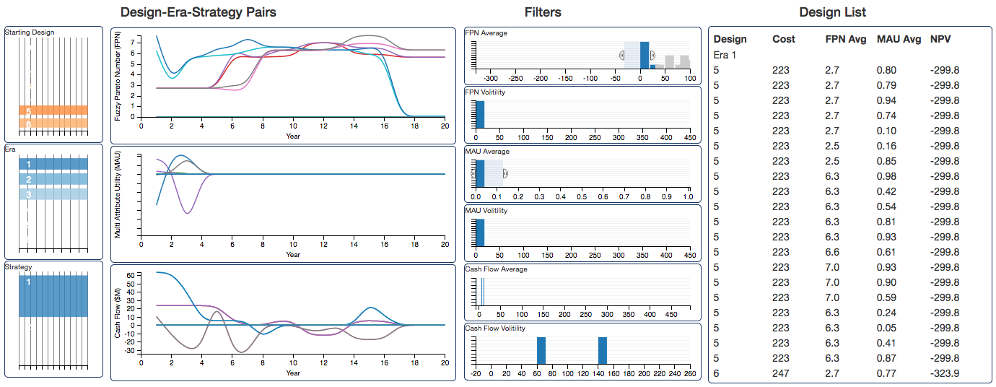
Era Analysis
Goal is to evaluate value of design-strategy pairs for sequences of future epochs
A strategy defines how change options will be used to sustain value (e.g. maximize utility or efficiency)
Coordinated visualization for interactive filtering based on 5 era-level metrics that evaluate temporal aspects of value delivery
Interactive Time Series with Filtering
Filtered subset of designs based on era performance
Efficiency, MAU, Cash Flows
Filters
40K design points x 20 yr eras (6 mos time step) = 1.6M data points per Era
Designs, Strategies, Eras
~20M data points across all 6 eras and 2 strategies
Notes:
I don’t want take up a lot more time on this example, but I did want to make one last, quick comment about the era-level analysis performed on the ship case study
Because it examined progressions of epochs over an assumed 20 year ship lifespan it ended up having an underlying database with 20 million records in it, but it is still essentially the same interactive application as was applied to the space tug case study (which scales well because OLAP is used for data aggregation).
This again just emphasizes the scalability and generalizability of the IEEA framework and tools.
Three narrative scenarios are considered in this case study. In two of the eras the ship gets the targeted five-year contract initially, and experiences a relatively strong market the rest of the assumed 20-year lifetime. In the third era, the ship does not get the targeted contract due to a market collapse.
The goal of single-era analysis is to analyze design-strategy pairs over a single unfolding sequence of epochs.
This type of analysis is very useful, for instance, if a subject matter expert has narratively defined a likely future scenario which you want to evaluate.
For this case study and as part of the broader research on IEEA, several interactive visualizations have been developed to extract insights from single era analysis
The one shown here uses coordinated visualizations to filter a set of design-strategy pairs to identify interesting candidates (could inform that certain designs or strategies are preferable)

