Slide 1
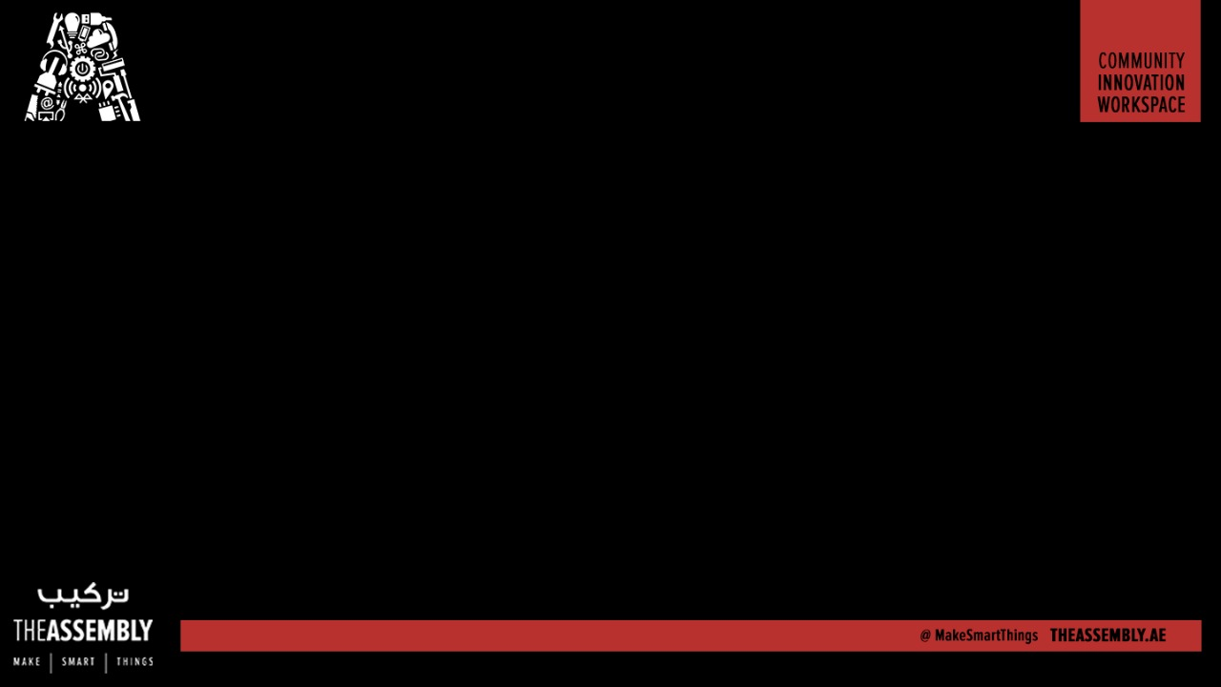
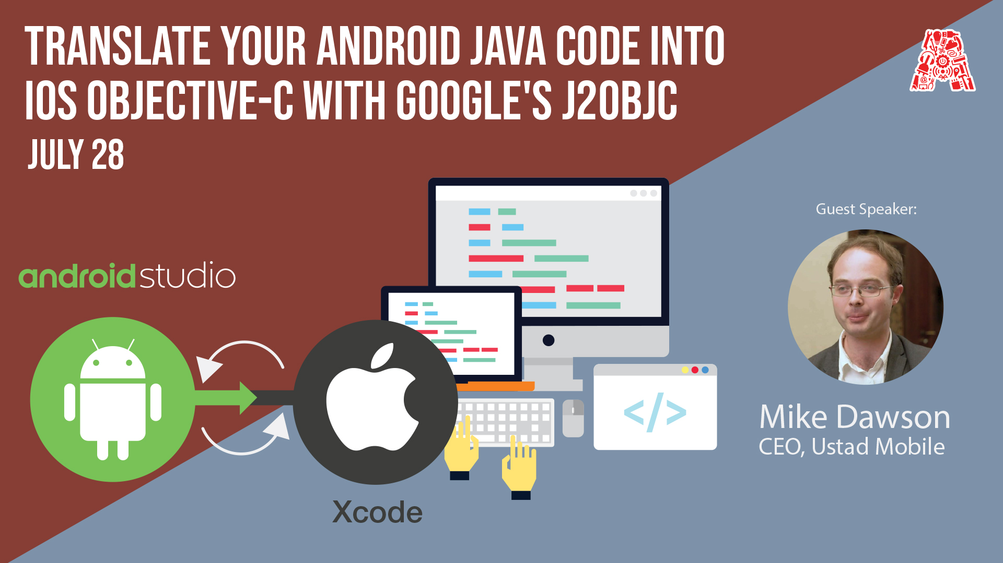
Wifi - In5-Tech [Code - WelcomeToIn5]

Slide 2
About the Assembly
A smart lab based out of In5 since Dec 2014
Over 200 free workshops done
ASSEMBLY: HACK - Embedded systems, iOT and hardware
ASSEMBLY: CODE - Software projects - APIs, frameworks, apps
Age range: 16-60 - students, professionals, entrepreneurs
Focus on smart technology and practical applications
Forum: members.theassembly.ae

Slide 3
TAG US ON SOCIAL MEDIA!
FACEBOOK - The Assembly (@MakeSmartThings)
TWITTER - @MakeSmartThings
INSTAGRAM - @MakeSmartThings
YOUTUBE - The Assembly

Slide 4
Overview
TOPICS
Quick overview of J2ObjC development using a Model View Presenter (MVP) pattern
Implementation in Java for Android
Transpile to Objective C and reuse on iOS

Slide 5
What J2ObjC is and is not
A tool to re-use business logic and data models between Android and iOS
Widely used by:
Google
Yahoo
(and others)
It’s not:
An all-in-one cross-platform kit
A UI toolkit

Slide 6
Using an MVP pattern with J2ObjC
ANDROID
Model – normal Java
View – Java interface implemented by an Activity or fragment
Presenter – normal Java
iOS
Model – Objective C transpiled from Java
View – UIViewController implementing interface (protocol) transpiled from Java
Presenter – Objective C transpiled from Java

