Slide 1
The Goldozi Mobile App
Practical Exam

Slide 2
Section 1: App onboarding
Please log into the Goldozi App.

Slide 3
Section 1: App onboarding
What are two things to avoid to keep your password safe?

Slide 4
Section 2: Managing sales to customers
Your examiner is now a customer. They would like to buy two scarves from you.

Slide 5
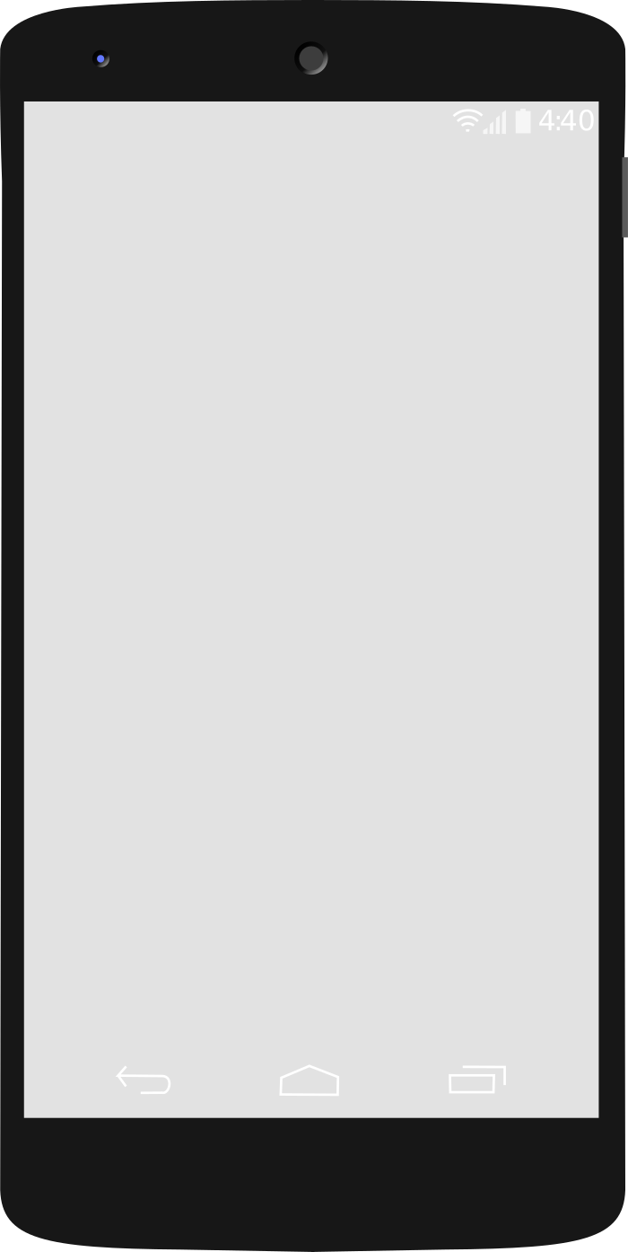
Section 2: Managing sales to customers
The first scarf is worth 200 Afs. You have it in stock.
Task 1:
Record the sale.
Stop when you reach this screen.

Slide 6
Section 2: Managing sales to customers
Your customer would like to add one more scarf - also worth 200 Afs - to their order. You don‘t have this scarf in stock.
Task 2:
Add the scarf to the customer‘s order.
Stop when you reach this screen.

Slide 7
Section 2: Managing sales to customers
Your customer makes a partial payment of 50 Afs on their order.
Task 3:
Record the amount and date of the partial payment.
Save the sale.
Stop when you reach this screen.

Slide 8
Section 2: Managing sales to customers
Your customer would like their second scarf to be a specific color - bright green.
Task 4:
Record this request as a voice order note.
Stop when you reach this screen.

Slide 9
Section 2: Managing sales to customers
You have received the second scarf and your customer would like to pay the remaining balance.
Task 5:
Tell your customer how much they owe you.
Enter their payment of the remaining balance.
Record the sale as delivered.
Stop when you reach this screen.

Slide 10
Section 3: Learning and reinforcing skills
Show your examiner how you downloaded a copy of this exam to revise for today.

Slide 11
Section 3: Learning and reinforcing skills
Your practical exam is complete – well done!

