Slide 1
HexRaysPyTools
Igor Kirillov
i.kirillov@dsec.com

Slide 2

About me
Security researcher in
Fields of interests:
reverse-engineering
game hacking
machine learning

Slide 3
Plugin designed for …
Reconstruction big structures or classes
Finding purpose of specific fields despite the fact that its usage can be spread anywhere all over the code
Dealing with negative offsets (Drivers, overloaded virtual functions or compiler being jerk)
Accelerating transformation applied to decompiled code

Slide 4
Structure Reconstruction Problems
It’s very time-consuming to determine types and purposes of all fields.
Even after creation of a new type there’s a problem - how to spread it among all variables of this type.
If we work with classes, new problem arises – how to recover virtual tables with correct virtual functions’ signatures.

Slide 5
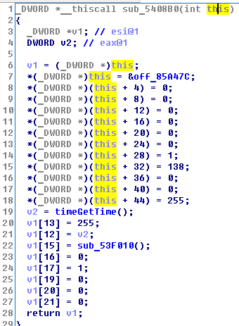
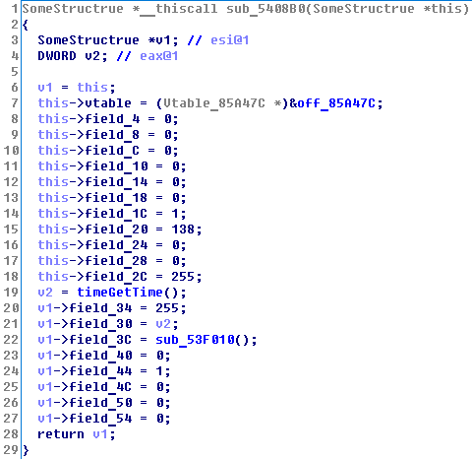
Desired transformation

Slide 6
What did we have before?
hexrays_tools by Milan Bohacek (Ida plugin contest winner in 2013)
Interactive reconstruction (but no help in understanding)
Lots of information can be retrieved before creating type.
Helps to visit virtual functions
Virtual table detection. Automatically creates structures for virtual tables, but considers all functions to be just integers (so, it’s even not a function pointer).
Pretty interactive, though still limited.
----------------------------------------
Written in C++
Abandoned since IDA PRO 6.3

Slide 7
What did we have before
HexRaysCodeExplorer
Type reconstruction from only one function body.
Virtual table creation (but doesn’t consider functions typedefs).
No interaction with user.
Double click on virtual methods.

Slide 8
HexRaysPyTools

Slide 9
Overall
Based on hexrays_tools plugin (incorporate and amplifies best features adding new).
Written using IDAPython
Much easier to develop and contribute compared to C++
Cross-platform: Windows, Linux, Mac
Works for both x32 and x64 code
Works on IDA PRO 6.8+

Slide 10
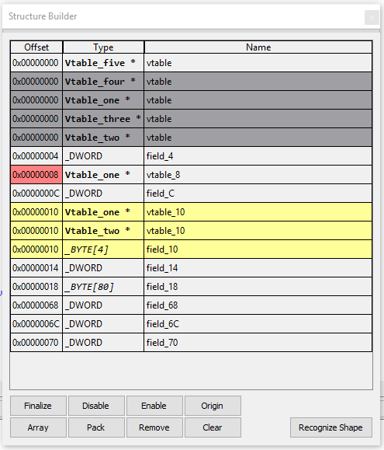
Reconstruction
Interactive type reconstruction
Helps to visit code places of every reference of the field
Detects virtual tables
Helps to get information about type from virtual functions (And create virtual table with right functions typedefs)
Shows collisions and allows to resolve it
Tip: Use Class Informer to retrieve original virtual tables names

Slide 11
Reconstruction
Scanning can be applied to many different types (int, DWORD, PVOID, char * etc)
Assignment of scanned variables starts scanning for them too.
Two modes of scanning:
Shallow – information added to builder will be gleaned from single function body
Deep – recursive applying scanning to every function which has our variable as argument (can be slow)
After finalizing applies new type to (almost) every scanned variable.

Slide 12
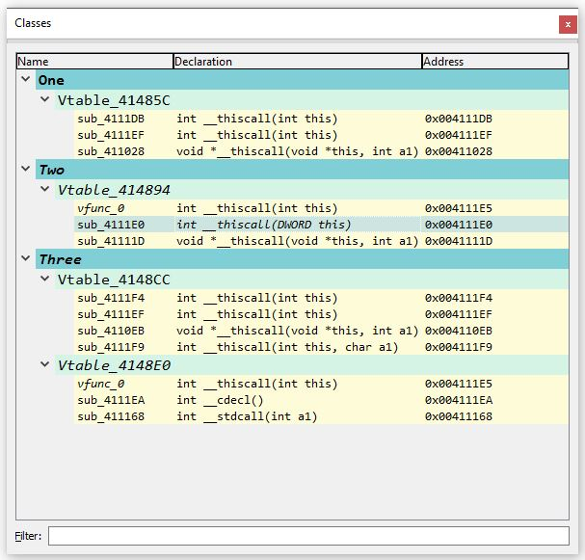
After reconstruction
Allows renaming virtual functions, editing declaration and navigation
Helps to avoid rebase process to spoil information about virtual functions

Slide 13
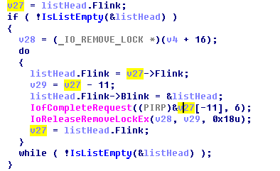
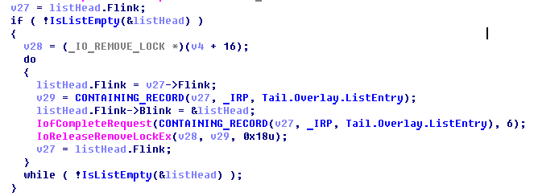
Negative Offsets
No Plugin
With Plugin

Slide 14
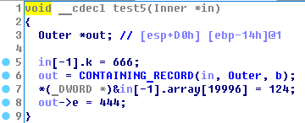
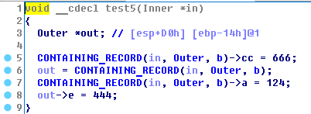
Negative Offsets (Automatic)
Automatically propagates following transformations:
Result

Slide 15
Negative offsets (Manual handling)

Slide 16
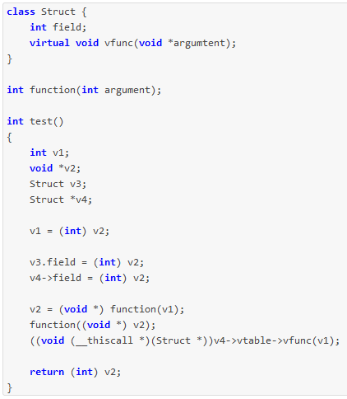
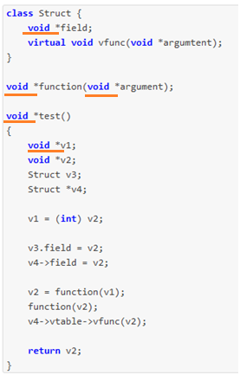
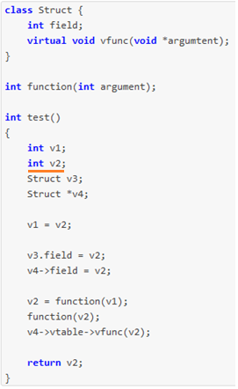
Type Recasting
Original code
Recast Left
Recast Right

Slide 17
Structures with given size

Slide 18
Graph of the structures

Slide 19
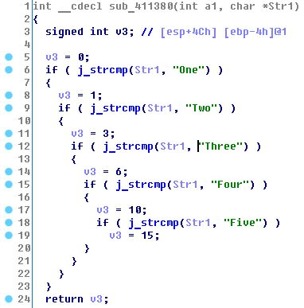
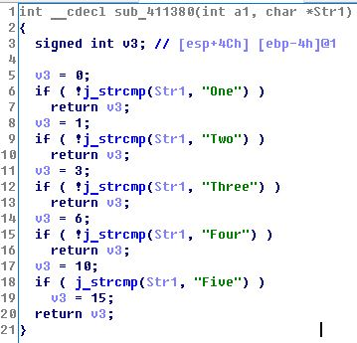
Untangling `if` statements
Original
With Plugin

Slide 20
Thank you for your attention!
https://github.com/igogo-x86/HexRaysPyTools

